Slide 1
LETOURNEAU UNIVERSITY EETC 3433 ELECTRICAL MACHINERY AND CONTROLS for JLNU Fall Semester 2024 Lesson 7: 20241105 Tue
By Judy WS Wong

Slide 2
Exam question – the solution proposal
How much can you write it in
1-2 hours?
Question:
Based on the dual-axis shredder requirement, design a solution.
Exercise: just spend about 20 min to draft out what you will write if this is an exam

Slide 3
How to hand up homework with github
Why am I going through all these trouble
For students to get familiarized with the “real working world”
Github App – have you downloaded?
Android / iOS
Web app – could submit binary file (image file)
(Demo)
Today to submit: https://classroom.github.com/a/a7w6QKNN

Slide 4
What have I written in the 20 min?
As said, there is no right or wrong answer. This is just an exercise. But you need to do it as a learning process - we aren’t ducks to be fed
I am sharing my sample version of the 20 min technical writing here. What difference do you see between yours and mine?
10 min exercise: Write down Miro, what do you see the major difference between your answer and the sample answer. Is it difference in the focus? What have you learn?

Slide 5
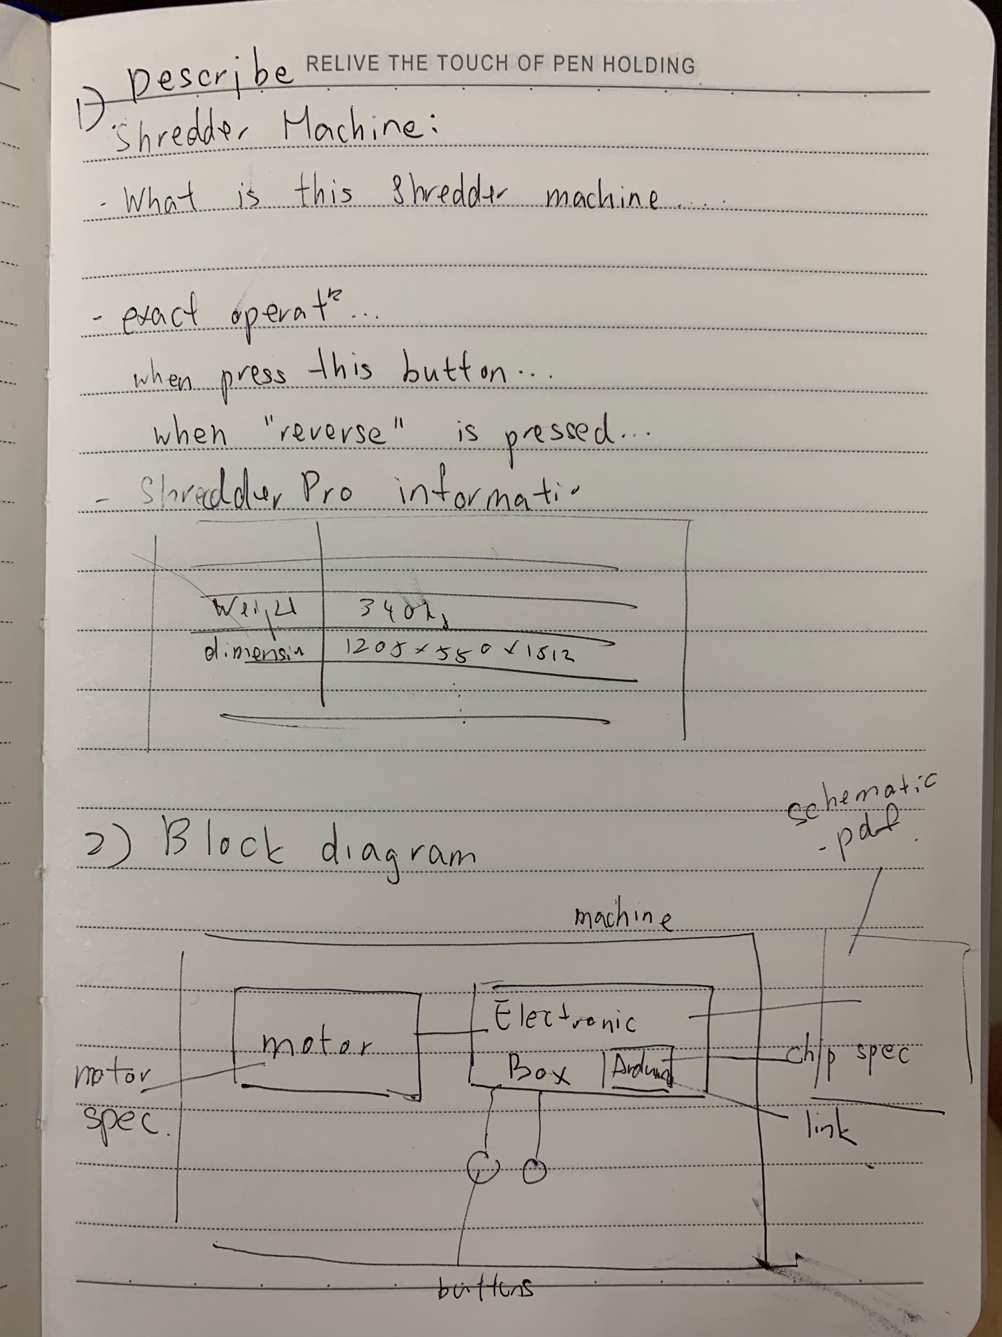
Sample Solution..
Nobody is prefect.. This is only a reference
Compare your answer to this sample:
https://miro.com/app/board/uXjVLNTuDhY=/
Submit to here:
https://classroom.github.com/a/J21YRYuh

Slide 6
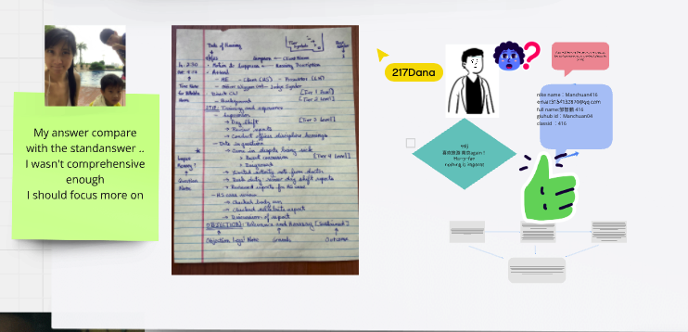
Update on the discussion board – 10 min
https://miro.com/app/board/uXjVLNTuDhY=/
Find your old board with system
Add a photo (so I can tell who you are)
Paste a copy of your answer
Tell us what you think between your answer and the sample answer
Do a screen capture of this – will be submitting
(if this is too slow, you can do it on your own board)
https://classroom.github.com/a/J21YRYuh

Slide 7
Homework submission – due Friday 11pm
Lesson 1: https://classroom.github.com/a/d7f9rWw_
Lesson 2: https://classroom.github.com/a/cuu4A9dQ
Lesson 3: https://classroom.github.com/a/puh2yRDJ
Lesson 6: https://classroom.github.com/a/a7w6QKNN (due today!)
Lesson 7: https://classroom.github.com/a/J21YRYuh

Slide 8
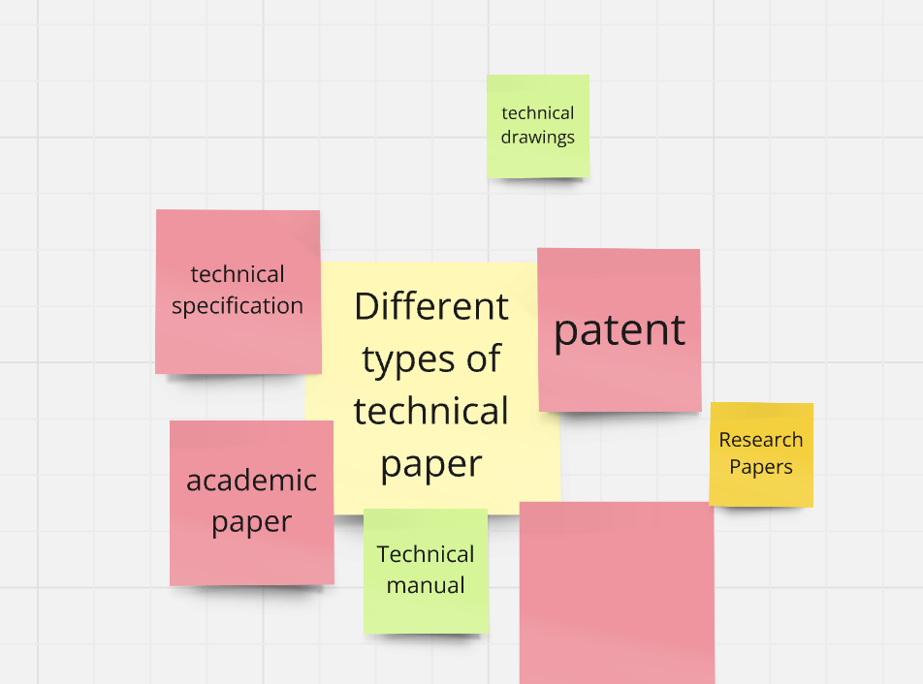
Different Types of technical writings [5 min]
https://miro.com/app/board/uXjVLNTuDhY=/
Academic Paper
Technical specification
Patents
??
??

Slide 9
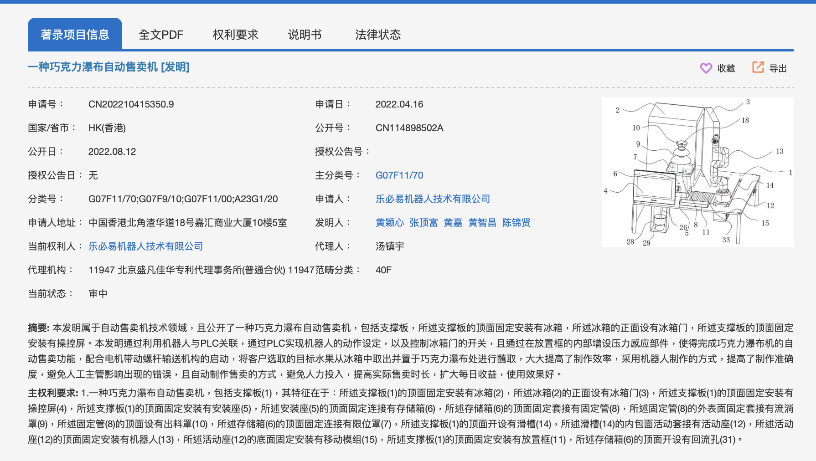
Patents
About Patent

Slide 10
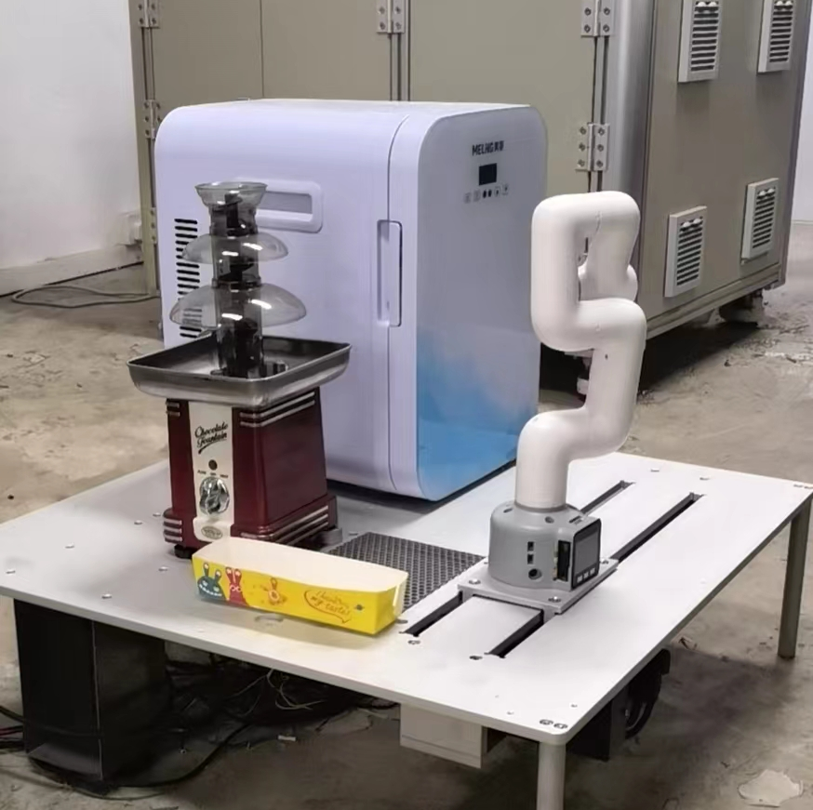
Next exercise
About the Chocolate fountain robot
(We will go back to the waffle machine after this… as that is way too complicated)

Slide 11
Back to Syllabus: PID controller
https://www.bilibili.com/video/BV1sVbseGEJz/
https://www.electricaltechnology.org/2015/10/what-is-pid-controller-how-it-works.html
Kahoot – Create a 10 question Kahoot! Based on the above information. No need to create teaching slides as these are all included.

