Slide 1

LETOURNEAU UNIVERSITY EETC 3433 ELECTRICAL MACHINERY AND CONTROLS for JLNU Fall Semester 2024 Lesson 8: 20241106 Wed
By Judy WS Wong

Slide 2
Agenda
Before Break
PID control
After Break
Kahoot! game
Writing on the Chocolate Foudue Machine

Slide 3
Back to Syllabus: PID controller
https://www.bilibili.com/video/BV1sVbseGEJz/. (20 min)
https://www.electricaltechnology.org/2015/10/what-is-pid-controller-how-it-works.html
Kahoot – Create a 10 question Kahoot! Based on the above information. No need to create teaching slides as these are all included.

Slide 4
Break then Kahoot Time!

Slide 5
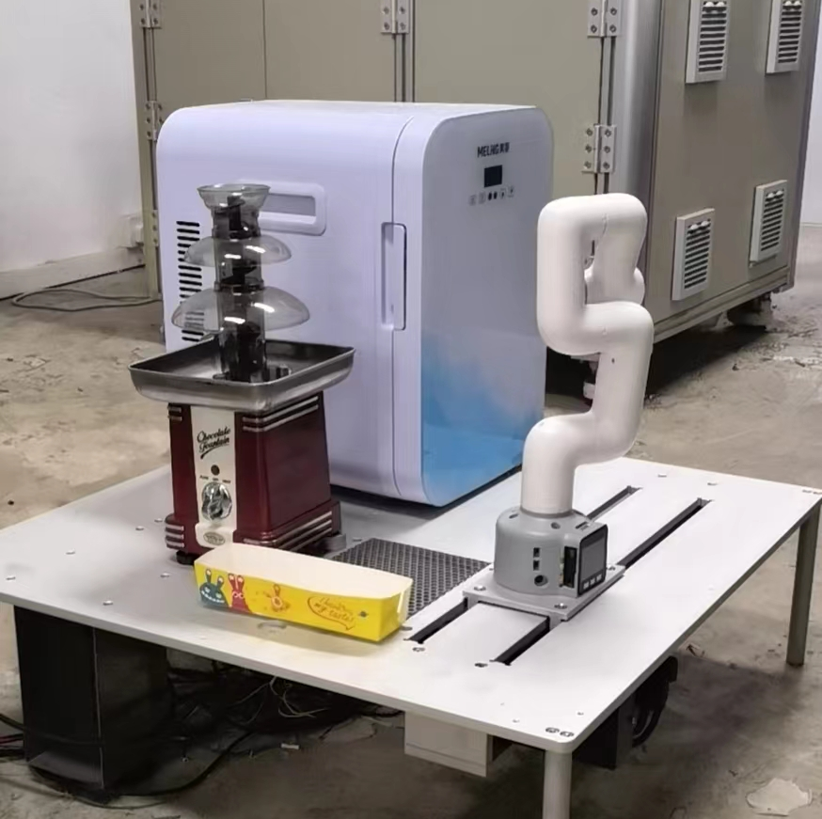
Next exercise
About the Chocolate fountain robot
(We will go back to the waffle machine after this… as that is way too complicated)

