Slide 1


LETOURNEAU UNIVERSITY EETC 3433 ELECTRICAL MACHINERY AND CONTROLS for JLNU Fall Semester 2024 Lesson 9: 20241108 Fri
By Judy WS Wong

Slide 2
Agenda
Before Break
Taking a note of students’ work (and correct them when where is mistakes)
After Break
Explaining different parts of a control

Slide 3
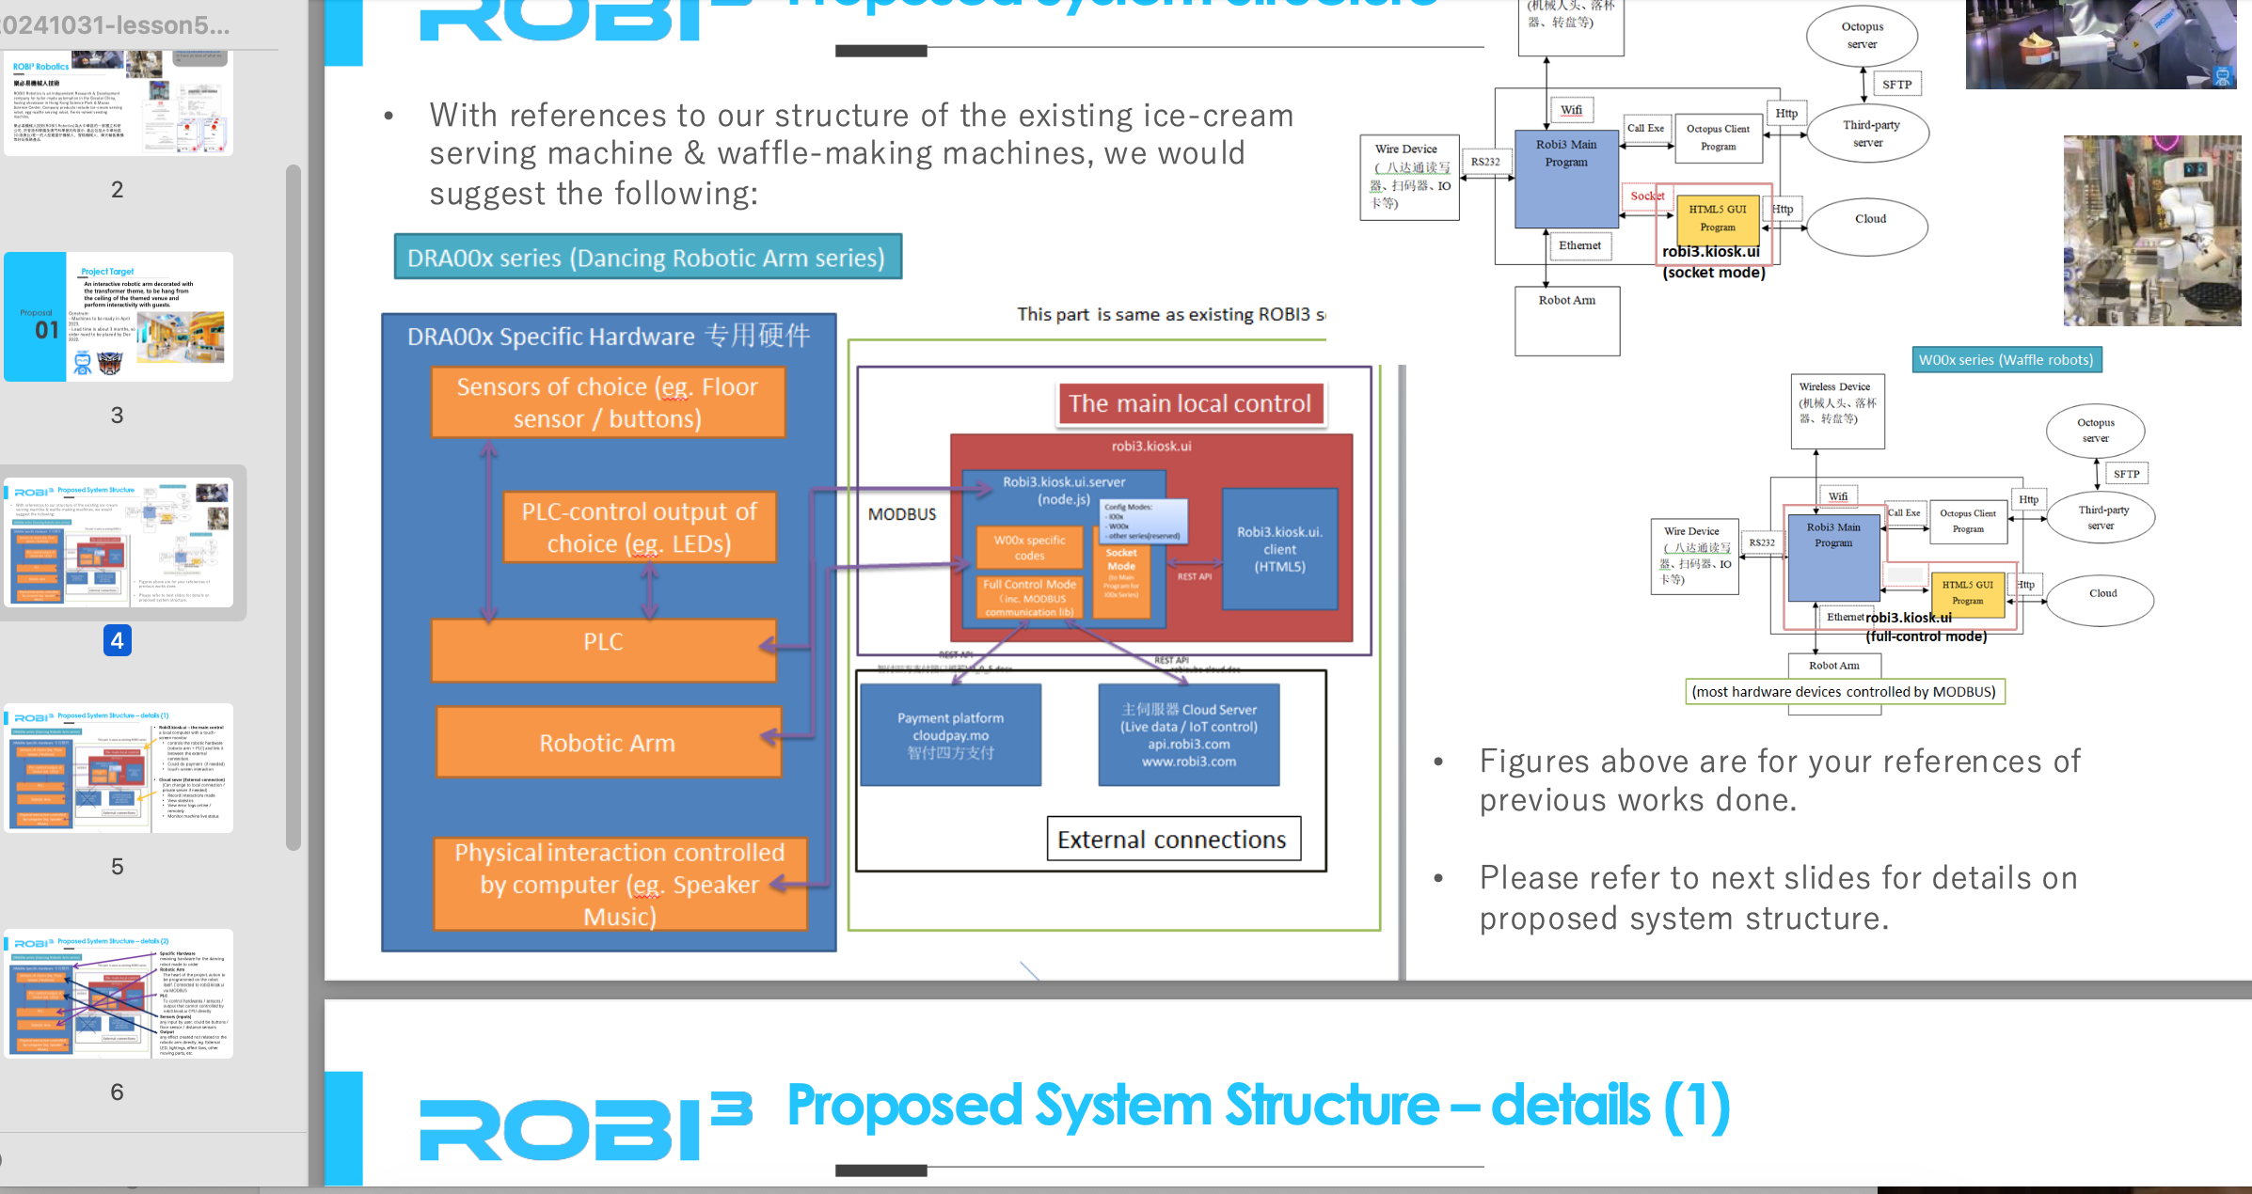
Note – there is no mid-term. This project is midterm
Please make sure you do it~~ We are spreading it into 2 classes…

Slide 4
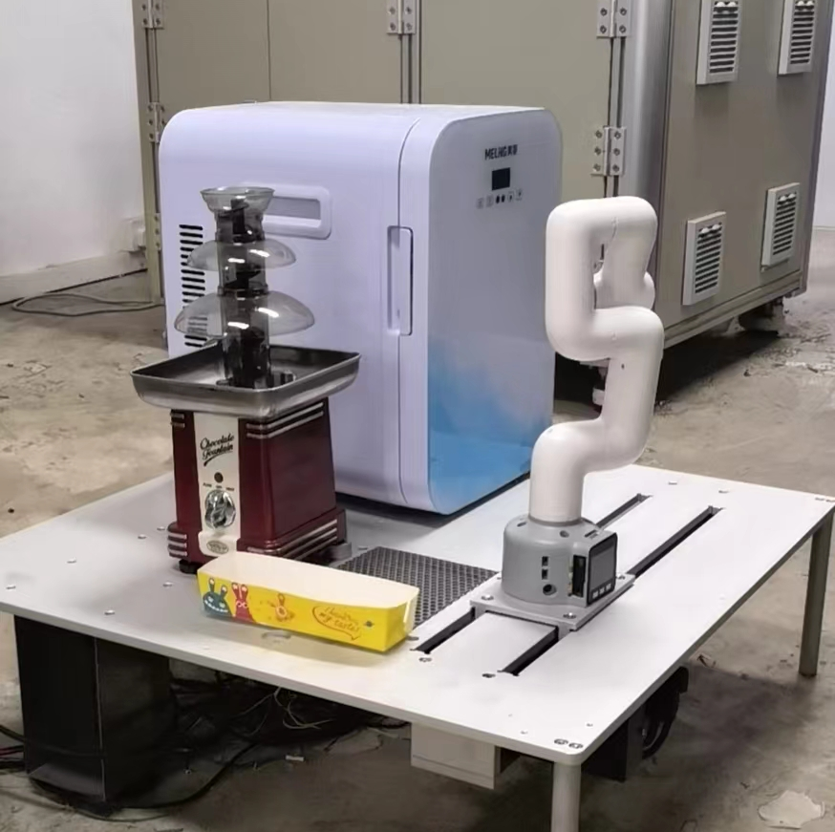
Writing the Block Diagram
About the Chocolate fountain robot
(We will go back to the waffle machine after this… as that is way too complicated)

Slide 5
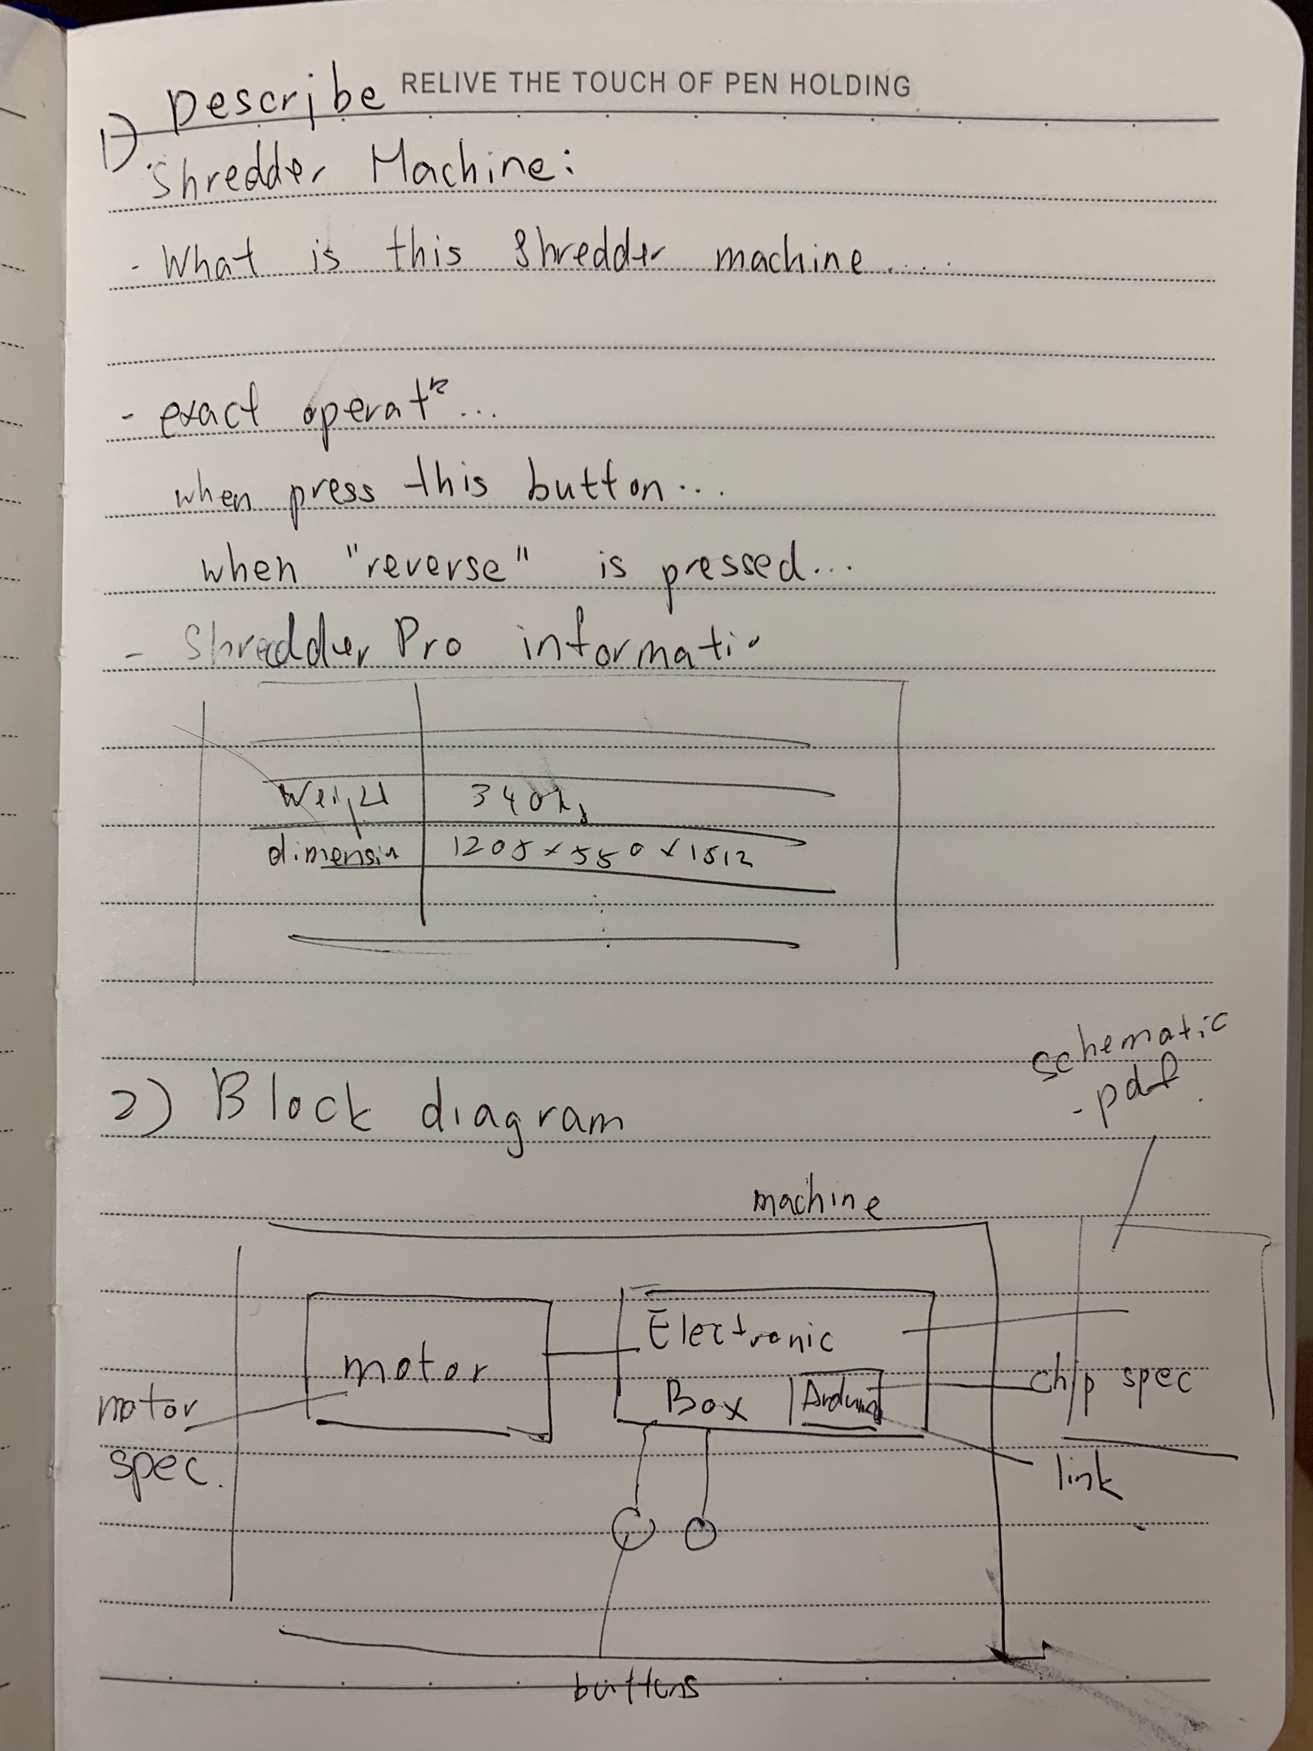
Block Diagram
Note: One of the exam question will be asking something like this. Please make sure you learn how to draw

Slide 7
Chocolate fondue machine

Slide 8
Door Opening Mechanism

Slide 9
Elephant Robotics
Read the Cobot-5 Datasheet

Slide 10
Dive next – the Waffle Machine!

