Slide 1

LETOURNEAU UNIVERSITY EETC 3433 ELECTRICAL MACHINERY AND CONTROLS for JLNU Fall Semester 2024 Lesson 5: 20241101 Fri
By Judy WS Wong

Slide 3

Discussion board
https://miro.com/app/board/uXjVLNTuDhY=/

Slide 4
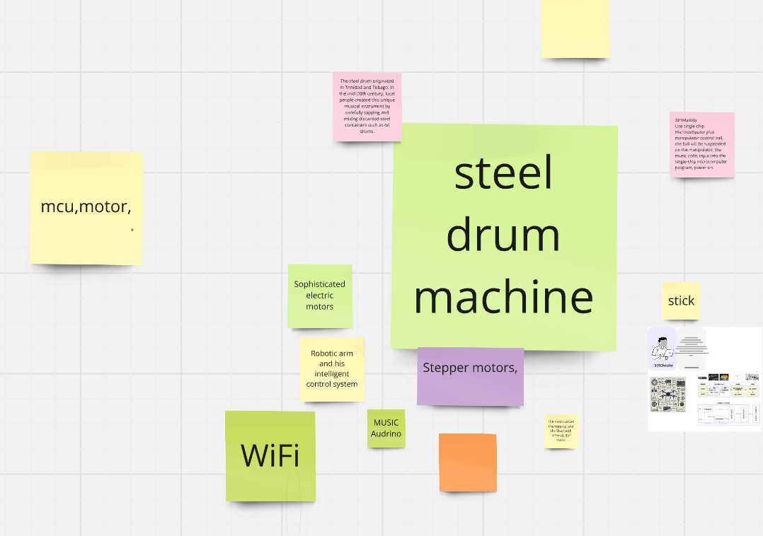
Case study – Steel drum machine (空灵鼓）
Keywords mentioned
Microprocessor (with I/O)
Audrino
Rasberry Pi
CPU with PCI card

Slide 5
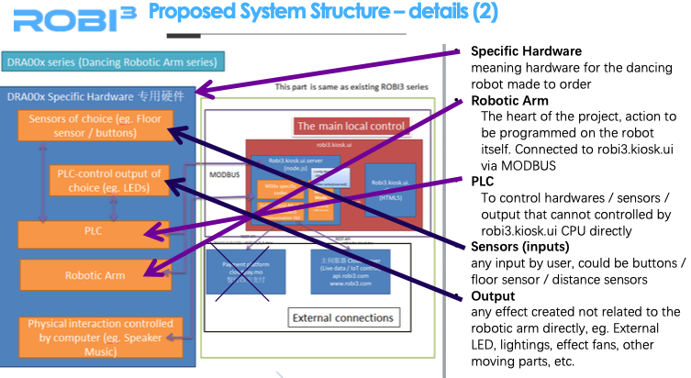
Case study on propose
Proposals for reference – will be uploaded into materials

Slide 6

Case study on Schematics – Precious Plastics
https://www.preciousplastic.com
Download the schematics and check them out
Although you might not be able to login (firebase restriction, so you can only use it when you have access with google
https://community.preciousplastic.com/academy/build/shredderpro

Slide 7
Exercise
Read on https://community.preciousplastic.com/academy/build/shredderpro
Create a 4 question Kahoot to make sure that your classmate read about the schematic. You win if most of the students can’t find the answer (but you have to prove your answer can be found) (no true and false question)

Slide 8
Patents
About Patent

Slide 9
How to hand up homework with github

