Slide 1

LETOURNEAU UNIVERSITY EETC 3433 ELECTRICAL MACHINERY AND CONTROLS for JLNU Fall Semester 2024 Lesson 4: 20241030 Wed
By Judy WS Wong

Slide 2

About designing a system for real!
An example for making a real practical machine – the waffle making machine

Slide 3
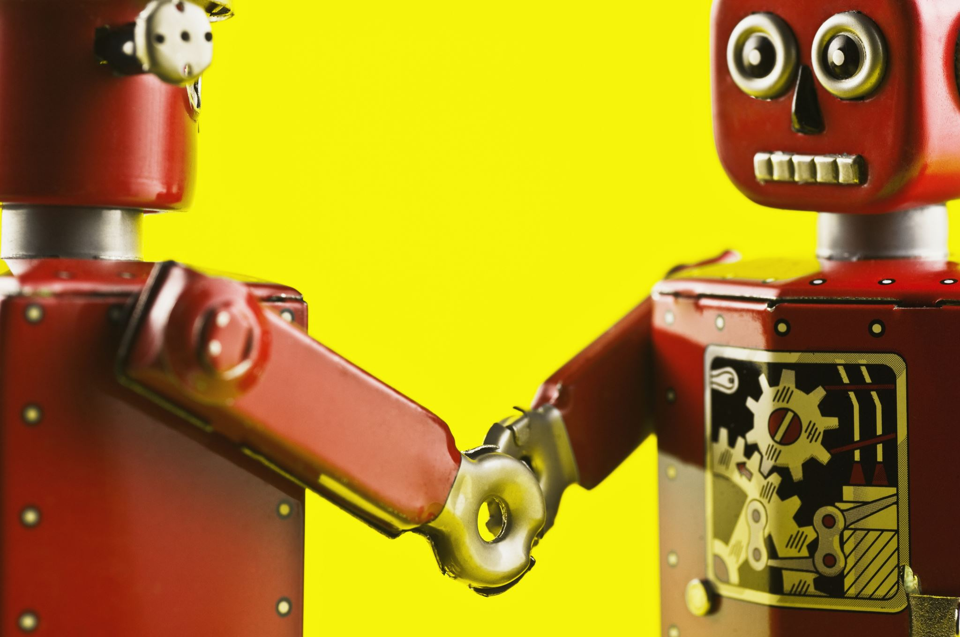
As you know, I am an engineer that has many real projects. One of the most significant is the waffle-making machine. Today we are going to show you how it is designed.
(show youtube 7 min if possible )

Slide 4
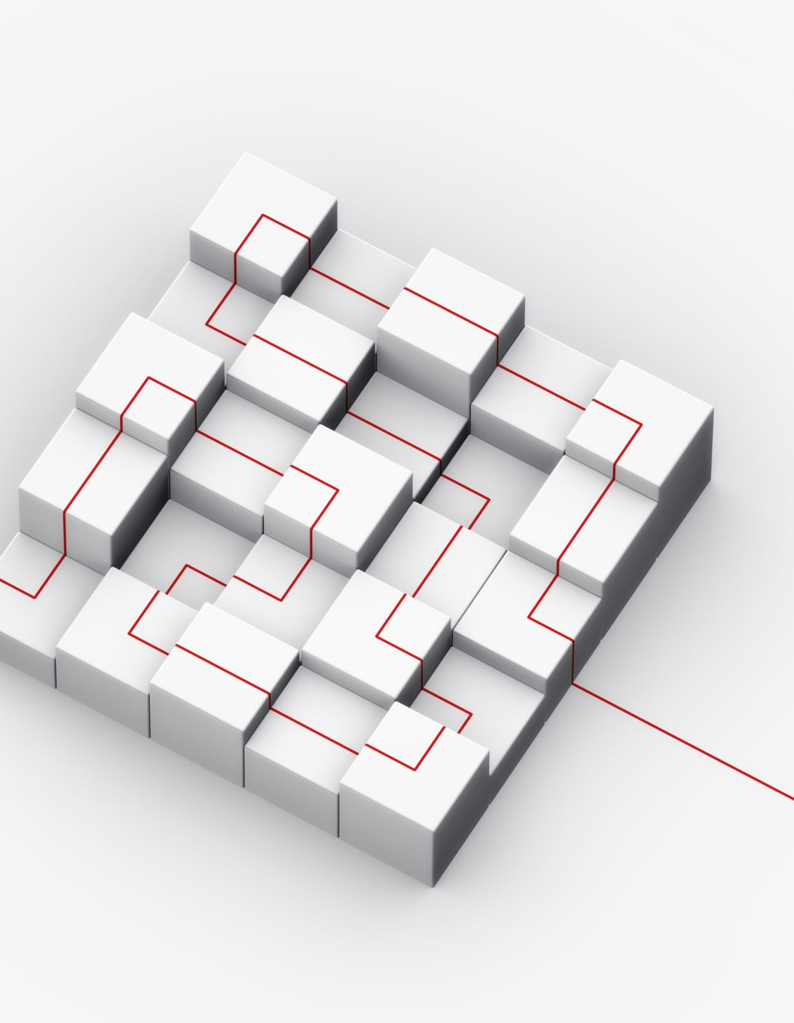
Agenda
Example: Waffle Machine
Show youtube 6 min https://www.youtube.com/watch?v=FmLO331LbEs
Explain how to differentiate different parts and draw them on block diagram (will be asked in Exam)
How different blocks works (PLC, robotic arm, etc)
How we work on these in Github
Before that – NDA (Non Disclosure Agreement 保密协议）
Other example of works (Casino Shredder, for example) - Intelligent Card Shredder pdf – note: only for educational purpose, no photo taking please

Slide 5
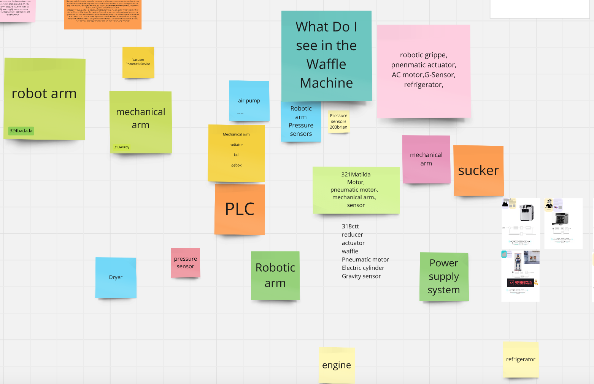
https://miro.com/app/board/uXjVLNTuDhY=/

Slide 6
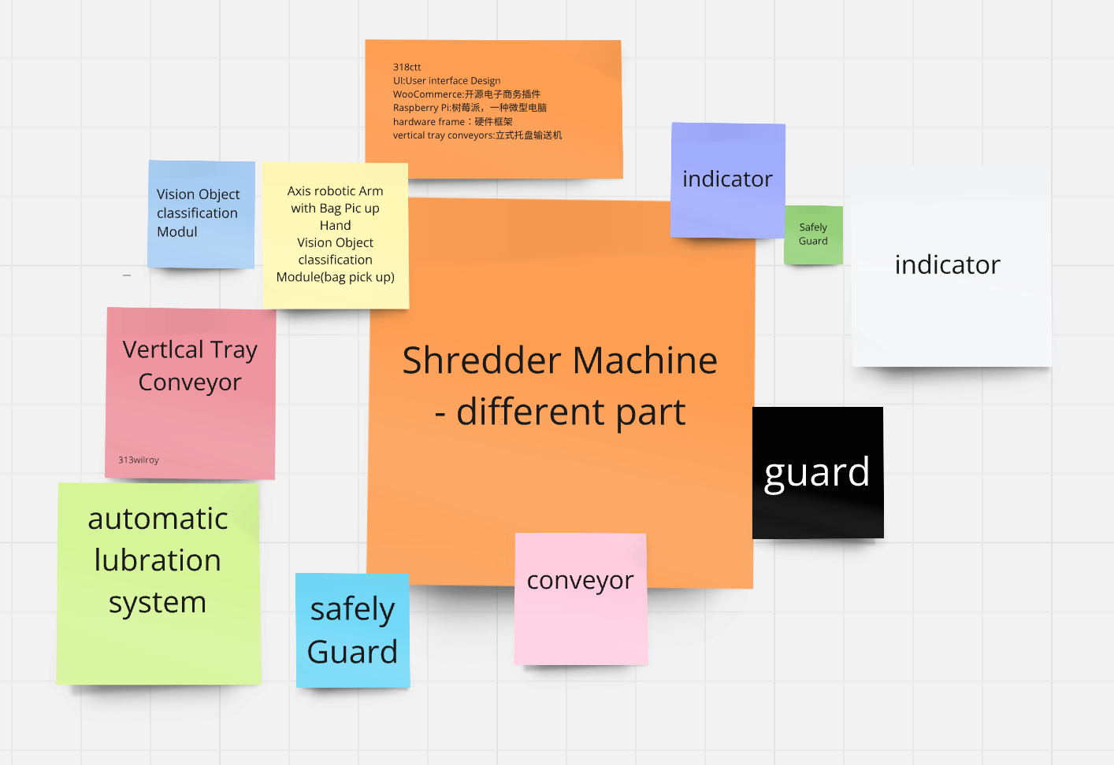
https://miro.com/app/board/uXjVLNTuDhY=/

Slide 7
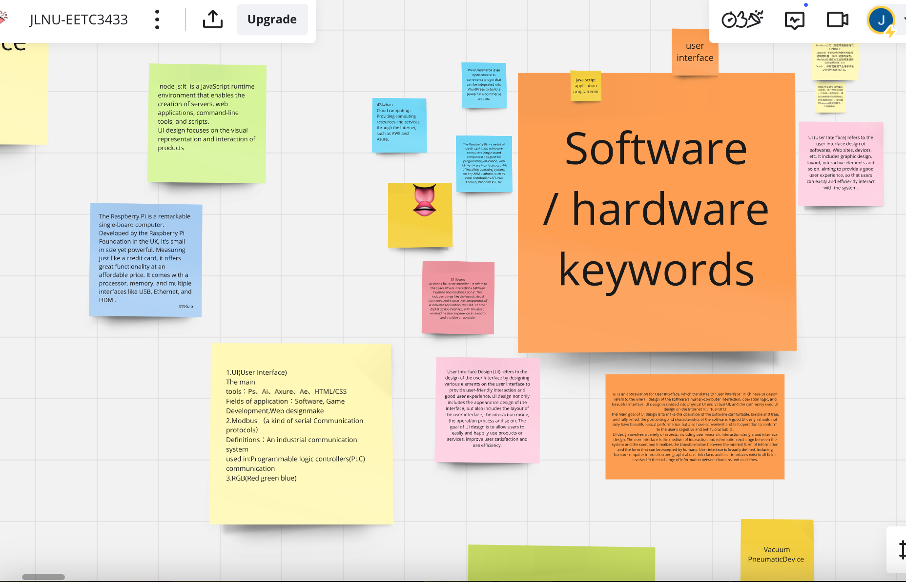
https://miro.com/app/board/uXjVLNTuDhY=/

Slide 8
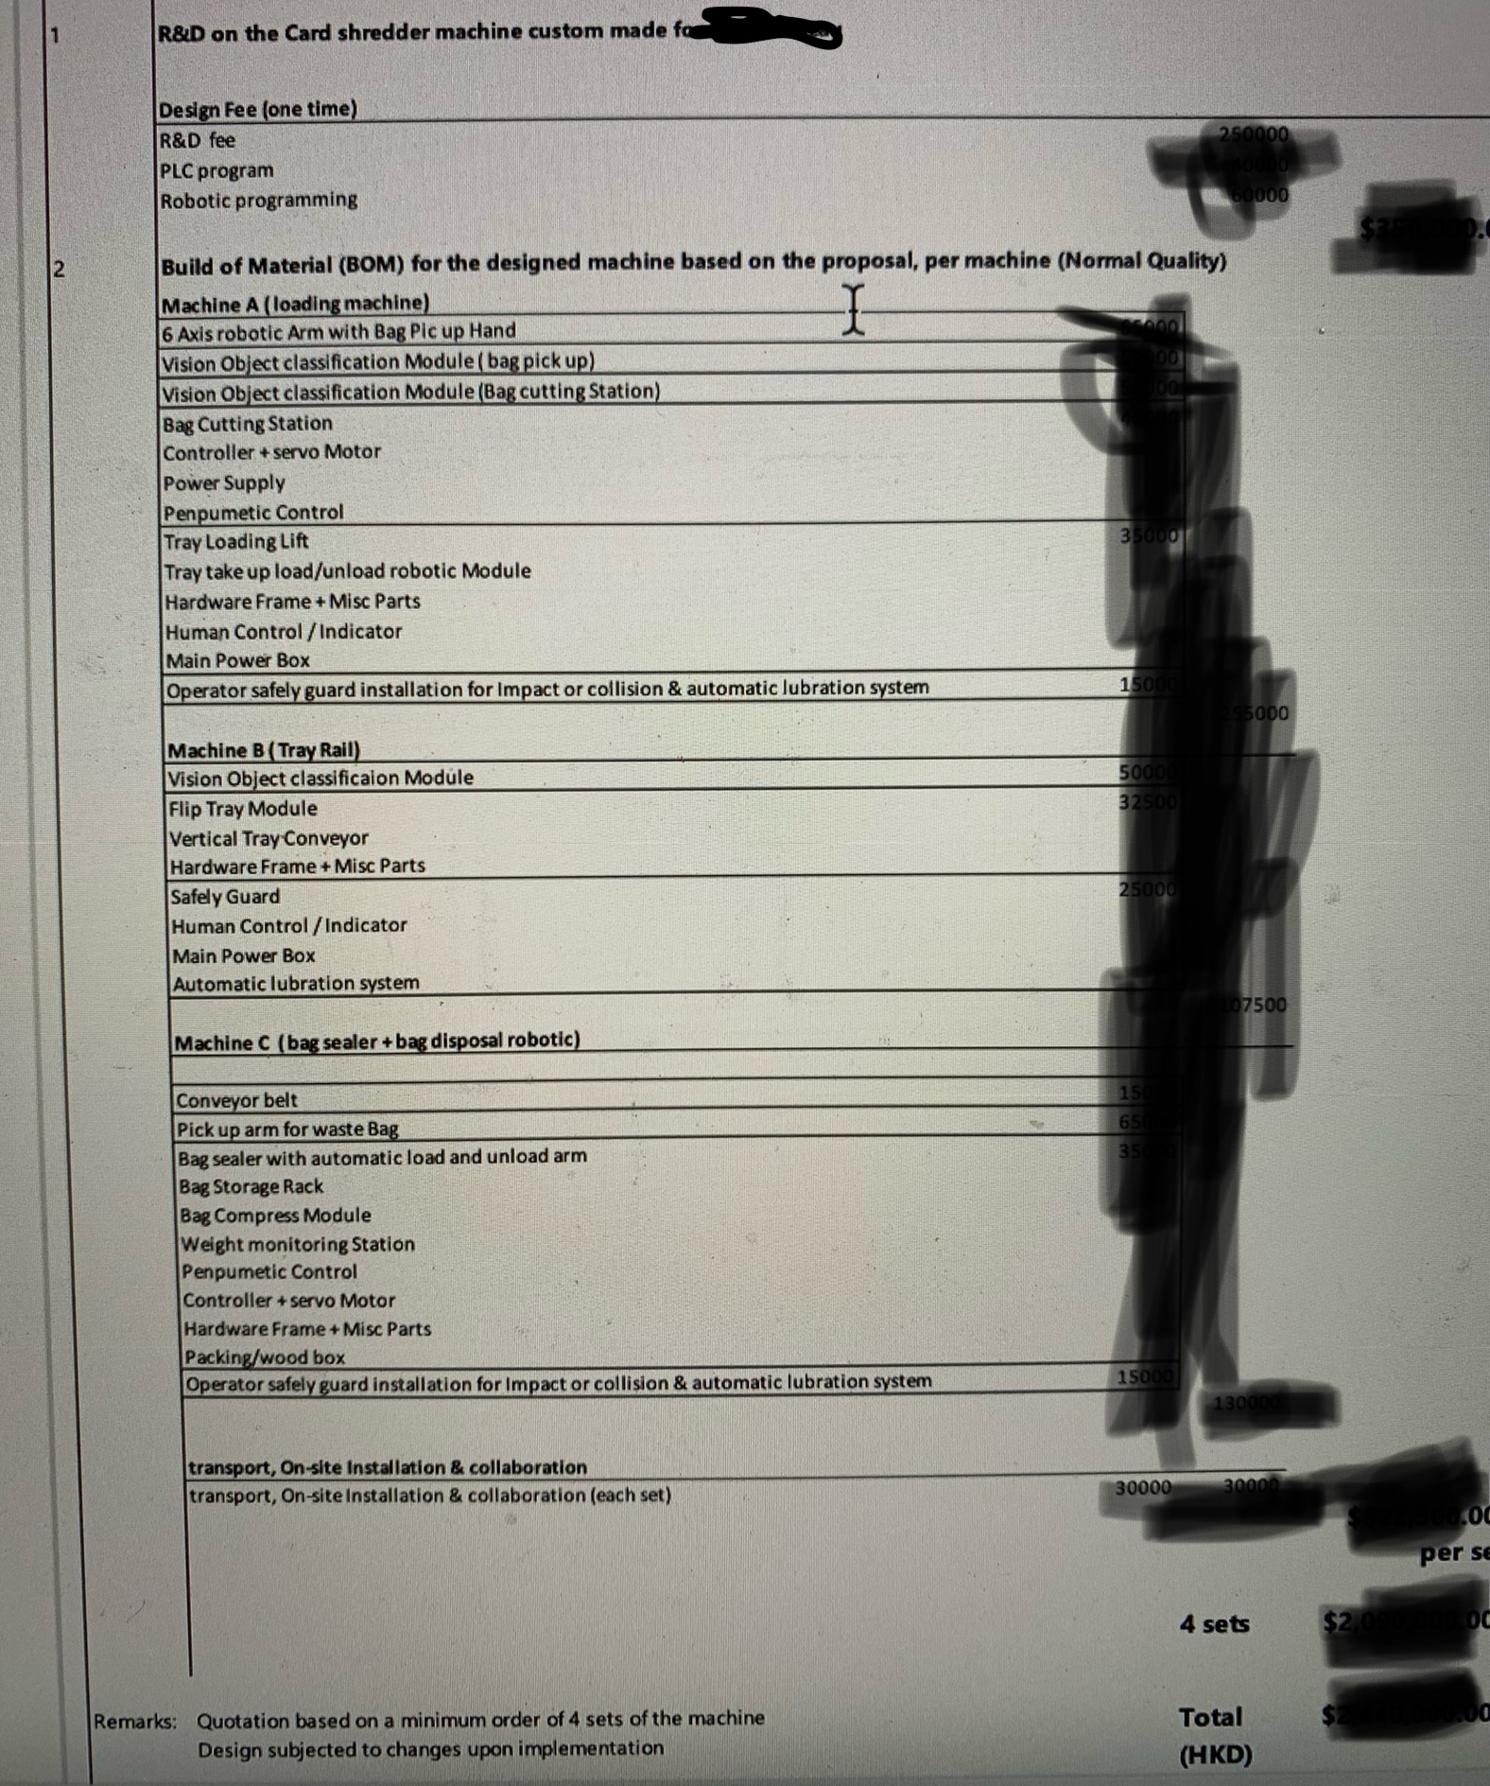
Quotation
This is how a real quotation loos like
A real proposal will also be shown…

Slide 9
Summary
Today you’ve seen in a real-life working environment:
A real machine set
Internal documents
Github Collaboration
NDA
Proposal
Quotation
Contract
We will have a practical question about this in exam. Please take note in this class.

Slide 10
孔子：古之学者为己，今之学者为人
我们不是填鸭， 填了你也不记得
We are here to learn, not to be fed. The purpose of being a university student – is to experience life, and to learn to learn.
Teachers are here to coach you, give you guidance. We give you a direction, and you should learn how to Baidu/google/search/AI the answer for yourself. (note: AI sometimes give you uncertain answers – so make sure you check the source and references)
Q: did you guys has syllabus about checking source and references for eg. Writing paper?

Slide 11
Homework
Kahoot – everyone create their own quiz for 8-questions on Chapter 3.
Note: Please name your game “Chapter 3: xxxx” for me to see it easily for marking.
Chapter 3: Synchronous Machines
Synchronous Generators in Renewable Energy Systems
Advanced Control Techniques for Synchronous Motors
Applications in Smart Grids and Energy Management Systems

