Slide 1


LETOURNEAU UNIVERSITY EETC 3433 ELECTRICAL MACHINERY AND CONTROLS for JLNU Fall Semester 2024 Lesson 11: 20241112 Tue
By Judy WS Wong

Slide 2
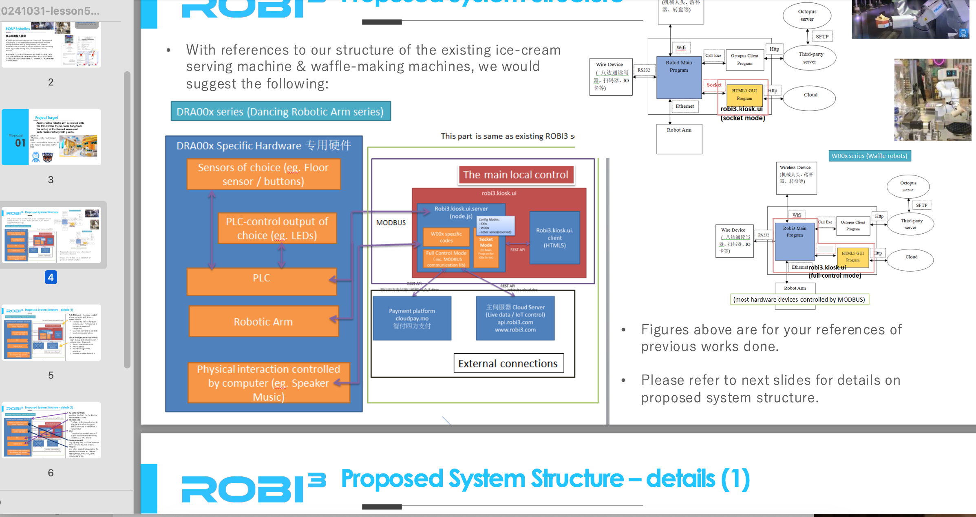
Note – there is no mid-term. This project is midterm (Friday, Tuesday, Wednesday)
Please make sure you do it~~ We are spreading it into 3 classes…
3-4 people in a group
Submit to Github
Due on Friday night

Slide 3
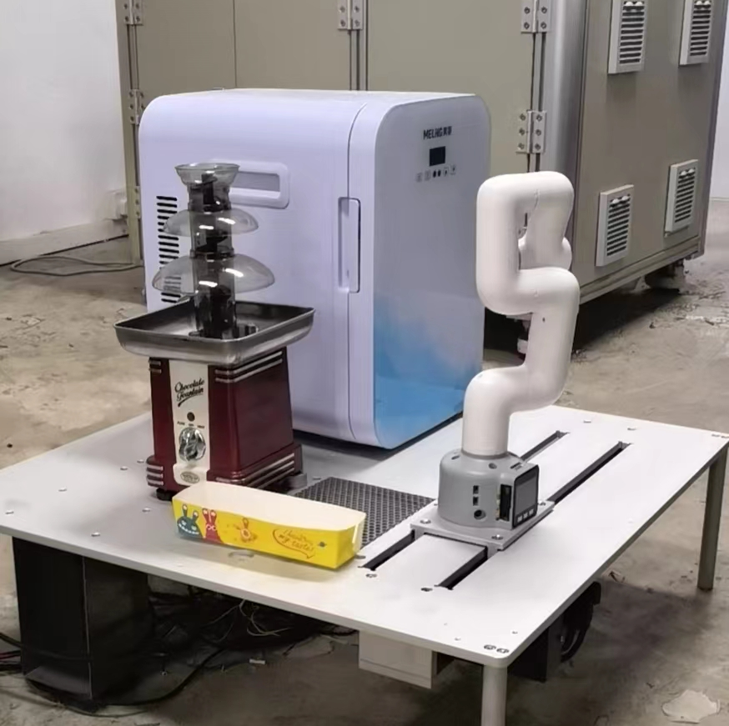
Writing the Block Diagram
About the Chocolate fountain robot
(We will go back to the waffle machine after this… as that is way too complicated)

Slide 4
Submit your block diagram now

Slide 5
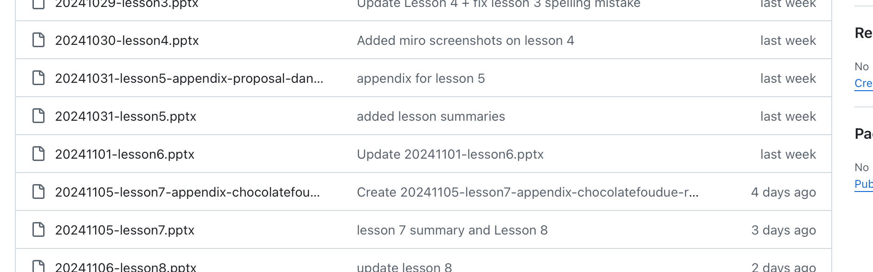
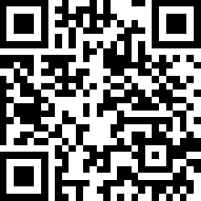
By End of class today – team name
Team name: https://classroom.github.com/a/U4QTG0NS Proposal sample (lesson 5)
Chocolate fondue Patent (lesson7)
Just make sure everyone has created the team

Slide 6
Chocolate fondue machine
I will come round and identify and talk to you. So if you miss not class I may not know you and see that you understand the exercise, so please try not to miss the class
For the same team, you might have different marks because of the participation.

Slide 7
Computer

Slide 8
Door Opening Mechanism
See if you can find it on Taobao

Slide 9
Elephant Robotics
Read the Cobot-5 Datasheet
Search on https://www.elephantrobotics.com/en/
Note – the robotic arm is not controlled by PLC – what is it controlled by?

Slide 10
Chocolate Foundue machine
Actually we just buy it from Taobao – how does it work?
(simply by turning the power on always – is there any control involved?)

Slide 11
Dive next – the Waffle Machine!

