Slide 1

LETOURNEAU UNIVERSITY EETC 3433 ELECTRICAL MACHINERY AND CONTROLS for JLNU Fall Semester 2024 Lesson 5: 20241031 Thu
By Judy WS Wong

Slide 2
If you find it’s too much last lesson…
If you understand everything, congratulation. You’ve already graduated from the class and is a successful engineer. You don’t have to be here and be listening to me
So anyway it is normal not to understand all the keywords – that’s why we are here to learn together, and my job is to coach you how to learn. The exam is going to be open book, so just jot down keywords that you don’t know, so you know how to search and learn about them
Upcoming lessons we will show you more existing real-life systems that I’ve been developing and we shall learn to write a proposal for a system – that would be your open book exam question!

Slide 3
Homework
Kahoot – everyone create their own quiz for 8-questions on Chapter 3.
Note: Please name your game “Chapter 3: xxxx” for me to see it easily for marking.
Chapter 3: Synchronous Machines
Synchronous Generators in Renewable Energy Systems
Advanced Control Techniques for Synchronous Motors
Applications in Smart Grids and Energy Management Systems

Slide 4

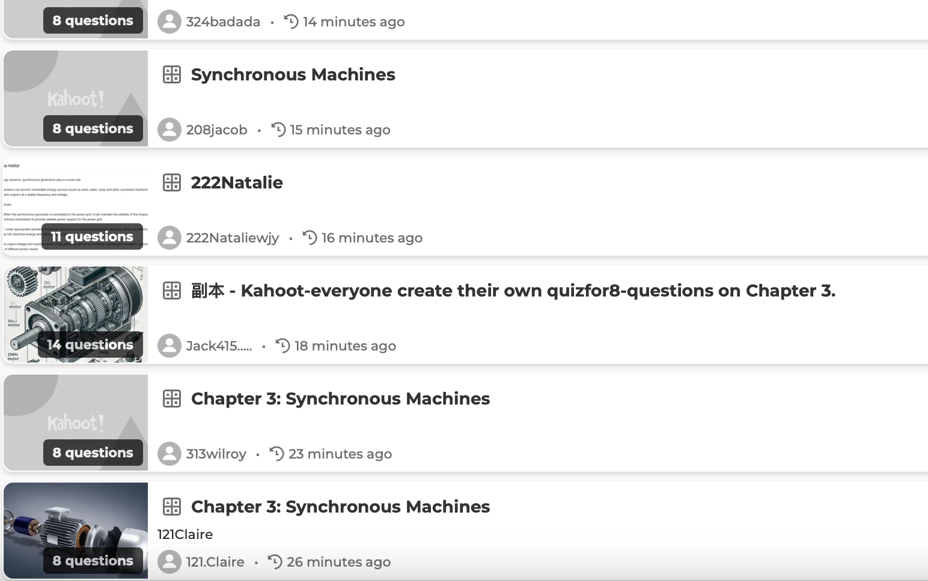
Kahoot! time
Will randomly pick 3-4 games to play before break

Slide 5
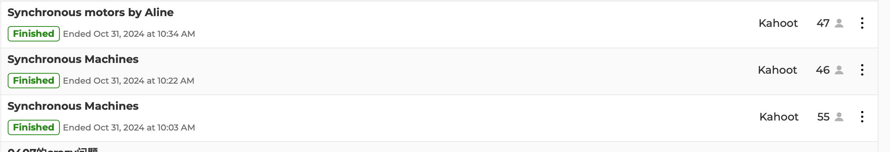
Summary – Synchronous Machines
We covered chapter 3 with 3 games today

Slide 6

After break
https://miro.com/app/board/uXjVLNTuDhY=/

Slide 7
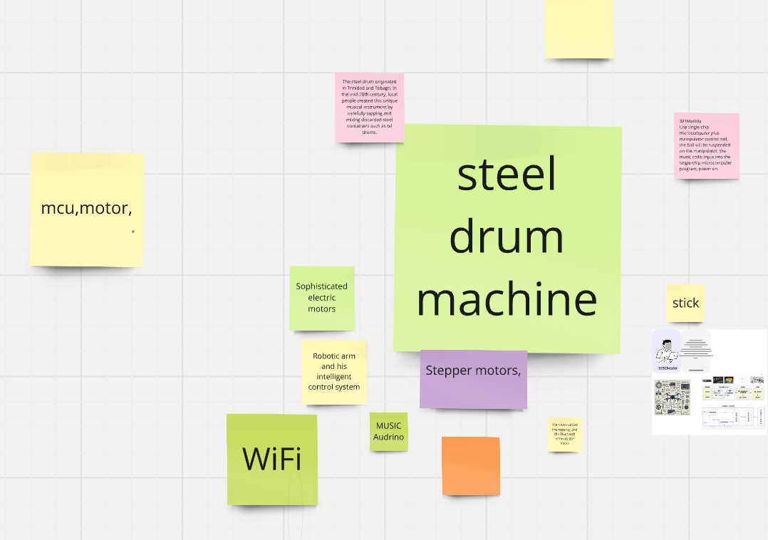
Case study – Steel drum machine (空灵鼓）
Keywords mentioned
Microprocessor (with I/O)
Audrino
Rasberry Pi
CPU with PCI card

Slide 8
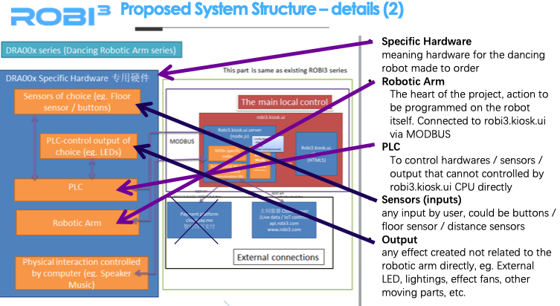
Case study on propose
Proposals for reference – will be uploaded into materials

Slide 9

Case study on Schematics – Precious Plastics
https://www.preciousplastic.com
Download the schematics and check them out
Will be prepared for next lesson.

Slide 10
About Patent

