Slide 1

LETOURNEAU UNIVERSITY EETC 3433 ELECTRICAL MACHINERY AND CONTROLS for JLNU Fall Semester 2024 Lesson 5: 20241101 Fri
By Judy WS Wong

Slide 2

After break
https://miro.com/app/board/uXjVLNTuDhY=/

Slide 3
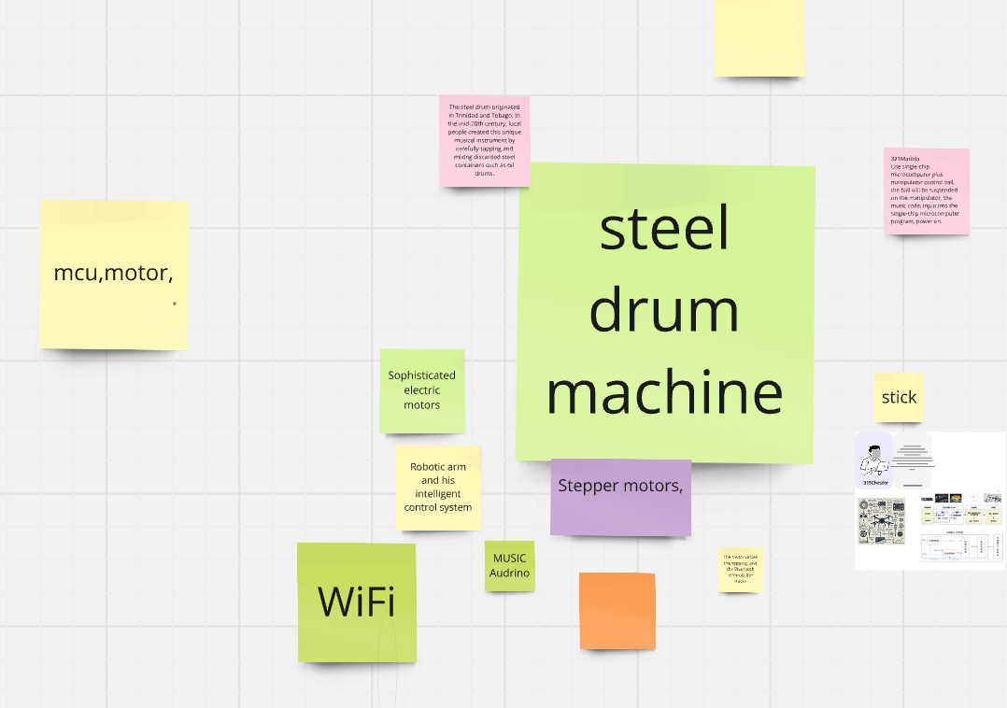
Case study – Steel drum machine (空灵鼓）
Keywords mentioned
Microprocessor (with I/O)
Audrino
Rasberry Pi
CPU with PCI card

Slide 4
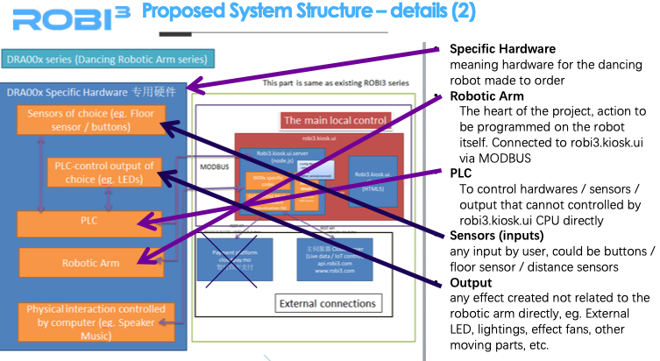
Case study on propose
Proposals for reference – will be uploaded into materials

Slide 5

Case study on Schematics – Precious Plastics
https://www.preciousplastic.com
Download the schematics and check them out
Will be prepared for next lesson.

Slide 6
About Patent

