Slide 1


LETOURNEAU UNIVERSITY EETC 3433 ELECTRICAL MACHINERY AND CONTROLS for JLNU Fall Semester 2024 Lesson 9: 20241108 Fri
By Judy WS Wong

Slide 2
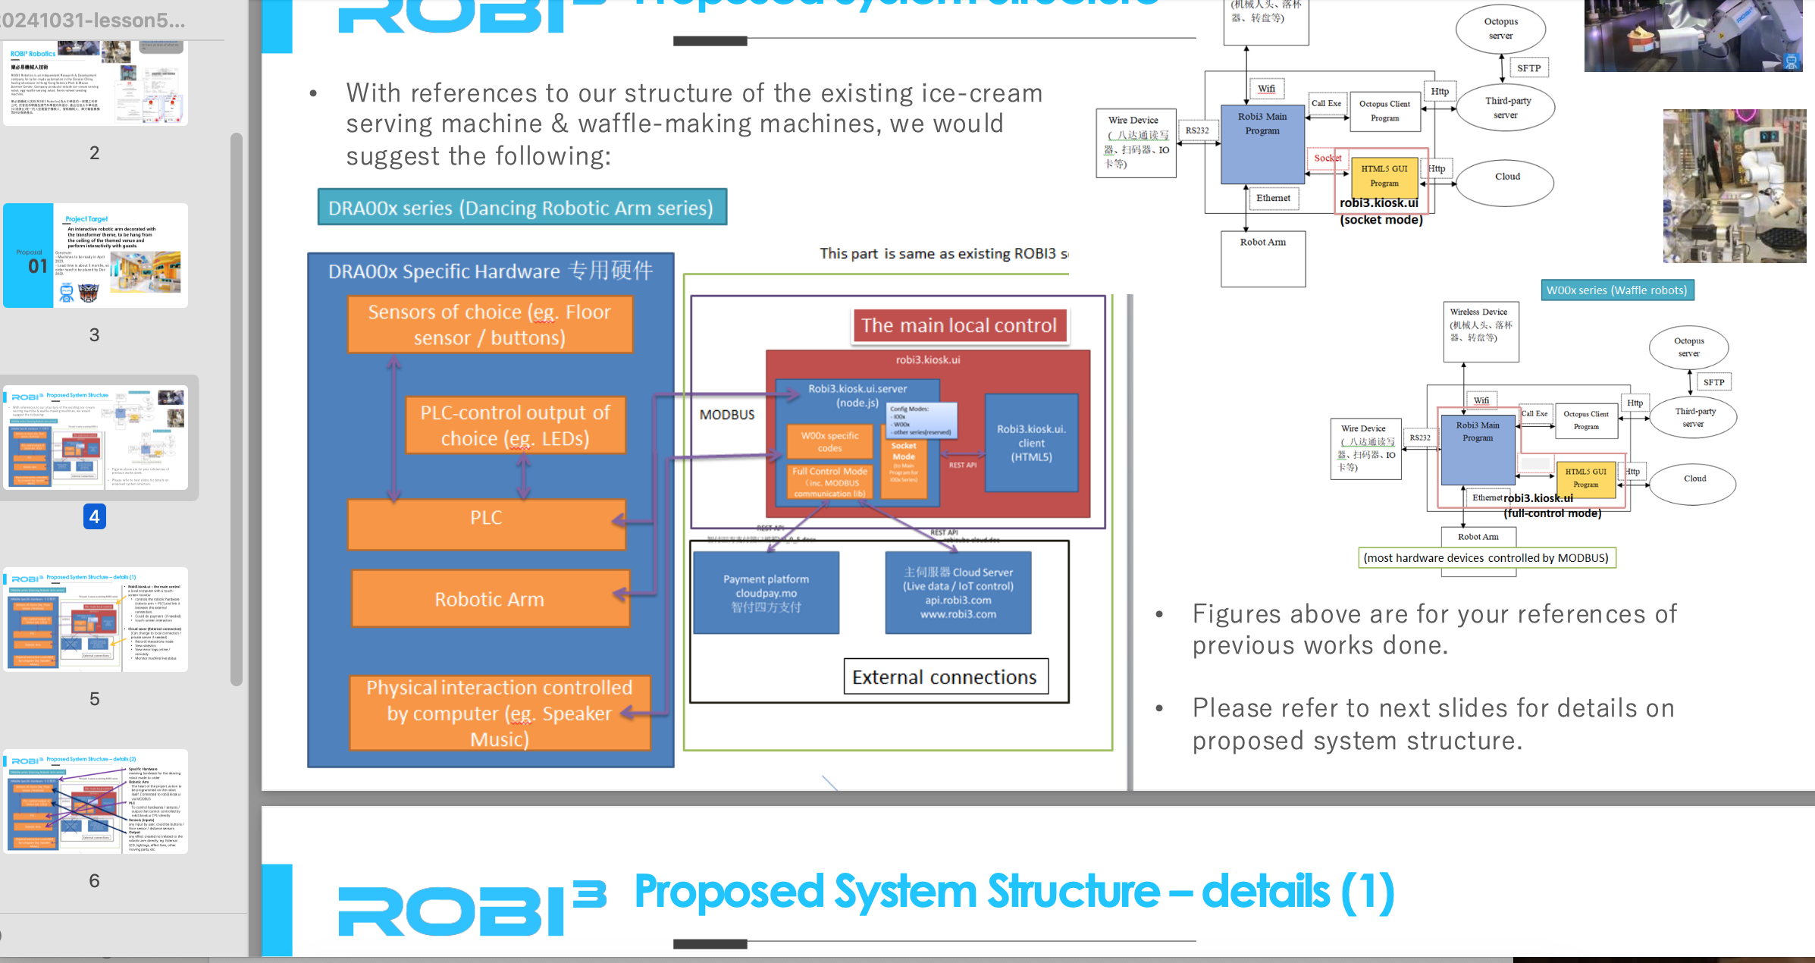
Note – there is no mid-term. This project is midterm (Friday, Tuesday, Wednesday)
Please make sure you do it~~ We are spreading it into 3 classes…
3-4 people in a group
Submit to Github
Due on Friday night

Slide 3
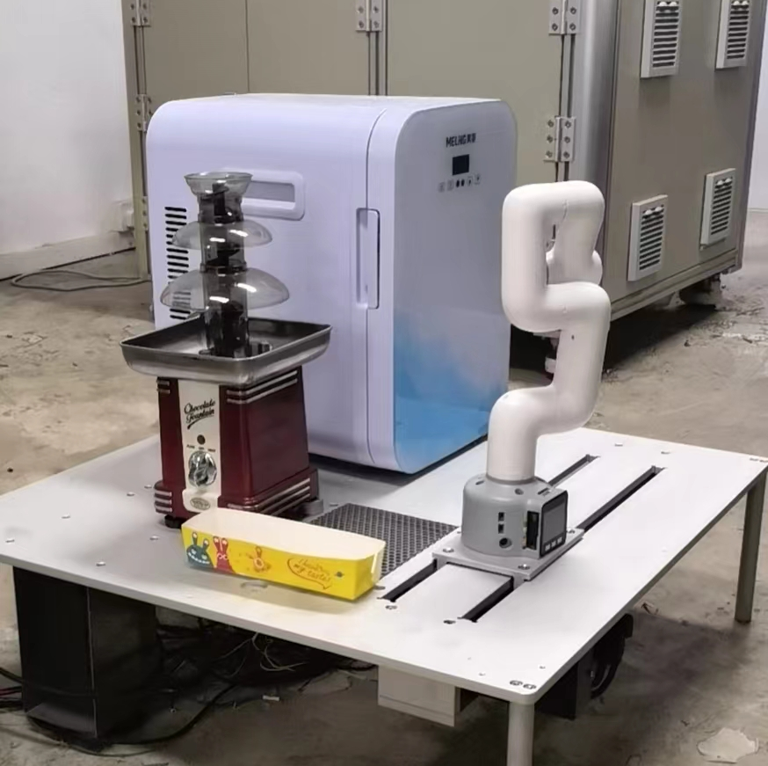
Writing the Block Diagram
About the Chocolate fountain robot
(We will go back to the waffle machine after this… as that is way too complicated)

Slide 4
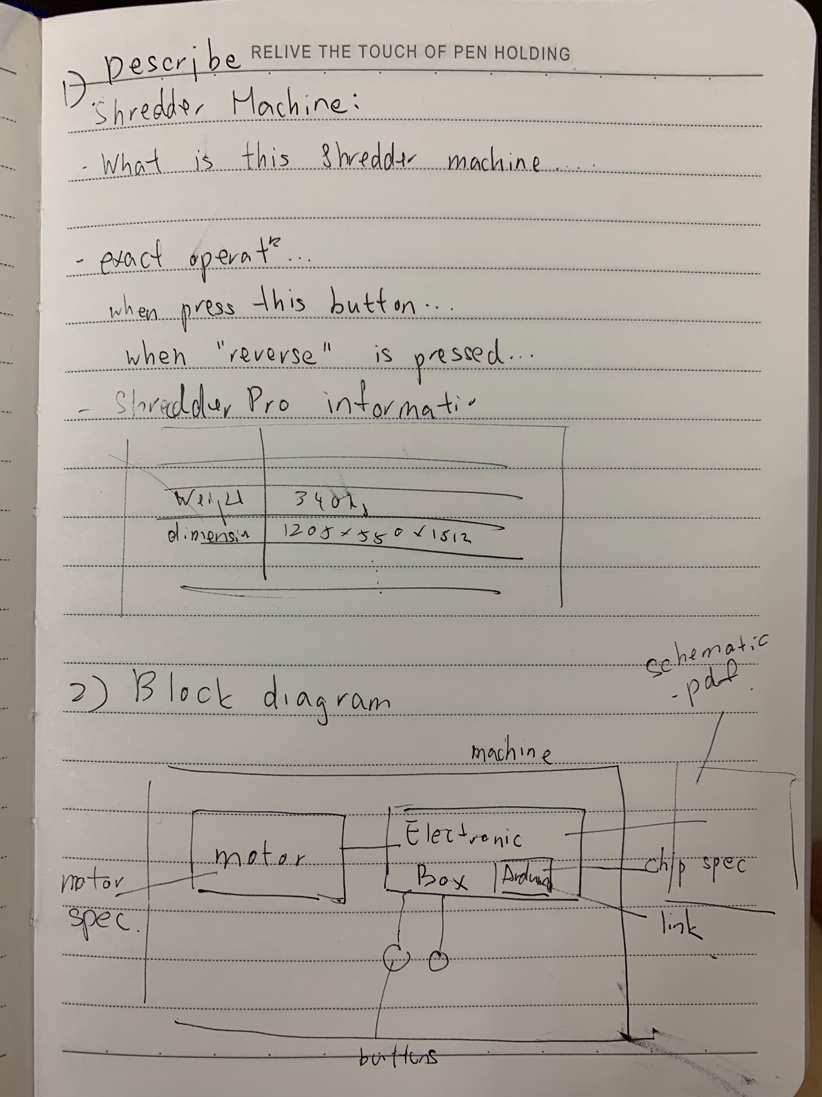
Block Diagram
Note: One of the exam question will be asking something like this. Please make sure you learn how to draw

Slide 5
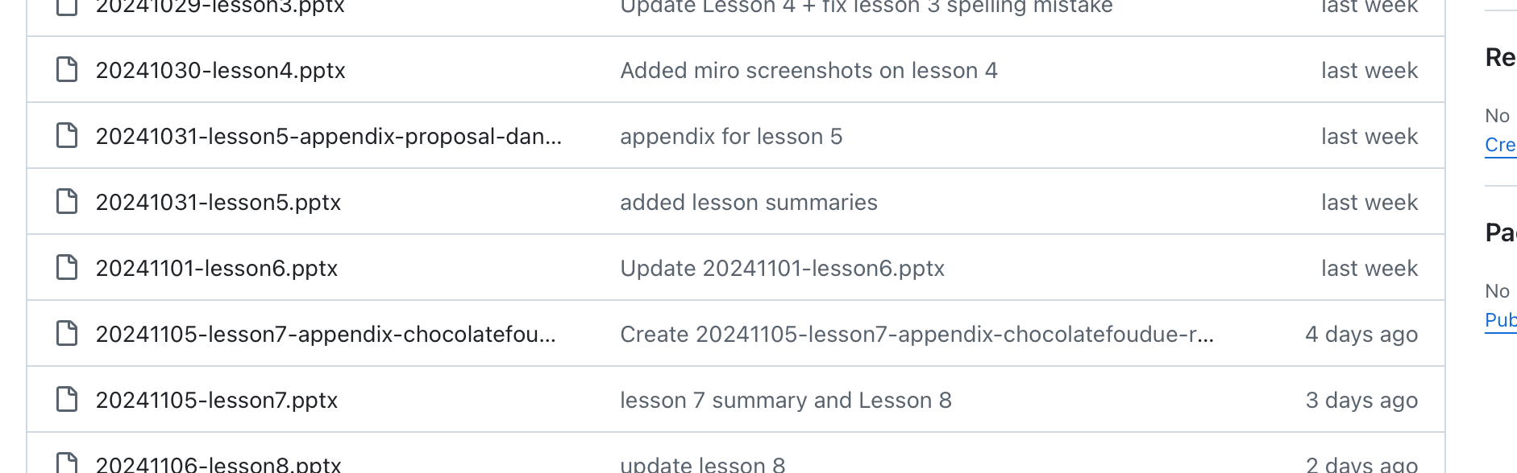
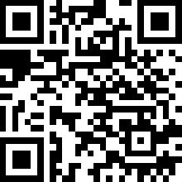
By End of class today – team name
Team name: https://classroom.github.com/a/75cq-Gag
Proposal sample (lesson 5)
Chocolate fondue Patent (lesson7)
Today: submit team.txt on this project

Slide 6
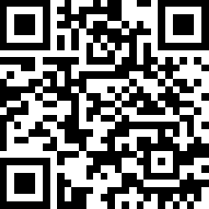
Reference
Submission: https://classroom.github.com/a/AfcaMNzf
Proposal sample (lesson 5)
Chocolate fondue Patent (lesson7)
Today: submit team.txt on this project

Slide 7
Chocolate fondue machine
I will come round and identify and talk to you. So if you miss not class I may not know you and see that you understand the exercise, so please try not to miss the class
For the same team, you might have different marks because of the participation.

Slide 8
Door Opening Mechanism

Slide 9
Elephant Robotics
Read the Cobot-5 Datasheet

Slide 10
Dive next – the Waffle Machine!

