Slide 1
National Park Reservation System
By:
Jesse Plummer
Raivat Alwar

Slide 2
System description
Create a basic National Park reservation system
Users can search for and research a National Park
Park staff can create/delete a permit for activities in the park

Slide 3
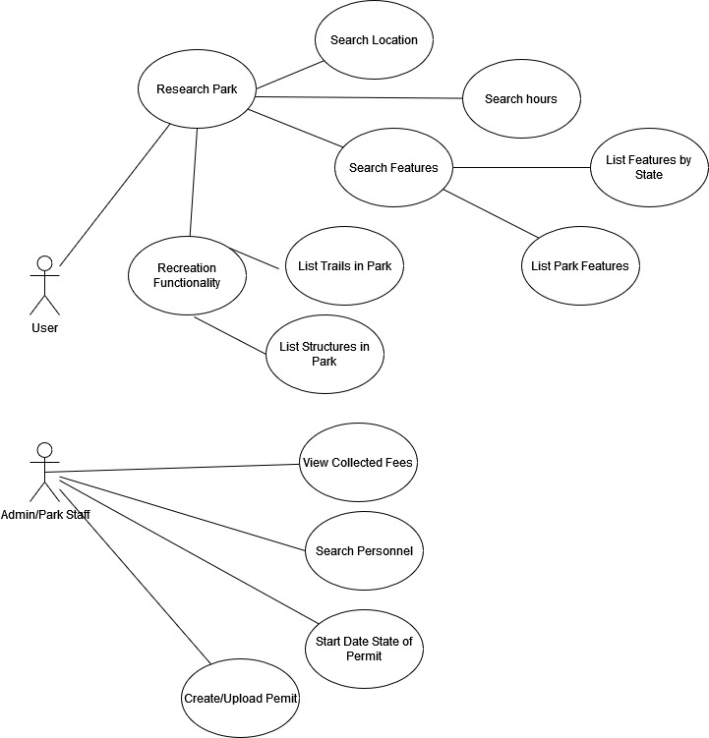
Use case diagram

Slide 4
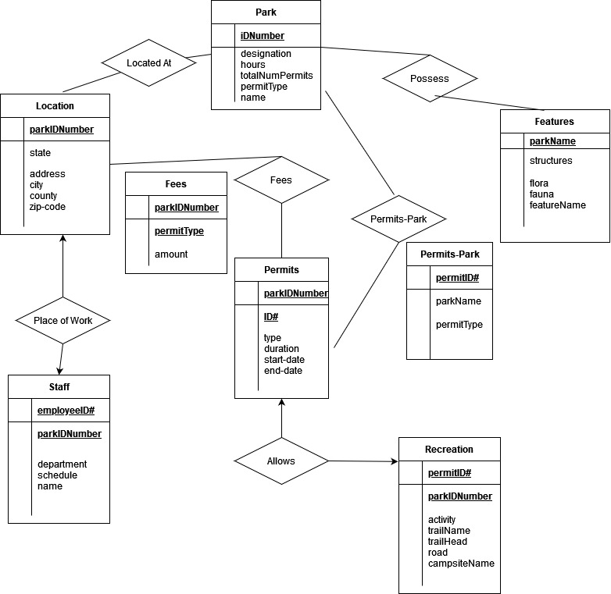
Entity-Relation Diagram

Slide 5
Schema
Park(
iDNumber int(15)
name varchar(45)
designation varchar(24)
hours varchar(12)
totalNumPermits int(5)
permitType varchar(25)
)
Location(
parkIDNumber int(15)
state varchar(10)
address varchar(25)
county varchar(25)
city varchar(45)
zipcode int(14)
)
Permits(
parkIDNumber int(15)
ID# int(20)
type varchar(25)
duration int(3)
start-date date()
end-date date()
)
Fees(
parkIDNumber int(15)
permitType varchar(24)
amount decimal(15)
)
Recreation(
parkIDNumber int(15)
permitID# int(20)
activity varchar(25)
trailName varchar(50)
trailHead varchar(50)
road varchar(50)
campsiteName varchar(50)
)
Features(
parkIDNumber int(15)
structures varchar(150)
flora varchar(200)
fauna varchar(200)
)
Staff(
employeeID# int(20)
parkIDNumber int(15)
department varchar(20)
schedule varchar(50)
name varchar(50)
)
Permit-Parks(
permitID# int(20)
parkIDNumber int(15)
permitType varchar(25)
)

Slide 6
Implementation Details
We used a sqlite database
The user interface is command line based written in python with the actual query functions in one file imported into a menu file in another.
It was constructed by mapping a base menu, then mapping out the sub-menus that would call query functions.
Basic error checking of number entries is used

