Slide 1
Snowfall and connections to Latitude
Jesse Plummer

Slide 2
Participants (or Observations)
Variable Name | Type | Description
station | character | the geographic location of the station where the data was collected
state | character | the state (or territory) where the data was collected
latitude | numeric | the latitude of the station
longitude | numeric | the longitude of the station
elevation | numeric | the height of the station
date | numeric | the date when the data was collected (year, month, day)
temp_min | numeric | the minimum temperature collected at the station
temp_max | numeric | the maximum temperature collected at the station
temp_avg | numeric | the avergae temperature collected at the station
av_day_wind_spd | numeric | the average daily wind speed at the station
wi_dir_5sec | numeric | the wind direction in 5 second intervals (at the station)
wi_spd_5sec | numeric | the wind speed in 5 second intervals (at the station)
snow_fall | numeric | the amount of snowfall recorded at the station
snow_dep | numeric | the snow depth recorded at the station
precip | numeric | the amount precipitation recorded at the station
The data that I used was the weather.csv which included the following variables:

Slide 3
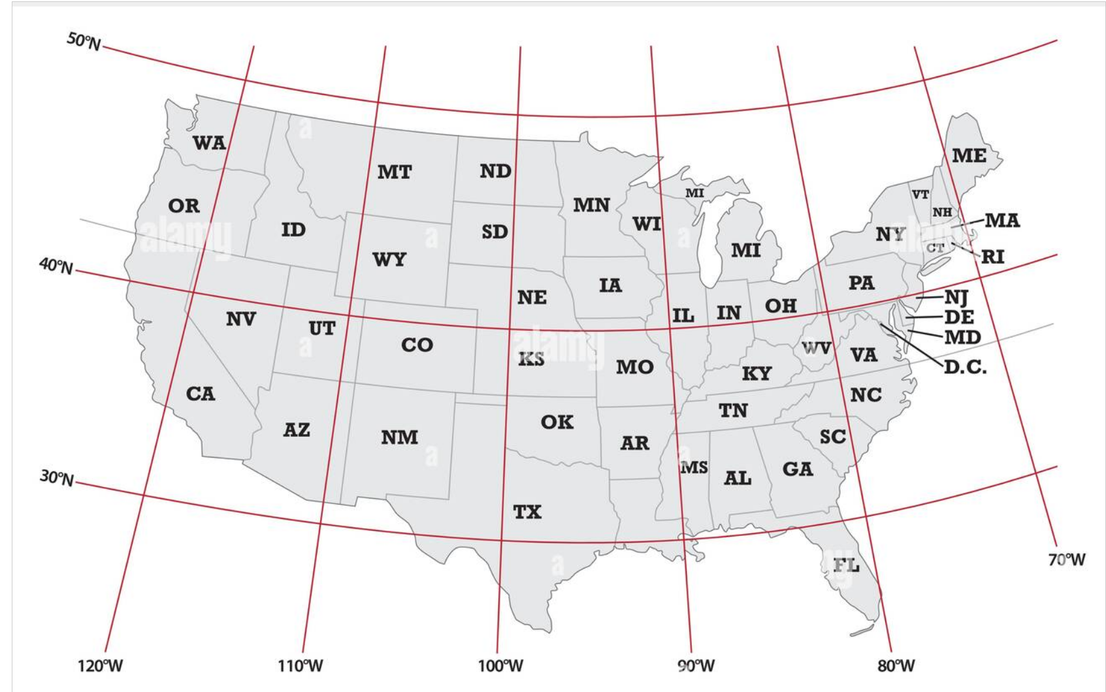
My hypothesis is that more snowfall would occur at stations above the 40th parallel.
Variables I used:
The variables that I used in this analysis were:
latitude: this would be used to create a clear division between data points
snow_fall: one of the variables being analyzed that would show that the hypothesis could be verified or dismissed.
temp_avg: another variable that demonstrates one possible explanation as to why the hypothesis could be true.
Map of the United States: Latitude & Longitude shown

Slide 4
How I did the analysis:
Load the required libraries into RStudio
#|label: load-packages #|code-summary: Packages required for analysis #|message: false #|include: false #|warning: false library(tidyverse) library(lme4) library(lmerTest) library(dplyr)
(Bates et al. 2015)
(Wickham et al. 2019)
(Kuznetsova, Brockhoff, and Christensen 2017)
(Wickham et al. 2023)
Move the data into RStudio then read the csv file into a tibble
#|label: Load data file #|code-summary: read csv into a tibble #| output: false #load("weather.csv") weather <- read_csv('weather.csv')
Add a column count to the new tibble and save it to a data frame (df0)
#|label: Create data frame #|code-summary: create data frame with count column #|output: false df0 <- weather %>% add_count(station, name = 'station_cnt') %>% add_count(state, name = 'state_cnt') %>% add_count(state, name = 'state_cnt') %>% add_count(latitude, name = 'latitude_cnt') %>% add_count(longitude, name = 'longitude_cnt') %>% add_count(elevation, name = 'elevation_cnt') %>% add_count(date, name = 'date_cnt') %>% add_count(temp_min, name = 'temp_min_cnt') %>% add_count(temp_max, name = 'temp_max_cnt') %>% add_count(temp_avg, name = 'temp_ave_cnt') %>% add_count(av_day_wi_spd, name = 'av_day_wi_spd_cnt') %>% add_count(wi_dir_5sec, name = 'wi_dir_5sec_cnt') %>% add_count(wi_spd_5sec, name = 'wi_spd_5sec_cnt') %>% add_count(snow_fall, name = 'snow_fall_cnt') %>% add_count(snow_dep, name = 'snow_dep_cnt') %>% add_count(precip, name = 'precip_cnt')
4. Make sure data is clean (remove any NAs), add a new column to the df0 data frame that differentiates above or below the 40th parallel, and save that to a new data frame, data_for_analysis.
#|label: Clean data and add new column #|code-summary: omit any NAs from df0, add another column df0 %>% na.omit() %>% mutate(lat_Abv_40 = ifelse(latitude > 40, "abv", "bel")) -> data_for_model
5. Create a data model that will show if we may accept or reject the null hypothesis
#|label: For a conclusion on the hypothesis based on p-value #|code_summary: using lmer find a p-value high_lat_model <- lmer(snow_fall ~ lat_Abv_40 + (1|station), data= data_for_model) summary(high_lat_model)
Linear mixed model fit by REML. t-tests use Satterthwaite's method [ lmerModLmerTest] Formula: snow_fall ~ lat_Abv_40 + (1 | station) Data: data_for_model REML criterion at convergence: 97063.1 Scaled residuals: Min 1Q Median 3Q Max -0.637 -0.185 -0.039 -0.008 59.716 Random effects: Groups Name Variance Std.Dev. station (Intercept) 0.002445 0.04945 Residual 0.268421 0.51809 Number of obs: 63536, groups: station, 272 Fixed effects: Estimate Std. Error df t value Pr(>|t|) (Intercept) 0.114634 0.005588 207.643785 20.52 <2e-16 *** lat_Abv_40bel -0.101701 0.007462 208.526977 -13.63 <2e-16 *** --- Signif. codes: 0 '***' 0.001 '**' 0.01 '*' 0.05 '.' 0.1 ' ' 1 Correlation of Fixed Effects: (Intr) lt_Abv_40bl -0.749
Based on this p value we can reject the null hypothesis, and conclude that stations above the 40th parallel (latitudes above 40 degrees) have more snowfall that stations below the 40th parallel.

Slide 5
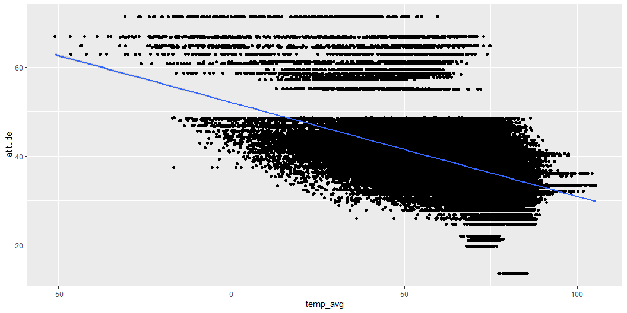
Pearson Correlation Test: The next thing I thought about was to to give a reason why my prediction could be true. Generally speaking (through common knowledge) the higher the parallel (the higher the latitude) the lower the average temperature would be. To show this correlation, I ran a Pearson’s correlation, looking for an r value that shows a correlation between the average temperature and latitude.
#|code_summary: running a pearson correlation on data_for_model data_cor_0 <- cor(data_for_model$latitude, data_for_model$temp_avg, method = c("pearson")) summary(data_cor_0)
Min. 1st Qu. Median Mean 3rd Qu. Max. -0.507 -0.507 -0.507 -0.507 -0.507 -0.507
The r-value shows a strong negative correlation between the average temperature and latitude, as shown in the plot below. This means that as the latitude increases, the temperature decreases. This meets my prediction and expectation in support of the hypothesis.
#|label: Plot of correlation #|code_summary: ggplot to plot all data points, add a line showing correlation #|fig-cap: Figure-1 Pearson correlation of average temperature and latitude data_for_model %>% ggplot(aes(x = temp_avg, y = latitude)) + geom_point() + geom_smooth(method="lm")
Plot of correlation: the blue line shows the strong negative correlation between the latitude and average temperature. Each of the dots represents a data point taken at a station, multiple readings from one station are common.

Slide 6
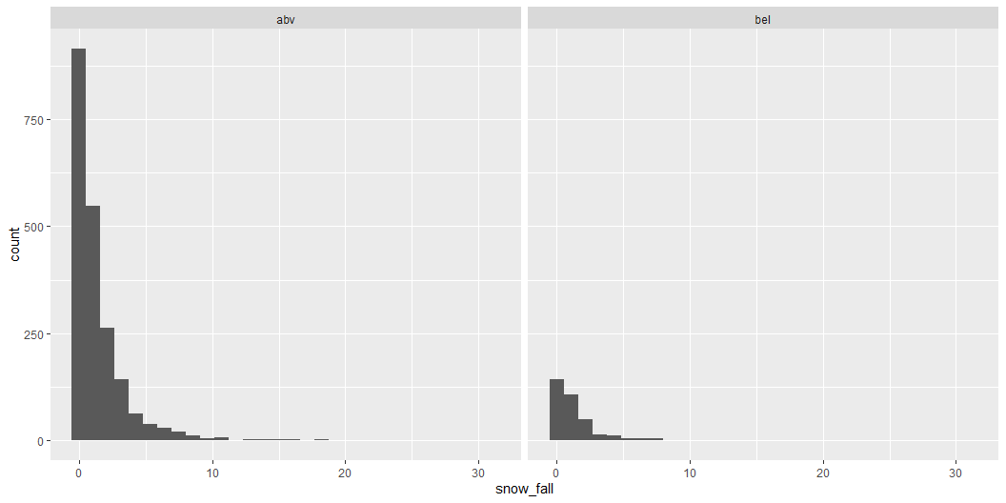
In order to show the snowfall in a different way, I cleaned the data once again and displayed it in a histogram
#|label: Clean data for use with histogram #|code_summary: filter out stations without snowfall #|fig-cap: Histogram showing only stations that received snowfall data_for_model %>% filter(snow_fall != 0) -> data_only_snow_fall
#|label: Plot hisgtoram #| code_summary: create histogram #| fig-cap: Histogram showing both stations that did and did not receive snowfall data_only_snow_fall %>% ggplot(aes(x = snow_fall)) + geom_histogram() + facet_wrap(~lat_Abv_40)
Left is the count of stations above the 40th parallel that accumulated snow. Right are the stations below the 40th parallel that had snow fall.

Slide 7
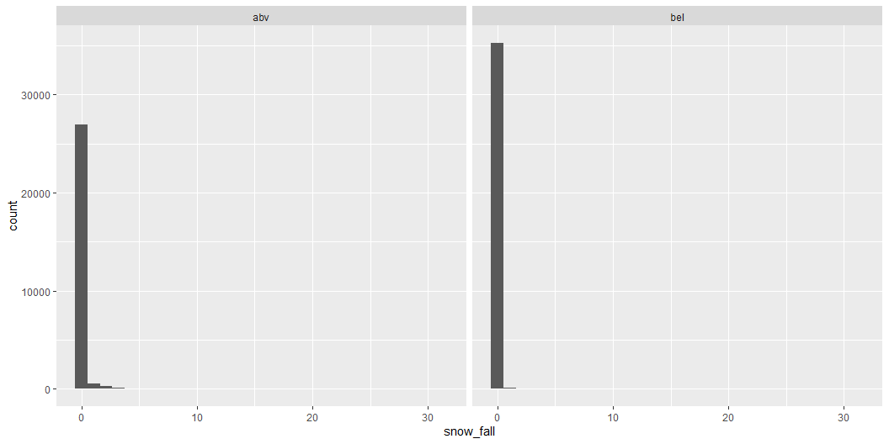
For context, this is what the data looks like with the stations without snowfall
#|label: Plot histogram (with no snowfall datapoints) #|code_summary: create a second histogram data_for_model %>% ggplot(aes(x = snow_fall)) + geom_histogram() + facet_wrap(~lat_Abv_40)

Slide 8
.
The relevant statistics that support the conclusion of the hypothesis were Section 5: the data model. The p-value allowed us to reject the null hypothesis and conclude that the amount of snowfall increases as the latitude increases.
A second relevant statistic supporting the conclusion of the hypothesis was from Section 6: correlating the average temperature with latitude. It is common knowledge that at the Equator (latitude 0) the temperature is extremely high. As one travels away from the Equator, the average temperature decreases. The r value showed that the latitude and temperature are negatively correlated; meaning that as the latitude increase, the temperature decreases. This was more clearly shown in Figure 1 with the blue line.
The analysis is appropriate for my data-set because snowfall prediction is an important, not only for forecasting reasons but considering where large amounts of water naturally occur that are released slowly over time (snow melt). Climate change is altering weather patterns, and increasing temperatures, and establishing baselines and convincing data is important to building sustainable plans on how the resources we have are being utilized, how much need to be set aside for the ecosystems that currently exist, and if there is a possible change from the trends of the past to the present.
In checking my assumptions the distribution for snowfall is skewed. In spite of this, the data set has met the assumptions of my statistical tests.
What my outcome means is that there is more snow falling above the 40th parallel than below it. This needs to be taken into consideration for natural resource planning, ecosystem preservation, urban planning, farming, etc. This is an essential guide post for people who want to ask questions with implications that rely on latitude and snowfall.
The implications of the relationship are that is is far more likely that one will find snow accumulated above the 40th parallel when compared to below the 40th parallel. What this means in the real world is that people need to consider geography when taking into consideration conditions they are to be living in. This analysis could have impacts on land use, urban planning, ecosystem and resource management.
Limitations
I cannot conclude that there is no snowfall below the 40th parallel, or that there may be other factors involved in higher snowfall accumulation.
Conclusions
The main takeaway from this study is that snowfall is more likely at or above the 40th parallel. Is it impossible to find it elsewhere? No, but less likely than above the 40th parallel.
References
[@ftp://ftp.ncdc.noaa.gov/pub/data/ghcn/daily/readme.txt]
Bates, Douglas, Martin Mächler, Ben Bolker, and Steve Walker. 2015. “Fitting Linear Mixed-Effects Models Usinglme4.” Journal of Statistical Software 67 (1). https://doi.org/10.18637/jss.v067.i01.
Kuznetsova, Alexandra, Per B. Brockhoff, and Rune H. B. Christensen. 2017. “lmerTest Package: Tests in Linear Mixed Effects Models.” Journal of Statistical Software 82 (13). https://doi.org/10.18637/jss.v082.i13.
Wickham, Hadley, Mara Averick, Jennifer Bryan, Winston Chang, Lucy McGowan, Romain François, Garrett Grolemund, et al. 2019. “Welcome to the Tidyverse.” Journal of Open Source Software 4 (43): 1686. https://doi.org/10.21105/joss.01686.
Wickham, Hadley, Romain François, Lionel Henry, Kirill Müller, and Davis Vaughan. 2023. “Dplyr: A Grammar of Data Manipulation.” https://CRAN.R-project.org/package=dplyr.

