Slide 1
Data Processing

Slide 2
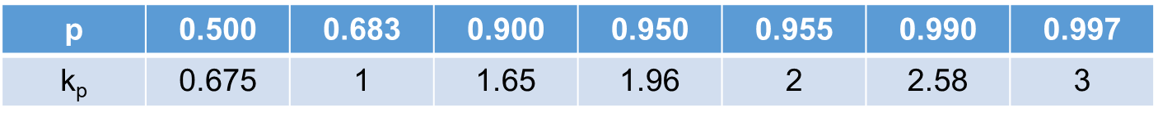
Introduction
1
a. Introduction to uncertainties
The values to evaluate the reliability of your data
1.Type-A uncertainty
The values to evaluate the data from different measurement
2.Type-B uncertainty
the values to evaluate the precision of the instruments
3.Type-C uncertainty
the uncertainty which combines measurement and instruments
4.Extensive uncertainty
The uncertainty with the following confident probability

Slide 3
Objective: 1. For different types of uncertainty, all can be calculated by one input from the user. 2. It can react to different types of experimental data 3.The user interface should be simple and easy to use
b. Introduction to the project
GOAL
calculating uncertainty of the data and linear data processing with its evaluation by means of least square method and differential method.

Slide 4

Analysis
Type-A
Type-B
Direct measurement
quantity
Type-C
Extensive
Calculation of uncertainty
2
Data
Processing
Indirect measurement
quantity
Differential method
Linear data
processing
Least square method

Slide 5
Design
3
Linear Data
Data Type
Nonlinear Data
Method
of Processing
Direct
Measurement?
Y
Successive
Difference
Method
Input Data
N
Least
Square
Method
Choose Formula
Processing
input Data
Input Data
Processing
Output
Outcome
Input Data
Processing
Processing
Output
Outcome
Output outcome
Output outcome

Slide 6
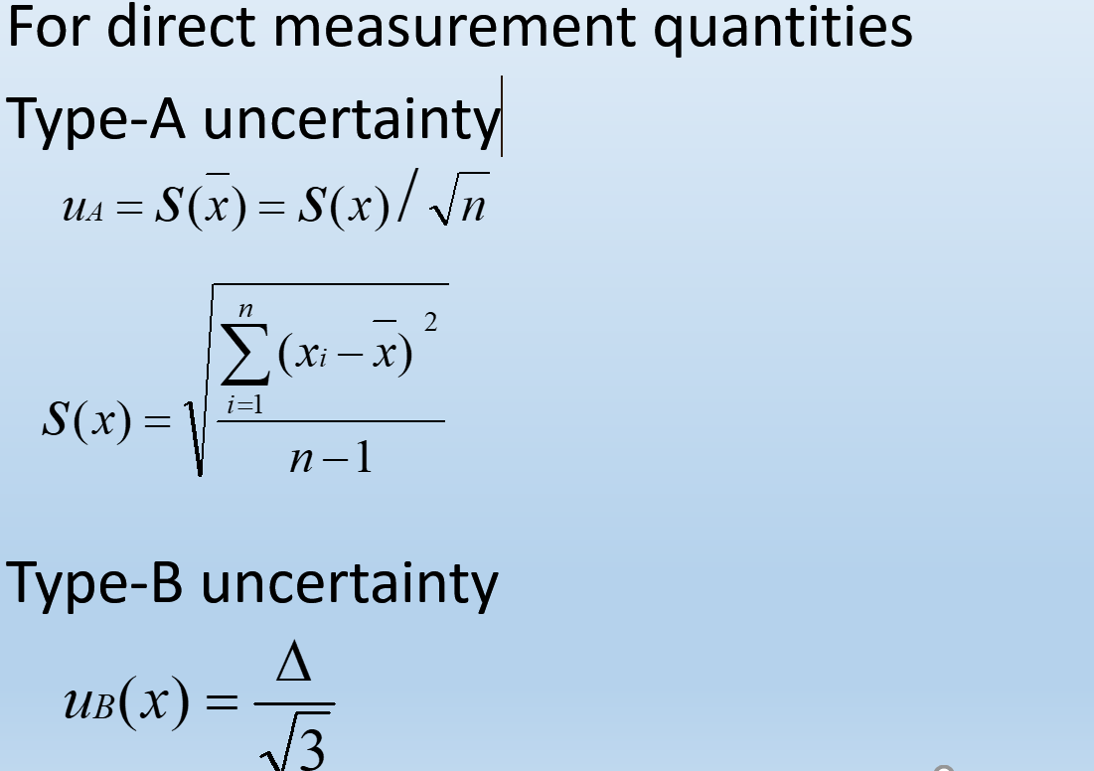
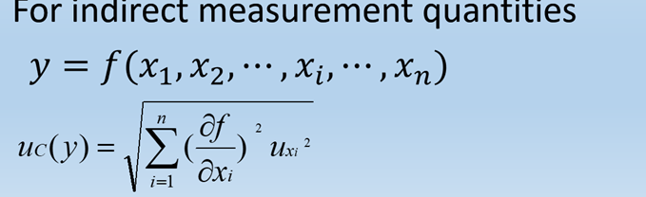
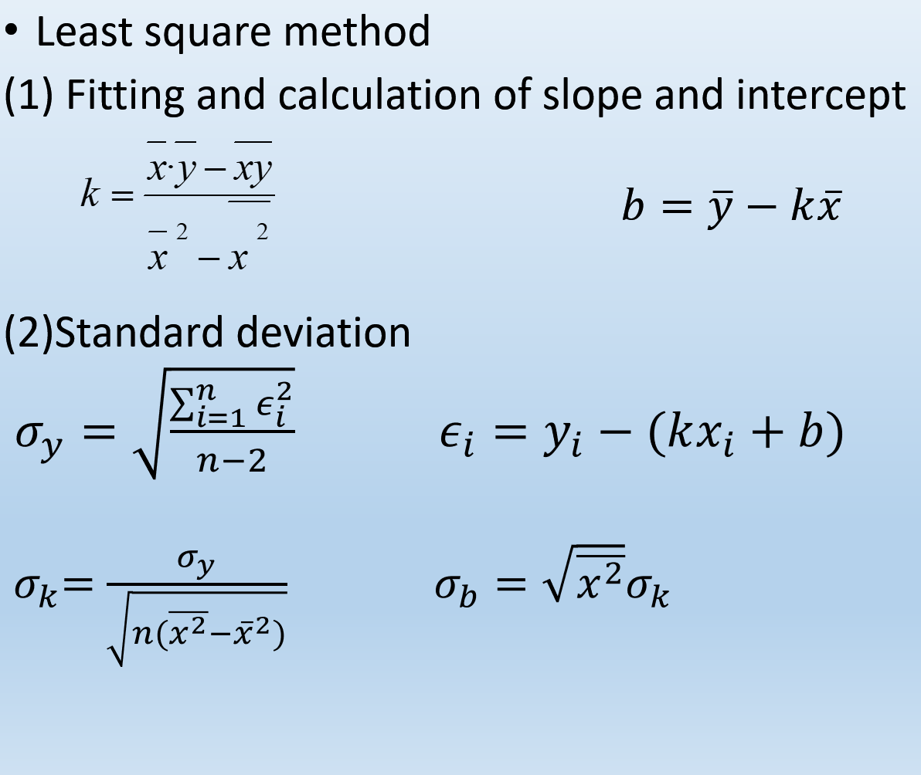
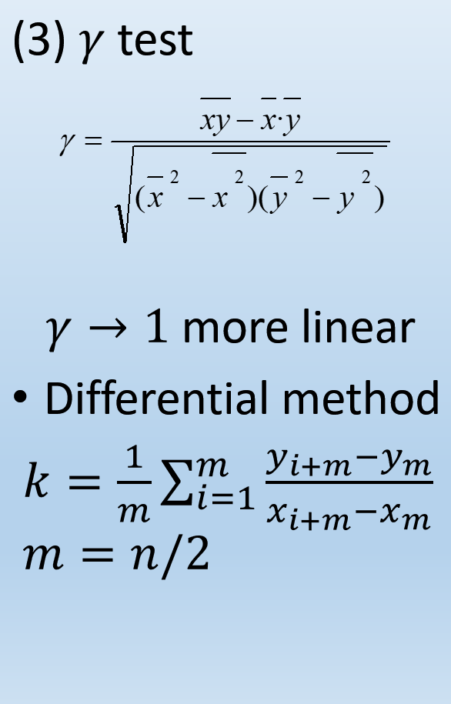
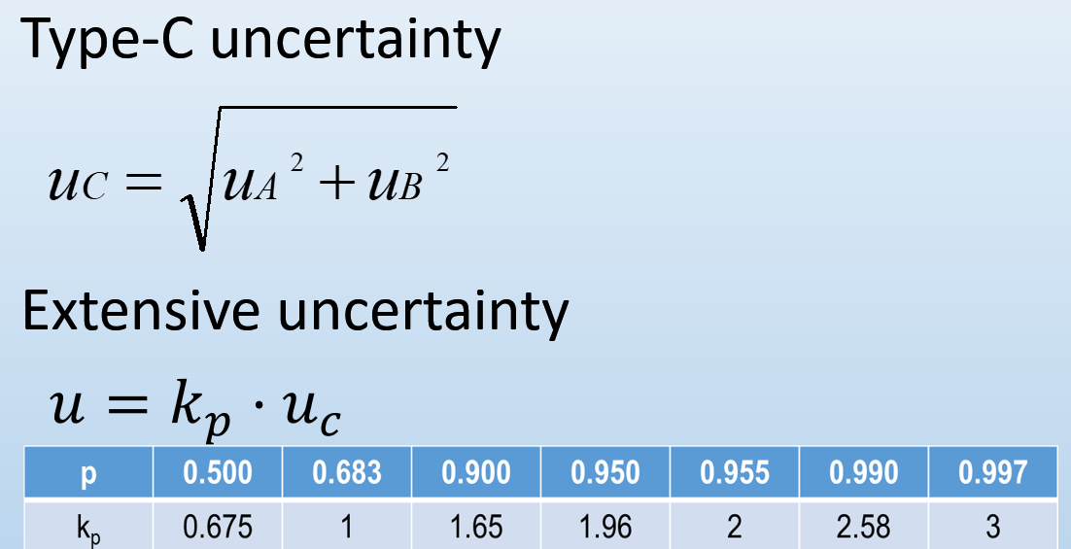
Implementation
4
What if n is an odd number?

Slide 7
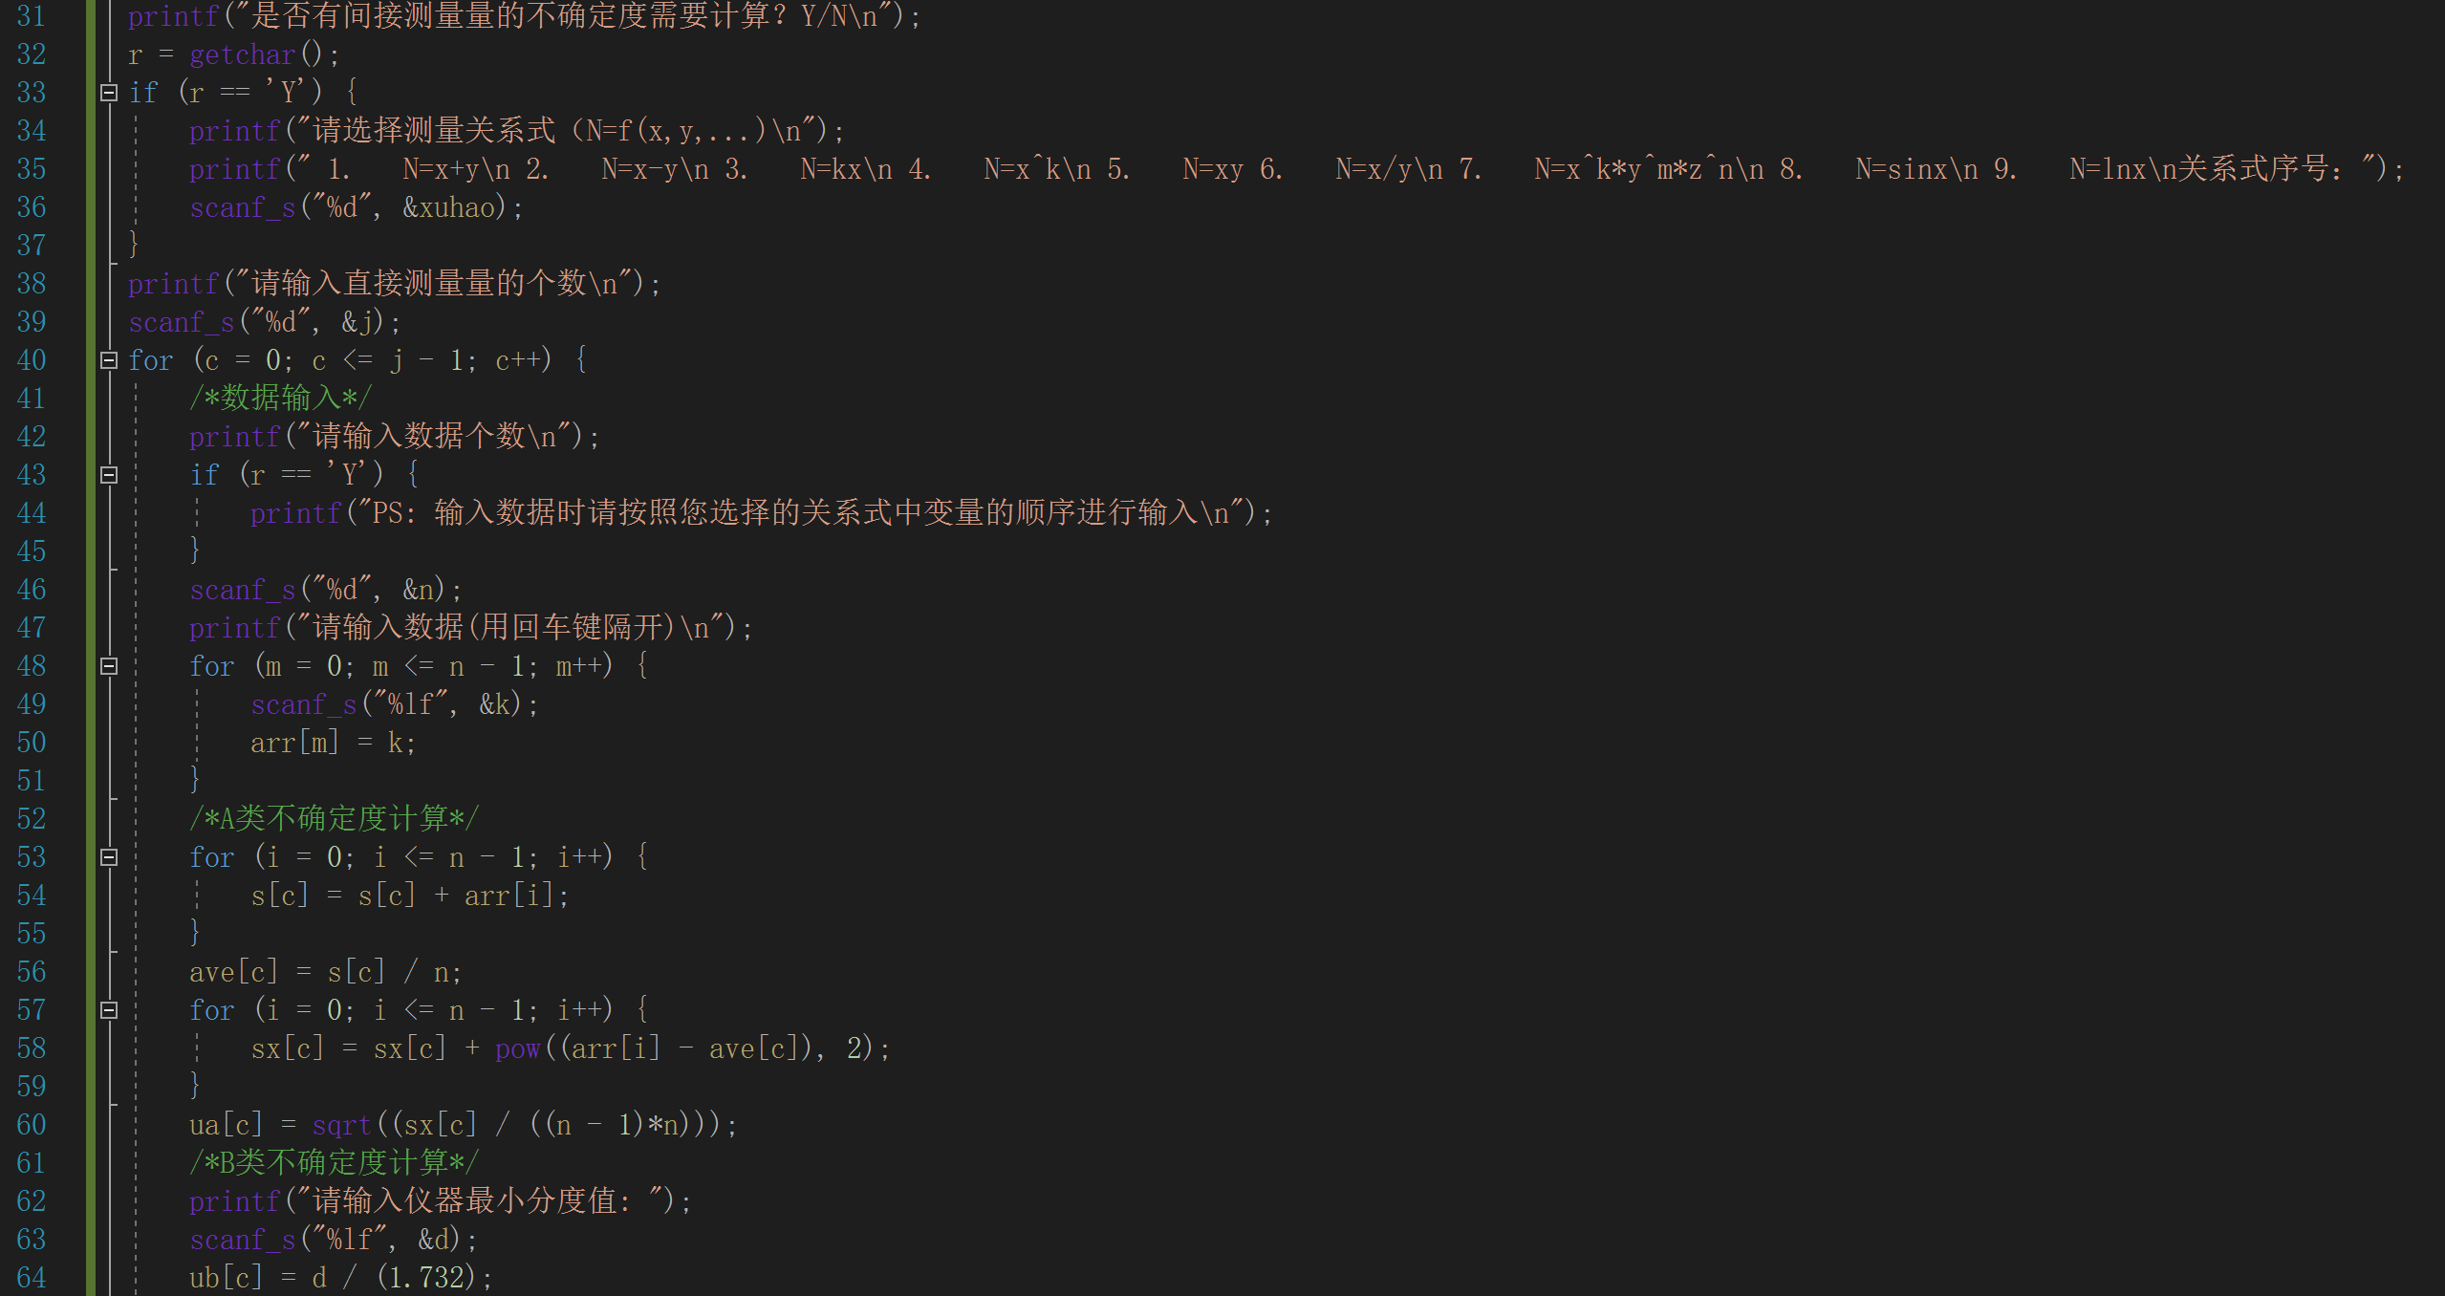
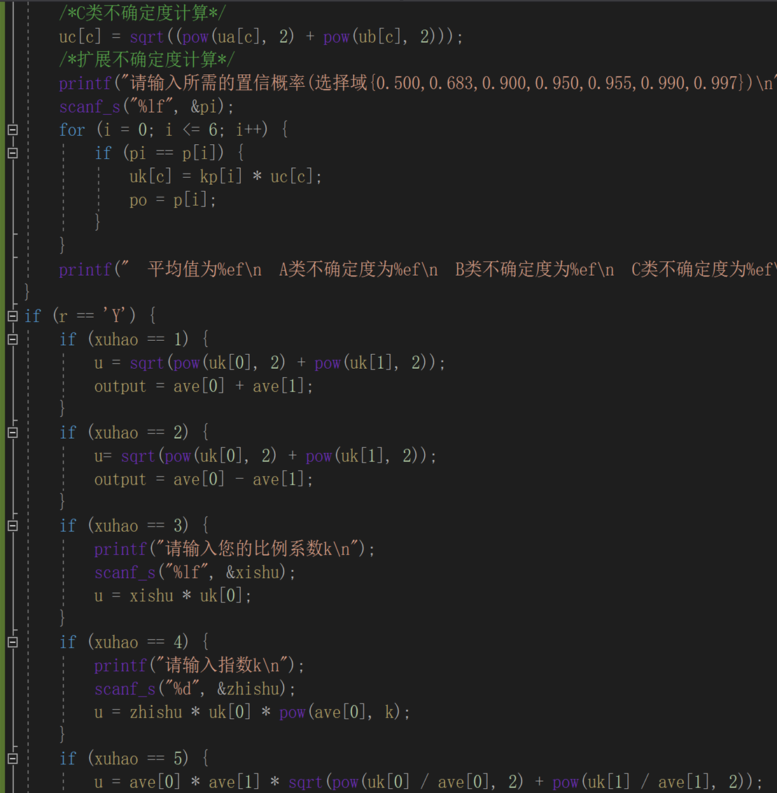


Slide 8
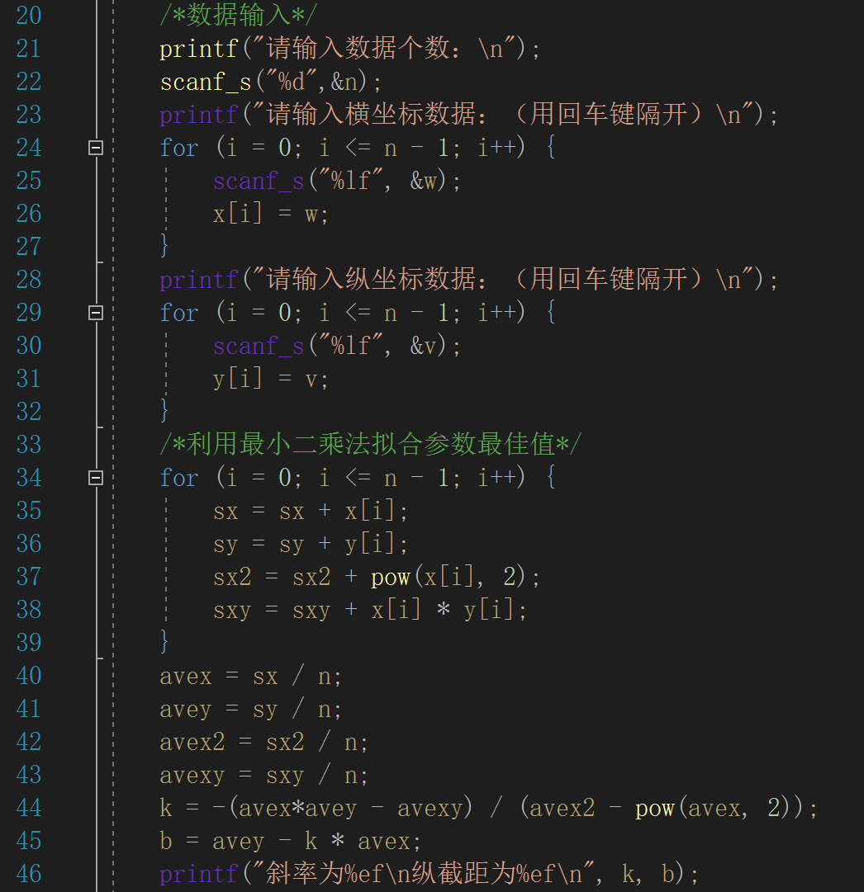
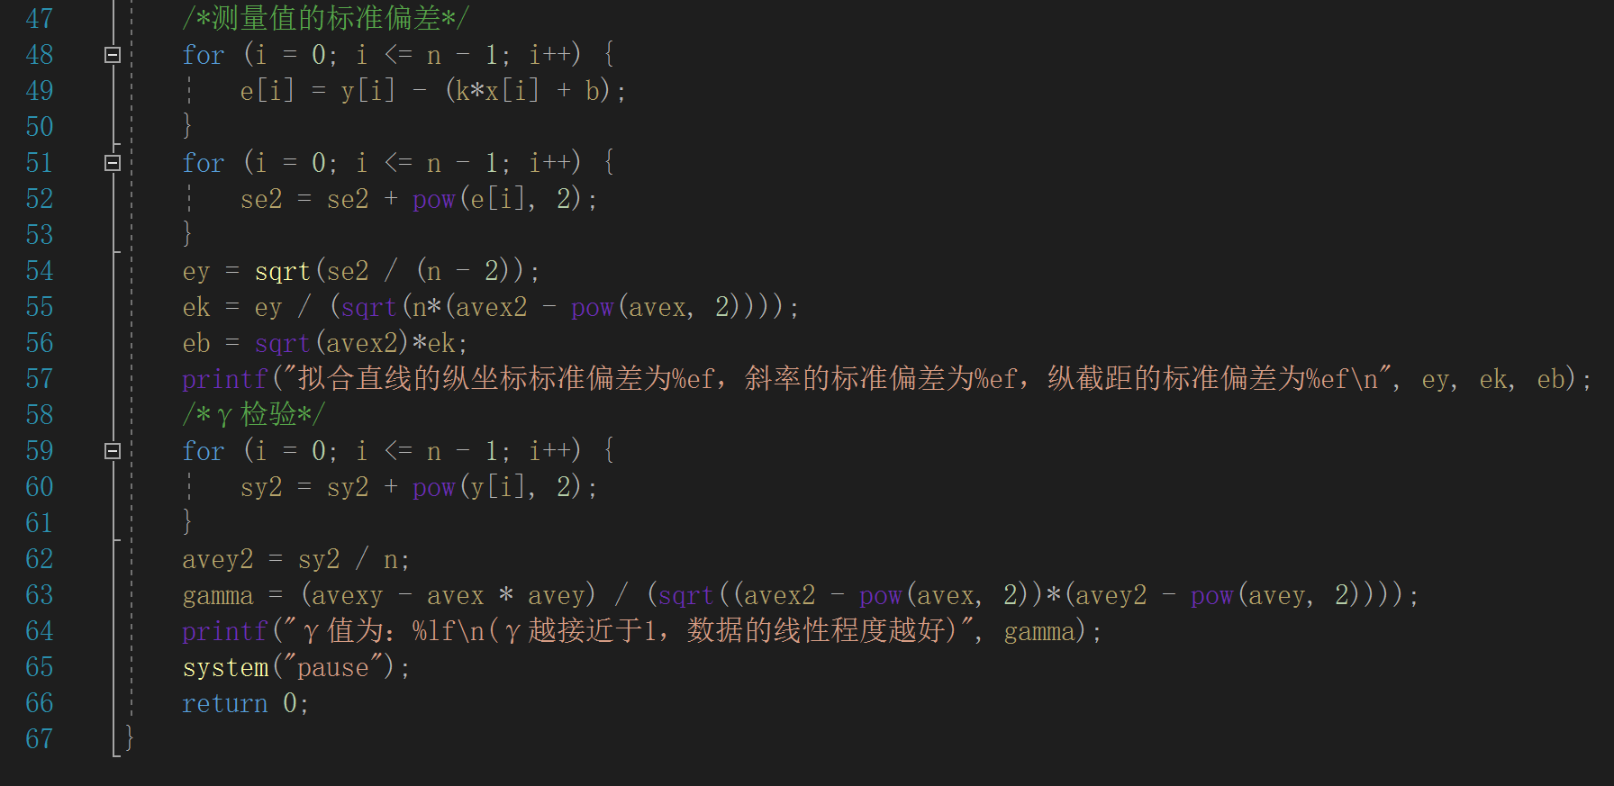
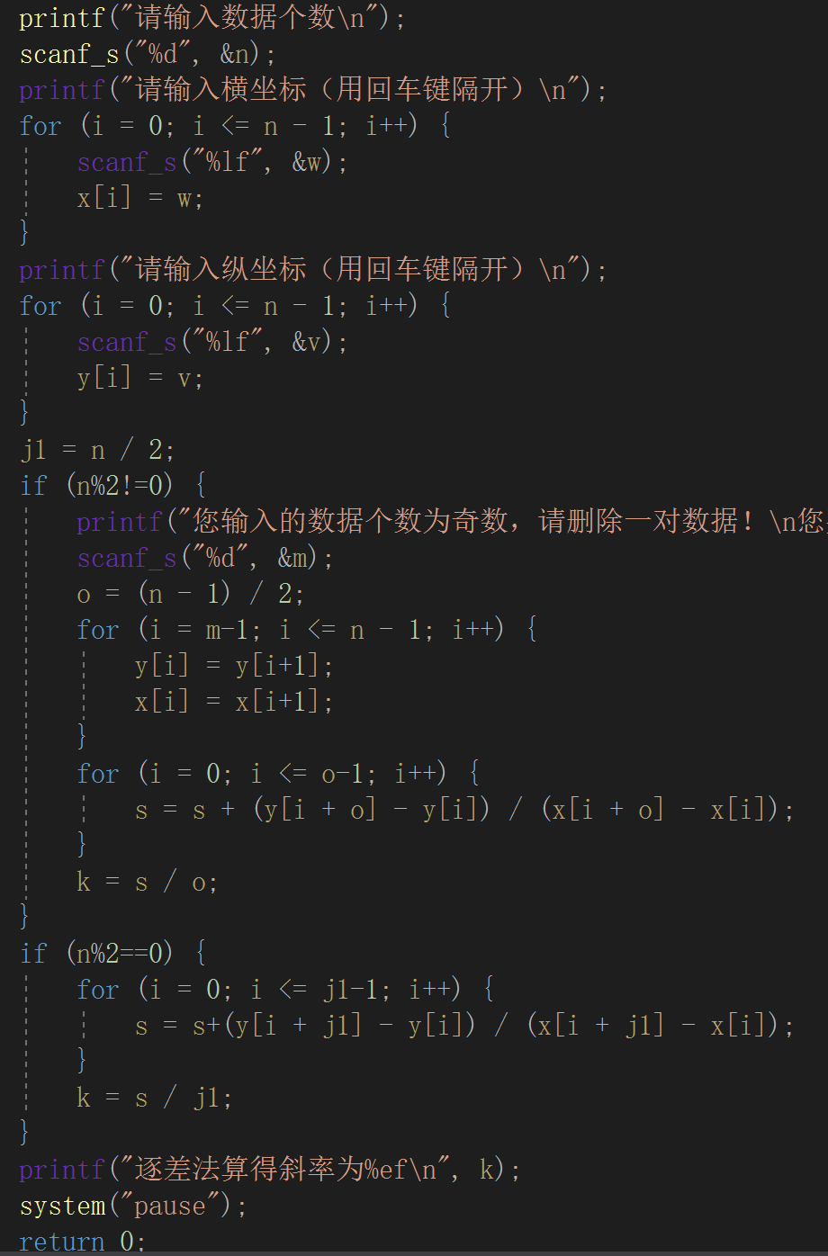



Slide 9
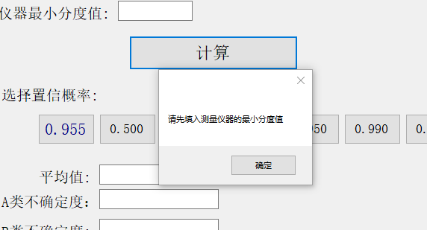
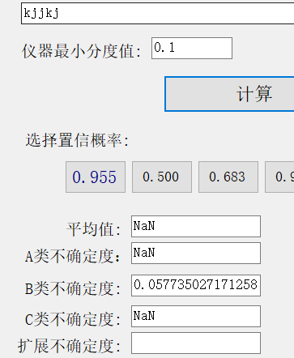
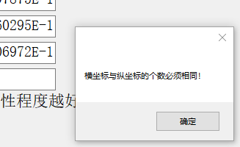
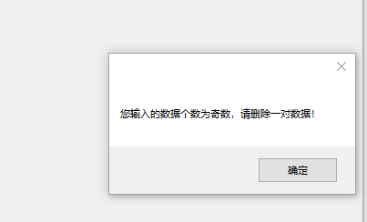
Showing and Testing
5
With no minimal division of the instrument
Illegal input
Lack of data pretreatment
program
Data missing

Slide 10
Results & Condusion
6
Our program has successfully achieved the goal of calculation of
uncertainties for direct and indirect measurement quantities
with interface of inputting and outputting.
We can successfully use this program to fit the linear data with least square method and differential method.
In a nutshell, we can leave the fussy data processing work to be done in computers successfully with our program.

