Slide 1
Final Report

Slide 2
1 introduction 2 group division 3 analysis 4 design 5 implementation 6 testing 7 result&conclusion

Slide 3
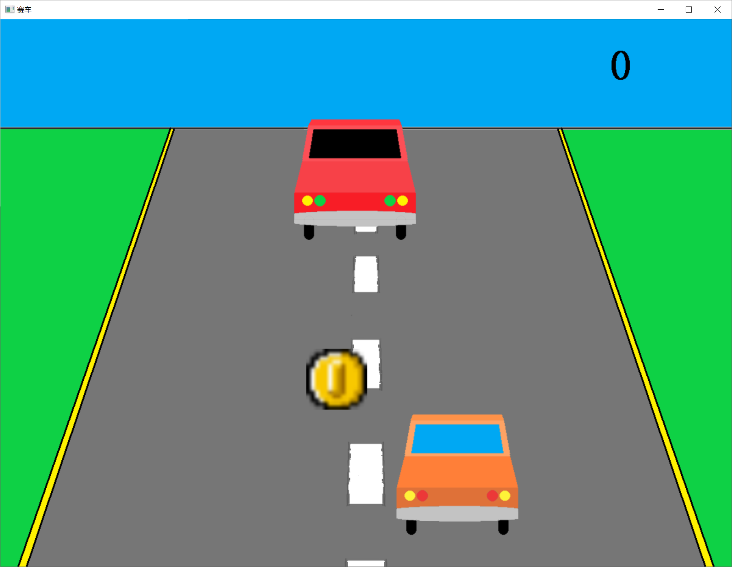
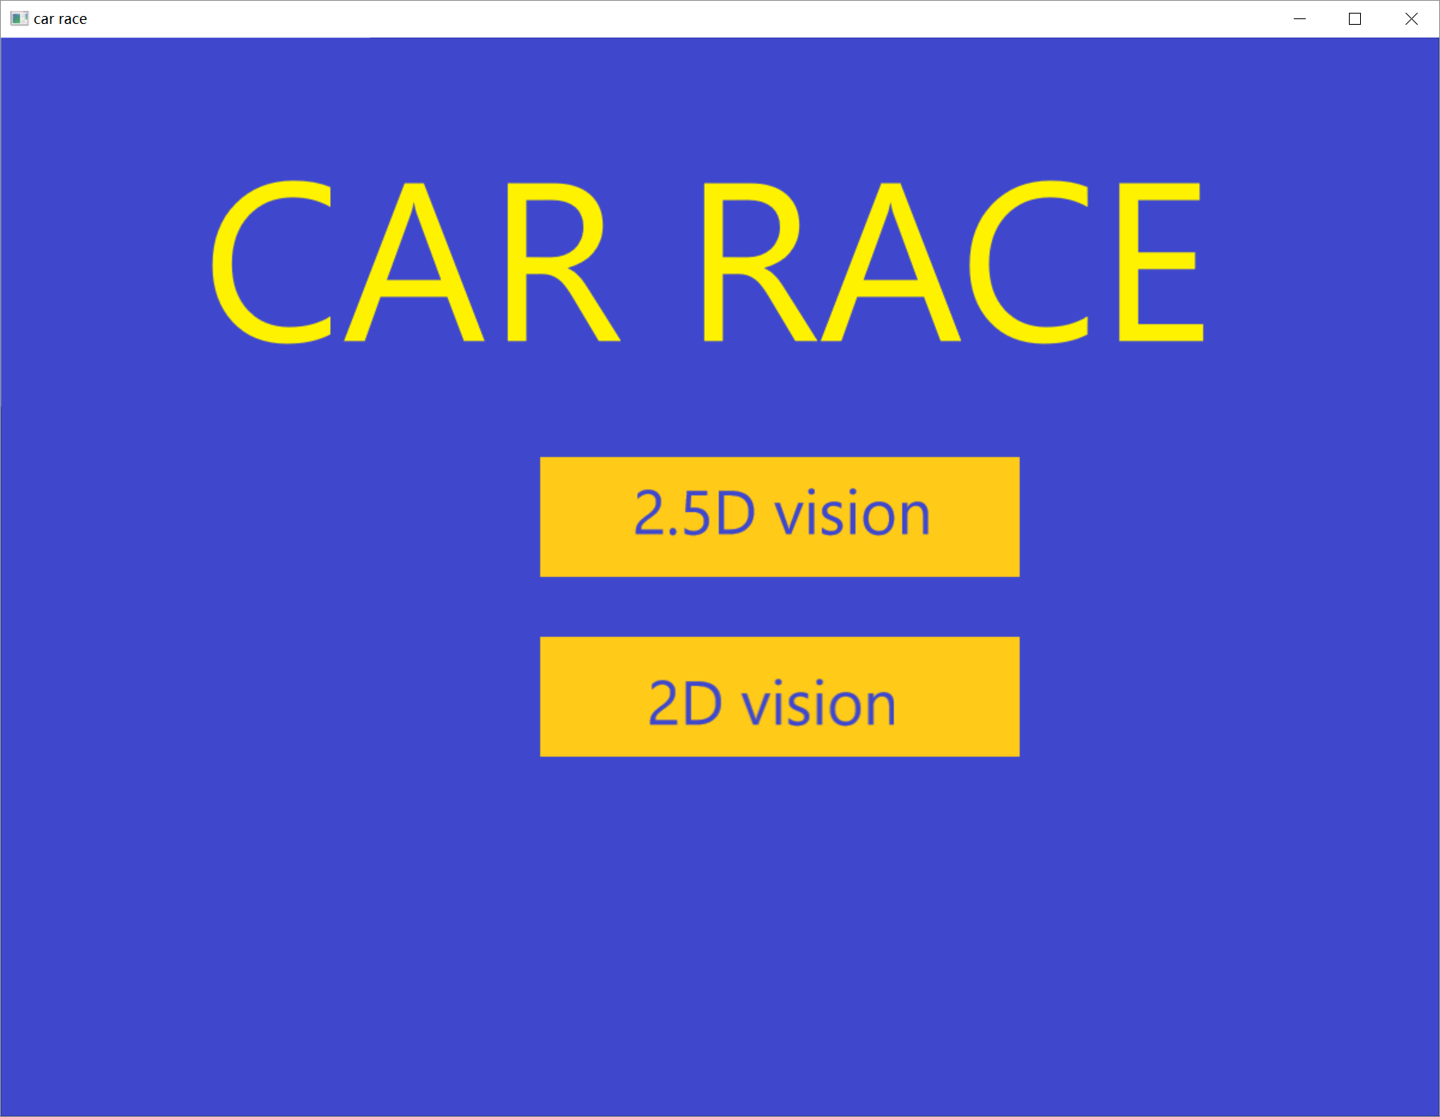
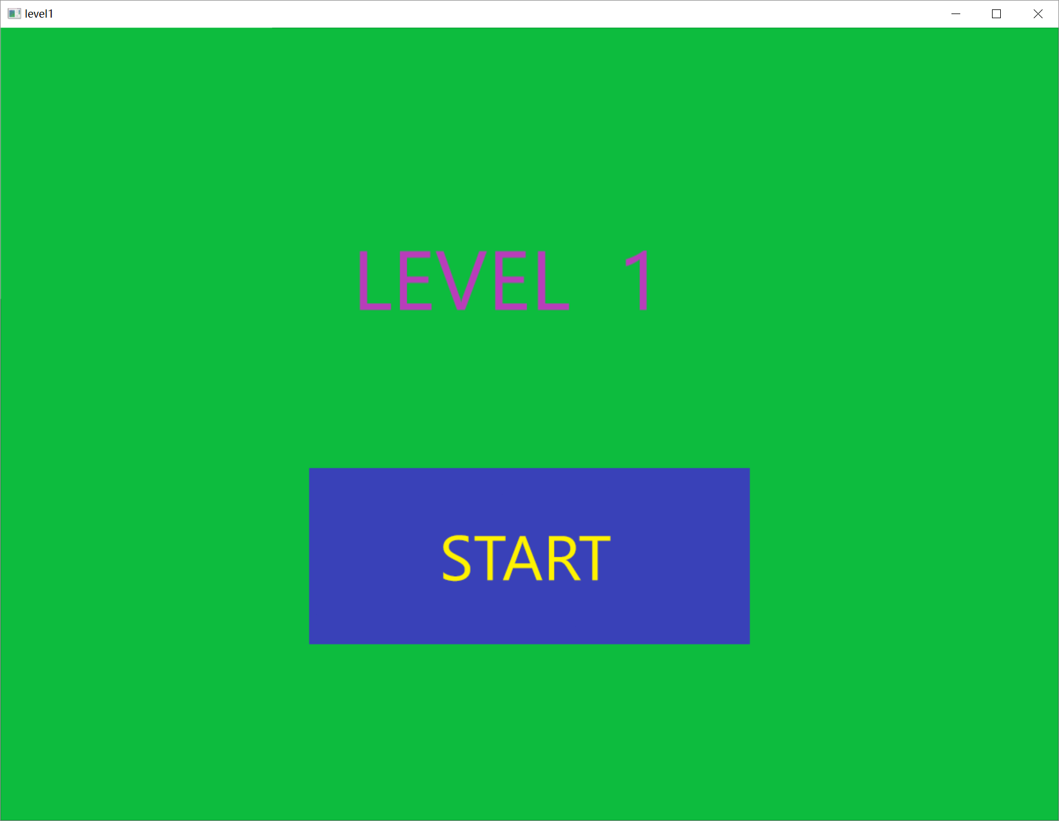
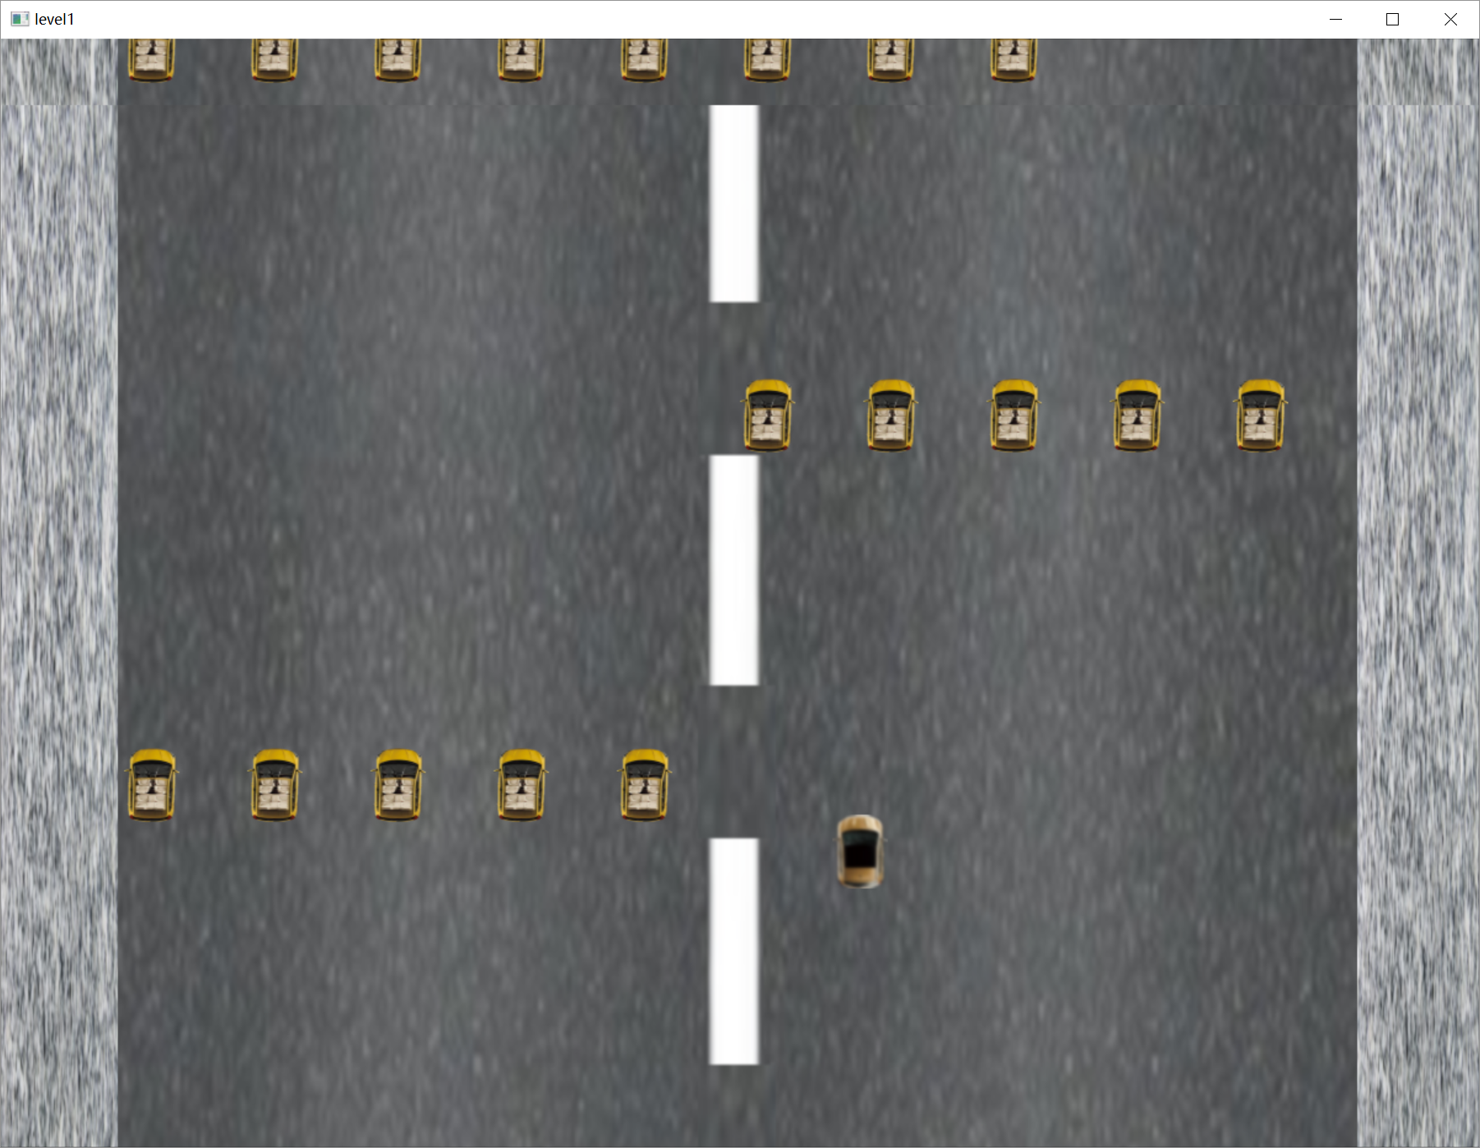
introduction

Slide 4
group division
hero sprite control,intersect judge.level3
enemy sprite control,click control.level1
start menu,link control level4
pictures,animation,music control,level2

Slide 5
analysis
How to judge if the crash happen or not
How can we control the car move as well as the enemy car coming and coins falling

Slide 6
design
start
set sprites position
show congratulation picture and next level button
control hero sprite
set sprites position
show start picture and button
input mouse imformation
judge hero sprite crashed
Y
N
input mouse information
hero crashed?
click next level button?
N
Y
Y
click start button?
N
N
close music
open next level
reach the goal?
Y
show game background
creat hero sprite and end sprite,play music
show gameover picture
creat enough sprites?
Y
N
end
creat sprites

Slide 7
main thread
start
get coin?
Y
score+1
thread enemycontrol
thread coin
N
creat image elements and show the needed
images
show score
start
start
creat enemy sprite
creat coin sprite
input mouse information
judge hero
sprite crashed
coin position and hidding
N
control enemy position with speed system
N
click start button?
hero crashed?
Y
Y
judge hero
sprite crashed
judge hero
sprite crashed
play music,creat score,creat hero sprite,start the thread “linechange”,”enemycontrol” and”coin”
show gameover picture
N
N
hero
crashed?
hero
crashed?
pause
Y
Y
control hero sprite
thread linechange
end
end
N
start
click close?
judge hero get coin
Y
change the picture
end

Slide 8
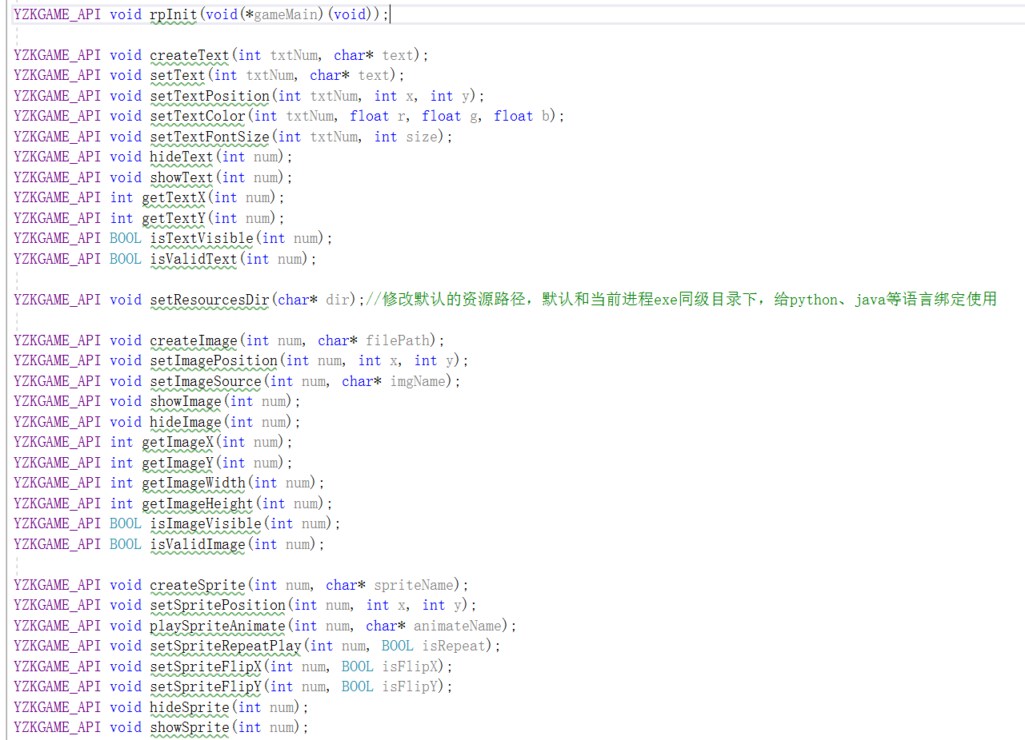
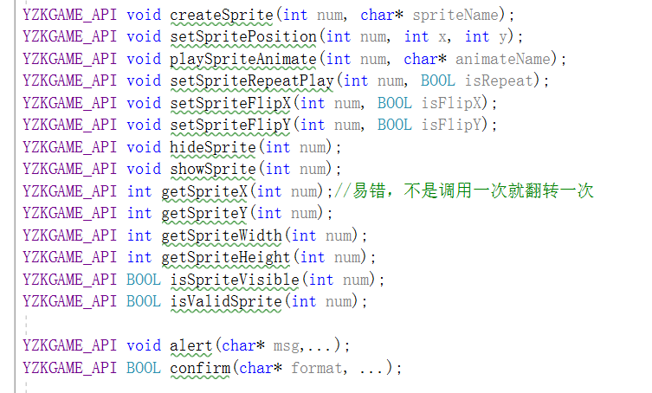
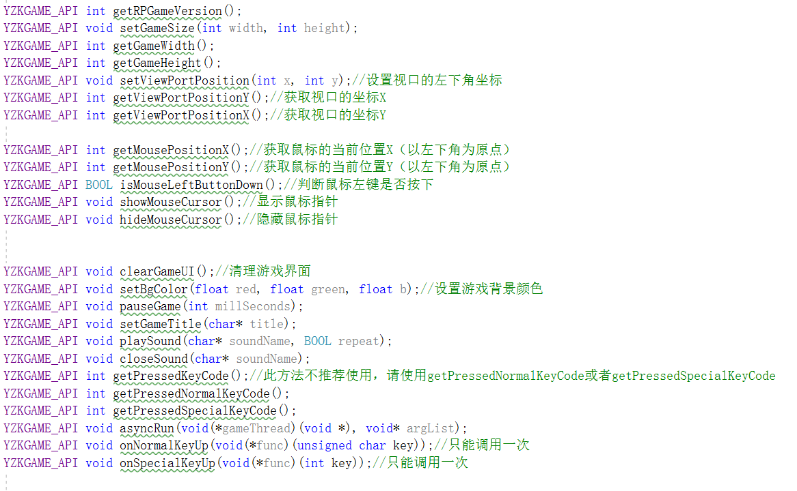
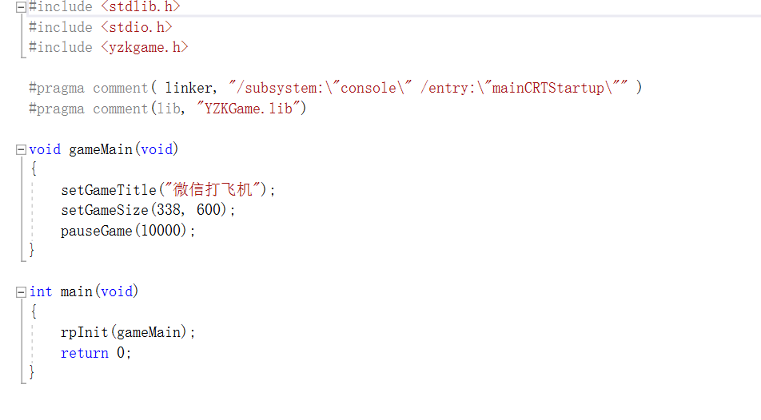
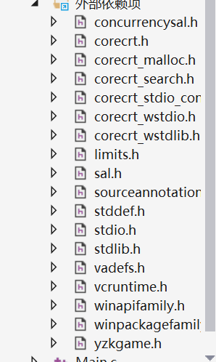
implementation
First of all,we used a game engine belong's to YangZhongke from www.rupeng.com,the head files are equiped with his game engine.

Slide 9
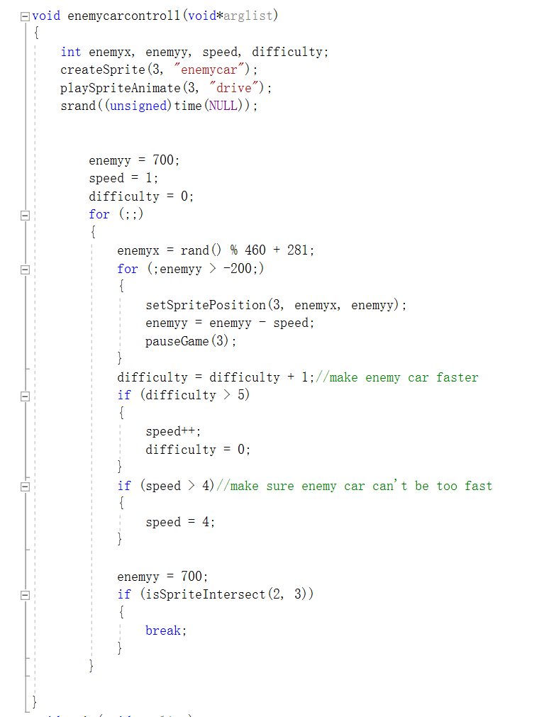
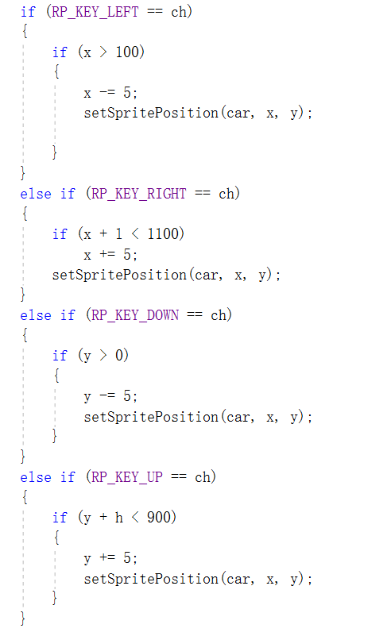
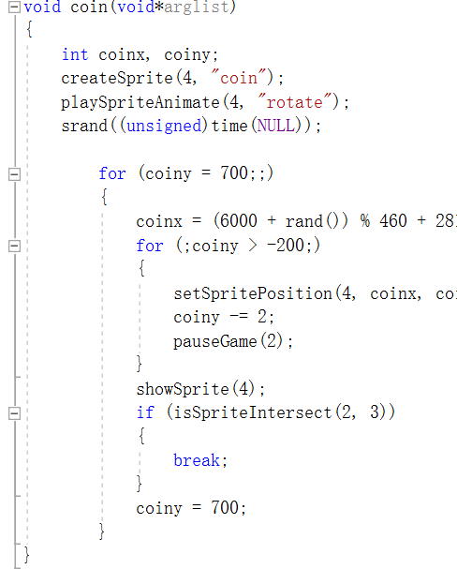
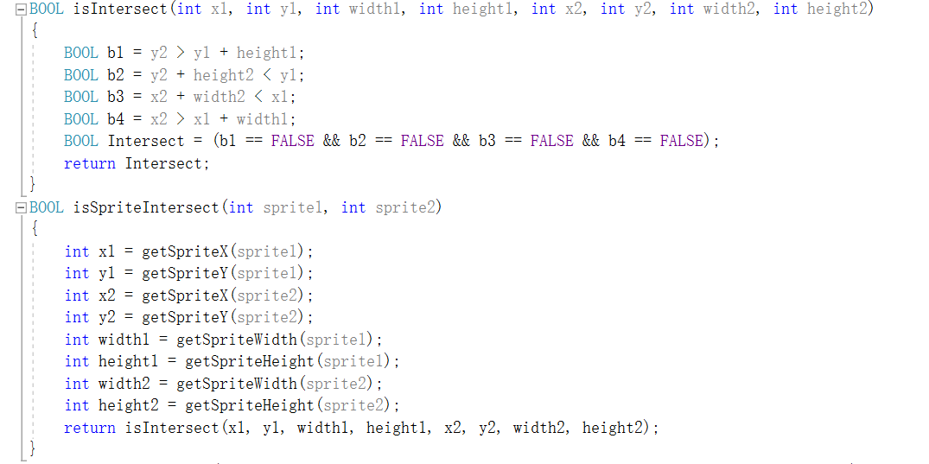
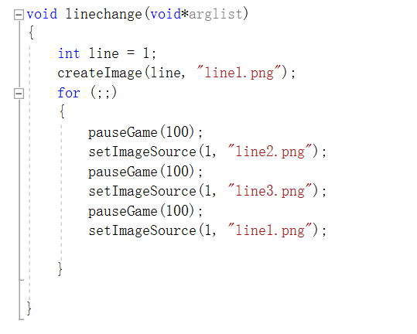
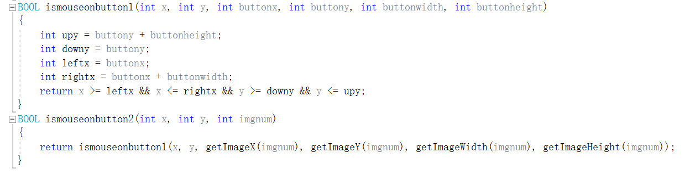

Slide 10
testing
input | expected results | actual result
direction button | car head to the input direction if car reach the edge of the road,the car keeps its position | car head to the input direction if car reach the edge of the road,the car keeps its position
run into enemy car | show the picture of explode,exit game | show the picture of explode,exit game
run into coin | the coin disappear,score+1 | the coin disappear,score+1
click the button | when click “start”, start game,when click “next level” enter next level | when click “start”,start game,when click “next level” enter next level
...... | ...... | ......

Slide 11
result&conclusion
The program works well
the game is interesting
and the fuction can work well.
But we should improve
pause
ranking list
......

Slide 12
THANK YOU!

