Slide 1

Final Report

Slide 2
Introduction
As we all know, improve civilian’s reading is very hot these years, especially in China. But it’s not easy for us to know how much we actually read and what we have read. So this is my motivation for starting the project Reading Record.
The Reading Record can save all of our reading trail just like the record on video websites and it can let us know whether we have done well or not in the past several days.
I want a project which can…
record the books the user owns and output the book list for user to view them
record everyday reading trail
statistics the pages read each day and give a brief summary

Slide 3
Analysis
Objectives:
Record the books the user owns and output the book list for user to view them
Record everyday reading trail
Statistics the pages read each day and give a brief summary
Show reading statistics
Statistics about books
Books records should be saved
The records is about book
Book basic information should be saved before saving records
Solution:
User can setup a library for himself/herself.
User can save reading records at any time.
Statistics can be showed in chart base on reading records

Slide 4
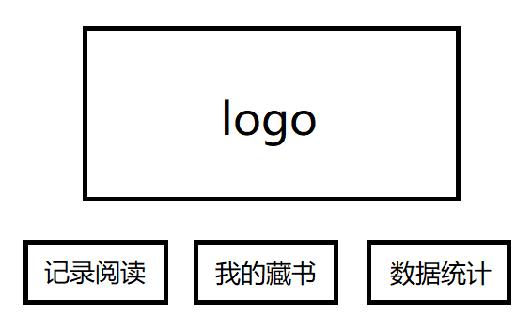
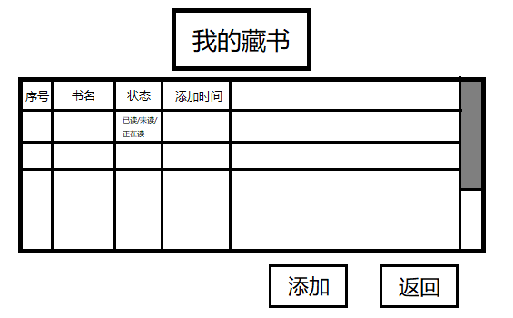

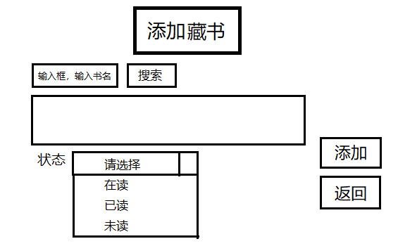
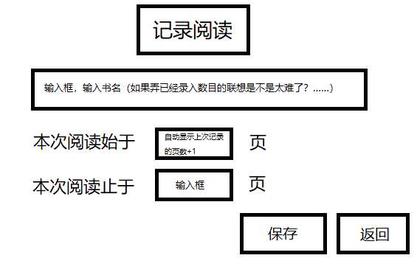
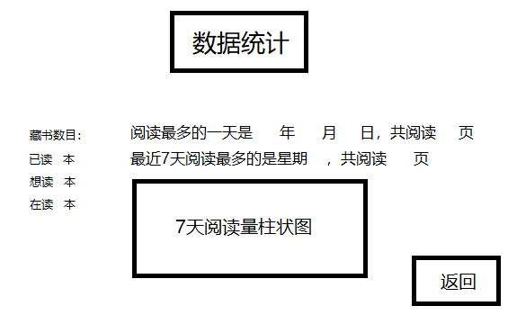
Design
Start
Add a Book into library
Save a Reading Record
Show Statistic Chart
End

Slide 5
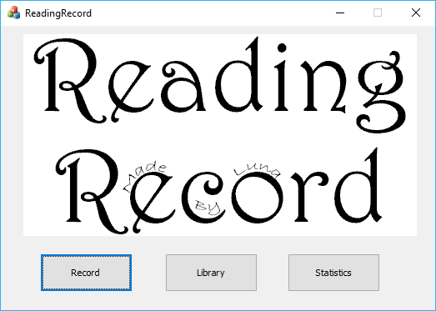
Main Page
Implementation

Slide 6
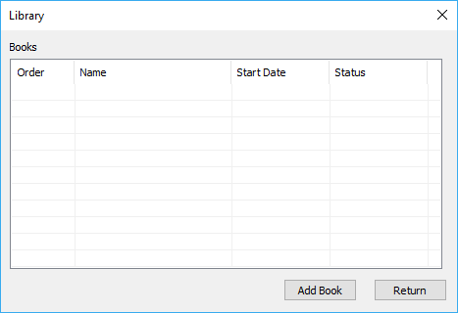
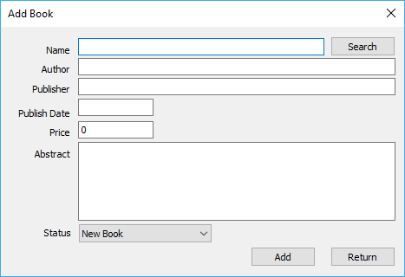
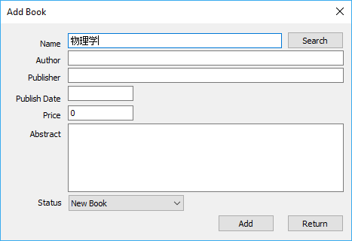
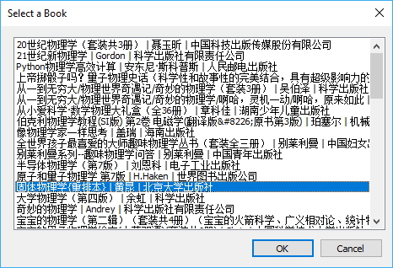
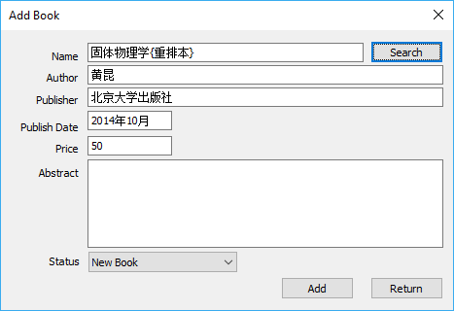
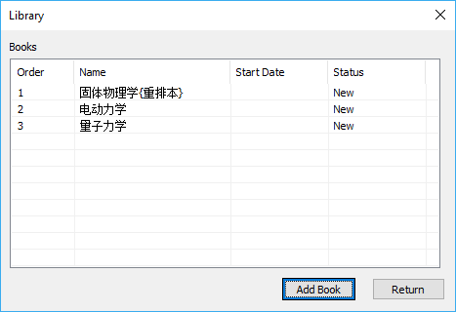
Add a Book
Implementation
Start
Click ‘Library’
Click ‘Add Book’
Input book name
Search on Web
No
yes
Click Button Search
Input Book’s Information
Select a Book
Click ‘Add’
Click ‘Return’
End

Slide 7
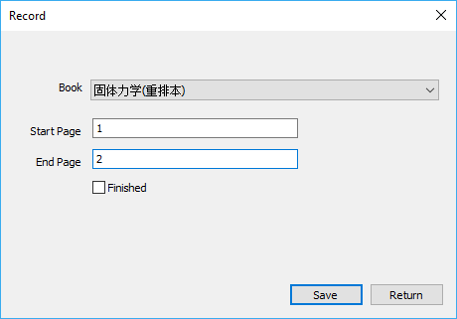
Implementation
Start
Add Reading Record
Add a Record
Select a Book
Input Start Page
Input End Page
(Optional) Check ‘Finished’
Click ‘Save’
Click ‘Return’
End

Slide 8
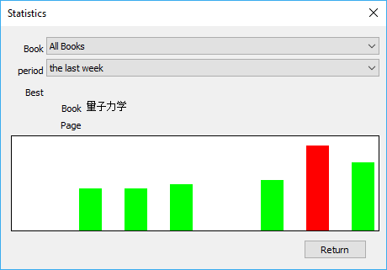
Show Statistics
Implementation
Start
Show Statistics
Select Book(s)
Select Period
Draw Chart
Click ‘Return’
End

Slide 9
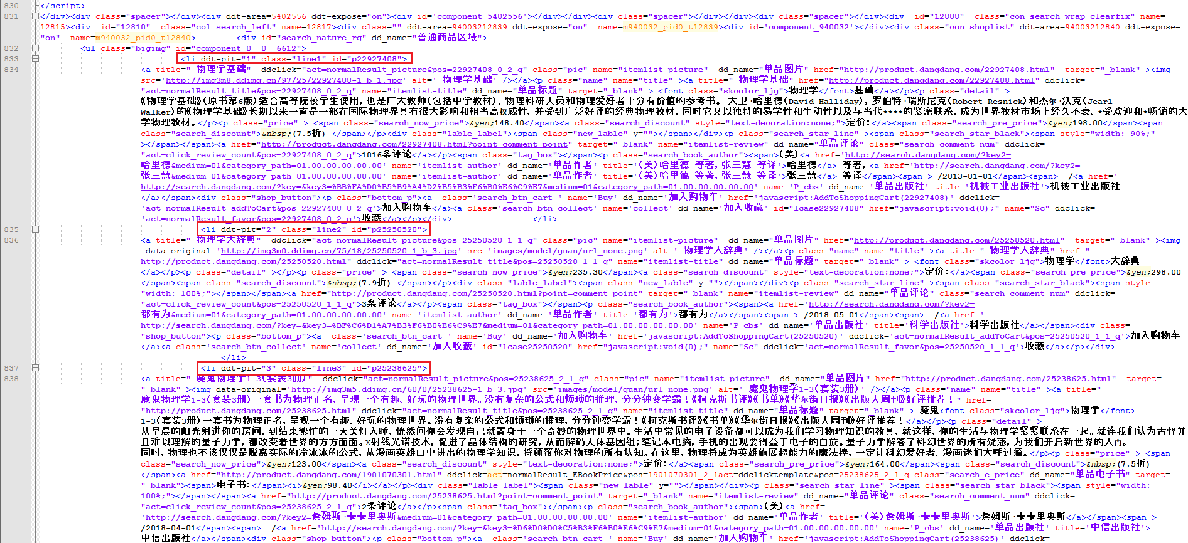
Search a Book on www.dangdang.com
Implementation
This is the HTML data from dangdang.com and we will search for useful information from it.

Slide 10
Search a Book on www.dangdang.com
Implementation
(CHTTPClient=>WIN32API)
Start
Start
Search by Key
Parse Search Result
Parse Search Result
This is how we use C language to grasp the information from the internet.
Search “<li ddt-pit=“
Select a Book
Found
No
yes
Search the Book
Get Book Info.
Parse Book Result
End
End

Slide 11
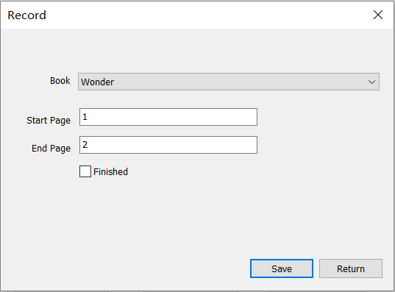
Testing
(The ID number of the book Wonder is 2)
Input | Expect | Output
Start Page:1 End Page:2 | Write the following words into ’book_02.txt’ [Record] [Date] 2018-06-04 [StartPage] 1 [EndPage] 2 Change the number bellow ‘[Status]’ in ’book_02.txt’ into ‘1’
negative number or decimal | Warning ‘Enter an integer between 0 and 100000’
Check ‘Finished’ | Change the number bellow ‘[Status]’ in ’book_02.txt’ into ‘2’

Slide 12
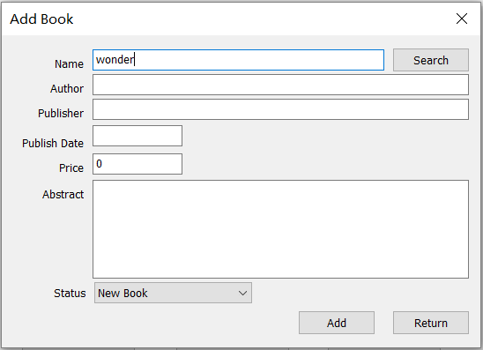
Testing
Input | Expect | Output
‘wonder’ behind Name and click ‘Search’ | A list with 60 books’ information from www.dangdang.com.
‘dfhruigre’(something cannot be found on line) | Warning ‘Can't find the book. Please try again or input the information by yourself.’
Tick ‘Add’ | Save the information of the book in ’book_XX.txt’(XX is the ID number of this book) in the form of [Id] XX [Name] XXXXXX [Author] XXX [Publisher] XXXXXX [Publish Date] XXXX [Price] XX.XX [Status] X [Abstract] XXXXXXXXXXXXXXXXXXXXXXXXXXXXXXXX

Slide 13
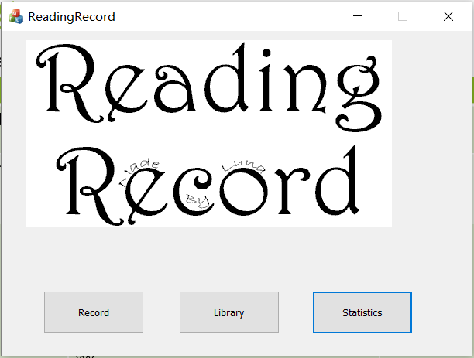
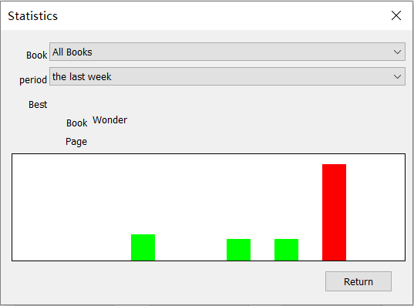
Testing
Input | Expect | Output
Click ‘Statistics’ on main page | Draw chart below (Use red color to mark the day/period with most pages read and use green for other days/periods) Output the name of the book with most pages being read
Change the option of ‘Book’ or ‘Period’ | Redraw the chart

Slide 14
Result and Conclusion
Real Result
Add book into library
  Search book’s information from web site to save input time
  Book’s initial status can be set
Save reading record
  Save records into file
  Give reading record page number base on last record
  Can change reading status manually
Show statistics
  Show all books’ reading record
  Show one single book’s reading record
  Show chart for different period
  Show when reading maximum page, which book for all books’ statistic
Finial Result:
  Meet initial goal

Slide 15
Thanks

