Slide 1
Super CET6 Testing

Slide 2
INTRODUCTION
1
Students can remember CET6 words while studying and taking tests
The scores they get and the time they use would be sent to the rank list, where their teachers could see how well they learn, and give them comments
The more tests students take, the more money they could get, and the more items they could buy from the shop

Slide 3
WORK DIVISION
2
Huang Jialing
WORK
DIVISION
test & rank & comment
33%
Liu Ruojin
login & register & study
33%
Zou Rong
shop & modify information & search
33%

Slide 4
3
ANALYSIS
Homepage
Administrator
Student
Teacher
Login
Login
Register
Login
Register
Check the data
Modify the information
Modify the information
Search student
Make comment
Study
Test
Rank
Shop
Rank
ADMINISTRATOR
NOTE BOOK
STUDENT NOTE BOOK
TEACHER NOTE BOOK
A tip
A pikaqiu
Play game

Slide 5
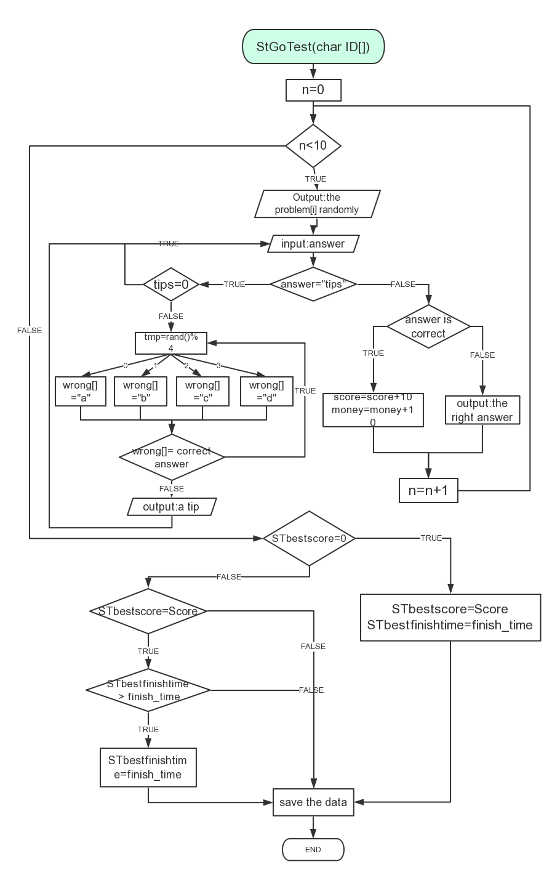

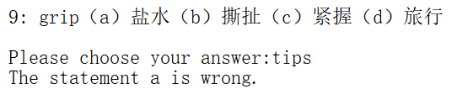
4
Question bank
DESIGN
--Student go to test
Judge whether the answer is right or not.
Give a tip that tells the student which option can be excluded.
Compare the final score in this test and the best score before.

Slide 6
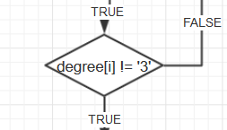
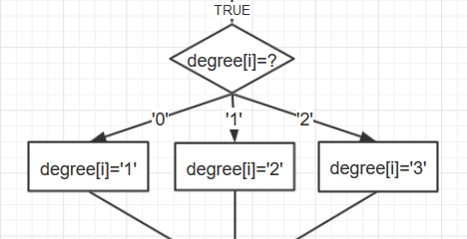
4
DESIGN
--Student go to study
Degree | Meaning
Degree 0 | Never Learn the Word Before
Degree 1 | Has Learn it for 1 Time
Degree 2 | Has Learn it for 2 Times
Degree 3 | Won’t See the Word Again

Slide 7
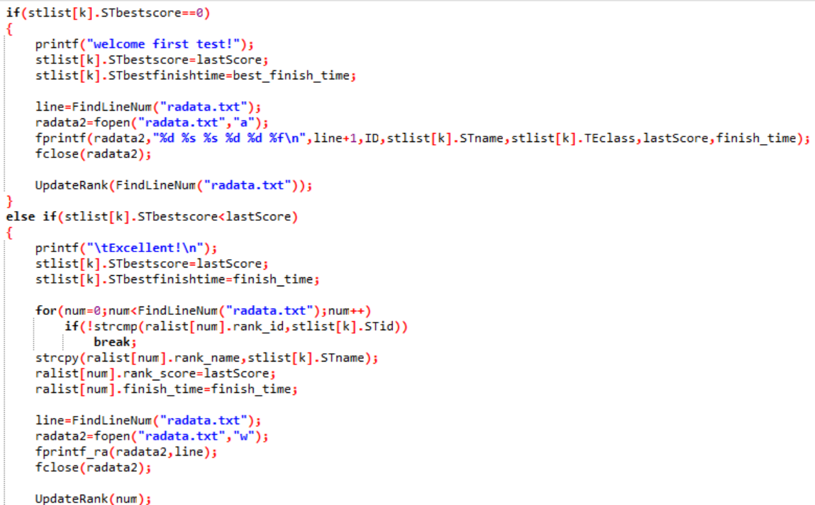
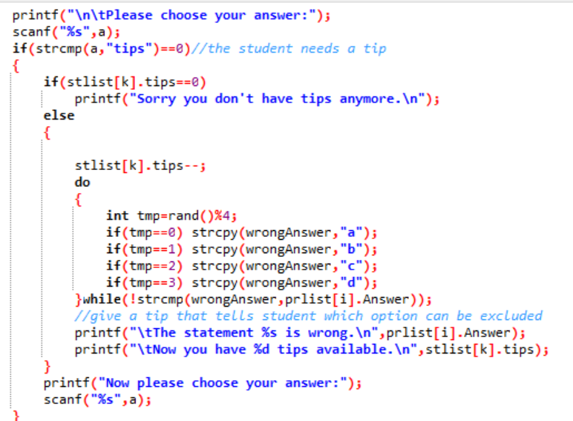
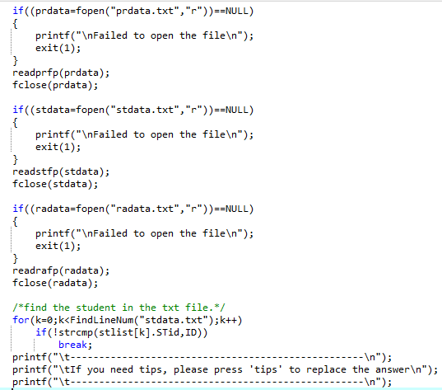
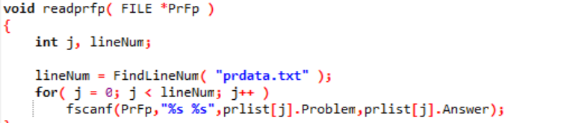
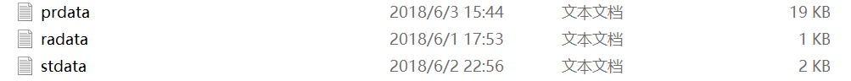
5
Implementation--StGoTest(char ID[])

Slide 8
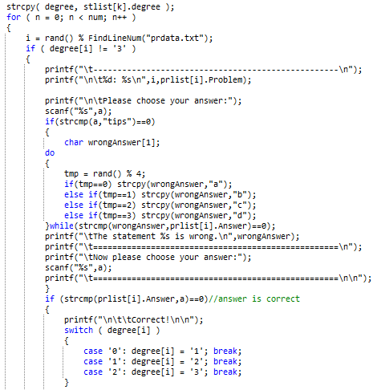
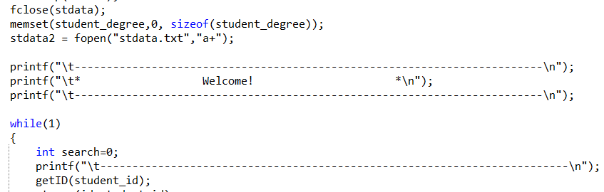
5
Implementation--StGoStudy(char ID[])

Slide 9
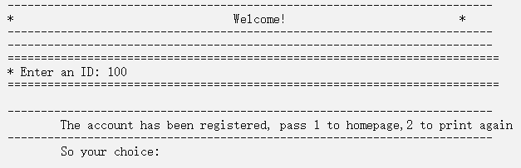
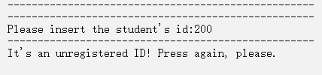
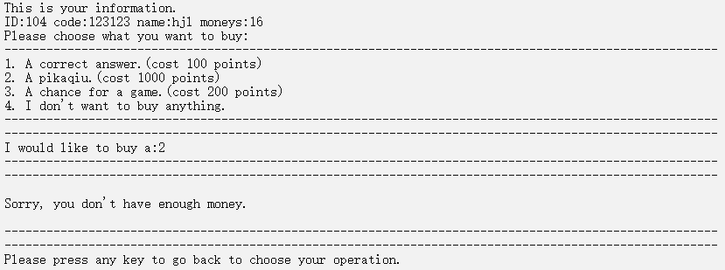
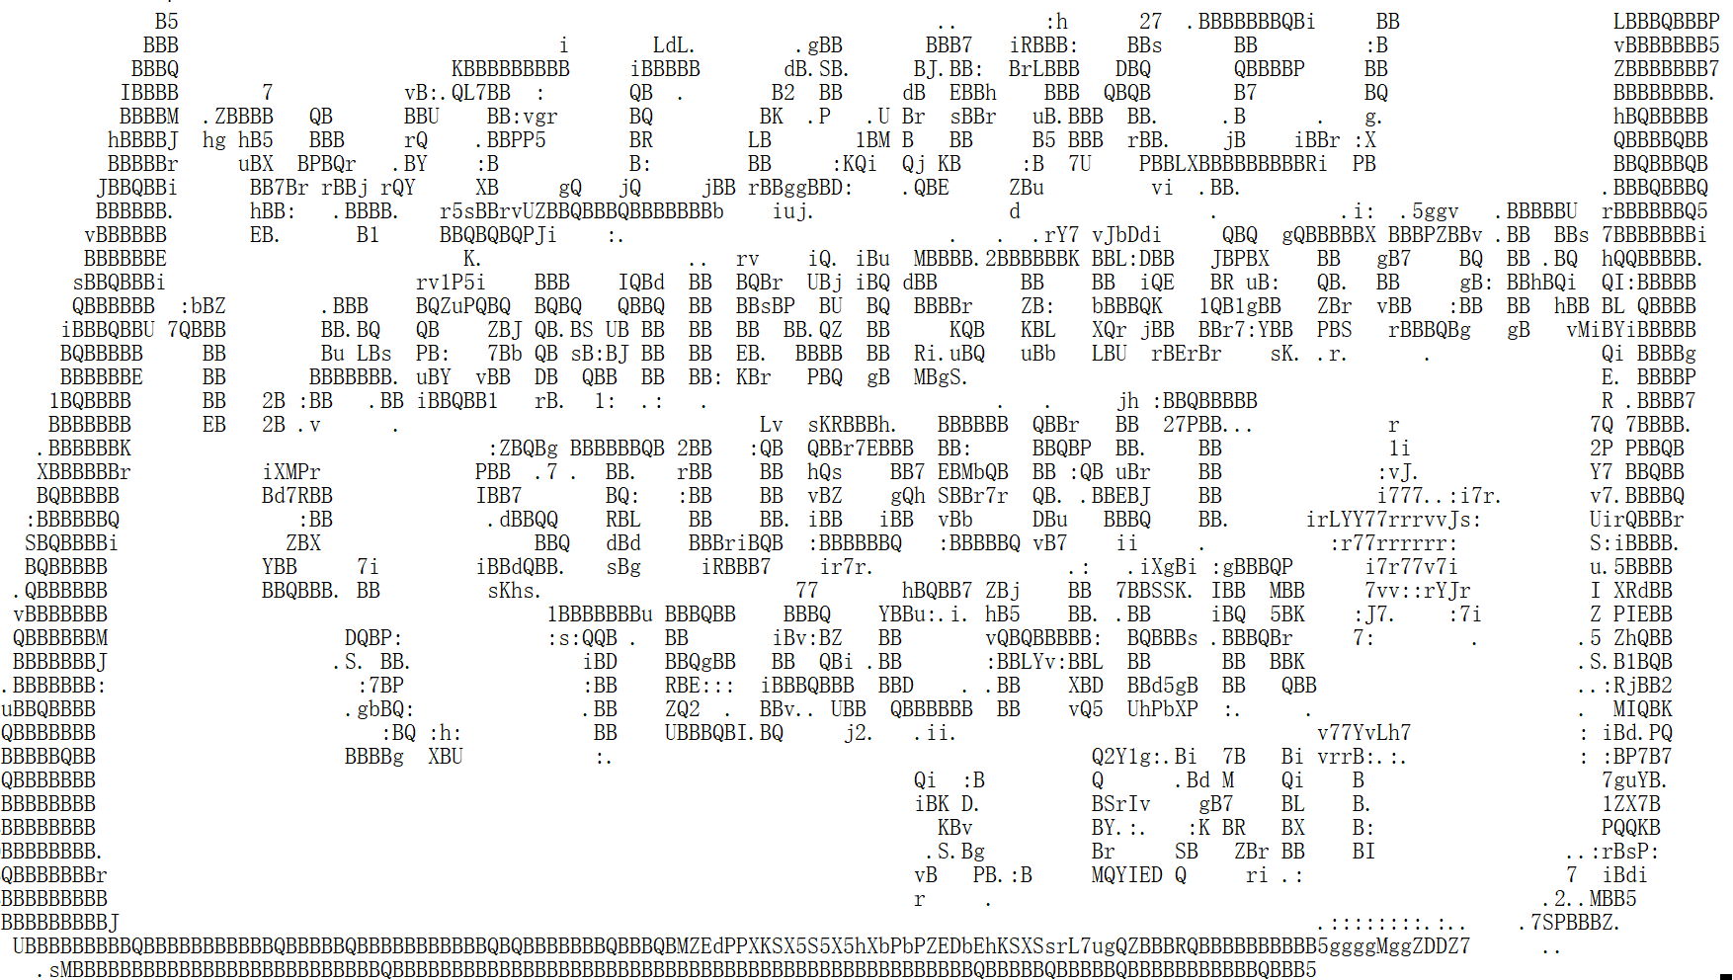
Testing
6
Input | Expected Result | Real Result
(Homepage) input 'a' | Couldn't run the project | Exit
(Register) A used ID | Forbidden | Forbidden.Output:”The account has been registered”
(teacher comment) A unregistered ID | Couldn’t comment | Couldn't comment. output:”It's an unregistered ID! Press again, please.”
(Shop) Don’t have enough money | Couln't buy anything. | Couldn't buy anything. output: “Sorry, you don't have enough money.”

Slide 10
Result&Conclusion
7
Built this program to help students learn English better
The process of writing it truly improved our ability

Slide 11
THANKS

