Slide 1



LET'S JUMP
C Language
李思达 吕静怡 柴若尘 张晶蕊

Slide 2
Division of Labor
welcome interface | timer | move/judge | end/ranking system
张晶蕊 | 李思达 | 吕静怡 | 柴若尘
 | 吕静怡 | 李思达

Slide 3
CONTENTS
Problem Statement
Analysis
Design
Implementation
Testing

Slide 4
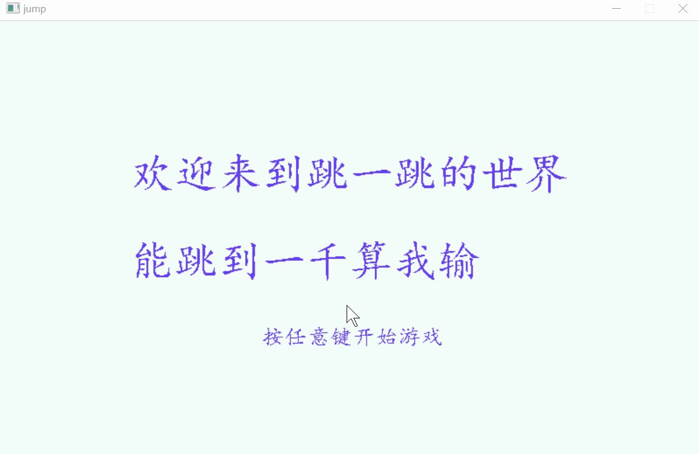
Problem Statement
It's a game called “Let's Jump”. Press the left button of mouse to make the man to jump to the next brick safely to reach a high score. The length and height the man jumps depends on the length of time the left mouse button was pressed.
△Jump to the red bricks can get a bonus;
△The closer the man jumps to the center of the brick, the higher scores you will get.
△When game is over, you can choose to restart or end.

Slide 5
Analysis
Solutions constraints:
All operations must be performed in a game interface to allow the user to operate the game, realising mouse interaction.
Requirement:
1.Mouse message (coordinates and state of its left button)
2.3 Functions:
A function to let the man jump;
A function to move the bricks;
A function to get the length of the left button of mouse pressed.

Slide 6
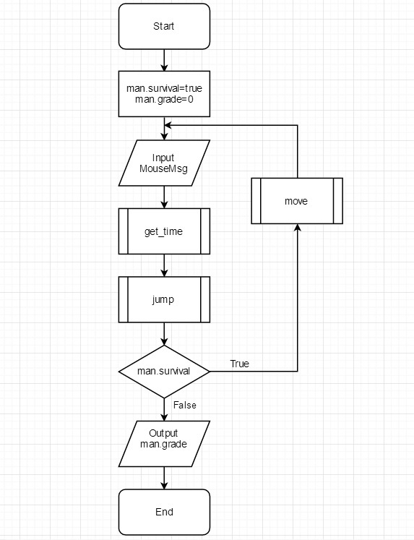
Design

Slide 7
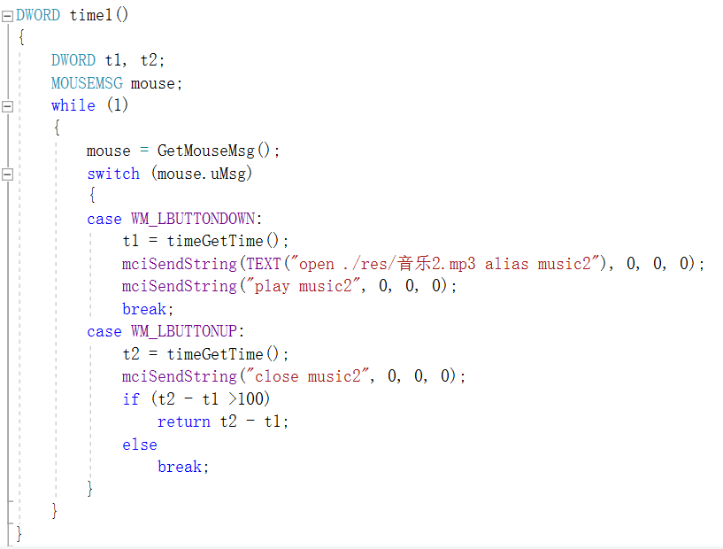
Implementation

Slide 8
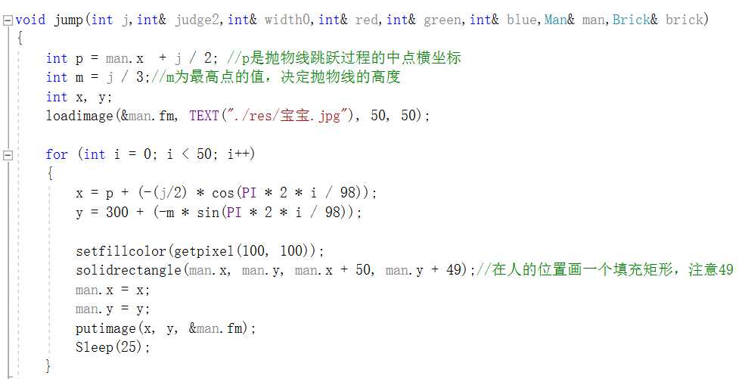
Implementation

Slide 9
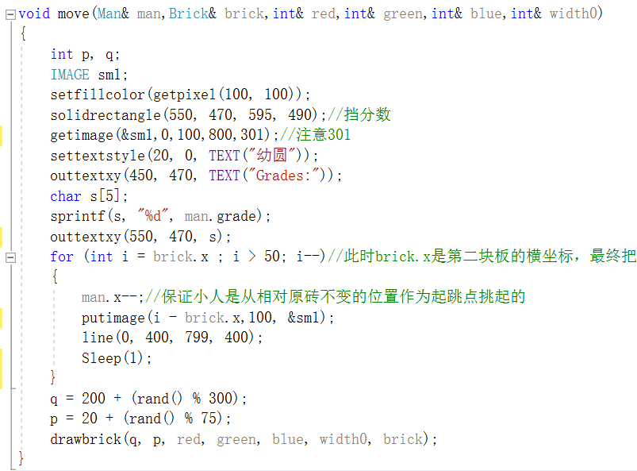
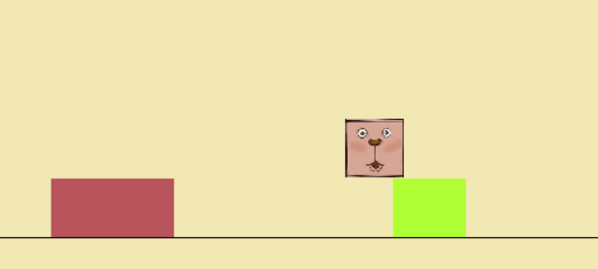
Implementation

Slide 10
Test
Input | Expected result | Real result
man.x=447 brick.x=400 brick.width=50 | man.grade=man.grade+1 | man.grade=man.grade+1
man.x=425 brick.x=400 brick.width=50 | man.grade=man.grade+1 | man.grade=man.grade+1
man.x=387 brick.x=400 brick.width=50 | man.grade=man.grade+3 | man.grade=man.grade+3
man.x=397 brick.x=400 brick.width=50 | man.grade=man.grade+5 | man.grade=man.grade+5
man.x=362 brick.x=365 brick.width=62 | man.grade=man.grade+5 | man.grade=man.grade+5
man.x=328 brick.x=288 brick.width=122 | man.grade=man.grade+5 | man.grade=man.grade+5
man.x=137 brick.x=400 brick.width=50 | man.survival=false | man.survival=false
man.x=77 brick.x=400 brick.width=50 | man.survival=false | man.survival=false

Slide 11
conclusion
·So far,we have implemented all function we expected. The game is completed and really playable.
·One only pity is that we did not finish the 3-D version.

Slide 12
Thanks for listening

