Slide 1
PAC-MAN
——Man-machine game

Slide 2



01.game and rules introduction
02.analysis
03.designing plan
CONTENTS
04.result show
05.game strategy

Slide 3









GAME INTRODUCTION
& GROUP DIVISION
01

Slide 4



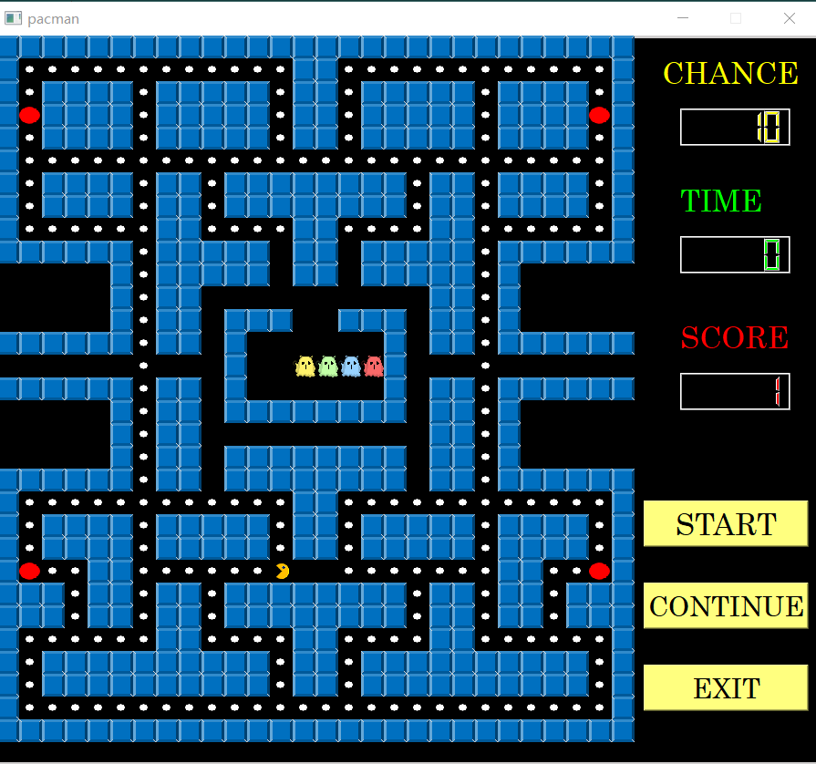
01
game introduction

Slide 5

02
ANALYSIS

Slide 6
Analysis
02
Question：
The four ghosts behaved similarly.
The ghosts were always behind pac-man, and the front stoppage had no effect.
when the ghost is very close to the pac-man, the strategy of the four ghosts is almost the same, showing no effect of cooperation
solution:
Write a function that allows the ghost to target four different points of pac-man

Slide 7
03
DESIGNING PLAN

Slide 8

03
designing plan
1
The game map is abstracted into a two-dimensional array of empty Spaces, walls, ghost homes, powerballs, and shuttle doors.
The game platform includes several judgment functions, such as pac-man and ghost movement, judgment between ghosts and the overlapping between ghosts and Pacman, and returns parameters to the interface for use.

Slide 9

03
designing plan
2
Written by QT, two interface classes are defined with QWidget as the base class in the GUI class library of QT to implement the two interfaces of the game.
It is divided into the initial interface of the game and the operation interface of the game, and the initial interface triggers the operation interface. Based on the game rules and algorithm implementation, the graphical effect of man-machine war is realized.

Slide 10

04
CODE AND PRODUCT
SHOW

Slide 11
04
algorithm show
Dijkstra algorithm
For the ghost-moving function, we use the Dijkstra algorithm to find the nearest way from the ghost to the Pac-man to chase the Pac-man. Once the ghosts leave the ghosts home, they will chase you at full speed. So, it is hard to escape from the chasing of ghosts. And the best way is to eat the red beans, so the ghost will keep away from you.
Simulated annealing algorithm
Once the Pac-man eat the red beans, he has the power to eat the ghosts. So, we use the Simulated annealing algorithm to find the best way for ghost to escape.

Slide 12
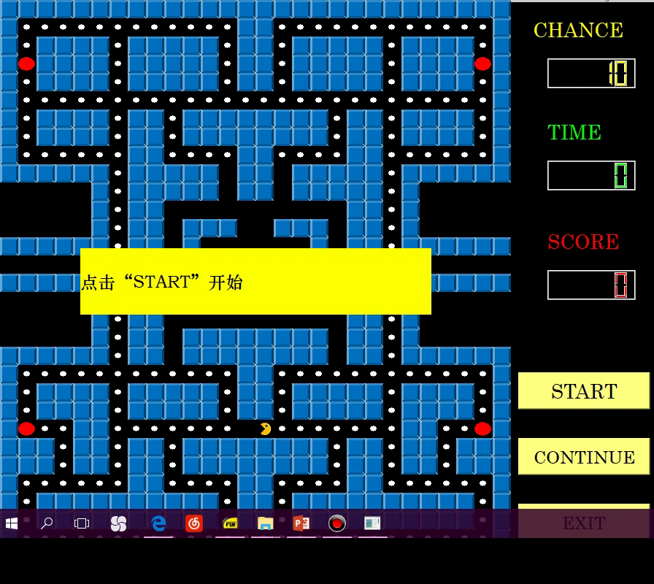
04
product show

Slide 13
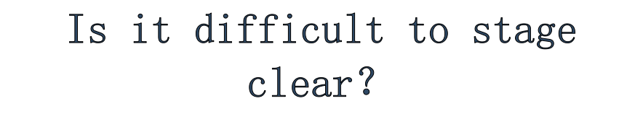
----of course

Slide 14

05
GAME LITTLE SKILL

Slide 15


05
game strategy
1
Try to use the big balls in four corners to eat the beans in four corners
The ghost is tricked into thinking that Pacman is going in the wrong direction, causing him to misjudge and walk in the opposite direction to reach the top.
2
3
The beans at the inflection point can be eaten within the time of the bolus
never abandon，never give up and finally you will succeed
4

Slide 16


