Slide 1
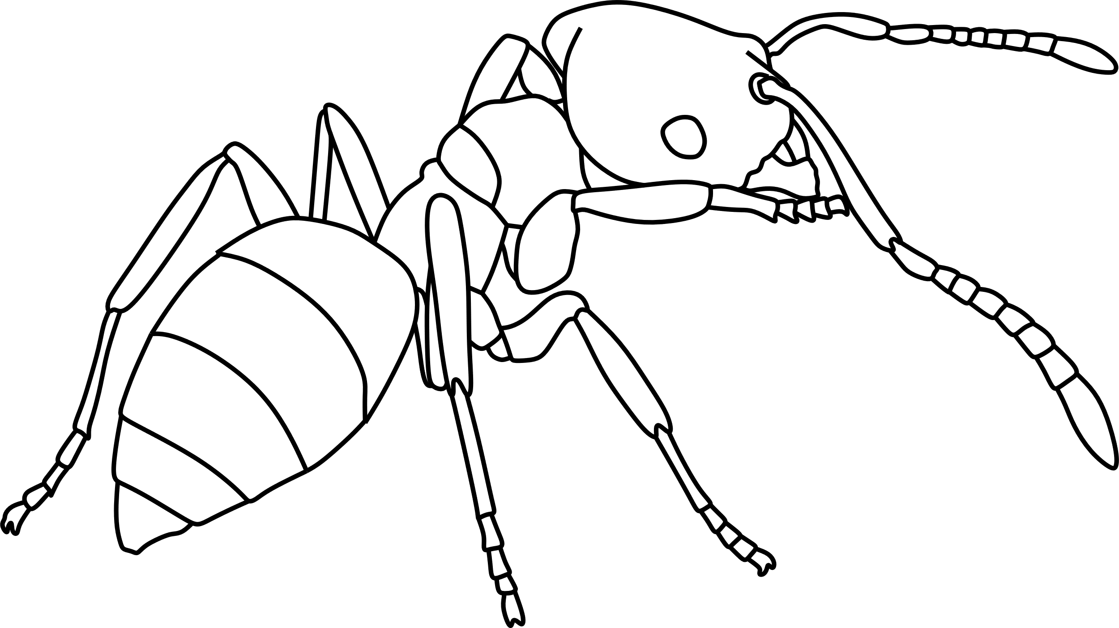
Obscure Rover Ant
Brachymyrmex obscurior

Slide 2
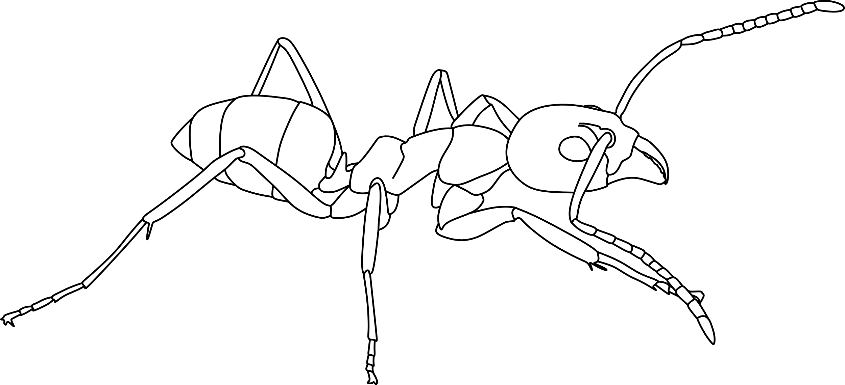
Argentine Ant
Linepithema humile

Slide 3
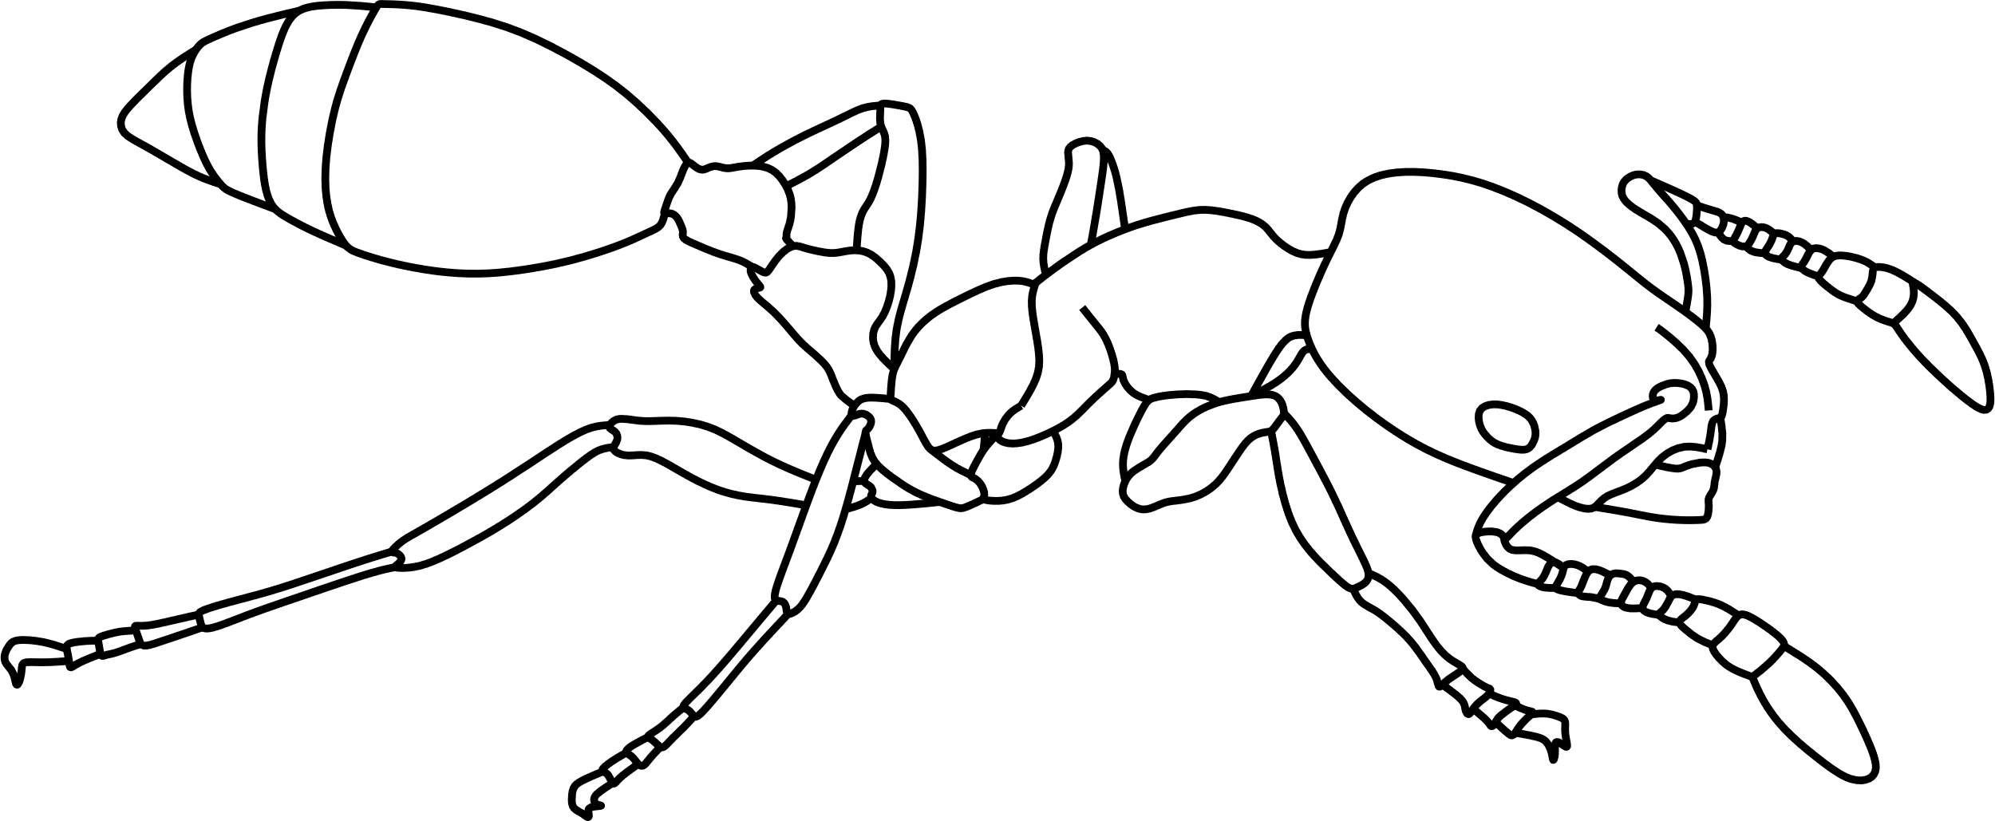
Bicolored Trailing Ant
Monomorium floricola

Slide 4
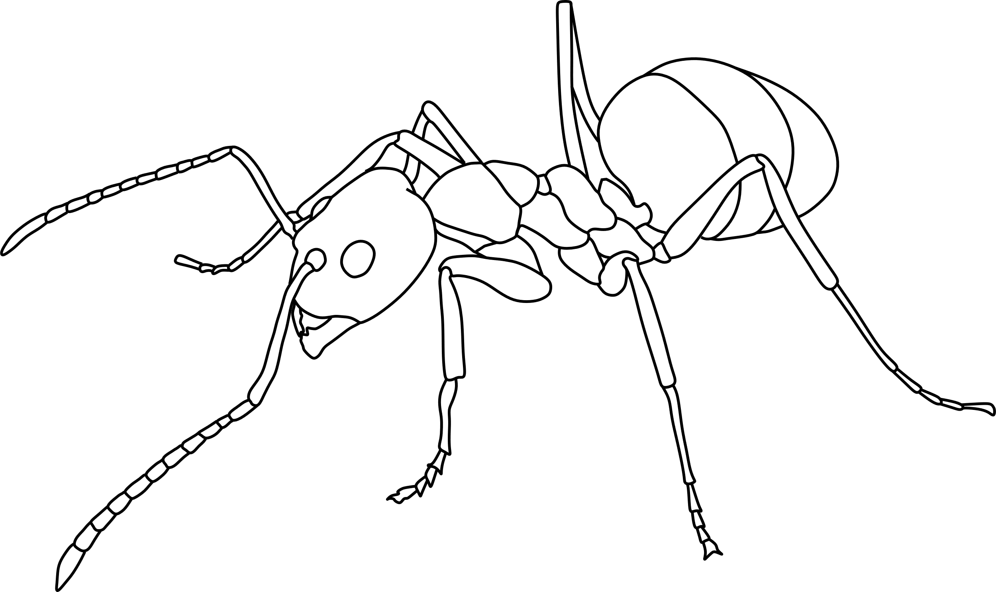
Tawny Crazy Ant
Nylanderia fulva

Slide 5
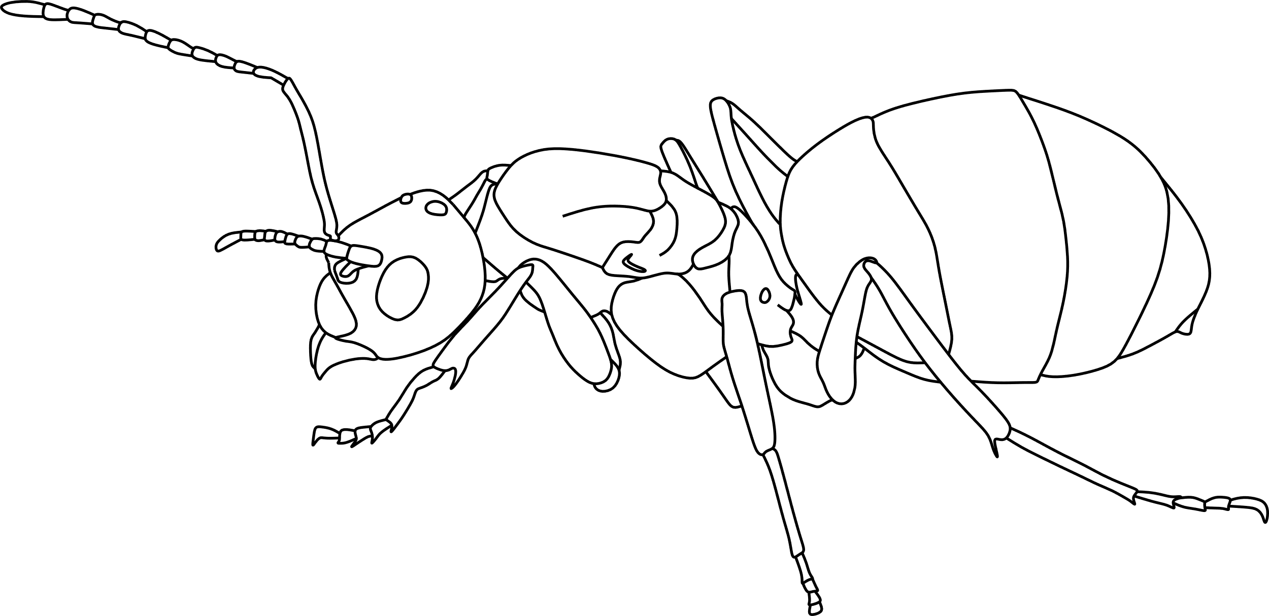
Tawny Crazy Ant (queen)
Nylanderia fulva

Slide 6
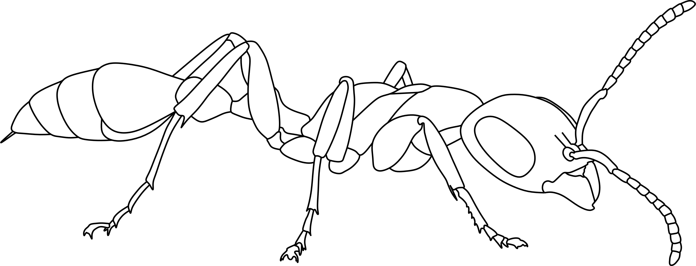
Elongate Twig Ant
Pseudomyrmex gracilis

Slide 7
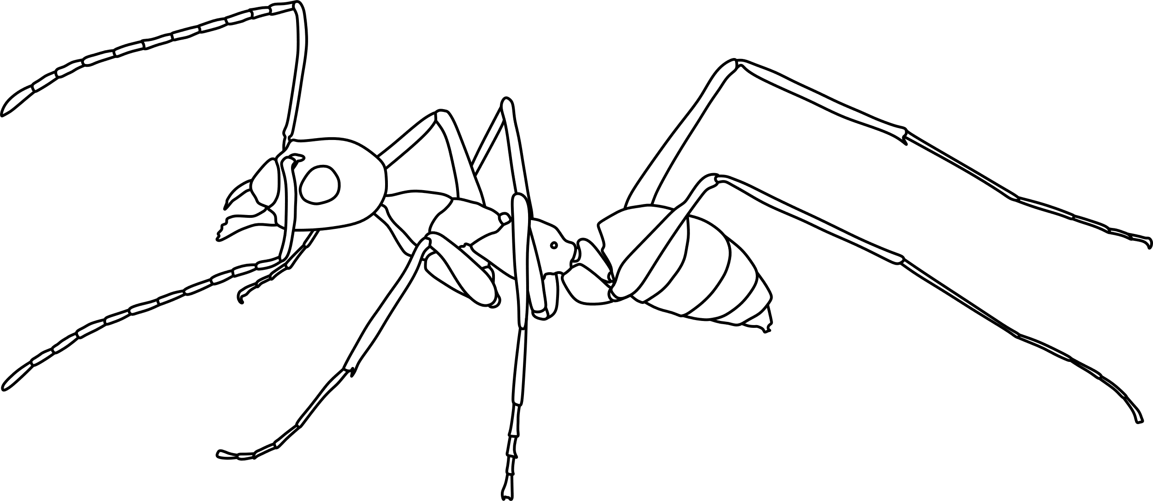
Longhorn Crazy Ant
Paratrechina longicornis

Slide 8
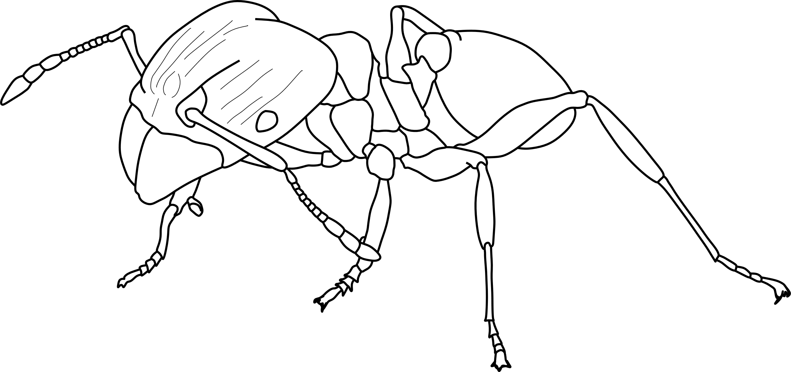
African Big-Headed Ant (major)
Pheidole megacephala

Slide 9
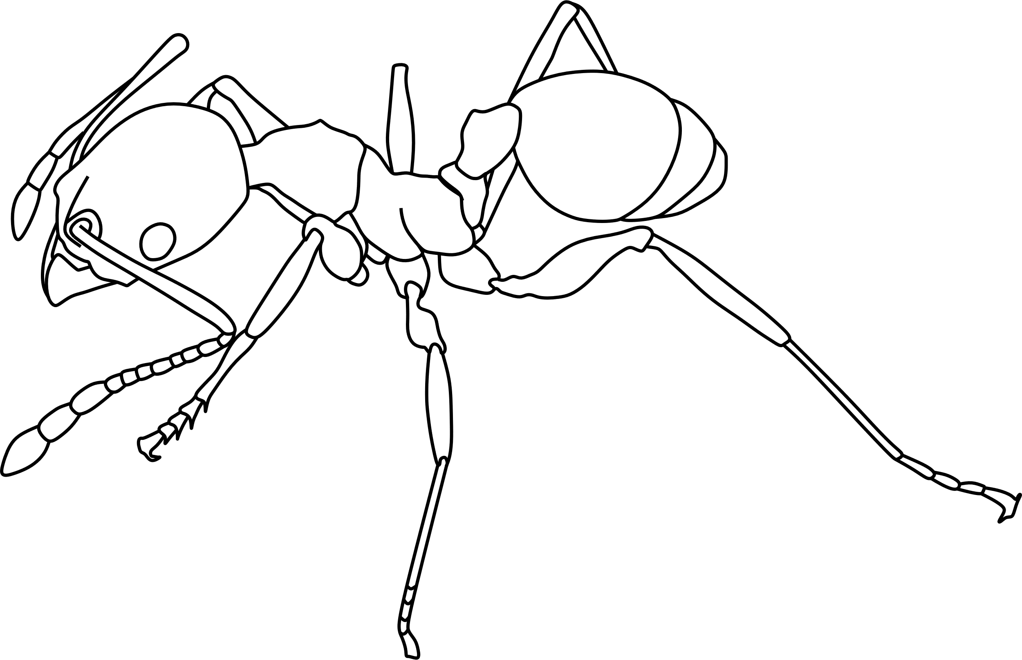
African Big-Headed Ant (minor)
Pheidole megacephala

Slide 10
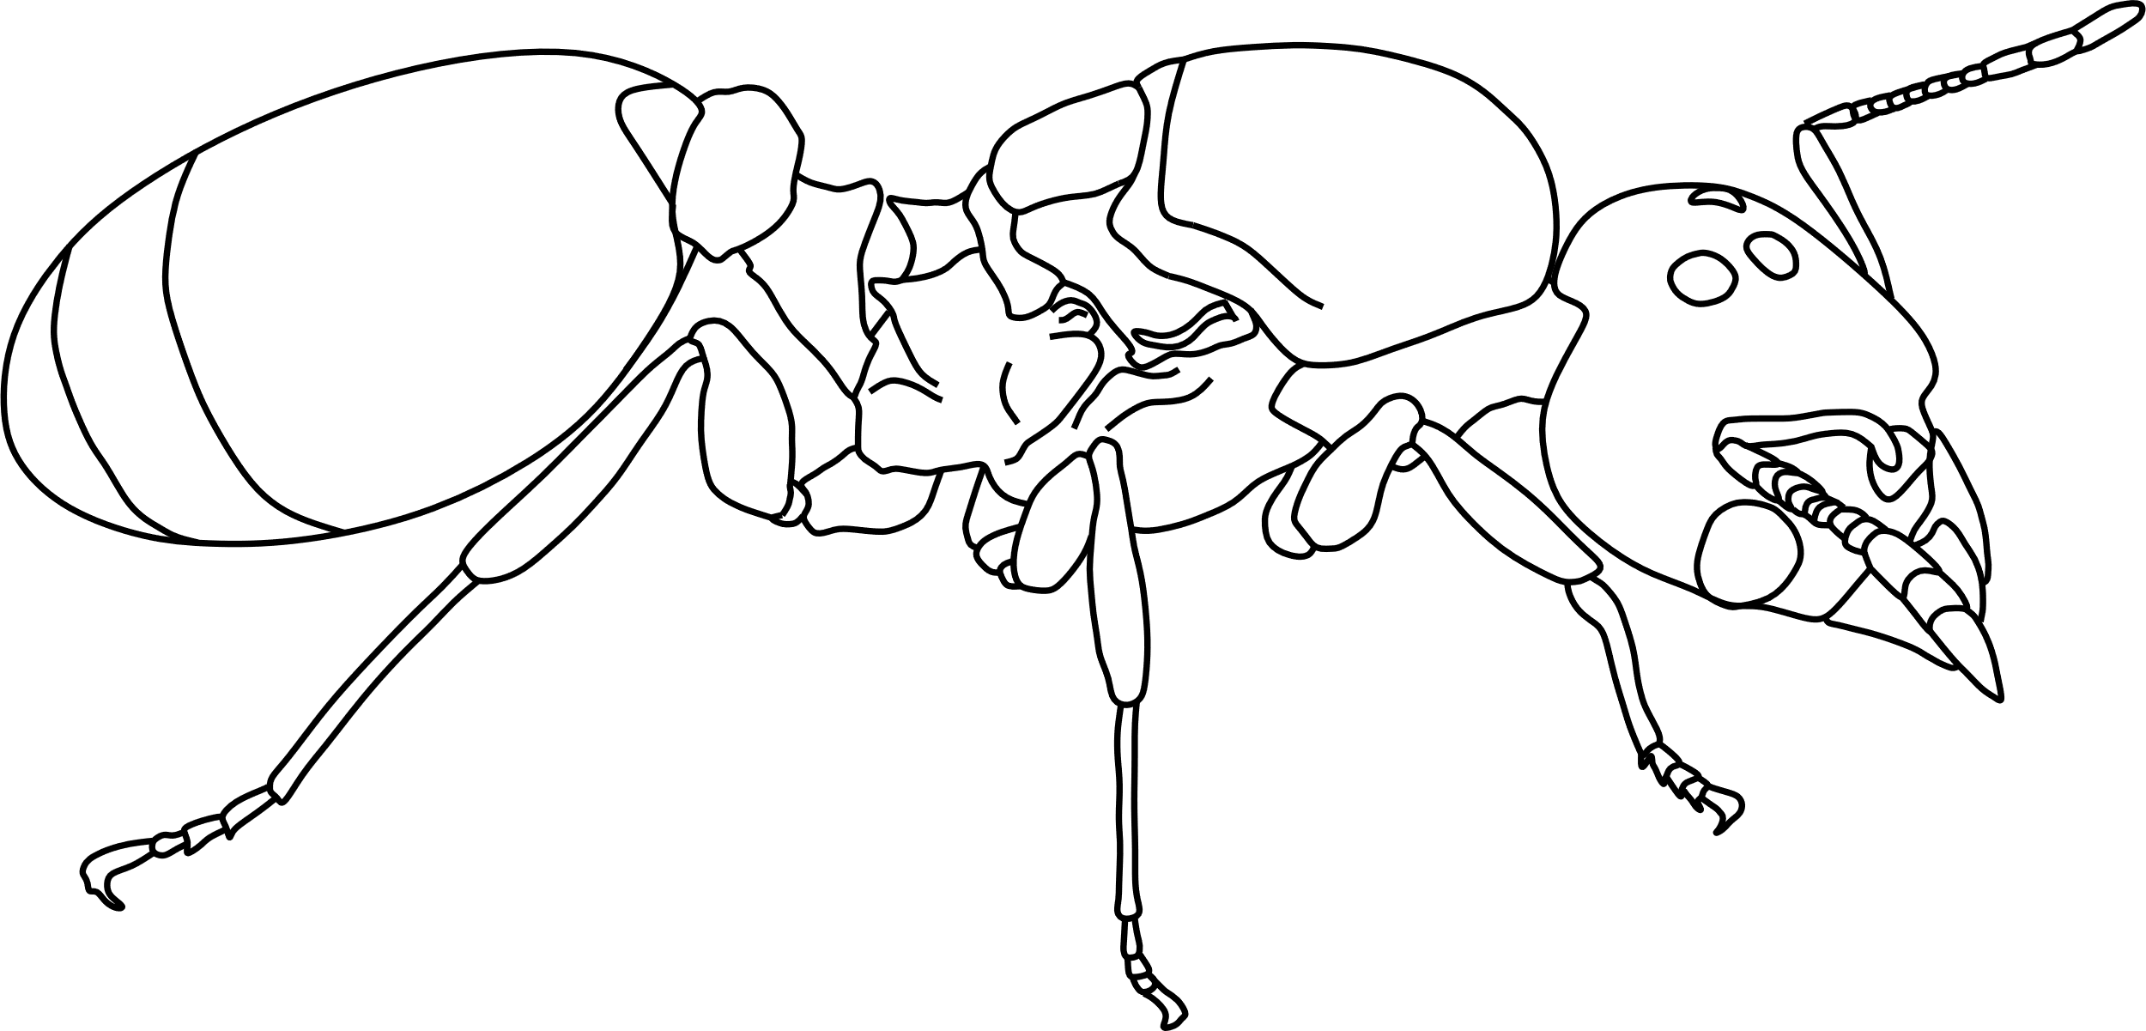
African Big-Headed Ant (queen)
Pheidole megacephala

Slide 11
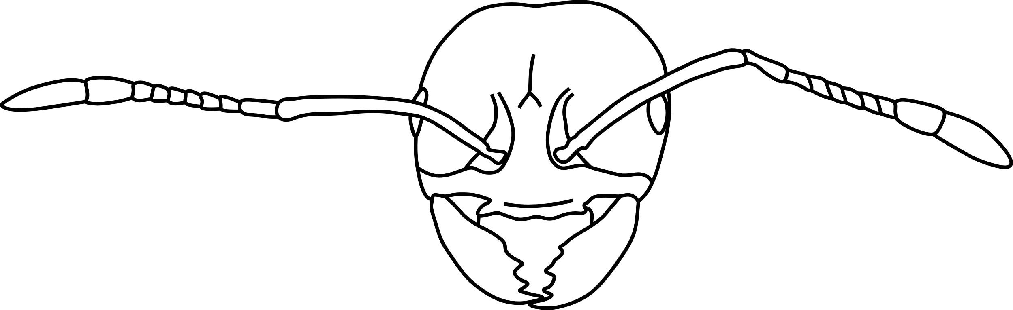
Red-Imported Fire Ant
Solenopsis invicta

Slide 12
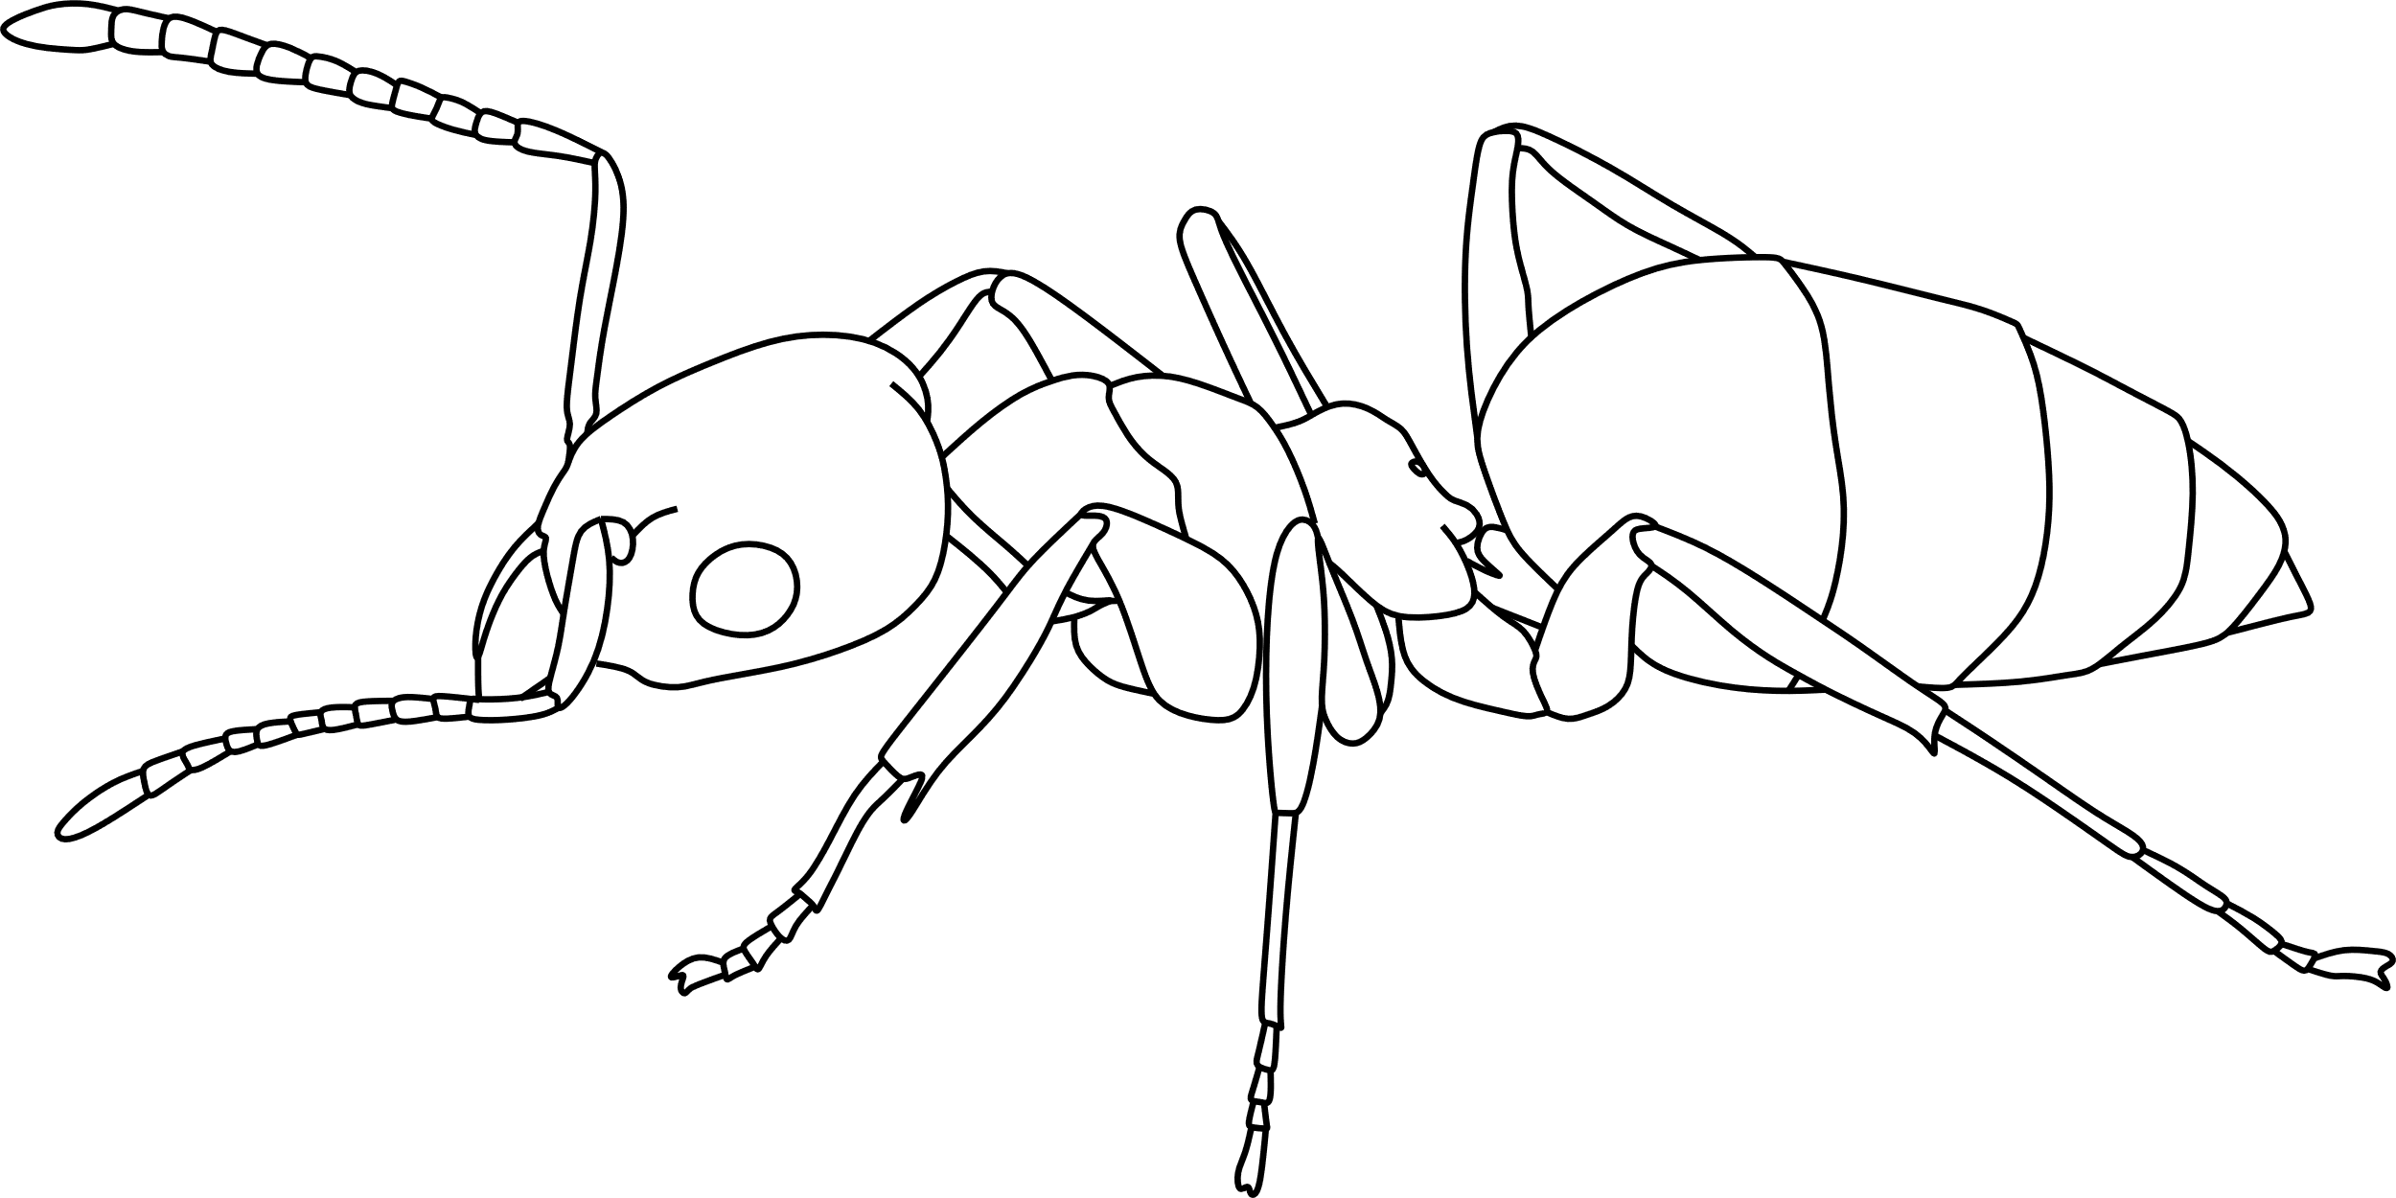
White-Footed Ant
Technomyrmex difficilis

Slide 13
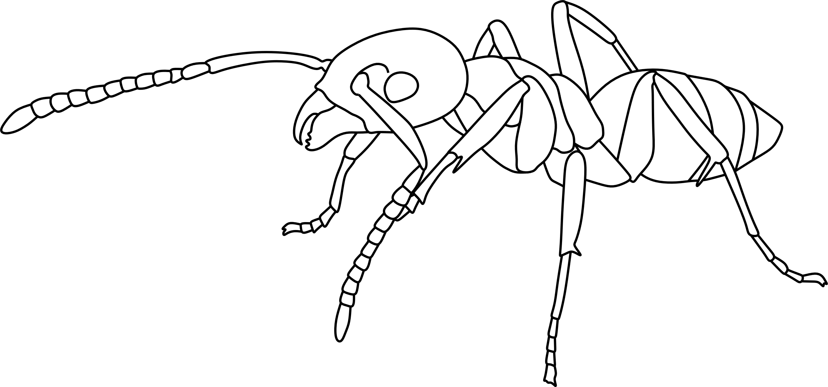
Ghost Ant
Tapinoma melanocephalum

