Slide 1
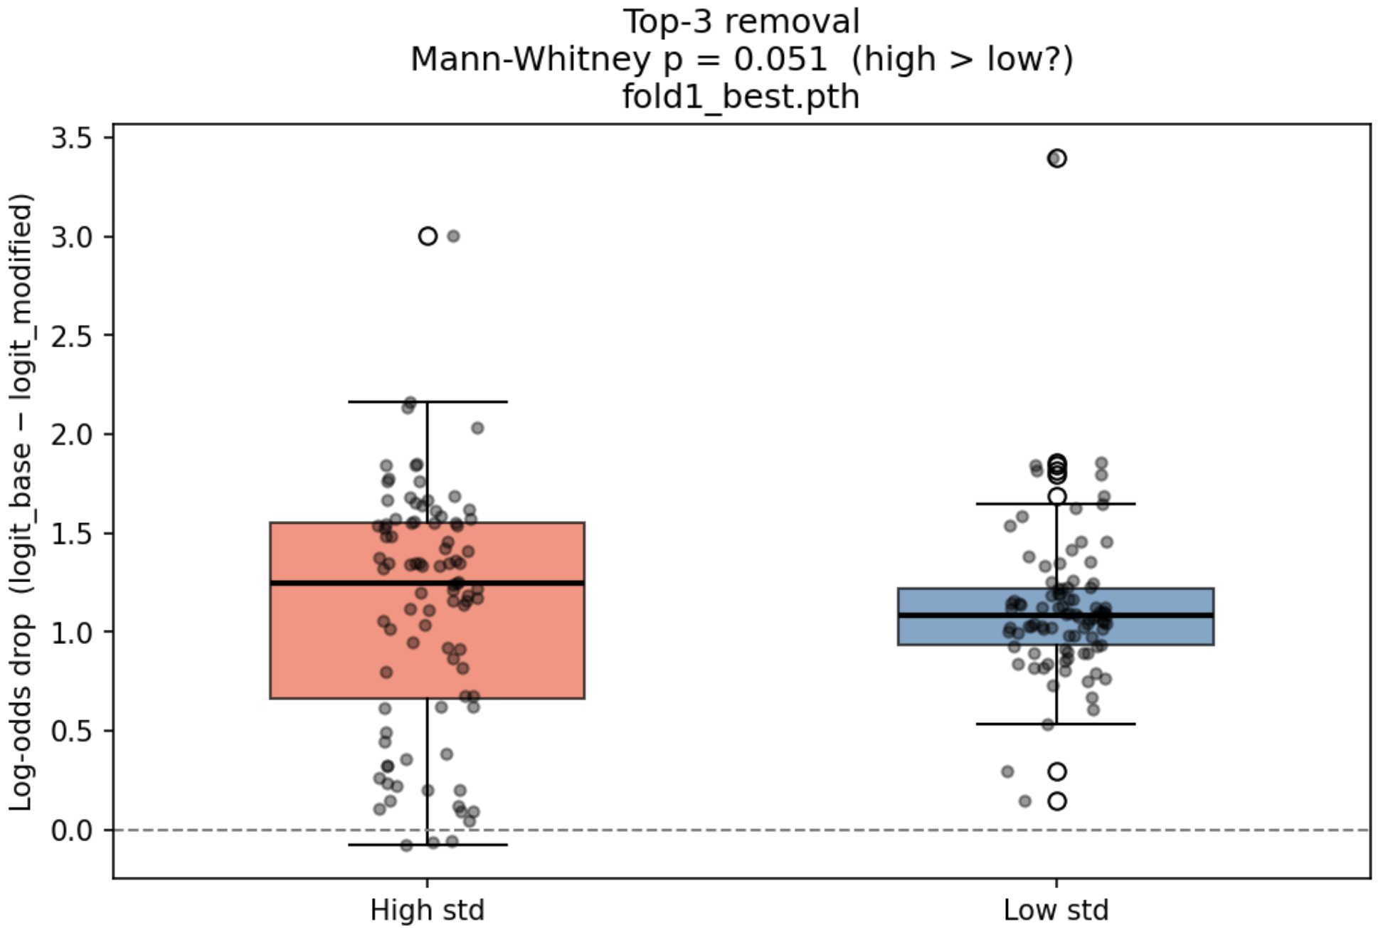
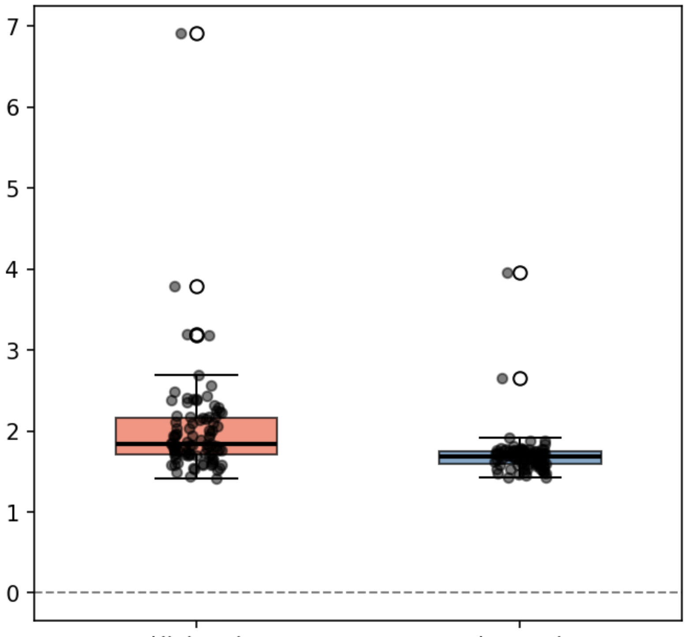
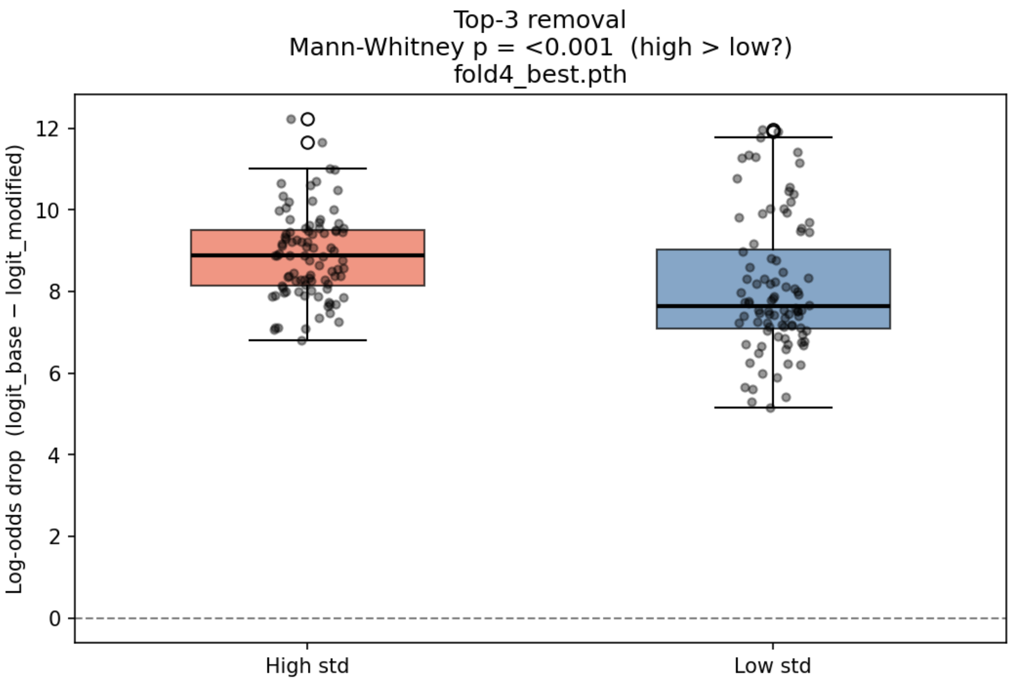
Fold 1 Top-3 removal
Mann-Whitney p = 0.051 (high > low)
Fold 2 Top-3 removal
Mann-Whitney p <0.05 (high > low)
Fold 4 Top-3 removal
Mann-Whitney p < 0.05 (high > low)
Log-odds drop (logit_base − logit_modified)
Log-odds drop (logit_base − logit_modified)
Log-odds drop (logit_base − logit_modified)
High std
Low std
High std
Low std

Slide 2
Top-3 removal
Mann-Whitney p = 0.051 (high > low)

