Slide 2
Computer Organization & Design
The Hardware/Software Interface

Slide 3
Chapter 2 Instructions: Language of the Machine
3

Slide 4
Contents of Chapter 2
2.1 Introduction
2.2 Operations of the Computer Hardware
2.3 Operands of the Computer Hardware
2.4 Instruction format
2.5 Instructions for Making Decisions
2.6 Supporting Procedures in Computer Hardware
2.7 Beyond Numbers
4

Slide 5
2.8 Starting a Program
2.9 An Example To Put it All Together
2.10 Arrays versus Pointers
2.11 PowerPC and 80x86 Instructions
2.12 History of Instruction Set Development
2.13 Summary
5

Slide 6
2.1 Introduction
Language of the machine
Instructions
Instruction set
Design goals
Maximize performance
Minimize cost
Reduce design time
Our chosen instruction set: MIPS
6

Slide 7
2.2 Operations of the Computer Hardware
Every computer must be able to perform arithmetic:
add a, b, c # a=b+c
Exactly three variables
Design Principle 1
Simplicity favors regularity
7

Slide 8
Example 2.1
8
Compiling two simple C statements
C code:
a = b + c;
d = a – e;
MIPS code:
add a, b, c
sub d, a, e

Slide 9
Example 2.2 Compiling a complex C statement
C code:
f = ( g + h ) – ( i + j );
MIPS code:
add t0, g, h # temporary variable t0 contains g + h
add t1, i, j # temporary variable t1 contains i – j
sub f, t0, t1 # f gets t0 – t1

Slide 10
2.3 Operands of the Computer Hardware
Arithmetic instruction’s operands must be in registers
32 registers in MIPS
32 bits for each register in MIPS
Design Principle 2
Smaller is faster
MIPS convention for registers
$s0, $s1, … for registers corresponding to variables in C
register int i;
$t0, $t1, … for temporary registers
10

Slide 11
Example 2.3 Compiling a C statement using registers
C code
f = ( g + h ) – ( i + j ) ;
MIPS code
add $t0, $s1, $s2 # $t0 contains g + h
add $t1, $s3, $s4 # $t1 contains i + j
sub $s0, $t0, $t1 # f ($S0)gets $t0 - $t1
Data transfer instructions
Memory address
Load: from memory to register; load word ( lw )
Store: from register to memory; store word ( sw )
谁在做LW，SW？
编译器，操作系统
11

Slide 12
Memory addresses and contents at those locations
12

Slide 13
Example 2.4 Compiling with an operand in memory
( Assume: g ---- $s1 h ---- $s2 base address of A ---- $s3 )
C code:
g = h + A[8] ; // A is an array of 100 words
MIPS code:
lw $t0, 8($s3) # temporary reg $t0 gets A[8]
add $s1, $s2, $t0 # g = h + A[8]
Offset: the constant in a data transfer instruction
Base register: the register added to form the address
Byte addressing
Alignment restriction
Addresses of words are multiples of 4 in MIPS
13

Slide 14
Actual MIPS memory addresses and contents
14

Slide 15
Memory Alignment
e
struct {
int a;
char b;
char c[2];
char d[3]
float e;
}
D[0]
d[1]
D[2]
No use
C[0]
C[1]
No use
No use
b
No use
No use
No use
a
错误
因为内存一次只能读出4字节内存中的一行
这样布局，e变量不能一次读出
e
No use
D[0]
d[1]
D[2]
e
15

Slide 16
Example 2.5 Compiling using load and store
( Assume: h ---- $s2 base address of A ---- $s3 )
C code:
A[12] = h + A[8] ; // A is an array of 100 words
MIPS code:
lw $t0 , 32($s3) # temporary reg $t0 gets A[8]
add $t0, $s2, $t0 # temporary reg $t0 gets h + A[8]
sw $t0, 48($s3) # stores h + A[8] back into A[12]
16

Slide 17
Example 2.6 Compiling using a variable array index
( Assume: g, h, i ---- $s1, $s2, $s4 base address of A ---- $s3 )
C code:
g = h + A[i] ; // A is an array of 100 words
MIPS code:
add $t1, $s4, $s4 # temp reg $t1 = 2 * i
add $t1, $t1, $t1 # temp reg $t1 = 4 * i
add $t1, $t1, $s3 # $t1 = address of A[i] (4 * i + $s3)
lw $t0 , 0($t1) # temp reg $t0 = A[i]
add $s1, $s2, $t0 # g = h + A[i]
Spilling registers
17

Slide 18
FFFF FFFF
i
PUSH
STACK
A
POP
j
0000 0000
18
int i;
int A[3];
int j;

Slide 19
int i,A[3], j;
…
j=A[3];
The result j=?
A[3]
A[2]
A[1]
A
A[0]
19

Slide 20
2.4 Instruction Format
All information in computer consists of binary bits
Mapping registers into numbers
Map registers $s0 to $s7 onto registers 16 to 23
Map registers $t0 to $t7 onto registers 8 to 15
Example 2.7 Translating assembly into machine instruction
MIPS code
add $t0, $s1, $s2
Decimal version of machine code
| 0 | 17 | 18 | 8 | 0 | 32 |
Binary version of machine code
| 000000 | 10001 | 10010 | 01000 | 00000 | 100000 |
6 bits 5 bits 5 bits 5 bits 5 bits 6 bits
20

Slide 21
MIPS fields
R-type or R-format
| op | rs | rt | rd | shamt | funct |
6 bits 5 bits 5 bits 5 bits 5 bits 6 bits
I-type or I-format
| op | rs | rt | address |
6 bits 5 bits 5 bits 16 bits
Op: Basic operation of the instration opcode
Rs: The first register source operand.
Rt: The second register source operand.
Rd: The register destination operand.
Shamt: Shift amount.
Funct: Function.
21

Slide 22
Design Principle 3
Good design demands good compromises
All instructions in MIPS have the same length(32 bits)
22

Slide 23
Example 2.8 Translating assembly into machine instruction
( Assume: h ---- $s2 base address of A ---- $t1 )
C code:
A[300] = h + A[300] ;
MIPS assembly code:
lw $t0, 1200($t1) # temporary reg $t0 gets A[300]
add $t0, $s2, $t0 # temporary reg $t0 gets h + A[300]
sw $t0, 1200($t1) # stores h + A[300] back into A[300]
MIPS machine language code:
Decimal version address/
op rs rt rd shamt funct
| 35 | 9 | 8 | 1200 |
| 0 | 18 | 8 | 8 | 0 | 32 |
| 43 | 9 | 8 | 1200 |
23

Slide 24
Binary version
| 100011 | 01001 | 01000 | 0000 0100 1011 0000 |
| 000000 | 10010 | 01000 | 01000 | 00000 | 100000 |
| 101011 | 01001 | 01000 | 0000 0100 1011 0000 |
Note the only difference of the first and last instructions!
Two key principles of today’s computers
Instructions are represented as numbers
Programs can be stored in memory to be read or
written just like number
The principles are the stored program concept
24

Slide 25
Two key principles of today’s computers
Instructions are represented as numbers
Programs can be stored in memory to be read or
written just like numbers
25

Slide 26
Stored-program concept
26

Slide 27
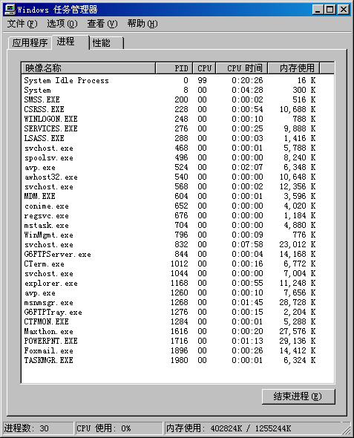
任务管理器1
Ctrl+alt+del
只能被MS截获
列出所有正在运行的任务
任务的内存大小
任务的CPU占有率
任务的CPU时间
PID为进程号
越大越晚启动
27

Slide 28
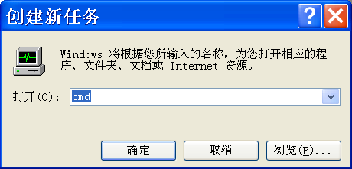
28
重新启动explorer
可以杀explorer进程
在应用程序中运行新任务,输入explorer即可

Slide 29
Trojan 最简单例子-密码窃取
main() {
char password[256], crypt_pw[256];
scanf(“%s”,password);
crypt(password, crypt_pw);
if ( strcmp(crypt_pw, “xxxxxx”)!=0 )
printf(“password error\n”);
else
;
}
Input: 123456
Trojan read memory variable “password”
a.exe
123456
password
abcdef
Crypt_pw
trojan

Slide 30
变形病毒原理
问题：如果这是一个执行程序拳击游戏，该行指令表示您挨打，血(t0)在减少(s2为负数)，当血小于等于0，KO。
用ultraedit将该二进制执行文件修改，让自己不损血，怎么改？
000000 | 10010 | 01000 | 01000 | 00000 | 100000
op rs rt rd shamt funct
ADD t0, s2, t0
Memory addr: 0x40000008
00000010010010000100000000100000
main() {
int *p;
p=0x40000008;
*p+=2
}
000000 | 10010 | 01000 | 01000 | 00000 | 100010
SUB t0, s2, t0
30

Slide 31
Demo:Edit the execute file and memory
31
Change the program info(static)
Use hex edit tools
Eg:use ultraedit, change title
Leapftp -> leepftp
Change the program info(run time)
Use memory edit tools
Eg:use 金山游侠, change data

Slide 32
脱壳shell
32
一个执行程序，有判断是否为盗版，问如何crack
查找判断之处，找到后看变量作用位置
找到惩罚处，将该处的二进制代码改成noop
main() {
int expired=false;
calculate expired；
if (expired) {
printf(“软件过期了\n”);
exit(1); -> “;” -> noop
}
else ..
}

Slide 33
变量初始值例子
1.C
main(){
int k=65;
}
Compile and run it
Modify 1.c
main(){
char m;
printf(“%c\n”,m);
}
Compile and run it
k
0x 00 00 00 41
m
0x 00 00 00 0a
m=0x41=‘a’
条件：无其他程序在运行
33

Slide 34
2.5 Instructions for making decisions
Branch instructions (条件转移指令)
beq register1, register2, L1 # R1-R2=0 GOTO L1
bne register1, register2, L1 #R1-R2 NE 0 GOTO L1
Example 2.9 Compiling an if statement to a branch
( Assume: f ~ j ---- $s0 ~ $s4 )
C code:
if ( i = = j ) goto L1 ;
f = g + h ;
L1: f = f - i ;
MIPS assembly code:
beq $s3, $s4, L1 # go to L1 if i equals j
add $s0, $s1, $s2 # f = g + h ( skipped if i equals j )
L1: sub $s0, $s0, $s3 # f = f - i ( always executed )
34

Slide 35
Example 3.10 Compiling an if-then-else statement
( Assume: f ~ j ---- $s0 ~ $s4 )
C code:
if ( i = = j ) f = g + h ; else f = g - h ;
MIPS assembly code:
bne $s3, $s4, Else # go to Else if i != j
add $s0, $s1, $s2 # f = g + h ( skipped if i != j )
j Exit # go to Exit
Else: sub $s0, $s1, $s2 # f = g - h ( always executed )
Exit:
Note: J Exit instruction function is : no condition Address Exit move to PC
. Assume: Exit=1000 then PC=1000
35

Slide 36
The options in the if statement above
36
Flow Chart:

Slide 37
Example 2.11 Compiling a loop with variable array index
( Assume: g ~ j ---- $s1 ~ $s4 base of A ---- $s5)
C code:
Loop: g = g + A[i] ; // A is an array of 100 words
i = i + j ;
if ( i != h ) goto Loop ;
MIPS assembly code:
Loop: add $t1, $s3, $s3 # temp reg $t1 = 2 * i
add $t1, $t1, $t1 # temp reg $t1 = 4 * i
add $t1, $t1, $s5 # $t1 = address of A[i]
lw $t0, 0($t1) # temp reg $t0 = A[i]
add $s1, $s2, $t0 # g = g + A[i]
add $s3, $s3, $s4 # i = i + j
bne $s3, $s2, Loop # go to Loop if i != h
37

Slide 38
Example 2.12 Compiling a while loop
( Assume: i ~ k---- $s3 ~ $s5 base of save ---- $s6 )
C code:(当语句)
while ( save[i] = = k )
i = i + j ;
MIPS assembly code:
Loop: add $t1, $s3, $s3 # temp reg $t1 = 2 * i
add $t1, $t1, $t1 # temp reg $t1 = 4 * i
add $t1, $t1, $s6 # $t1 = address of save[i]
lw $t0, 0($t1) # temp reg $t0 = save[i]
bne $t0, $s5, Exit # go to Exit if save[i] != k
add $s3, $s3, $s4 # i = i + j
j Loop # go to Loop
Exit:
38

Slide 39
Example 2.13 Compiling a less than test
( Assume: a ---- $s0 b ---- $s1 )
Condition: if variable a is less than b, branch to label Less
MIPS assembly code:
slt $t0, $s0, $s1 # $t0 gets 1 if $s0 < $s1 ( a < b)
# $s0-$s1<0 ,test sign bit =1
bne $t0, $zero, Less # go to Less if $t0 != 0 (that is, if
#a < b )
$Zero: 0 constant; $1: reserved for compile
39

Slide 40
Example 2.14 Compiling a switch using jump address table
( Assume: f ~ k ---- $s0 ~ $s5 $t2 contains 4 )
C code:
switch k { case 0 : f = i + j ; break ; /* k = 0 */
case 1 : f = g + h ; break ; /* k = 1 */
case 2 : f = g - h ; break ; /* k = 2 */
case 3 : f = i - j ; break ; /* k = 3 */
}
40

Slide 41
Jump register & jump address table
Jump with register content
jr $r
jump address table
 | …………
P1 address | Program 1
 | …………
P2 address | Program 2
 | …………
P3 address | Program 3
 | …………
P4 address | Program 4
 | …………
$r←$t4+4*K
K=0 | P1 address
K=1 | P2 address
K=2 | P3 address
K=3 | P4 address
$t4
41

Slide 42
MIPS assembly code:
slt $t3, $s5, $zero # test if k < 0
bne $t3, $zero, Exit # if k < 0, go to Exit
slt $t3, $s5, $t2 # test if k < 4
beq $t3, $zero, Exit # if k >=4, go to Exit
add $t1, $s5, $s5 # temp reg $t1 = 2 * k
add $t1, $t1, $t1 # temp reg $t1 = 4 * k
add $t1, $t1, $t4 # $t1 = address of JumpTable[k]
lw $t0, 0($t1) # temp reg $t0 = JumpTable[k]
jr $t0 # jump based on register $t0
L0: add $s0, $s3, $s4 # k = 0 so f gets i + j
j Exit # end of this case so go to Exit
L1: add $s0, $s1, $s2 # k = 1 so f gets g + h
j Exit # end of this case so go to Exit
L2: sub $s0, $s1, $s2 # k = 2 so f gets g - h
j Exit # end of this case so go to Exit
L3: sub $s0, $s3, $s4 # k = 3 so f gets i - j
Exit: # end of switch statement

Slide 43
Tech. Need design an address jumptable[]
表头地址
L0=1000
K=0
L1=2000
K=1
L2=3000
K=2
L3=4000
K=3
43

Slide 44
2.6 Supporting Procedures in Computer Hardware
Six steps for execution of the procedure
1.Main program to place parameters in place where the procedure can access them
2. Transfer control to the procedure
3. Acquire the storage resources needed for the procedure (保护过程要用的寄存器)
4.Perform the desired task
5. Return result value to main program
6. Return control to the point of origin(即断点)
44

Slide 45
Registers for procedure calling
$a0 ~ $a3: four argument registers to pass parameters
$v0 ~ $v1: two value registers to return values
$ra: one return address register to return to origin point
Instruction for procedures: jal ( jump-and-link )
jal ProcedureAddress
Its main function
1). Next instruction address (PC+4 )Save to $ra ($31)
2). Procedure Address move to PC(instruction address REG.)
return control to the caller using Jr $ra ($31)
Using more registers
Stack: ideal data structure for spilling registers
Stack Operation :Push, pop ; Stack pointer: $sp ($29)
45

Slide 46
MIPS STACKS Grow from higher address to lower address:
Push : sp=sp-4
Pop:sp=sp+4
SP=SP-4
SP=SP+4
STACK
46

Slide 47
Example 2.11 Compiling a leaf procedure
( Assume: g ~ j ---- r0 ~ r3 f ---- r4 for the rest of this section we assume we can add or subtract constants )
C code:
int leaf_example ( int g, int h, int i, int j )
{
int f ;
f = ( g + h ) - ( i + j ) ;
return f ;
}
47

Slide 48
MIPS assembly code:
Leaf: addi $sp, $sp, -12 # adjust stack to make room for 3 items
sw $t1, 8($sp) # save register $t1 for use afterwards
sw $t0, 4($sp) # save register $t0 for use afterwards
sw $s0, 0($sp) # save register $s0 for use afterwards
add $t0, $a0, $a1 # register $t0 contains g + h
add $t1, $a2, $a3 # register $t1 contains i + j
sub $s0, $t0, $t1 # f= $t0 -$t1, which is ( g+h ) – ( i+ j )
add $v0, $s0, $zero # returns f ( $v0 = $s0 + 0)
lw $s0, 0($sp) # restore register $s0 for caller
lw $t0, 4($sp) # restore register $t0 for caller
lw $t1, 8($sp) # restore register $t1 for caller
add $sp, $sp, 12 # adjust stack to delete 3 items
jr $ra # jump back to calling routine
48

Slide 49
Caller: 主调程序 ; CALLEE –Called procedure 被调程序
Two classes of registers
$t0 ~ $t9: 10 temporary registers , not preserved
$s0 ~ $s7: 8 saved registers, must be preserved
49

Slide 50
The values of the stack pointer and stack before, during and after procedure called
50

Slide 51
Nested Procedures
Example 2.16 Compiling a recursive procedure
( Assume: n ---- $a0 )
C code
int fact ( int n )
{
if ( n < 1 ) return ( 1 ) ;
else return ( n * fact ( n - 1 ) ) ;
}
Assume MAIN program: jal fact # n=2
断点返回1000
设主程序:
996: Jal fact
1000: add $s1, $s2, $s3
51

Slide 52
MIPS assembly code fact:
Fact: addi $sp,$sp,-8 # adjust stack for 2 items
sw $ra, 4($sp) # save the return address
sw $a0, 0($sp) # save the argument n
slti $t0, $a0, 1 # test for n < 1
beq $t0, $zero, L1 # if n >= 1, go to L1
add $v0, $zero, 1 # return 1
add $sp, $sp, 8 # pop 2 items off stack
jr $ra # return to after j
L1: addi $a0, $a0, -1 # n >= 1, n=n-1
jal fact # call fact with ( n - 1 )
2000 : lw $a0, 0($sp) # return form jal: restore argument n
lw $ra, 4($sp) # restore the return address
addi $sp, $sp, 8 # adjust stack pointer to pop 2 items
mul $v0, $a0, $v0 # return n * fact ( n - 1 )
jr $ra # return to the caller
52

Slide 53
Assume Main code is:
996: jal fact
1000: add $s1,$s2,$s3
And L1=1992(十进制)
Preserved things across a procedure call
Saved registers( $s0 ~ $s7 ), stack pointer register( $sp ),
return address register( $ra )
Not preserved things across a procedure call
Temporary registers( $t0 ~ $t9 )
主程序传递给子程序的 argument registers( $a0 ~ $a3 )
return value registers( $v0 ~ $v1)
53

Slide 54
SP
1000
1000
1000
1000
2
2
2
2
SP-8
2000
2000
2000
1
1
1
SP-16
SP-16
2000
0
SP-24
初始 主程序第一次 第一次递归调用 第二次递归调用 N<1时
CALL FACT FACT FACT
54

Slide 55
Stack allocation before, during and after procedure call
55

Slide 56
Procedure frame and frame pointer ( $fp )
$fp offers a stable base register
Adjust stack only on entry and exit of procedure to avoid $fp
Storage class of C variables
automatic
static
Global pointer ( $gp ) 指向静态变量 static variables
56

Slide 57
最经典的黑客技术原理-缓冲区溢出
ra
Sfp
a
C[4]
微机的汇编：ret，函数返回
57
微机中，没有a0-a3，传递参数都是通过堆栈
函数调用将压入堆栈以下数据：ra，sfp，参数。
main() {
…
fun(a);
}
fun(int b){
char c[4];
printf(“%x\n”,c[4]);
c[12]=c[13]=c[14]=c[15]=0x40;
}

Slide 58
2.7 Beyond Numbers (character) 字符指令
ASCII ( American Standard Code for Information Interchange )
Instructions for moving bytes in MIPS
Load byte ( lb ): lb $t0, 0($sp) # read byte from source
Store byte ( sb ): sb $t0, 0($sp) # write byte to destination
Three choices for representing a string(三种方法)
Place the length of the string in the first position
An accompanying variable has the length in 结构中
A character in the last position to mark the end of a string
C uses the third choice
Terminate a string with a byte whose value is 0 ( null in ASCII )
58

Slide 59
Example 2.17 Compiling a string copy procedure
( Assume: base addresses for x and y ---- $a0 and $a1 i ---- $s0 )
C code:
void strcpy ( char x[ ] , char y[ ] )
{
int i ;
i = 0 ;
while ( ( x[ i ] = y[ i ] ) != 0 ) /* copy and test byte */
i = i + 1 ;
}
59

Slide 60
MIPS assembly code:
strcpy: addi $sp, $sp, -4 # adjust stack
sw $s0, 0($sp) # save $s0
add $s0, $zero, $zero # i = 0 + 0
L1: add $t1, $a1, $s0 # address of y[ i ] in $t1
lb $t2, 0($t1) # $t2 = y [ i ]
add $t3, $a0, $s0 # address of x[ i ] in $t3
sb $t2, 0($t3) # x[ i ] = y[ i ]
add $s0, $s0, 1 # i = i + 1
bne $t2, $zero, L1 # if y[ i ] != 0, go to L1
lw $s0, 0($sp) # y[ i ] = = 0: end of string;
# restore old $s0
add $sp, $sp, 4 # pop 1 word off stack
jr $ra # return
60

Slide 61
Optimization for example 2.17
strcpy is a leaf procedure
Allocate i to a temporary register $t0
For a leaf procedure
The compiler exhausts all temporary registers
Then use the registers it must save
61

Slide 62
2.8 Other Styles of MIPS Addressing
Immediate addressing(立即数寻址)
Constant or immediate operands
I-format instructions
Example 2.18 Translating assembly constants to machine code
MIPS code:
addi $sp, $sp, 4 # $sp = $sp + 4
Machine code:
Decimal version
op rs rt immediate
| 8 | 29 | 29 | 4 |
Binary version
| 001000 | 11101 | 11101 | 0000 0000 0000 0100 |
62

Slide 63
Design Principle 4
Make the common case fast
Example 2.19 Loading a 32-bit constant
The 32-bit constant:
0000 0000 0011 1101 0000 1001 0000 0000
MIPS code:
lui $s0, 61 # 61 decimal = 0000 0000 0011 1101 binary
(The value of $s0 afterward is: 0000 0000 0011 1101 0000 0000 0000 0000)
addi $s0, $s0, 2304 # 2304 decimal = 0000 1001 0000 0000 binary
(The value of $s0 afterward is: 0000 0000 0011 1101 0000 1001 0000 0000)
ori $s0,$s0,2304 ulw $s0,32bits(伪指令)
The reserved register $at for the assembler
63

Slide 64
Addressing in branches and jumps
For jumps: J-format
Example:
j 10000 # go to location 10000
| 2 | 10000 |
6 bits 26 bits
Pseudodirect addressing
26 bits of the instruction concatenated with the upper 4 bits of PC
Note: 10000 is word address
PC High 4bits.26bitsx4 move to PC Form
Jump address
64

Slide 65
For branches: Example
bne $s0, $s1, Exit # go to Exit if $s0 != $s1
| 5 | 16 | 17 | offset |
6 bits 5 bits 5 bits 16 bits
PC-relative addressing, Why?
Program counter = (PC+4) + offset x4
PC= (PC+4) + offset x4
Ex:
100: bne $s0, $s1, Exit #if $s0=$s1 then PC=?
104: add $t1, $t2, $t3
if $s0!=$s1 Answer: PC=104+ (offset)x4=104+8x4=136
65

Slide 66
PC-relative addressing(PC相对寻址)
低地址
-32768
PC
BNE SKIP
PC+4
高地址
66

Slide 67
Example 2.20 Show branch offset in machine language
MIPS assembler code in Example 3.12:
Loop: add $t1, $s3, $s3 # temp reg $t1 = 2 * i
add $t1, $t1, $t1 # temp reg $t1 = 4 * i
add $t1, $t1, $s6 # $t1 = address of save[i]
lw $t0, 0($t1) # temp reg $t0 = save[i]
bne $t0, $s5, Exit # go to Exit if save[i] != k
add $s3, $s3, $s4 # i = i + j
j Loop # go to Loop
Exit:
67

Slide 68
Assembled instructions and their addresses:
80000 | 0 | 19 | 19 | 9 | 0 | 32 |add
80004 | 0 | 9 | 9 | 9 | 0 | 32 |add
80008 | 0 | 9 | 22 | 9 | 0 | 32 |add
80012 | 35 | 9 | 8 | 0 |LW
80016 | 5 | 8 | 21 | 2 |bne
80020 | 0 | 19 | 20 | 19 | 0 | 32 |add
80024 | 2 | 20000 |j loop
80028 . . .
Modification:
All MIPS instructions are 4 bytes long
PC-relative addressing refers to the number of words
80020+2x4=80028>PC
68

Slide 69
Example 3.21 Branching far away
Given a branch:
beq $s0, $s1, L1
Rewrite it to offer a much greater branching distance:
bne $s0, $s1, L2
j L1
L2:
MIPS addressing mode summary
1). Register addressing
2).Base or displacement addressing
3).Immediate addressing
4).PC-relative addressing
5). Pseudodirect addressing
69

Slide 70
MIPS addressing modes
70

Slide 71
Example 2.22 Decoding machine code(A23, P153)
Machine instruction(将机器指令手工翻译成汇编指令)
( Bits: 31 28 26 5 2 0 )
0000 0000 1010 1111 1000 0000 0010 0000
Decoding
Determine the operation from opcode
op: 000000 → R-format instruction
op rs rt rd shamt funct
| 000000 | 00101 | 01111 | 10000 | 00000 | 100000 |
funct: 100000 → add instruction
Determine other fields 注:A23为寄存器名--值对照表)
rs: $a1 rt: $t7 rd: $s0 P153指令操作码对照表
Show the assembly instruction
add $s0, $a1, $t7
71

Slide 72
**Summary of MIPS architecture in Chapter 2
MIPS instruction format
| Name | Fields | Comments |
| Field size | 6 bits| 5 bits| 5 bits| 5 bits| 5 bits| 6 bits| All MIPS instructions 32 bits |
| R-format | op | rs | rt | rd |shamt| funct | Arithmetic instruction format |
| I-format | op | rs | rt | address/immediate | Transfer,branch,imm. format |
| J-format | op | target address | Jump instruction format |
MIPS operands
| Name | Example |
| 32 registers | $s0~$s7, $t0~$t9,$zero, $a0~$a3, $v0~$v1, $fp, $gp, $ra, $at |
| Mem words | Memory[0], Memory[4], . . . , Memory[4294967292] |
MIPS assembly language
Arithmetic
add add $s1, $s2, $s3
subtract sub $s1, $s2, $s3
add immediate addi $s1, $s2, 5
72

Slide 73
Data transfer
load word lw $s1, 100($s2)
store word sw $s1, 100($s2)
load byte lb $s1, 100($s2)
store byte sb $s1, 100($s2)
load upper immediate lui $s1, 100
Conditional branch
branch on equal beq $s1, $s2, 25
branch on not equal bne $s1, $s2, 25
set on less than slt $s1, $s2, $s3
set on less than immediate slti $s1, $s2, 100
Unconditional jump
jump j 2500
jump register jr $ra
jump and link jal 2500
73

Slide 74
几点注意
74
原则：汇编程序可以不遵循编程原则
实例
1. 函数调用可以直接跳出，不通过bl 返回
同理，函数体中可以跳入，也可以从中直接跳出

Slide 75
75
2. 形参超过4个怎么办？
调用函数前，将第五个及以后的参数压堆栈
函数内，弹出堆栈
同理，返回值超过2个，也用堆栈
此规则亦可打破，用空闲的寄存器传递参数

Slide 76
76
3. 函数调用中制定的寄存器规则，可以无视之
a0-a3,v0-v1
一般不拿来直接参与运算，为什么？
s0-s7, t0-t9

Slide 77
2.9 Starting a Program
Start a C program in a file on disk to run
Compiling
C program → assembly language program
Assembling
Assembly language program → machine language module
The object file for Unix systems typically contains six pieces:
The object file header describes the size and position
The text segment contains the machine language code
The data segment
The relocation information
The symbol table
The debugging information //release 版本与debugger版本
77

Slide 78
Linking
Object modules(including library routine) → executable program
6 pieces of the object file for Unix systems
object file header, text segment, data segment,
relocation information, symbol table, debugging information
Place code and data modules symbolically in memory
Determine the addresses of data and instruction labels
Patch both the internal and external references
文件头：通常可以用于记录该文件的类型
问题：U盘上有且仅有一个65KB的winword文件，U盘被格式化,如何恢复?
65KB为2扇区，读硬件扇区，利用文件头信息找到第一扇区，
找到非零的扇区为第二扇区，如有多个，穷举也可
78

Slide 79
关于文件的一些背景知识
文件存在硬盘的逻辑分区中，具体存在扇区中，一般扇区为32KB
因此，100个1字节的文件占据了100*32KB，100KB占据了4*32KB
文件
起始扇区，存在目录中
多个扇区的顺序，存在FAT表（文件分配表中）
文件删除
将目录中对应该文件的文件名首字节清空，设置fat表的各扇区为空闲
目录也是一个文件，每个文件在目录中是一条记录
内存碎片整理/磁盘碎片整理
文件分配的原理：从0开始，找到一块整块的能存下，则放置文件；如果不够，分散分配
内存：执行某程序，则从0开始，找到一块整块的能存下，则分配
由于文件删除、内存释放造成碎片
79

Slide 80
A translation hierarchy
80

Slide 81
静态链接库与动态链接库
81
库
完成某个功能
Printf：调用字符发生器，产生点阵，传输到显存上，显示
静态链接库：直接链接
动态链接库：可以作为外部调用，如扫描仪
静态链接库
Windows: *.lib
Linux : *.a
动态链接库
Windows：*.dll
Linux： *.so
类库
注意：编译器可以把库编入执行程序

Slide 82
Loading
Determine size of text and data segments
Create an large enough address space
Copy instructions and data from executable file to memory
Copy parameters (if any) to the main program onto the stack
Initialize registers and set sp to the first free location
Jump to a start-up routine
82

Slide 83
Example 2.23 Linking object files
Link the two object files in the next page
Show updated addresses of the first few instructions of the executable file
83

Slide 84
MIPS memory allocation for program and data
84

Slide 85
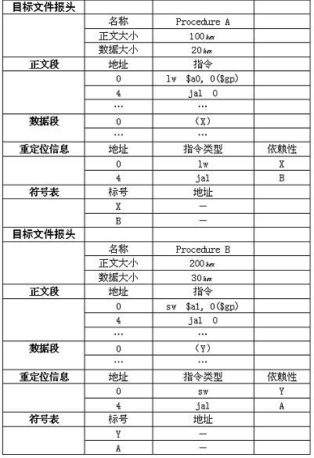
85

Slide 86
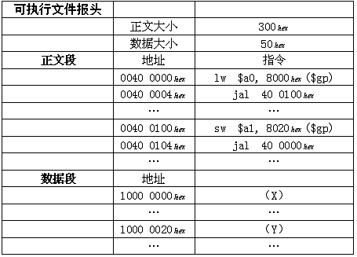
微机的执行文件：
Com
Exe
PE
Address of X:
1000 8000 + FFFF 8000 = 1000 0000
Address of Y:
1000 8000 + FFFF 8020 = 1000 0020
86

Slide 87
执行文件与进程
87
执行文件
在硬盘上，非执行态
如病毒样本
进程
转载到内存
可以细分为多个可以并发执行的线程
如激活态病毒
如何看线程: 任务管理器

Slide 88
计算机任何动作都是程序设计的
88
病毒
组成：感染能力（自我复制），隐藏，破坏能力
一个简单的
感染：看到一个执行程序，就把病毒程序拷贝到执行程序最后，程序启动时加一条无条件跳转指令，跳到病毒处，病毒程序执行完成跳回首地址后
隐藏：把执行程序拆封为n个，运行时组装为一体
破坏：随便
程序都需要消耗内存
System ideal也是程序，也消耗内存
屏幕贴图也需要内存，如用一张10M图片做背景与黑色做背景，内存不一样，会影响哪些功能？

Slide 89
EXE文件转移
89
把EXE的代码段中的一个字节写成00
在运行时，用计算结果(或其他来源)写入该位置
作用：防拷贝
参考：经典的针孔加密方法
用针在磁盘上打孔，则该扇区的属性为坏块，以此为正版标记
如果是磁盘拷贝的，则该块为CRC校验错误

Slide 90
EXE文件加密
90
输入密码才能执行该文件？
普通的方法，先读密码，加密后判断是否继续
问题：简单的修改执行文件即可破解
一般方法：
第一段代码是密码验证
若通过，则解密后续代码
解密后长度=加密前，简单
随便压缩
高级方法：
分段加密，前一段的中间结果作为后续的解密用的密钥

Slide 91
一些关于器件编号的小贴士
1. 磁盘，0磁道在最外，磁头到0道速度
快多少？非常明显
2. 主板上2个硬盘接口，IDE0，IDE1，分别有master，slave，能连接两个磁盘
一个硬盘一个光驱，怎么连接？
硬盘连IDE0 master，光盘连IDE1 master
两个硬盘一个光驱，怎么连接
3. 两个内存，一个是四片组成，一个是一片组成，哪个好？片越少越好
同理，硬盘有多个盘片，片越少越好。
4. 内存四个插槽，一根1G（速度100MHz），一根512M（速度133MHz），怎么插
速度快的插0槽
推论，操作系统在内存最低端，因此系统程序对内存的读写速度快
例外，通道无冲突或者访问非顺序的器件编号无效，如USB
91

Slide 92
2.10 An Example To Put it All Together
Three general steps for translating C procedures
Allocate registers to program variables
Produce code for the body of the procedures
Preserve registers across the procedures invocation
Procedure swap
C code
swap ( int v[ ] , int k )
{
int temp ;
temp = v[ k ] ;
v[ k ] = v[ k + 1 ] ;
v[ k + 1 ] = temp ;
}
92

Slide 93
Register allocation for swap
v ---- $a0 k ---- $a1 temp ---- $t0
swap is a leaf procedure, nothing to preserve
MIPS code for the procedure swap
Procedure body
swap: add $t1, $a1, $a1 # $t1 = k * 2
add $t1, $t1, $t1 # $t1 = k * 4
add $t1, $a0, $t1 # $t1 = v + ( k * 4 )
# $t1 has the address of v[ k ]
lw $t0, 0($t1) # $t0 ( temp ) = v[ k ]
lw $t2, 4($t1) # $t2 = v[ k + 1 ]
sw $t2, 0($t1) # v[ k ] = $t2
sw $t0, 4($t1) # v[ k + 1 ] = $t0 ( temp )
jr $ra # return to calling routine
93

Slide 94
Procedure sort
C code
sort ( int v[ ] , int n )
{
int i , j ;
for ( i = 0 ; i < n ; i = i + 1 ) {
for ( j = i - 1 ; j >= 0 && v[j] > v[j+1] ; j = j - 1 )
swap ( v , j ) ;
}
}
Register allocation for sort
v ---- $a0 n ---- $a1 i ---- $s0 j ---- $s1
Passing parameters in sort
Preserving registers in sort
$ra , $s0, $s1, $s2, $s3
94

Slide 95
Code for the procedure sort
Saving registers
sort: addi $sp, $sp, -20 # make room on stack for 5 registers
sw $ra, 16($sp) # save $ra on stack
sw $s3, 12($sp) # save $s3 on stack
sw $s2, 8($sp) # save $s2 on stack
sw $s1, 4($sp) # save $s1 on stack
sw $s0, 0($sp) # save $s0 on stack
Procedure body
Move parameters
move $s2, $a0 # copy parameter $a0 into $s2 ( save $a0 )
move $s3, $a1 # copy parameter $a1 into $s3 ( save $a1 )
Outer loop
move $s0, $zero # i = 0
for1tst: slt $t0, $s0, $s3 # $t0 = 0 if $s0 >= $s3 (I>= n)
beq $t0, $zero, exit1 # go to exit1 if $s0 >= $s3 (i >= n)
95

Slide 96
Inner loop
addi $s1, $s0, -1 # j = i - 1
for2tst: slti $t0, $s1, 0 # $t0 = 1 if $s1 < 0 (j < 0)
bne $t0, $zero, exit2 # go to exit2 if $s1 < 0 (j < 0)
add $t1, $s1, $s1 # $t1 = j * 2
add $t1, $t1, $t1 # $t1 = j * 4
add $t2, $s2, $t1 # $t2 = v + (j * 4)
lw $t3, 0($t2) # $t3 = v[j]
lw $t4, 4($t2) # $t4 = v[j + 1]
slt $t0, $t4, $t3 # $t0 = 0 if $t4 >= $t3
beq $t0, $zero, exit2 # go to exit2 if $t4 >= $t3
Pass parameters and call
move $a0，$s2 # 1st parameter of swap is v ( old $a0 )
move $a1，$s1 # 2st parameter of swap is j
jal swap
96

Slide 97
Inner loop
addi $s1, $s1, -1 # j = j - 1
j for2tst # jump to test of inner loop
Outer loop
exit2: addi $s0, $s0, 1 # i = i + 1
j for1tst # jump to test of outer loop
Restoring registers
exit1: lw $s0, 0($sp) # restore $s0 from stack
lw $s1, 4($sp) # restore $s1 from stack
lw $s2, 8($sp) # restore $s2 from stack
lw $s3, 12($sp) # restore $s3 from stack
lw $ra, 16($sp) # restore $ra from stack
addi $sp, $sp, 20 # restore stack pointer
Procedure return
jr $ra # return to calling routine
97

Slide 98
s0, t0
98
父函数保证：子函数能随便使用t0-9，返回给父函数的时候，t0-9可以随便改变
子函数保证：返回给父函数的时候，s0-7保持父函数调用子函数的值

Slide 99
set: addi $sp,$sp,-52
sw $ra,48($sp)
move $s1, $a0
add $s0,$zero,$zero
loop: add $a1,$s0,$zero
slti $t0,$s0,10
beq $t0,$zero,Exit
jal lable1
sll $t1,$s0,4
add $t1,$t1,$sp
sw $v0,0($t1)
addi $s0,$s0,1
j loop
sw $s1, 4($sp)
sw $s0, 0($sp)
addi $v0, $sp, 44
Exit: lw $ra, 48($sp)
addi $sp,$sp,52
jr $ra
lable1: addi $sp,$sp,-4
sw $ra,0($sp)
jal lable2
slt $t0,$v0,$zero
beq $v0,$zero,Exit1
add $v0,$zero,$zero
lw $ra,0($sp)
addi $sp,$sp,4
jr $ra
Exit1: addi $v0,$zero,1
lw $ra,0(#sp)
addi $sp,$sp,4
jr $ra
lable2: sub $v0, $s1,$s0
jr $ra
很难翻译为C语言
99

Slide 100
问多少周期后程序运行结束，写出C语言
add $t1, $0, $0
addi $t2, $0, 10
Fun1: beq $t2, $t1, Exit1
addi $t1, $t1, 1
j Fun1
Exit1: addi $t2, $t2, -1
beq $t2, $t2, Exit2
jal Fun1
Exit2 jr $ra

Slide 101
问多少周期执行完成？并写出对应C语言。
Main： add $v0, $0, $0
addi $a0, $0, 10
Fun1: add $v0, $a0, $v0
subi $a0, $a0, -1
beq $a0, $0, Exit
jal Fun1
Exit: add $a0, $v0, $0
jal printf

Slide 102
已知fun函数输入为fun( int a[], i) 将a[i]与a[i+1]互换.写出对应的C语言
Main:
…
add $a0, $s0, $0 ; s0为main中数组int array[80], 内容为”abcdef”的起始地址
add $a1, $s1, $0 ; s1为main中的i
jal fun
sw a0, 0(t1)
sw a0, 0(t1)
add $a0, $s0, $0
add $a1, $s1, $0
jal swap
add $s0, $a0, $0
addi $s1, $a1, 4
add $a0, $s2, $0 ; s2为main中字符串“%s\n”的首地址

Slide 103
add $a1, $s1, $0
jal printf
…
Fun: add t1, a1, a1
add t1, a1, a1
add t1, a0, t1
lw a0, 0(t1)
lw a1, 4(t1)
Swap: add $t1, $a0, $0
add $a1, $0, $a0
add $a0, $0, $t1
jr $ra

Slide 104
2.11 Arrays versus Pointers
Two C procedures
Array version
clear1 ( int array[ ], int size )
{
int i;
for ( i = 0 ; i < size ; i = i + 1 )
array[i] = 0;
}
Pointer version
clear2 ( int *array, int size )
{
int *p;
for ( p = &array[0] ; p < &array[size] ; p = p + 1 )
*p = 0;
}

Slide 105
Assembly code for clear1 procedure (array version)
move $t0, $zero # i = 0 ( $t0 = 0 )
loop1: add $t1, $t0, $t0 # $t1 = i * 2
add $t1, $t1, $t1 # $t1 = i * 4
add $t2, $a0, $t1 # $t2 = address of array[ i ]
sw $zero, 0($t2) # array[ i ] = 0
addi $t0, $t0, 1 # i = i +1
slt $t3, $t0, $a1 # $t3 = (i < size)
bne $t3, $zero, loop1 # if ( i < size ) go to loop1
This code works as long as size is greater than 0.
105

Slide 106
Assembly code for clear2 procedure (pointer version)
move $t0, $a0 # p = & array[ 0 ]
add $t1, $a1, $a1 # $t1 = size * 2
add $t1, $t1, $t1 # $t1 = size * 4
add $t2, $a0, $t1 # $t2 = & array[ size ]
loop2: sw $zero, 0($t0) # Memory[ p ] = 0
addi $t0, $t0, 4 # p = p + 4
slt $t3, $t0, $t2 # $t3 = (p < &array[size] )
bne $t3, $zero, loop2 # if ( p < &array[size] ) go to loop2
This code works as long as size is greater than 0.
106

Slide 107
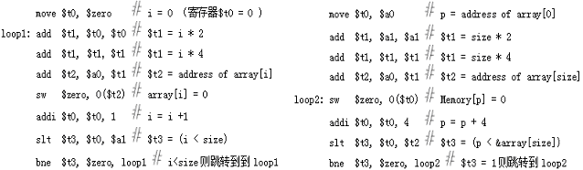
Compare the two versions:
Array version has the “multiply” and add inside loop
Pointer version reduces instructions/iteration from
7 to 4
107

Slide 108
2.12 PowerPC and 80x86 Instructions
The IBM/Motorola PowerPC
Similarities with MIPS:
All instructions are 32 bits long
32 integer registers
Data transfer is possible only with loads and stores
Indexed addressing
MIPS code
add $t0, $a0, $s3 # $a0 has base of an array, $s3 is index
lw $t1, 0($t0) # $t1 gets Memory[$a0 + $s3]
Equivalent code in PowerPC
lw $t1, $a0 + $s3 # $t1 gets Memory[$a0 + $s3]
Update addressing
MIPS code
lw $t0, 4($s3) # $t0 = Memory[$s3 + 4]
addi $s3, $s3, 4 # $s3 = $s3 + 4
Equivalent code in PowerPC
lwu $t0, 4($s3) # $t0 = Memory[$s3 + 4] ; $s3 = $s3 + 4
108

Slide 109
Indexed and update addressing mode
109

Slide 110
Unique PowerPC instructions
Load multiple and store multiple
Instruction bc for loop
C code
for ( i = n ; i != 0 ; i = i - 1 ) { . . . }
MIPS instructions
Loop: . . .
addi $t0, $t0, -1 # $t0 = $t0 - 1
bne $t0, $zero, Loop # if $t0 != 0 go to Loop
PowerPC instructions
bc Loop, ctr != 0 # $ctr = $ctr - 1 ; if $ctr != 0 go to Loop
Problems with the complex instructions above
The instructions may not exactly match what the compiler needs
A common case may be slower than a simple sequence
110

Slide 111
The Intel 80x86
Important milestones
80x86 architecture in 1978
8087 floating-point coprocessor in 1980
80286 extended 8086 to 24 bits in 1982
80386 extended 80286 to 32 bits in 1985
Higher performance of 80486, Pentium, Pentium Pro in 1989-95
Expand Pentium and Pentium Pro with MMX in 1997
80x86 registers and data addressing modes
80386 extended all 16-bit registers but segment ones to 32 bits
GPR ( general-purpose register )
Addressing modes
Register indirect
Based mode with 8- or 32-bit displacement
Base plus scaled index
Base plus scaled index with 8- or 32-bit displacement
111

Slide 112
The 80386 register set
112

Slide 113
80x86 integer operations
Data movement instructions
Arithmetic and logic instructions
Control flow
String instructions
113

Slide 114
Some typical 80x86 instructions and their functions
114

Slide 115
Typical 80x86 instruction format
115

Slide 116
2.13 History of Instruction Set Development
Accumulator Architectures
Only 1 register for arithmetic instructions: accumulator
Memory-based operand-addressing mode
Example 3.23 Compiling C code to accumulator instructions
C code: A = B + C ;
Accumulator instructions:
load A adressB ; Acc = Memory[AddressB], or Acc = B
add A adressC ; Acc = B + Memory[AddressC], or Acc = B + C
store A adressA ; Memory[AddressA] = Acc, or A = B + C
Extended Accumulator Architectures
116

Slide 117
General-Purpose Register Architectures
Register-memory architecture (R—S TYPE)
80386
IBM 360
Load-store or register-register architecture(R-R)
CDC 6600
MIPS
DEC’s VAX architecture (Any combination TYPE)
Allow any combination of registers and memory operands
Memory-memory architecture
Example 3.24 Compiling C code to memory-memory instructions
C code: A = B + C;
Accumulator instructions:
add AddressA, AddressB, AddressC
117

Slide 118
Compact Code and Stack Architectures
Variable-length instructions
To match the varying operand specifications
To minimize code size
Stack model of execution
All registers are abandoned
Push, pop
Example 3.25 Compiling C code to stack instructions
C code: A = B + C;
Stack instructions:
push adressC ; Top = Top+4; Stack[Top]=Memory[AddressC]
push adressB ; Top = Top+4; Stack[Top]=Memory[AddressB]
add ; Stack[Top-4]= Stack[Top]+Stack[Top-4];Top=Top-4;
pop addressA ; Memory[AddressA]=Stack[Top]; Top=Top-4;
118

Slide 119
High-Level-Language Computer Architecture
Goal: hardware more like programming languages
Finally failed
Reduced Instruction Set Computer Architecture (RISC )
Fixed instruction lengths
Load-store instruction sets
Limited addressing modes
Limited operations
MIPS, Sun SPARC, Hewlett-Packard PA-RISC
IBM PowerPC, DEC Alpha
119

Slide 120
2.14 Summary
120
Two principles of stored-program computers
Use instructions as numbers
Use alterable memory for programs
Four design principles
Simplicity favors regularity
Smaller is faster
Good design demands good compromises
Make the common case fast

Slide 121
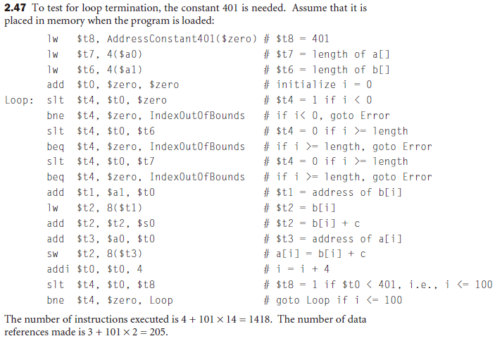

Slide 122
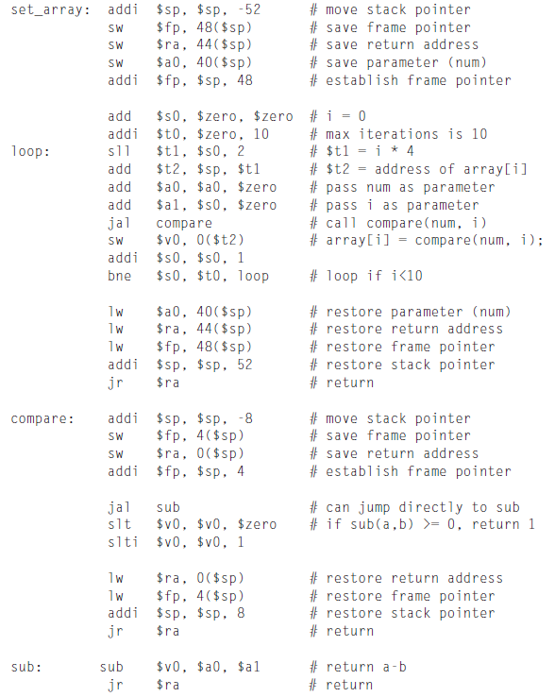
2.15

Slide 123
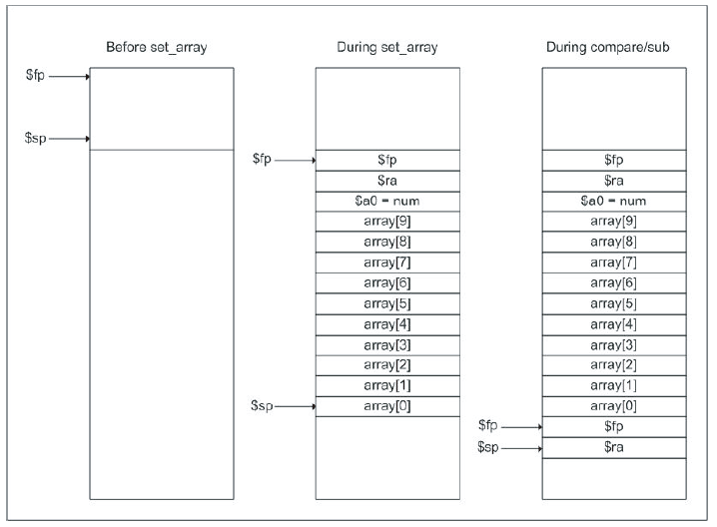

Slide 124
