Slide 1
A Guide to Eliminate Your Personal Info from Your Report
RZ Pan @ ZJU

Slide 2
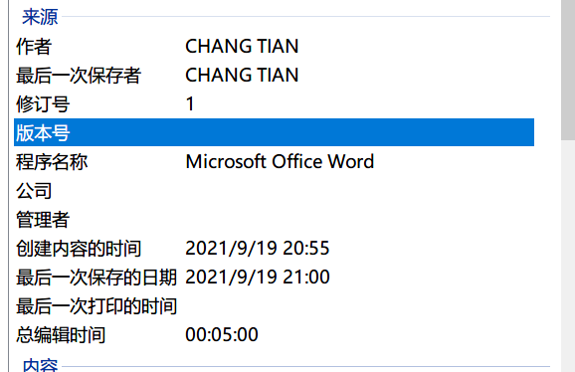
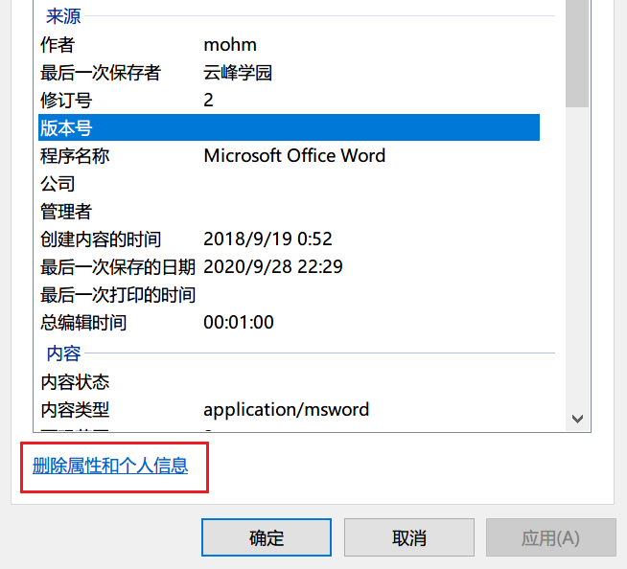
MS Word/PPT/Excel
“Author” attribute
“Last Modified By” attribute
Right-click on the file, “Attribute (R)”, Click on the “Details” Tab
Solution: Click “Remove Attribute and Personal Info” which can be found at the bottom of the “Details” Tab
Don’t make further edit, or you’ll need to clear these attributes again!

Slide 3
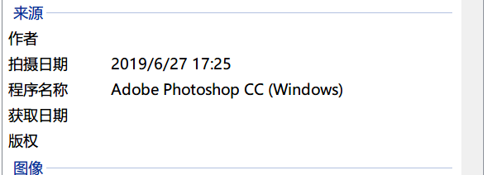
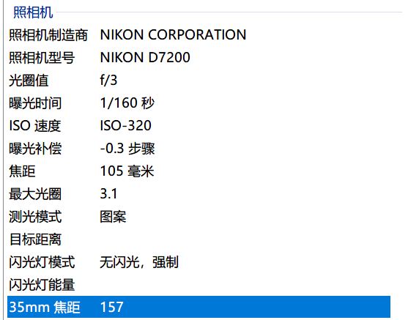
Image
JPEG EXIF –Solution: Ditto
Shot on a phone: GPS Info, phone manufacturer, etc.
Screenshots might contain sensitive information, such as the path of your .exe (shown in cmd title bar)
$ strings 1.jpg | head -n 11
Adobe
'JExif
NIKON CORPORATION
NIKON D7200
Adobe Photoshop CC (Windows)
2019:07:10 23:07:41
0221
2019:06:27 17:25:44
2019:06:27 17:25:44
8120437
105.0 mm f/2.8

Slide 4
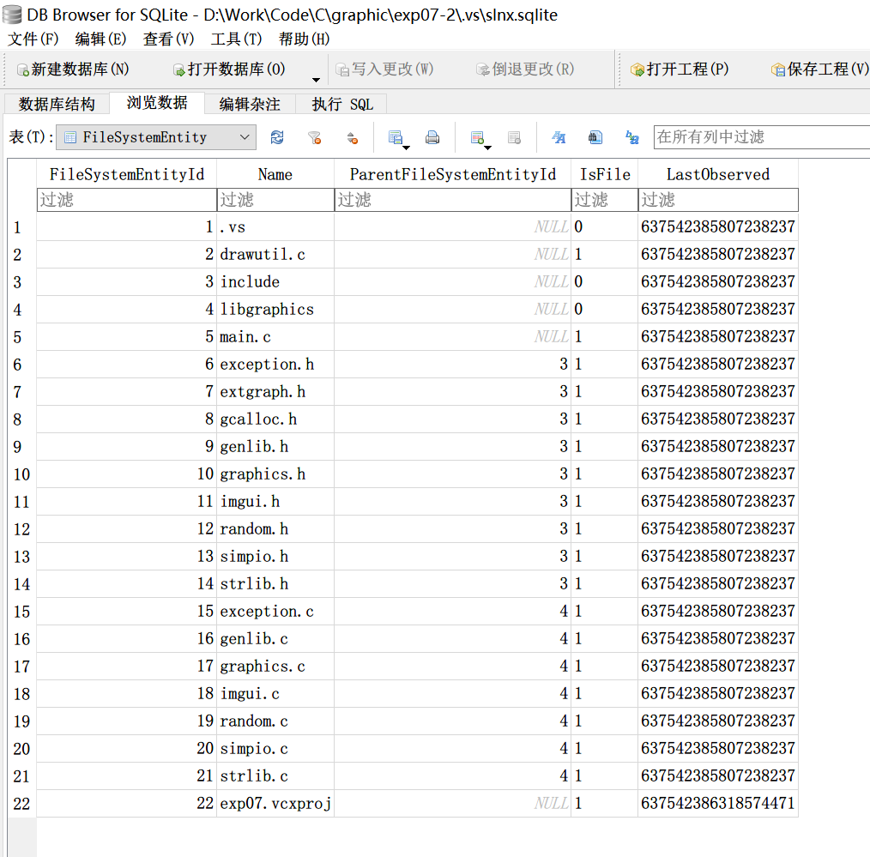
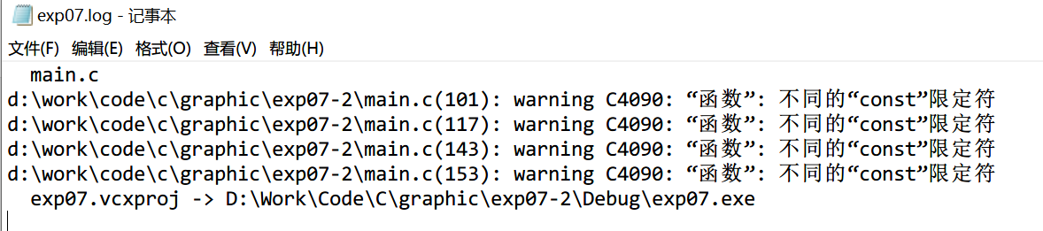
Visual Studio
<PropertyGroup Condition="'$(Configuration)|$(Platform)'=='Debug|Win32'">
<LinkIncremental>true</LinkIncremental>
<IncludePath>$(VC_IncludePath);$(WindowsSDK_IncludePath);.\include\</IncludePath>
</PropertyGroup>
.sln, .vcxproj, -.filters, -.user
(Possible) IncludePath attribute
.vs folder
(Possible) slnx.sqlite database, can be opened with sqlite3
Debug folder
Name.log
Name.pdb
Solution: Delete Debug/, double-check .sln & .vs/, etc.

Slide 5
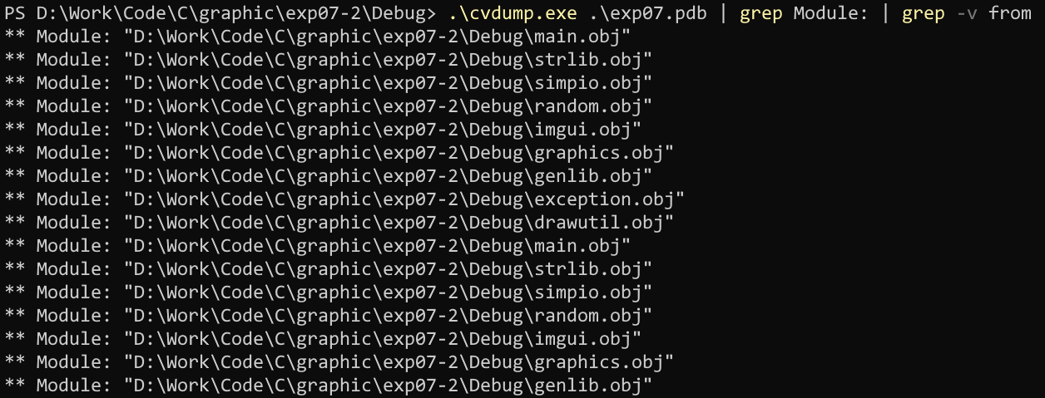
PDB: cvdump.exe

Slide 6
Dev C++
.dev file
[Project]
FileName=expSort.dev
Name=expSort
Type=0
Ver=2
ObjFiles=
Includes="D:\Work\Code\C\graphic\exp08 - 副本\include"
Solution: Double-check .dev file, make sure no absolute path is included

Slide 7
Visual Studio Code
.vscode folder
"miDebuggerPath": "C:\\Program Files\\mingw-w64\\x86_64-8.1.0-posix-seh-rt_v6-rev0\\mingw64\\bin\\gdb.exe",
"args": [
"${workspaceFolder}\\task2\\libgraphics\\exception.c",
"${workspaceFolder}\\task2\\libgraphics\\genlib.c",
Solution: Delete .vscode/

Slide 8
.DS_Store
$ ds_store_exp.py http://hd.zj.qq.com/themes/galaxyw/.DS_Store
hd.zj.qq.com/
└── themes
└── galaxyw
├── app
│ └── css
│ └── style.min.css
├── cityData.min.js
├── images
│ └── img
│ ├── bg-hd.png
│ ├── bg-item-activity.png
│ ├── bg-masker-pop.png
Solution: Delete .DS_Store file before compressing/uploading your file

Slide 9
.md
If you use specific platforms as your image bed, your personal info might be leaked
Retrieve weibo uid (--> user homepage) from image link
https://www.cnblogs.com/idjl/p/9610593.html
Or, you use your self-hosted image bed
image.me.com --> me.com, blog.me.com, ......
site:me.com inurl:me.com
Also, .md might leak path info if you import any image by specifying its absolute path
Example: ![Image](C:\Users\username\Desktop\MyImage\1.jpg)
Solution: Submit .pdf, not .md

Slide 10
Git
.git folder
upstream url: can get your GitHub/Gitlab account
Username & email if you use git config --local
Also, git log
Solution: Delete .git

Slide 11
Conclusion
Submit less files
Use pdf if possible
If you have to submit Word/PPT/Excel, see page 3 for steps to create an anonymous copy

