Slide 1
Modelling the Effectiveness of vaccination in Preventing the Transmission of COVID-19 in Sabah
Dr Jesica Jenah Ak Ramping
Dr Wong Liang Tung
Dr Izzaty Hamidi
Doctor of Public Health Year 1
UNIMAS

Slide 2

Outline
Introduction
Objective
Significant of the study
Methodology
Result
Discussion
Recommendation and limitation

Slide 3
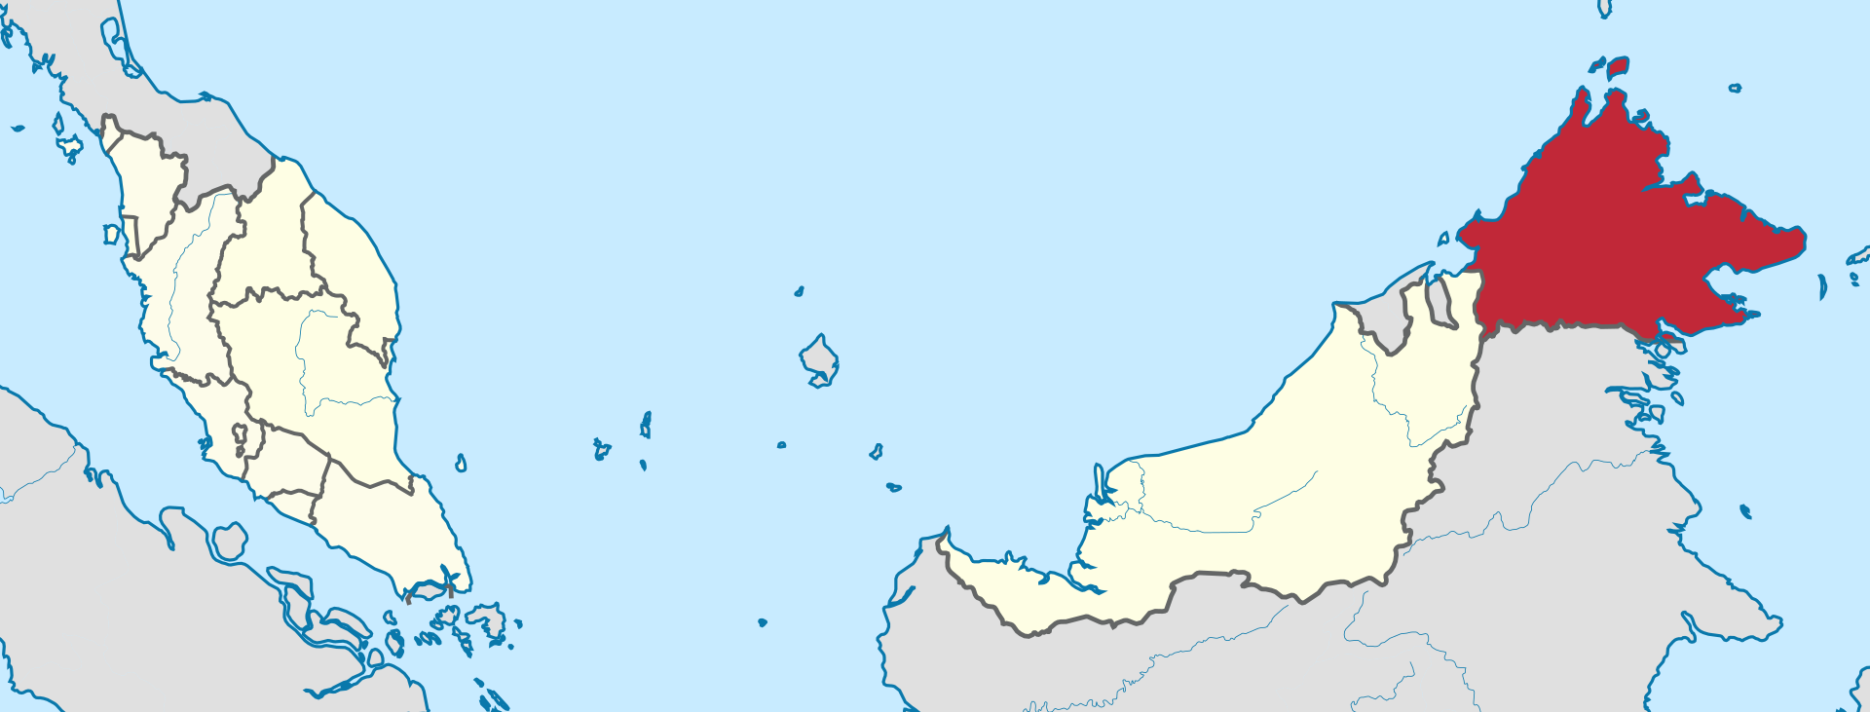
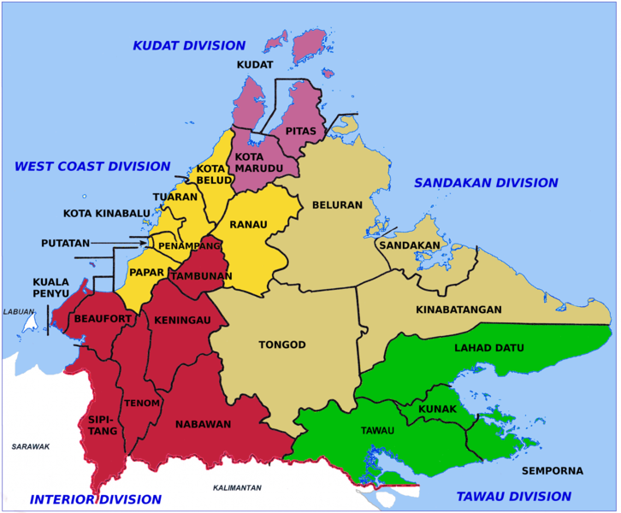
Introduction
Total population ((DOSM, 2021)
3.91 million
2.7 million (>18 years olds)
Boundaries :
i. South China Sea in the north, east and west; ii. Indonesia in the south; and iii. Sarawak and W.P. Labuan in the southwest
First case : Tawau division, March 2020 , Tabligh (Sri Petaling) cluster
Malaysia 3rd wave: September 2020, following Sabah state election in August 2020.Contributed to 45 000 confirmed cases in Sabah alone (August 2020-January 2021) .
Current confirmed cases (as of 10th August 2021) : 100 031 (Statista,2021)
COVID-19 Vaccination Programme:
26 February 2021 (First Phase),
19 April 2021 (Second Phase)
Total coverage as of 10th August 2021
(JKJAV, 2021)
1,158 000 completed 1st dose
495 000 completed 2nd dose
Total: 1.653 million out of 3.91 million ( 12.6%)

Slide 4
Objective
Statement of Problem
As of August 2021, Sabah recorded top 3 highest daily Covid-19 cases
(>1000 cases/day) and lowest vaccination rate among states in Malaysia.
To study the impact of vaccination rate and efficacy on the COVID-19 spread in Sabah ,Malaysia
Significance of study
The outcome of this study would give insight on preventive and control measures implementation during Covid-19 in Sabah.

Slide 5
Methodology (Model Development)
Susceptible
S
β
Infectious
I
γ
Removed
R
β(1-μ)
α
dS/dt = -βSI
dI/dt = (βS+β(1-μ)V-γ)I
dV/d t= -β(1-μ)VI
dR/dt = γI
Time(t) ; t=0 = 10/5/2021
Vaccinated
V
Model calibration
(Sum Square)
β= 0.32256388
γ=0.01565981
μ =0.83

Slide 6
Methodology (Model Development)
Parameter | Initial Value | Description | Reference
Susceptible (S) | 3,847382 | Population susceptible in Sabah (S= N-I-R-V) | (DOSM, 2021)
Infectious (I) | 96 | Active cases | (MOH, 2021) T=0 ,=10/5/2021
Removed (R) | 53323 | Death + Recovery cases
Vaccinated (V) | 56988 | 2nd dose vaccination completion
β | 0.32256388 | Transmission rate (per person/day) | Assumed
α | 0.126 | Vaccination rate (per 100 person) Nominator =2nd dose completed denominator=adult population) | https://covidvax.live/location/mys 494270 / 3910000 =12.6%
γ | 0.01565981 | Recovery rate (per person/day) | Assumed
μ | 0.83 | Vaccine (Sinovac) Effectiveness | (Alimoradi, 2021)
1-μ | 0.17 | Vaccine (Sinovac) ineffectiveness

Slide 7
Model Assumptions
1) We assumed the local transmission is an continuation from previous third waves affecting Sabah(September 2020-February 2021) ,assuming a closed population.
(2) This SIRV model has the basic compartments of SIR (Susceptible(S), Infected (I), and Removal (R) as well additional one compartment, namely Vaccinated (V). It was assumed that, initially, the entire Sabah population was susceptible, hence S0 = N= 3,910 000.
(3) All Sabah residents were assumed to be of equal measure in their likelihood to contract and transmit the virus, assuming there was homogenous mixing within the population.
(4) All others preventive measures are assumed as constantly adhered by Sabah residents during the period of simulation.

Slide 8
Model Assumption
(4) A constant population was assumed due to the short time period for the model development and projection, wherein changes of birth and death rates would be negligible
(5) Some of the parameters used were developed based on the previous study done in Malaysia(Wonga et al., 2021). As such ,we assumed homogeneity of the disease dynamics established.
6) Removal is including death and recovered patients which would be assumed getting long-life immunity from Covid-19 (would not re-entered in susceptible)

Slide 9
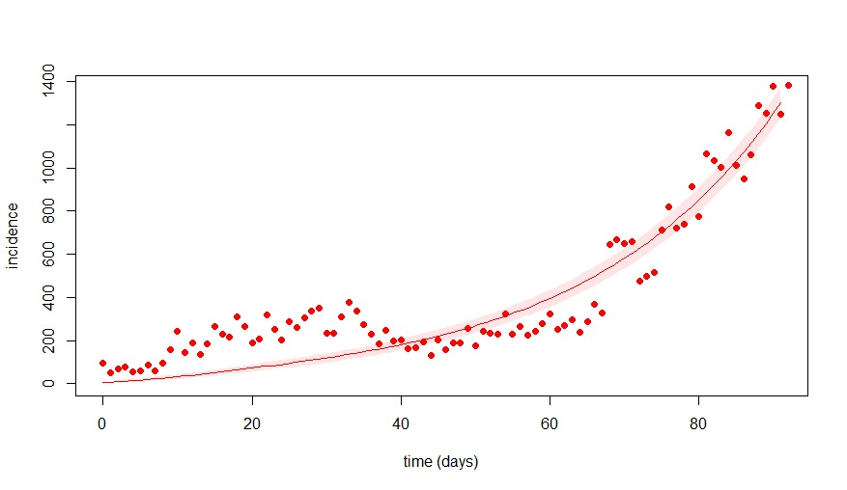
Figure 1: Daily Projection with R-naught = 20
Daily cases projection can be acquired by ∆R in the R compartment of the population.
Our best fit parameters give
γ = 0.01565981 with
β =0.32256388
R0 = 20
(t0)=10/5/2021
Day 30 – MCO 3.0 started
Lack of adherence in SOP leads to rising and multiple clusters (workplaces, prisons, detainees in immigration) (Anjumin, 2021).

Slide 10
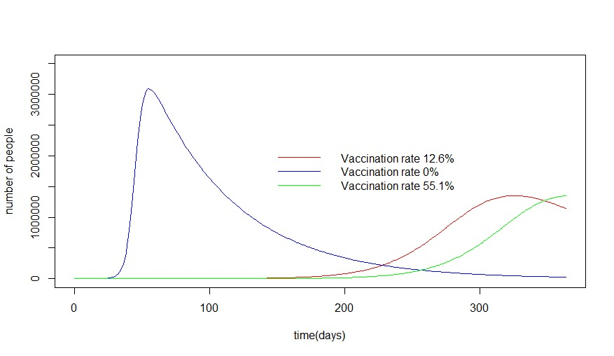
Figure 2: Modified SIR simulation with and without vaccination for Sabah, R0 = 20
By fixing μ =0.83 , different vaccination rate ,α (0,0.126,0.551) to simulate SIRV model in Sabah (t0 =10/5/2021) for next 365 days period.
There is reduction in number of COVID-19 infections with vaccination. Higher vaccination rate has projected in further reduction of COVID-19 infections.

Slide 11
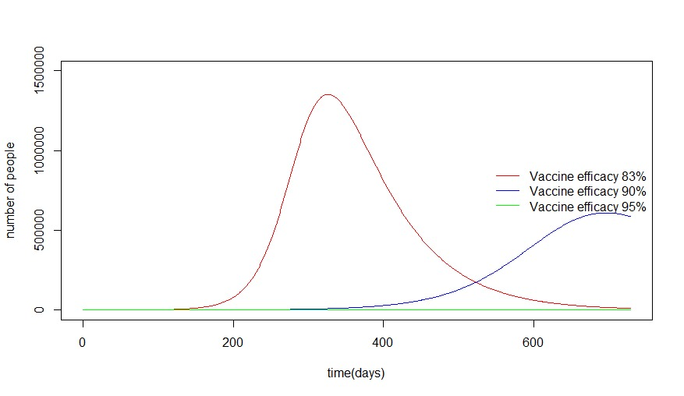
Figure 3: Modified SIR simulation with different vaccine efficacy for Sabah, R0 = 20
Compare between different vaccines μ,with similar rate,α (0.126)
Higher vaccine efficacy rate has projected in lower number of COVID-19 infections. The timeline has been increased up to two years post vaccination.

Slide 12
Discussion
Vaccination rate reduces the transmission of new COVID-19 cases as has been demonstrated in the simulation model. Earlier study has shown that as the vaccination rate increases, the infection rate reduces (Chen, 2021).
Vaccination efficacy help in protecting community immunity longer. This is due to the fact that epidemiological consequence of the vaccine-induced herd immunity effectively controls or eliminates the disease (Iboi, Ngonghala, & Gumel, 2020).

Slide 13
Recommendation and Limitation
Infection rate of COVID-19 can be reduced by increasing the vaccination rate among community.
Strict enforcement of other preventive measure such as physical distancing, face mask, in public area and workplace as well isolation for PUI should be carried out along with the vaccination program as these control measures have synergistic effect in further reducing the transmission of COVID-19.
Limitation
The COVID-19 simulation model is based on notified active cases only. Thus, there maybe underreporting of the disease as there are asymptomatic infected individuals and this signifies the higher burden of diseases in community .

Slide 14
Conclusion
Vaccination plays an important role in controlling transmission of COVID-19 cases.
However other preventive and control measures are equally important and should be implemented simultaneously in order to control COVID-19 outbreak.

Slide 15
References
(MOH, 2021)DOSM. 2021. Malaysia @ a glance: Sabah [Online]. Available: https://www.dosm.gov.my/v1/index.php?r=column/cone&menu_id=dTZ0K2o4YXgrSDRtaEJyVmZ1R2h5dz09 [Accessed 10 August 2021].
JKJAV 2021. Total Cumulative COVID-19 Vaccine Doses Malaysia.
MOH, M. 2021. Open data on COVID-19 in Malaysia. Ministry Of Health Malaysia.
WONGA, W. K., JUWONOA, F. H. & CHUA, T. H. 2021. SIR Simulation of COVID-19 Pandemic in Malaysia:Will the Vaccination Program be Effective? arXiv e-prints.
ALIMORADI, M. 2021. Comparison Of Covid 19 Vaccines [Online]. Available: https://myacare.com/blog/comparison-of-covid-19-vaccines [Accessed 10 August 2021].

Slide 16
References
Anjumin, E. (2021, 1.8.2021). Rise in Covid-19 cases in Sabah due to non-compliance of SOP. New Straits Times. Retrieved from https://www.nst.com.my/news/nation/2021/08/713930/rise-covid-19-cases-sabah-due-non-compliance-sop
Chen, Y. T. (2021). The Effect of Vaccination Rates on the Infection of COVID-19 under the Vaccination Rate below the Herd Immunity Threshold. Int. J. Environ. Res. Public Health, 18.
Iboi, E. A., Ngonghala, C. N., & Gumel, A. B. (2020). Will an imperfect vaccine curtail the COVID-19 pandemic in the U.S.? Infectious Disease Modelling, 5, 510-524.
Inus, K. (2021, 8.8.2021). Covid-19: Sabah‘s daily cases hit all-time high of 1,379 on Sunday (Aug 8). The Star. Retrieved from https://www.thestar.com.my/news/nation/2021/08/08/covid-19-sabahs-daily-cases-hit-all-time-high-of-1379-on-sunday-aug-8

