Slide 1
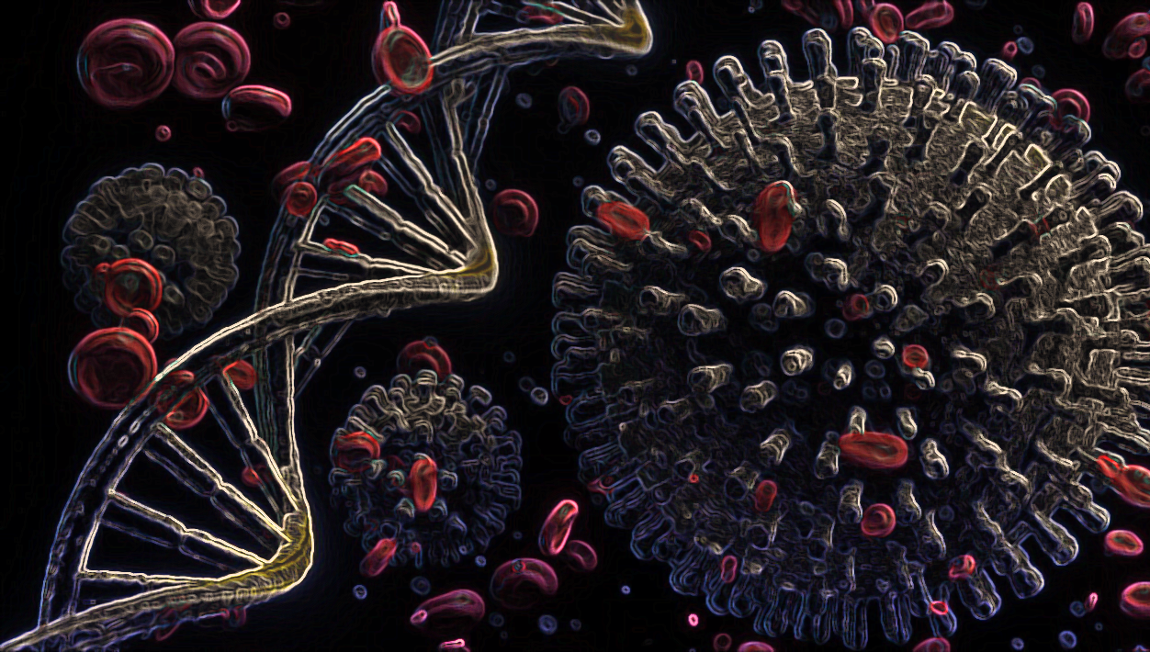

Mathematical analysis of Covid-19 in Kelantan state using SIRD-V model
Prepared by:
Wan Muhd Noor Al Hadi Bin Ab. Razak
Yassimear Anak Ugak
Lalitha Malar A/P Maniam
DrPH Year 1
18th August 2021

Slide 2
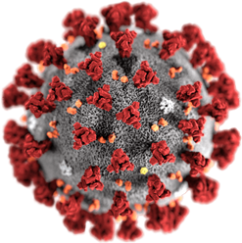
OUTLINE
Introduction
Methodology
Results
Discussion
Conclusion
Reference

Slide 3
INTRODUCTION

Slide 4
Introduction
Coronavirus-SARS-CoV-2 (COVID-19) is an infectious disease which began as a localized outbreak in Wuhan, China in December 2019 and now has become a massive global pandemic that has major socio-economic impact.
Up to date, over 207 million people have become infected with COVID-19 with more than 4.3 million deaths worldwide¹.
To combat the spread of this virus, COVID-19 vaccine was introduced since December 2020 as one of the control strategy ².
Sources:
World Health Organization. WHO Coronavirus Disease (COVID-19) Dashboard (2021).
Ledford, H., Cyranoski, D. & Noorden, R. V. Te UK has approved a COVID vaccine—Here’s what scientists now want to know. Nature 588, 205–206 (2020).

Slide 5
The first mass of vaccination program in Malaysia was started in early February 2021 and still ongoing which target population aged 18 years old and above¹.
Up to 11th Aug 2021 10.4 million of 32.7 million Malaysian population have been fully vaccinated.
The reported efficacy of the vaccines averaged at 60-95%².
Vaccination is an important strategy to create herd immunity, to protect people who are at risk and to prevent serious illness³.
The SIR model is one of the mathematical tools which is widely used to model the disease epidemic trend and forecasting the impact of intervention strategies such as vaccination program⁴.
Sources:
https://www.vaksincovid.gov.my/pdf/National_COVID19_Immunisation_Programme.pdf
Kim, J. H., Marks, F. & Clemens, J. D. Looking beyond covid-19 vaccine phase 3 trials. Nat. Med. (2021).
https://www.who.int/news-room/q-a-detail/coronavirus-disease-(covid-19)-vaccines
Tolles, J., & Luong, T. (2020). Modelling epidemics with compartmental models. JAMA, 173(1), 21–28. https://doi.org/10.7326/M20-1260

Slide 6
Current Covid-19 situation in Malaysia

Slide 7
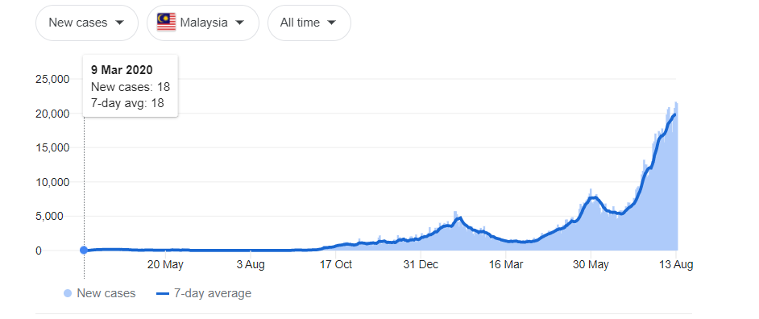
Trend of Covid-19 new cases in Malaysia
Sources: 1. Ministry of Health Malaysia
2. JHU CSSE COVID-19 Data

Slide 8
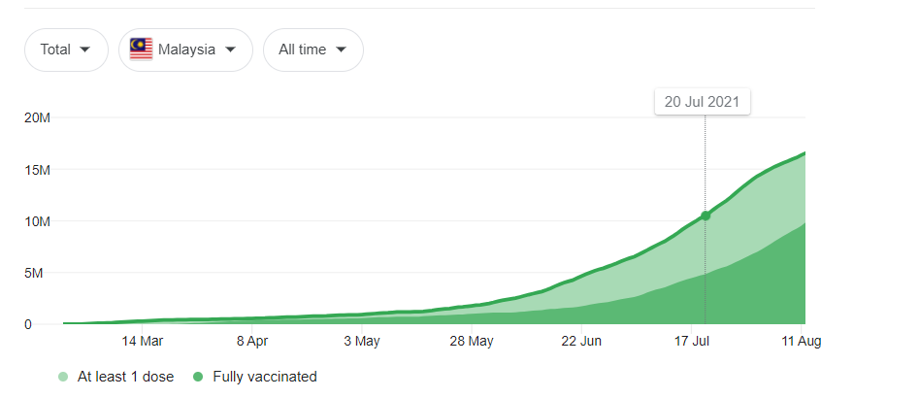
Trend of Covid-19 vaccination in Malaysia
Sources: 1. Ministry of Health Malaysia
2. JHU CSSE COVID-19 Data
Notes:
32.6% has fully vaccinated as of 11th Aug 221

Slide 9
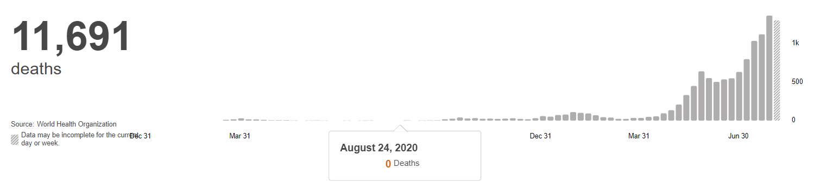
Trend of death (total) due to Covid 19 in Malaysia
Data updated till 9th Aug 21
Sources: 1. Ministry of Health Malaysia
2. World Health Organization
Notes:
Up to 9th Aug 2021

Slide 10
Current Covid-19 situation in Kelantan

Slide 11
Trend of Covid-19 total cases in Kelantan
Source: https://github.com/MoH-Malaysia

Slide 12
Trend of Covid-19 (new cases) in Kelantan
Source: https://github.com/MoH-Malaysia

Slide 13
Trend of Covid-19 deaths in Kelantan
Source: https://github.com/MoH-Malaysia
Up to Aug 21 (0.0012 %)

Slide 14
Trend of Covid-19 vaccination in Kelantan
Source: https://github.com/MoH-Malaysia
Up to Aug 2021( 22%)

Slide 15
Objective
General Objective
To model the Covid-19 epidemic in Kelantan state, Malaysia.
Specific Objectives
To develop a mathematical model using SIRD-V model for Covid-19 cases in Kelantan state.
To compare SIRD-V model of Covid-19 cases in Kelantan between 3 peaks: (i) 1st peak :5th April- 17th May 2021, (ii) 2nd peak: 17th May- 24th June 2021, (iii) 3rd peak: 24th June- 16th August 2021.

Slide 16
METHODOLOGY

Slide 17
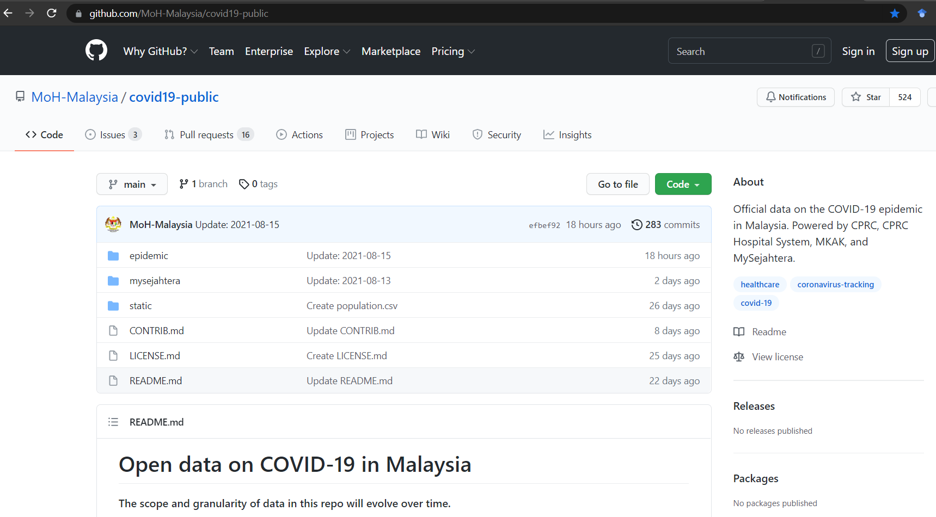
Data sources
Epidemic data for the model analysis of Covid-19 in Kelantan state was obtained from an open source at https://github.com/MoH-Malaysia
Data included into model:
1st peak :(5th April- 17th May 2021)
2nd peak: (17th May- 24th June 2021)
3rd peak: (24th June- 16th August 2021)

Slide 18
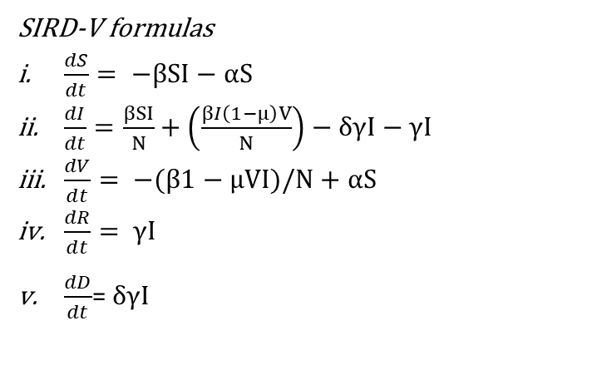




SIRD-V Model structures
Parameters | Description
N | Total population in Kelantan
S | Susceptible population in Kelantan: (N-I-R-V-D)
I | Infectious population in Kelantan
R | Recovered population in Kelantan
V | Vaccinated population in Kelantan
D | Number of death due to Covid-19 in Kelantan
α | Vaccination rate
β | Baseline transmission rate
γ | Recovery rate
μ | Vaccine effectiveness
δ | Case fatality rate
1-μ | Vaccine ineffectiveness
D
$$δ$$
S
$$β$$
I
$$γ$$
R
α
$$β (1−ϻ)$$
SIRD-V formulas
$\frac{dS}{dt}= −βSI−αS$
$\frac{dI}{dt}=\frac{βSI}{N}+\left(\frac{βI\left(1−μ\right)V}{N}\right)−δγI−γI$
$\frac{dV}{dt}= −(β1−μVI)/N+αS$
$\frac{dR}{dt}= γI$
$\frac{dD}{dt}$= $δγI$
V
Notes:
S0 = N – I0 – R0 – V0
I0 = infected (infectious) at time = t
R0 = recovered (removed) at time = t
Vs = V(1-μ)

Slide 19
Model Assumptions
1.
2.
3.
4.
5.
6.
7.
8.
9.
The population is assumed to have homogenous mixing behavior where all susceptible individuals have identical rate of disease-causing contacts.
No one is added to the susceptible group, we ignored births and immigration. The only way an individual leaves the susceptible group is by becoming infected and vaccinated.
We assume that the time-rate of change the number of susceptible (St), depends on the number already susceptible, the number of individuals already infected, transmission rate the disease (β), and vaccination rate (α).
The transmission rate among vaccinated individuals is assumed to follow an exponential function (β(1-μ)) considering the fact that fewer individuals are infected after the vaccination.
We assumed the vaccine effectiveness, (μ) is at 95%.
We assume that the time-rate of change of V(t), the number of vaccinated, depends on the number already susceptible (S), the number of individuals already vaccinated (V), the number of individuals already infected (I) and the vaccination rate (α).
We also assume that a fixed fraction, (γ ) of the infected group will recover during any given day.
Dead (D) and recovered (R) individual is removed from the system and has no ability to infect others or be re-infected.
We also assume that a fixed fraction, (δ) of the infected group will die due to Covid-19 during any given day.

Slide 20
Model Parameters
Parameters | Description | Value(s) |  |  | Source
 |  | 1st peak (5th April- 17th May 2021) | 2nd peak (17th May- 24th June 2021) | 3rd peak (24th June- 16th August 2021)
α | Vaccination rate | 0.20 | 0.20 | 0.20 | https://github.com/MoH-Malaysia
β | Baseline transmission rate | 0.85 | 0.99 | 0.19 | MLE
γ | Recovery rate | 0.75 | 0.90 | 0.16 | MLE
μ | Vaccine effectiveness | 0.95 | 0.95 | 0.95 | Kim, J. H., Marks, F. & Clemens, J. D. Looking beyond covid-19 vaccine phase 3 trials. Nat. Med. (2021).
δ | Case fatality rate | 0.006 | 0.006 | 0.006 | https://github.com/MoH-Malaysia
N | Total population in Kelantan | 1 906 700 | 1 906 700 | 1 906 700 | https://github.com/MoH-Malaysia
S | Susceptible population in Kelantan (N-1-R-V) | 1 902 161 | 1 860 683 | 1 771 685 | https://github.com/MoH-Malaysia
I | Infectious population in Kelantan | 31 | 343 | 98 | https://github.com/MoH-Malaysia
R | Recovered population in Kelantan | 4 045 | 11 514 | 21 960 | https://github.com/MoH-Malaysia
V | Vaccinated population in Kelantan | 16 199 | 34 420 | 112 848 | https://github.com/MoH-Malaysia
D | Number of death due to Covid-19 in Kelantan | 18 | 83 | 207 | https://github.com/MoH-Malaysia

Slide 21
RESULTS

Slide 22
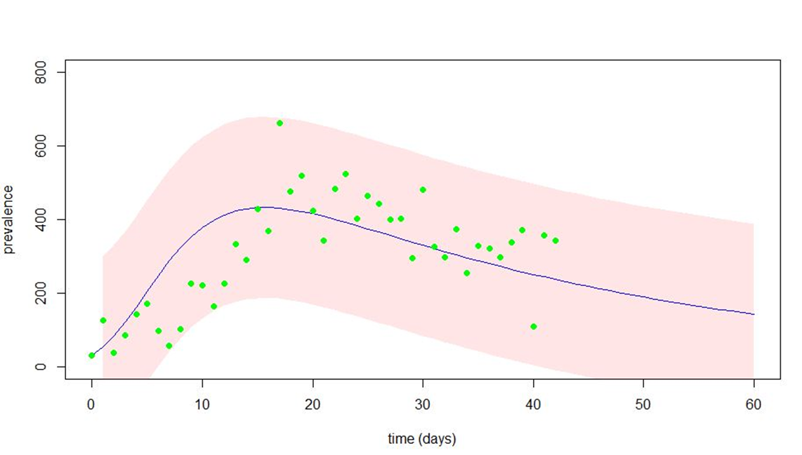
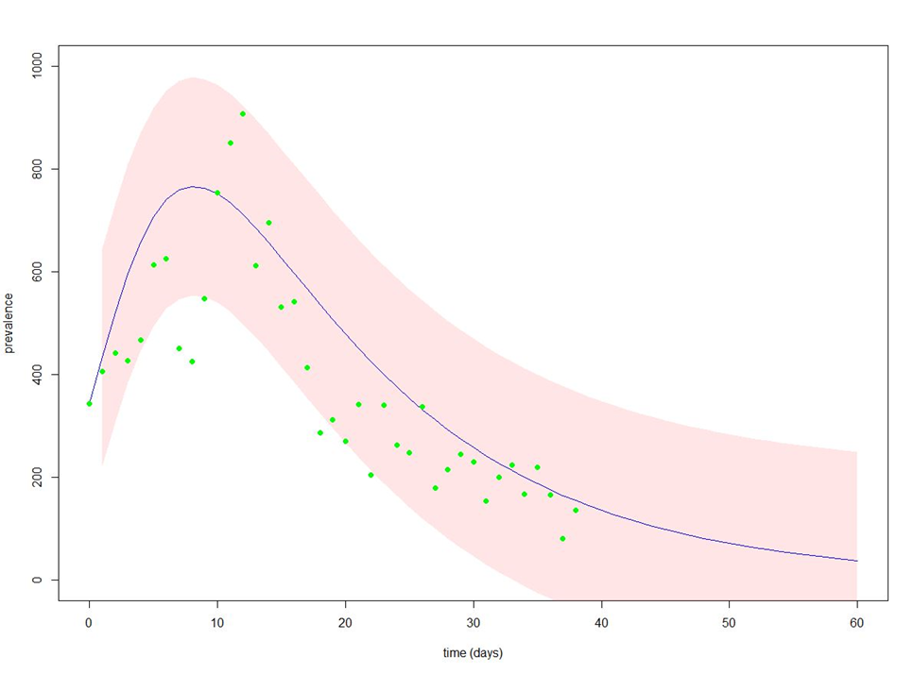
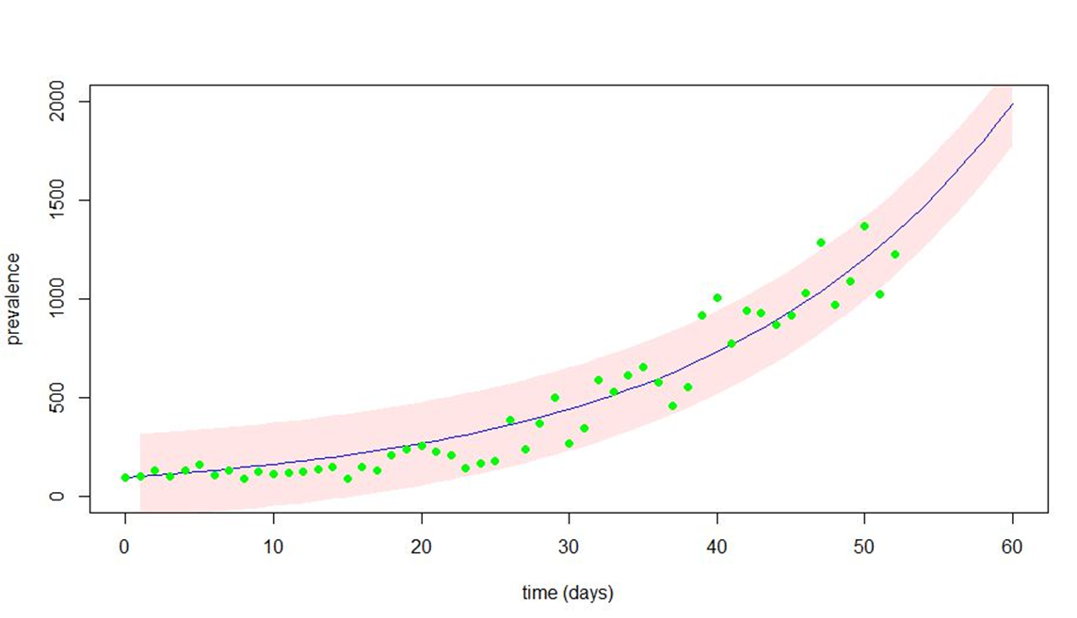
Results
Figure 1: Model analysis for 1st peak (5th April- 17th May 2021)
Figure 2: Model analysis for 2nd peak (17th May-24th June 2021)
β:0.71,
γ: 0.06,
Ro:11.75
β:0.35,
γ:0.07
Ro:4.71
Figure 3: Model analysis for 3rd peak (24th June-16th August 2021)
Vaccination policy=1/Ro *S
1st peak: 161 683, 8.5%
2nd peak: 390 743, 21%
3rd peak: 230 319, 13%
β:0.64
γ:0.08
Ro:7.72
Notes:
This is our model analysis outcome.
Figure 1 shows model analysis for 1st peak (5th April- 17th May 2021).
Our model shows declining trend of covid-19 cases with β:0.71,γ: 0.06, Ro:11.75
Figure 2 shows model analysis for 2nd peak (17th May-24th June 2021).
Our model shows declining trend of covid-19 cases with β:0.35, γ:0.07,Ro:4.71
Figure 3 shows model analysis for 3rd peak (24th June-16th August 2021).
Our model shows increasing trend of covid-19 cases with β:0.64 , γ:0.08, Ro:7.72, and predict that cases will still be increasing for the next 10 days.
Based on the R naught in the model output, we calculated the proportion of susceptible population should be vaccinated in order to effectively reduced number of cases
with formula of 1/Ro x number of susceptible:
1st peak: 161 683, 8.5%
2nd peak: 390 743, 21%
3rd peak: 230 319, 13%

Slide 23
Results..cont
From the observation of actual Covid-19 cases data in Kelantan, it shows three peaks in 2021 indicating a surge in no of cases.
1st peak (5th April- 17th May 2021): cluster outbreak from schools and workplace¹
2nd peak (17th May- 24th June 2021): post Aidilfitri festival²
3rd peak (24th June- 16th August 2021): post Idul Adha festival³
Our SIRD-V modeling is able to fit and predict the COVID-19 case in Kelantan state for the selected time frame.
Based on our model, it was estimated that the number of new cases should been reduced after the 1st peak and 2nd peak if we are able to vaccinate at least 8.5% and 21% of susceptible population, respectively.
However, breakthrough point in the actual data is seen as reflected by re-occurrence of massive surge of cases in 2nd and 3rd peaks, which might be contributed by the festive seasons.
As for the 3rd peak, our model predict that the number of cases will continue to increase in the next ten days from 17th August to 26th August 2021, in which the number of new cases is almost reaching 2000.
Sources:
https://www.thestar.com.my/news/nation/2021/04/20/cases-surge-in-Kelantan
https://www.nst.com.my/news/nation/2021/05/692045/surge-cases-and-new-clusters-melaka-kelantan-due-raya-visits
https://www.hmetro.com.my/mutakhir/2021/07/734620/kluster-aidiladha-punca-kes-meningkat-di-kelantan

Slide 24
DISCUSSION

Slide 25
Discussion
Ro value from our model ranges from 4.71 to 11.75, which is higher than the national threshold (1.05) ¹.
Possible reasons includes:
The exposed and infected people are isolated and quarantine which decrease the possibility to transmit the disease to other susceptible population.
Our model did not incorporate the effect of other measures such as compliance to social and physical distancing, hand washing, wearing face mask, quarantine, isolation, social and mass gathering and travelling ban which also affect the outcomes in number of cases.
High Ro value from our model output also reflect that, at the moment, vaccination alone is not adequate to reduce number of cases. Therefore, it need to be combined with other intervention strategies.
Changes in mixing behaviors of susceptible population, such as mixing in crowded area, close conversation, closed space may also affect the transmissibility of Covid-19.
New delta variant of Covid-19 is 2 times more contagious² with the ongoing national vaccination program which have not reach the optimal herd immunity threshold yet may also contributes to surging number of cases.
https://covid-19.moh.gov.my/kajian-dan-penyelidikan/nilai-r-malaysia/0821/r-naught-malaysia-hari-ini-16082021
https://www.cdc.gov/coronavirus/2019-ncov/variants/delta-variant.html

Slide 26
Recommendations
To improve the SIRD-V model, we can include other parameters which can also influence the outcome of the model such as social distancing, hand washing, wearing face mask, quarantine, isolation, social and mass gathering and travelling.
To tackle the current situation surging number of Covid-19 cases, we suggest to increase the vaccination rate in order to decrease number of susceptible population because at current vaccination rate (20%) we predict that the case will still continue to rise.
We suggest to prolong the model prediction timeframe, if we want to estimate when is the number of cases will decrease for the 3rd peak.

Slide 27
CONCLUSION

Slide 28
Conclusion
Despite the limitations in the estimation of transmission parameters, our SIRD-V model is able to fit the actual data and predict the trend of Covid 19 cases in Kelantan.
There is differences observed between SIRD-V model of 1st peak, 2nd peak, and 3rd peak in term of the R naught values.
SIRD-V model can be a useful tool for modeling the Covid-19 epidemic and assessing the impact of diverse disease control strategies such as vaccination program that will help to guide informed policy decisions for decision makers and the general public.

Slide 29
Reference
A model and predictions for COVID‑19 considering population behavior and vaccination Thomas Usherwood, Zachary LaJoie & Vikas Srivastava www.nature.com/srep/
Commissioner, O. o. t. COVID-19 Vaccines. FDA (2021).
Kim, J. H., Marks, F. & Clemens, J. D. Looking beyond covid-19 vaccine phase 3 trials. Nat. Med. (2021).
Ledford, H., Cyranoski, D. & Noorden, R. V. Te UK has approved a COVID vaccine—Here’s what scientists now want to know. Nature 588, 205–206 (2020).
https://www.cdc.gov/coronavirus/2019-ncov/variants/delta-variant.html
https://covid-19.moh.gov.my/kajian-dan-penyelidikan/nilai-r-malaysia/0821/r-naught-malaysia-hari-ini-16082021
https://github.com/MoH-Malaysia/covid19-public
https://www.vaksincovid.gov.my/pdf/National_COVID19_Immunisation_Programme.pdf
https://www.who.int/health-topics/coronavirus#tab=tab_1
https://www.who.int/news-room/q-a-detail/coronavirus-disease-(covid-19)-vaccines
https://www.thestar.com.my/news/nation/2021/04/20/cases-surge-in-Kelantan
https://www.nst.com.my/news/nation/2021/05/692045/surge-cases-and-new-clusters-melaka-kelantan-due-raya-visits
https://www.hmetro.com.my/mutakhir/2021/07/734620/kluster-aidiladha-punca-kes-meningkat-di-kelantan
Tolles, J., & Luong, T. (2020). Modelling epidemics with compartmental models. JAMA, 173(1), 21–28. https://doi.org/10.7326/M20-1260
World Health Organization. WHO Coronavirus Disease (COVID-19) Dashboard (2021).

Slide 30


