Slide 1

A Model That Predicts The Effect Of Vaccination On Controlling COVID‑19 In Johor
Prepared by;
Dr Mardhiyyah Azmi (20040005)
Dr Teoh Wan Jool (20040003)
Dr Muhammad Najib Hasan (20040010)

Slide 2
Contents
Introduction
Objectives
Data source
Data analysis
Model formulation
Model simulation
Results & Discussion
Conclusion

Slide 3
INTRODUCTION
In December 2019, a novel strand of Coronavirus (SARS-CoV-2) was identified in Wuhan, Hubei Province, China causing a severe and potentially fatal respiratory syndrome, COVID-19.
Since then, it has become a pandemic declared by World Health Organization (WHO) on March 11, 2020 which has spread around the globe and become public health threat.
Malaysia is one of the country that have been severely effected by the disease, and Johor was one of the state that contribute to the highest cases in Malaysia.
Health Organization, Coronavirus disease (COVID-19) outbreak, https://www.who.int/emergencies/ diseases/novel-coronavirus-2019.
https://covid-19.moh.gov.my/terkini-negeri

Slide 4
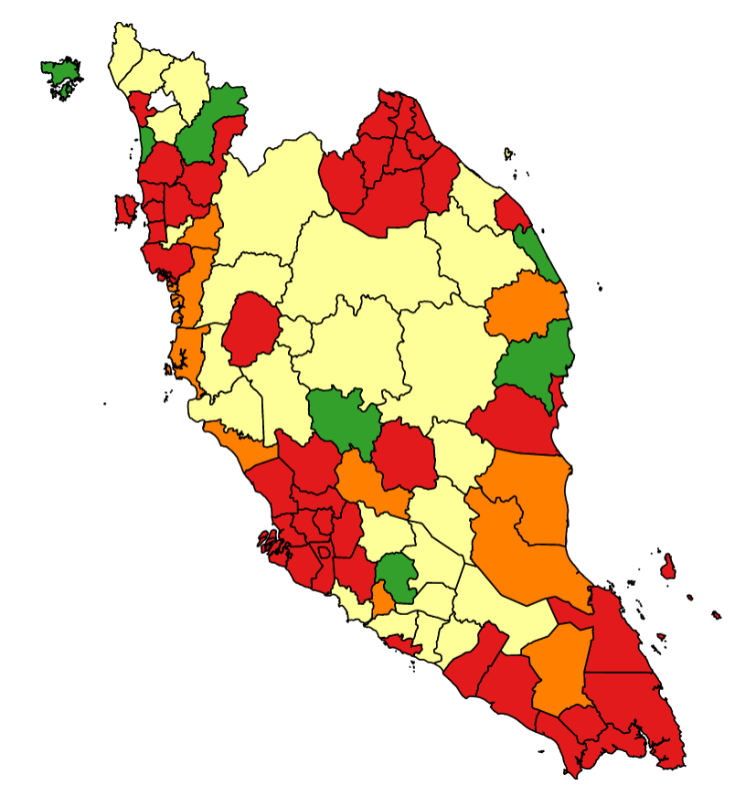
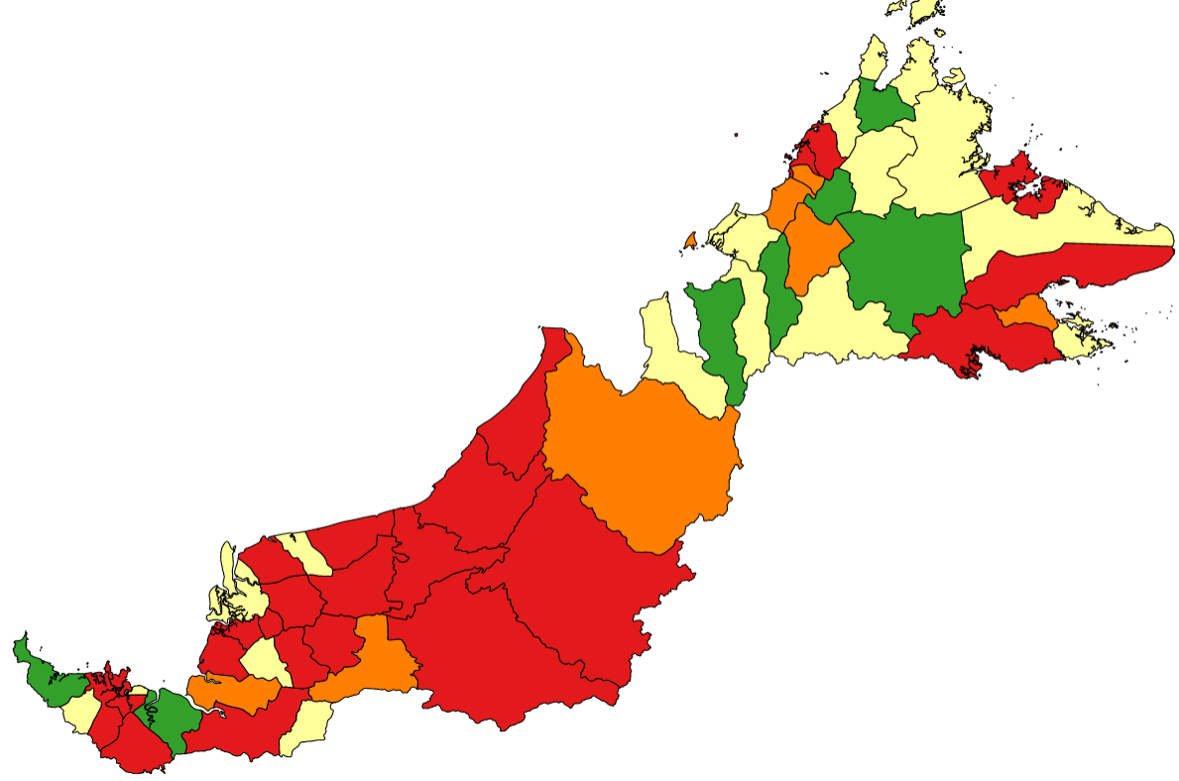
COVID-19 Cases in last 2 weeks

Slide 5
INTRODUCTION
In this context, mathematical models are required to estimate disease transmission, recovery, deaths and other significant parameters separately for various countries, that is for different, specific regions of high to low reported cases of COVID-19.
Different countries have already taken precise and differentiated measures to control the spread of the disease and one of the control measure was vaccination program.
It is imperative that mathematical models are developed to provide insights and make predictions about the pandemic, when the vaccination program implemented.[1]
Modelling approaches are helpful to understand and predict the possibility and severity of the disease outbreak and, provide key information to determine the intensity of COVID-19 intervention.[2]
1.Scarpino, S. V., & Petri, G. (2019). On the predictability of infectious disease outbreaks. Nature communications, 10(1), 1-8.
2.Yang, Z., Zeng, Z., Wang, K., Wong, S. S., Liang, W., Zanin, M., ... & Liang, J. (2020). Modified SEIR and AIprediction of the epidemics trend of COVID-19 in China under public health interventions. Journal of Thoracic 345 Disease, 12(3), 165.

Slide 6
OBJECTIVES
To propose the mathematical model and a framework that incorporates the vaccination coverage into the classic models involving compartments for susceptible, infectious, and recovered individuals (SIR model) for the available COVID-19 case data in the state of Johor, Malaysia.
To enable the prediction of future trends for pandemics with the advent of vaccine distribution based on the proposed model.

Slide 7
DATA SOURCE
The Malaysian case data for COVID-19 in Johor from 12th April 2021 to 8th August 2021, which were used in the estimation of parameters, incorporated total population, infected cases, recovered cases, and vaccinated cases.
The case data which were used in this simulation were sourced from the official GitHub account of Malaysia's Ministry of Health.
https://github.com/MoH-Malaysia/covid19-public/tree/main/epidemic
https://github.com/CITF-Malaysia/citf-public/blob/main/vaccination/vax_state.csv

Slide 8
DATA ANALYSIS
As of 8th August 2021, Johor has recorded a total of 100,452 COVID-19 cases.(MOH)
Vaccination program started on February 24, 2021.
There were 2 waves of COVID-19 transmission after the vaccination program was started in Johor;
First wave after vaccination program: mid-April until end of June 2021
Second waves after vaccination program: started around early July 2021

Slide 10
MODEL FORMULATION
We incorporated the effect of vaccination program into the classic susceptible-infected-recovered (SIR) model.
The model was formulated based on several important assumptions.
S
I
R

Slide 11
Assumptions
All Johor population is homogenous and has equal measure in likelihood to contract and transmit the virus.
We assume that the international border is closed and not contribute to the current infection.
No one is added to the susceptible group, since we are ignoring births, death and immigration. The only way an individual leaves the susceptible group is by becoming infected.
The infected person only infected once and no re-infection can occur.
Recovered individual is removed from the system and has no ability to infect others or be infected.

Slide 12
Assumptions (Cont.)
Apart from the basic compartments of SIR model, we added a vaccinated compartment into the model.
The changes in the number of infected individuals depend on the number of susceptible, already infected, transmission rate, recovery rate and vaccine effectiveness.
The vaccination rate used were calculated based on the vaccination data from Johor.
The vaccine effectiveness (µ) was constant and based on the effectiveness of Pfizer-BioNTech COVID-19 vaccine.

Slide 13
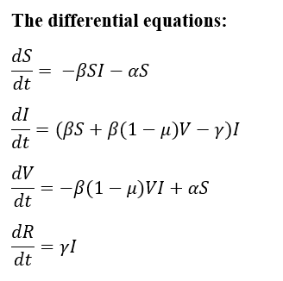
SIR-V Model
S = S(t), the number of susceptible individuals
I = I(t), the number of infected individuals
R = R(t), the number of recovered (removed) individuals
V= V(t), the number of vaccinated individuals
S(t) = N – I(t) – R(t) – V(t)

Slide 14
Table 1 Parameters setting up the model
Parameters | Indicators | Time frame, t
 |  | 12 Apr – 10 Jun 2021 | 7 Jul – 8 Aug 2021
Initial total number of individuals | N | 3719095 | 3669238
Initial number of susceptible individuals | S | N – I – R – V | N – I – R – V
Initial number of infected individuals | I | 61 | 224
Initial number of recovered individuals | R | 108 | 202
Initial number of vaccinated individuals (cumulative) | V | 27,830 | 315,091
Transmission rate (% per day) | β | Calibrated using data
Recovery rate (% per day) | γ | Calibrated using data
Vaccination rate * (% per day) | α | 0.09
Vaccine effectiveness, % (Pfizer) | μ | 95%
* Total vaccinated / total population / number of days*100 (Based on cumulative 2nd dose until 8/8/2021)
Notes:
N (total population) = 3,781,000

Slide 15
MODEL SIMULATION
The SIR-V model was simulated using the R software with the deSolve package.
Two methods were used to calibrate the model, i.e. sum of square and maximum likelihood estimation method.
The parameters for calibration were disease transmission rate, β and recovery rate for the infected person, γ.
Two periods were used for the model simulation;
First wave after vaccination program (12 Apr – 10 Jun 2021),
Second waves after vaccination program (7 Jul – 8 Aug 2021)

Slide 16
RESULT & DISCUSSION

Slide 17
Table 2 Estimation of model parameters utilizing dataset from website (after calibration)
Time frame | Method of estimation
 | Sum of Squares |  |  | Maximum Likelihood Estimation
 | Transmission rate, β (% per day) | Recovery rate, γ (% per day) | RMSE | Transmission rate, β (% per day) | Recovery rate, γ (% per day) | RMSE
12 Apr – 10 Jun 2021 | 4.23 x 10⁻⁶ | 0.20 | 0.607 | 4.42 x 10⁻⁶ | 6.67 x 10⁻³ | 1.632
7 Jul – 8 Aug 2021 | 4.68 x 10⁻⁶ | 0.27 | 3.780 | 5.33 x 10⁻⁶ | 1.24 | 4.482
Note: RMSE = Root Mean Square Error

Slide 18
Comments
Using the sum of squares estimation, the transmission rate (β = 4.68 x 10-6 % per day) was slightly higher during the second wave (7 Jul – 8 Aug 2021) compared to the first wave (12 Apr – 10 Jun 2021). Otherwise, the recovery rates were almost the same.
Based on the MLE, the transmission rate was higher during the second wave (β = 5.33 x 10-6 % per day) compared to the first wave after vaccination program. However, the recovery rate was higher during the second wave (γ = 1.24 % per day)
The root mean square error (RMSE) was used as another metric to analyze cases, and the results in Table 2 show that the best RMSE value belongs to the first wave (period).

Slide 19
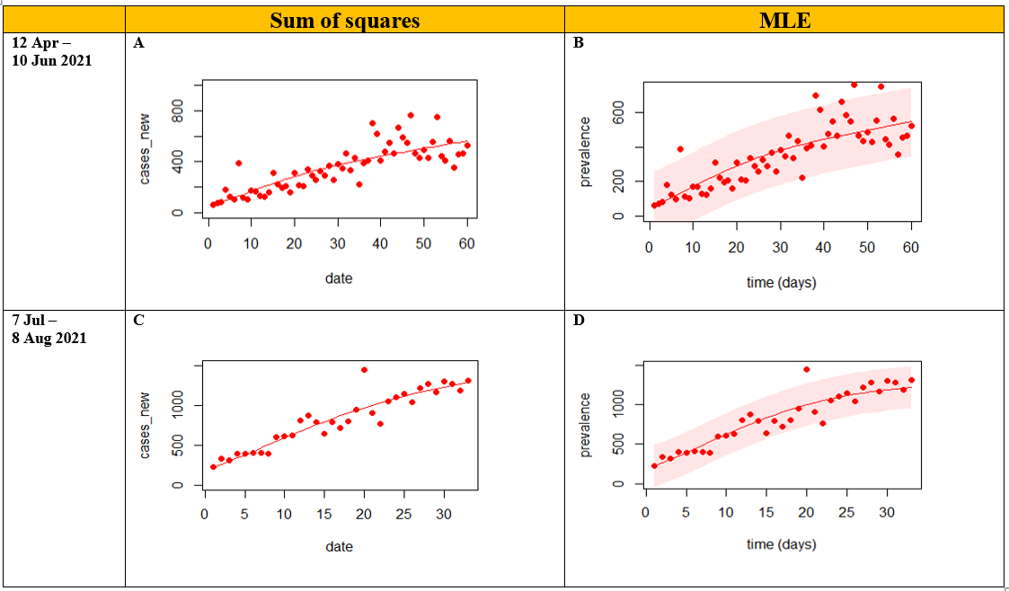
Figure 1 Comparison of daily new cases in Johor between the actual data and model predictions (model fitting)

Slide 20
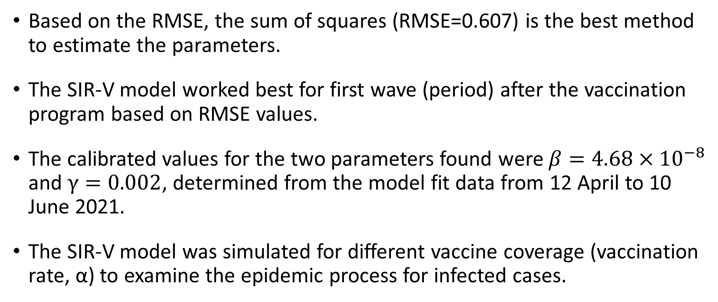
Based on the RMSE, the sum of squares (RMSE=0.607) is the best method to estimate the parameters.
The SIR-V model worked best for first wave (period) after the vaccination program based on RMSE values.
The calibrated values for the two parameters found were ${β=4.68×10}^{−8}$ and $γ=0.002$, determined from the model fit data from 12 April to 10 June 2021.
The SIR-V model was simulated for different vaccine coverage (vaccination rate, α) to examine the epidemic process for infected cases.

Slide 21
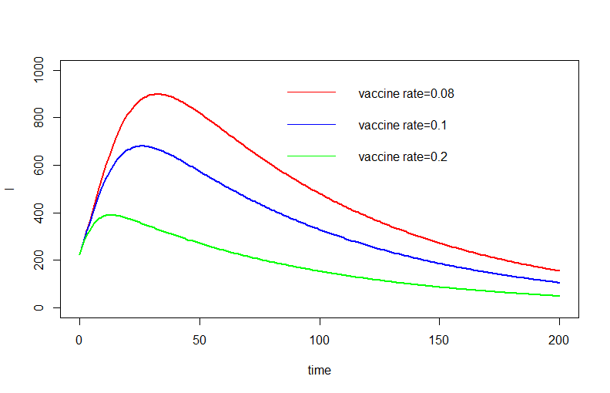
Figure 2 Simulation, the forecast of the epidemic process.
The results show that by increasing the vaccine coverage (α), the epidemic peak for infected cases decreases.
The number of infected cases at the epidemic peak is approximately 890 and it has reduced to 390 by the increasing vaccination rate from 0.08 to 0.2.
N = 3,781,000.

Slide 22
CONCLUSION
We have augmented the classic SIR model with the ability to accommodate surges in the number of vaccinated individuals.
Thus, our SIR-V model provides a theoretical framework to predict the spread of the COVID-19 virus within communities after introduction of vaccination program in Johor.
In this context, it can be applied to the communities or other states in Malaysia, given reliable data are available.

Slide 23
References
Ministry of Health, Makaysia [MOH] (2021). Covid-19-public; epidemic. https://github.com/MoH-Malaysia/covid19-public/tree/main/epidemic
Ministry of Health, Makaysia [MOH] (2021). Citf-public;vaccination; vax_state.csv. https://github.com/CITF-Malaysia/citf-public/blob/main/vaccination/vax_state.csv
Health Organization, Coronavirus disease (COVID-19) outbreak, https://www.who.int/emergencies/ diseases/novel-coronavirus-2019.
https://covid-19.moh.gov.my/terkini-negeri
Scarpino, S. V., & Petri, G. (2019). On the predictability of infectious disease outbreaks. Nature communications, 10(1), 1-8.
Yang, Z., Zeng, Z., Wang, K., Wong, S. S., Liang, W., Zanin, M., ... & Liang, J. (2020). Modified SEIR and AI prediction of the epidemics trend of COVID-19 in China under public health interventions. Journal of Thoracic 345 Disease, 12(3), 165.

Slide 24


Slide 25
Infection rate,
= cumulative number of infection (12 Apr – 30 Jun 2021) / 80 (days) /population at risk x 100
= 28517 / 80 / 3719095 *100
= 0.009584657 (per 100 people per day)
Recovery rate (based on cumulative case until 12 Apr 2021),
= cumulative recovered /total confirmed cases / 443 (days) x 100
= (7362+12236) / 42307 /443 *100
= 0.1045673 (per 100 people per day)

Slide 26
Vaccination rate (based on cumulative 2nd dose until 8/8/2021)
= total vaccinated / total adult / number of days*100,
= 557392 / 2711900 / 166 *100
= 0.1238166 (per 100 people per day)
(Based on cumulative dose)
= 1956062/ 2711900 / 166 *100
= 0.4345111

