Slide 1
Models Probability models Time series models Mechanistic / compartmental models
Notes:
Abstract is included as part of the requirement of presentation by module coordinator. I wont go through in details as they will be discussed in details in each chapters later.

Slide 2
FORECASTING DAILY CONFIRMED COVID-19 CASES IN MALAYSIA USING ARIMA MODEL WITH EXTERNAL REGRESSOR
Group 6
NELSON LEAN
SUNITA SARA GILL BINTI SHAMSUL
SITI RASIDAH BT ABD GHANI
Notes:
This is my title.
My supervisor is prof azizan and co supervisor is prof Richard.

Slide 3
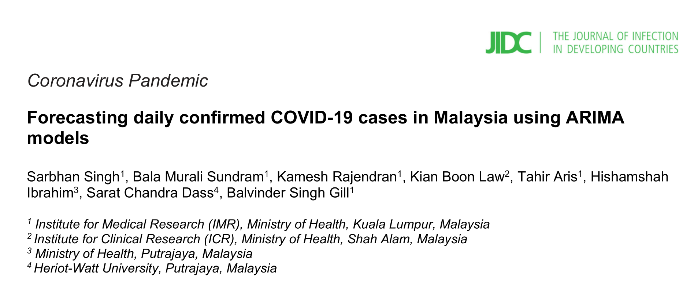
Notes:
Abstract is included as part of the requirement of presentation by module coordinator. I wont go through in details as they will be discussed in details in each chapters later.

Slide 4

Data collection
Daily confirmed cases of COVID-19 data and daily COVID-19 test data collected from https://github.com/MoH-Malaysia/covid19-public
Historical COVID-19 data from 25th January 2020 – 13th August 2021
Training data: 25th January 2020 – 14th July 2021 (537 data points)
Test data: 15th July 2021 – 13th August 2021(30 data points)
COVID-19 swab tests data (PCR / PCR + RTK Ag) as external regressors (xreg)

Slide 5
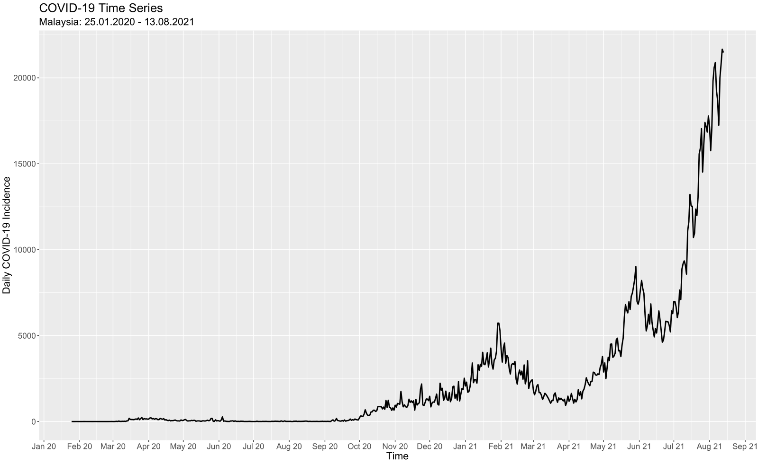
Figure 1: COVID-19 time series (25.01.20 – 13.08.21)

Slide 6
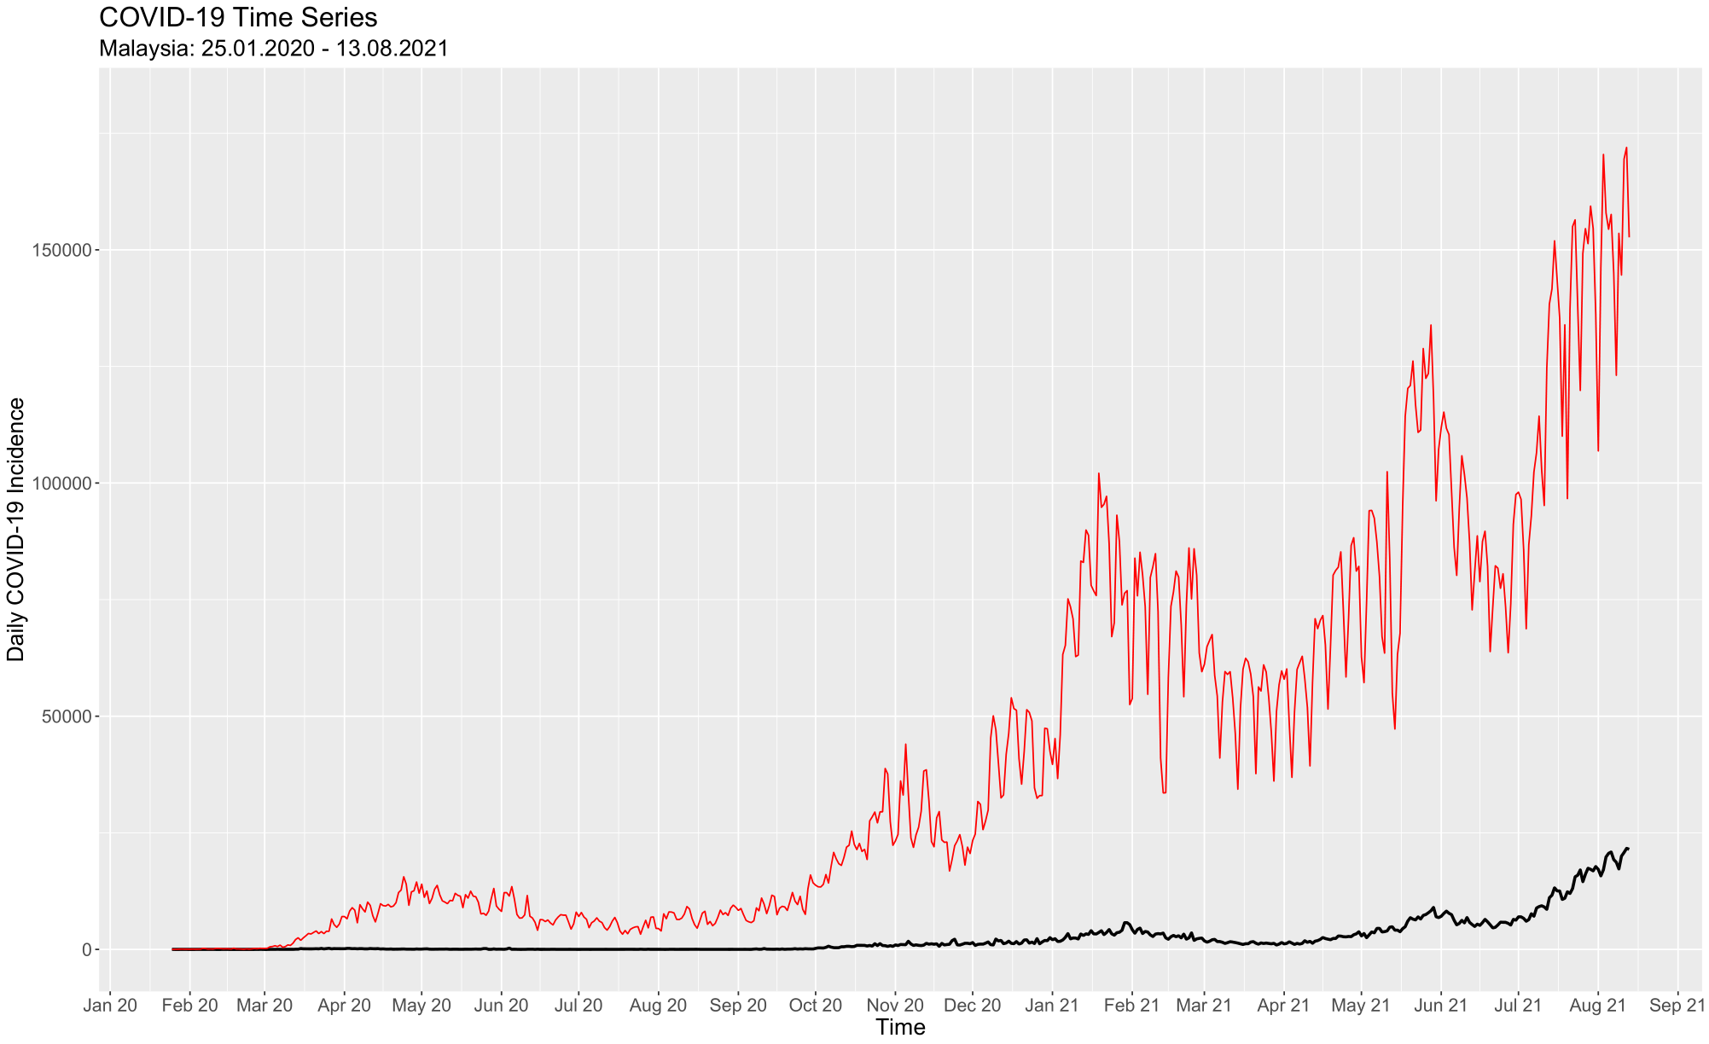
Figure 2: COVID-19 against total COVID-19 daily tests (25.01.20 – 13.08.21)

Slide 7
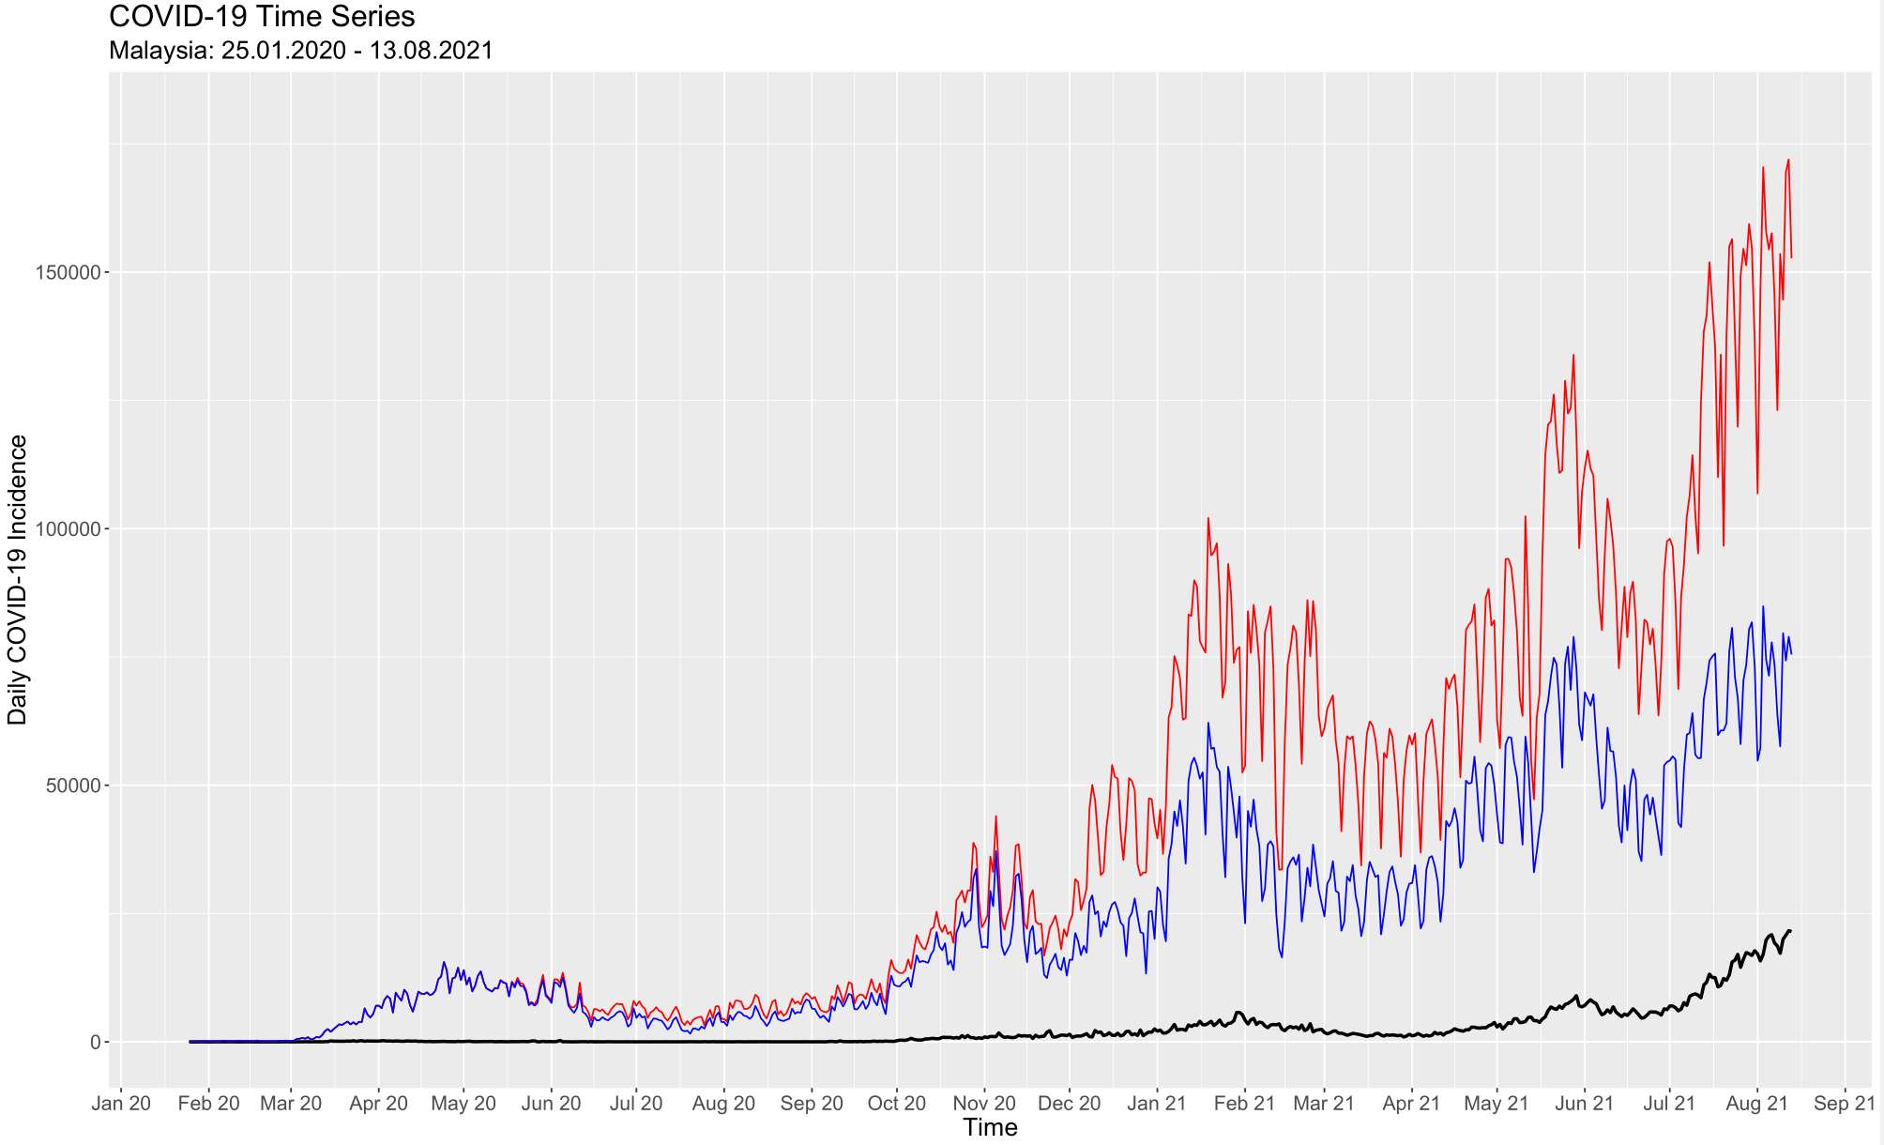
Figure 3: COVID-19 against total COVID-19 daily tests and PCR tests (25.01.20 – 13.08.21)

Slide 8
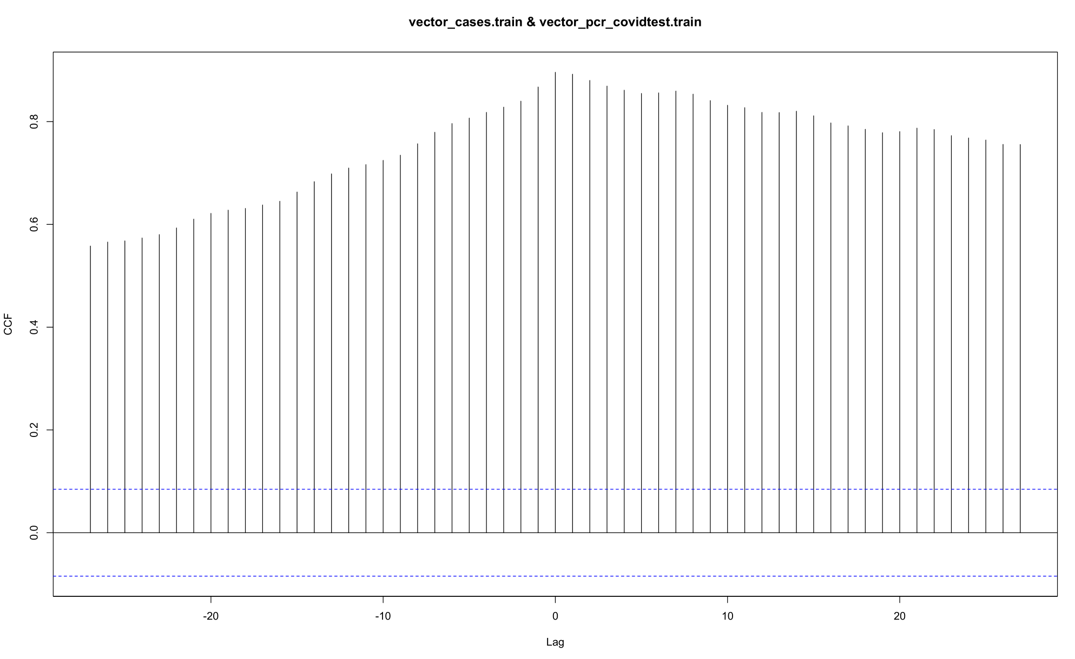
rlag0 = 0.896
Figure 4: Cross-correlation function between COVID-19 daily incidence and daily COVID-19 PCR tests

Slide 9
Table 1: COVID-19 time series stationarity test
Kwiatkowski-Phillips-Schmidt-Shin (KPSS) | KPSS level | Truncation lag parameter | p-value | Stationarity
 | 5.3209 | 6 | <0.01 | non-stationary
Augmented Dickey–Fuller (ADF) t-statistic test for unit root | Dickey-fuller | Lag order | p-value | Stationarity
 | -0.011906 | 8 | > 0.1 | Non-Stationary

Slide 10
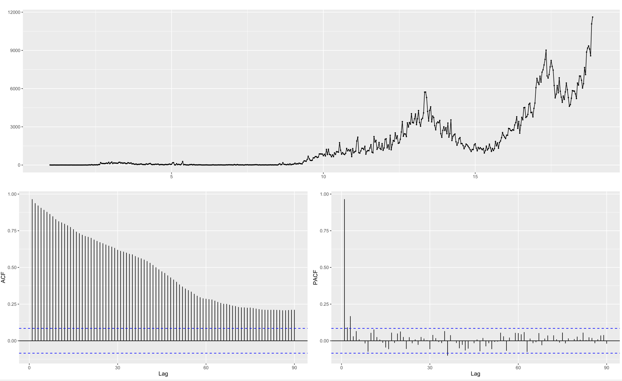
Figure 5: ACF and PACF of COVID-19 time series

Slide 11
Table 2: COVID-19 time series stationarity test (differenced time series)
Kwiatkowski-Phillips-Schmidt-Shin (KPSS) | KPSS level | Truncation lag parameter | p-value | Stationarity
 | 0.58488 | 6 | < 0.05 | non-stationary
 | 0.01319 | 6 | > 0.1 * | stationary
Augmented Dickey–Fuller (ADF) t-statistic test for unit root | Dickey-fuller | Lag order | p-value | Stationarity
 | -3.8303 | 8 | < 0.05 | stationary
* Order of differencing = 2

Slide 12
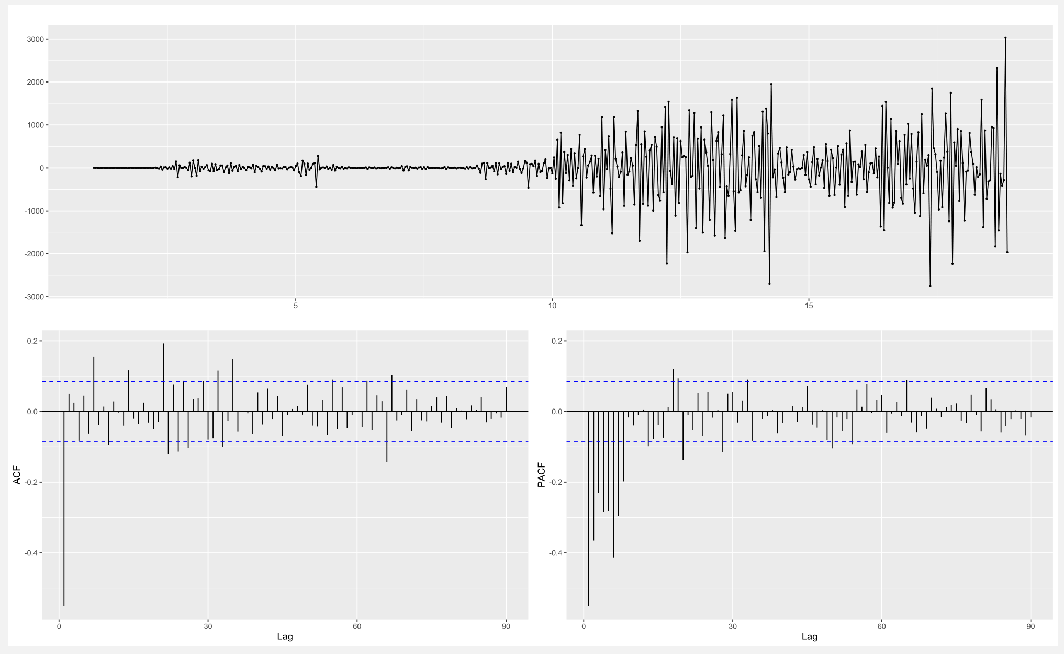
Figure 6: ACF and PACF of COVID-19 time series (differenced)

Slide 13
MODEL SELECTION
Table 3: ARIMA models
Models | AIC
ARIMA (6,2,1) with xreg (PCR), λ = 0.317 | 2341.76
ARIMA (6,2,1) with xreg (PCR + RTK Ag), λ = 0.317 | 2348.72
ARIMA (6,2,1) , λ = 0.317 | 2354.28
ARIMA (5,2,1) , λ = 0.317 | 2360.25

Slide 14
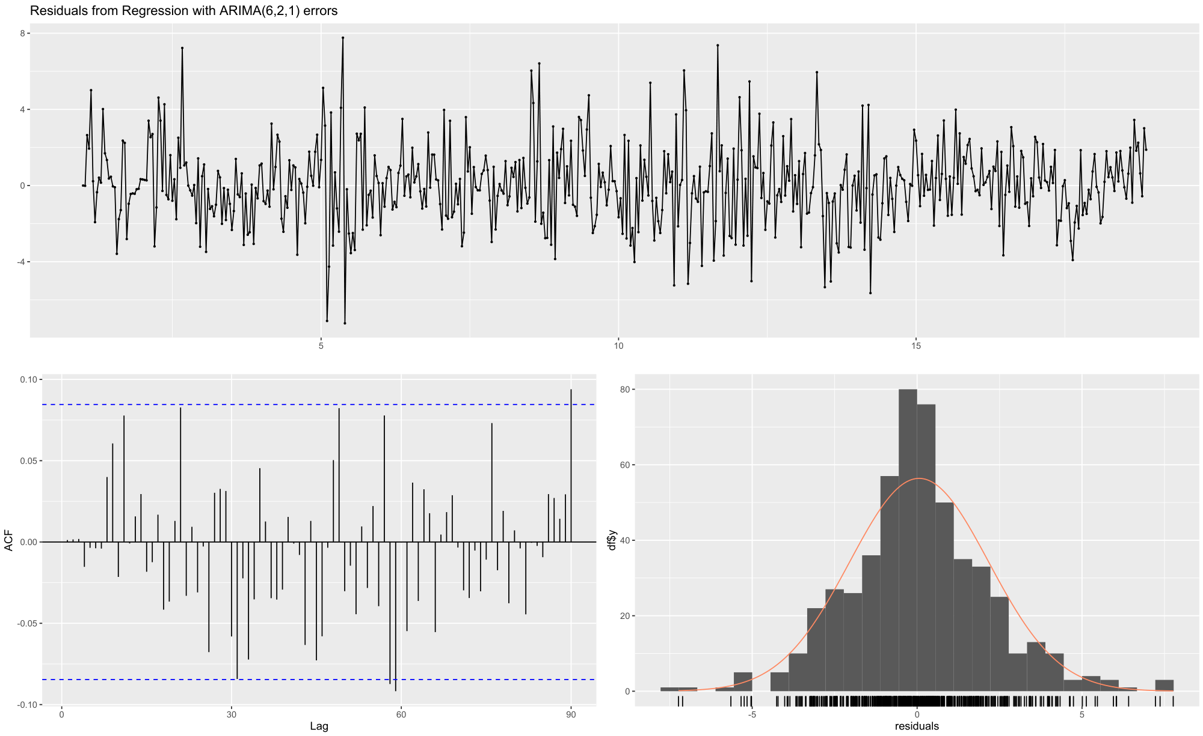
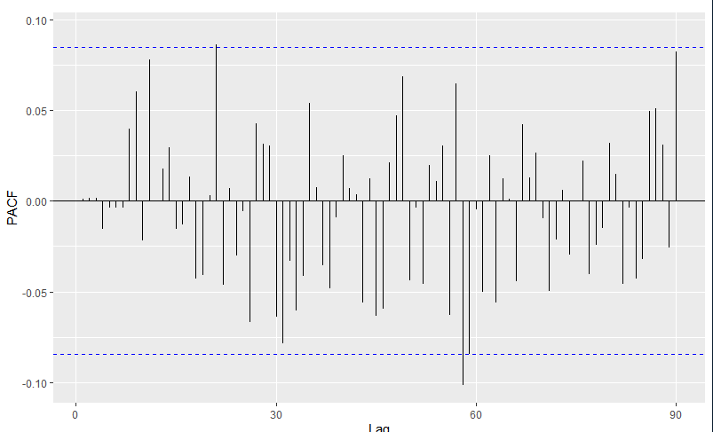
RESIDUAL ANALYSIS OF SELECTED MODEL
Table 4: Ljung-Box test for residuals from ARIMA (6,2,1) with xreg
Ljung-Box test for independence | Q | df | p-value
 | 62.244 | 52 | 0.1563
Figure 7: Residuals from ARIMA (6,2,1) with xreg (PCR)

Slide 15
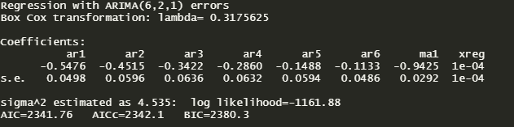
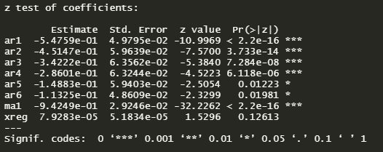
SUMMARY OF SELECTED MODEL
Table 5: Model summary

Slide 16
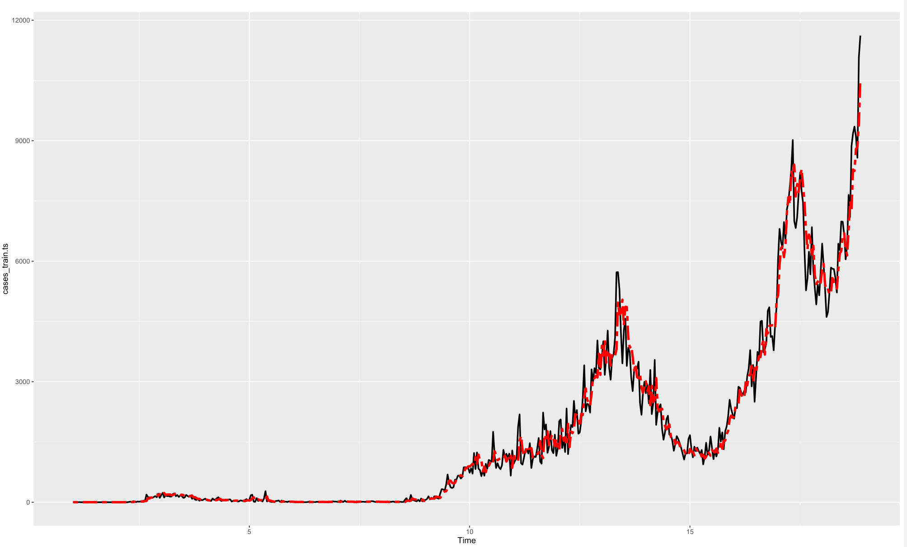
Model Fit
Figure 8: Model fit ARIMA (6,2,1) with xreg (PCR)

Slide 17

MODEL ACCURACY
Table 5: Forecast accuracy (n.ahead = 30)
Model | External regressors | MAPE | RMSE
ARIMA (6,2,1) with xreg | Daily PCR tests | 10.28339 | 2104.5034
ARIMA (6,2,1) with xreg | Daily PCR + RTK Ag tests | 10.15448 | 2037.5127
27

Slide 18
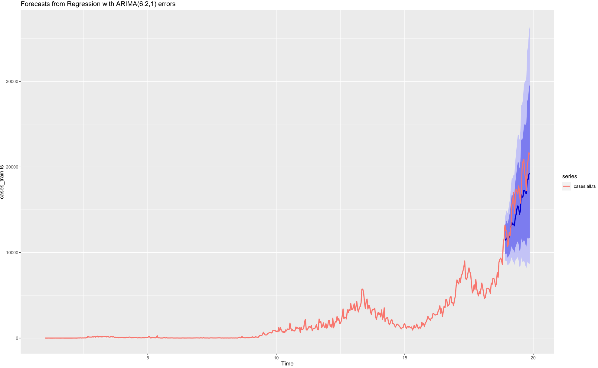
Figure 9: Forecasted COVID-19 daily incidence vs observed incidence

Slide 19
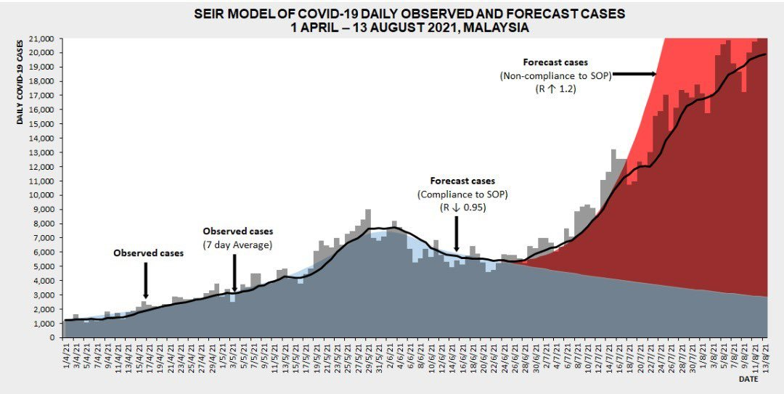
Figure 10: SEIR Model of COVID-19 Daily Observed and Forecast cases 01.04.21 – 13.08.21, Malaysia (MOH)

Slide 20
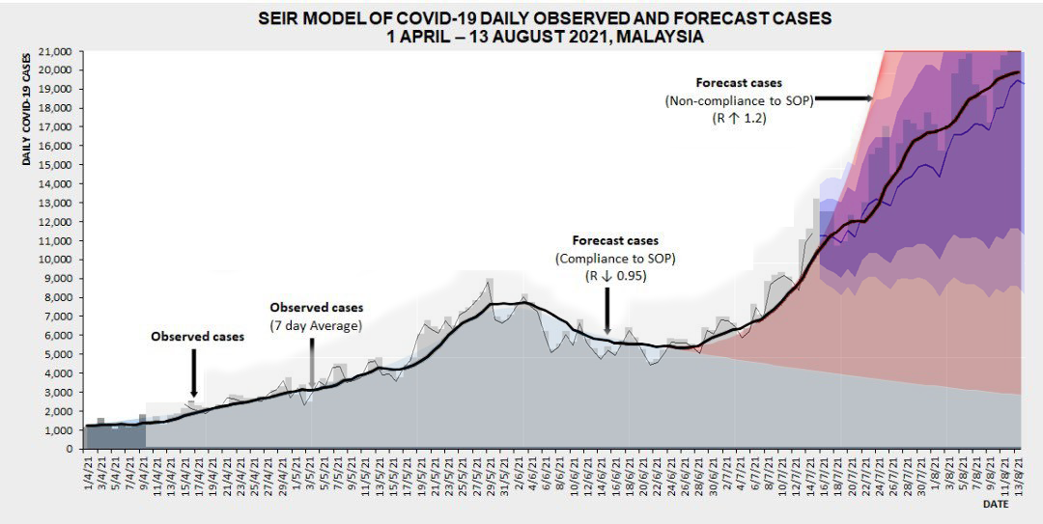
Figure 9: Forecasted COVID-19 daily incidence vs observed incidence

Slide 21
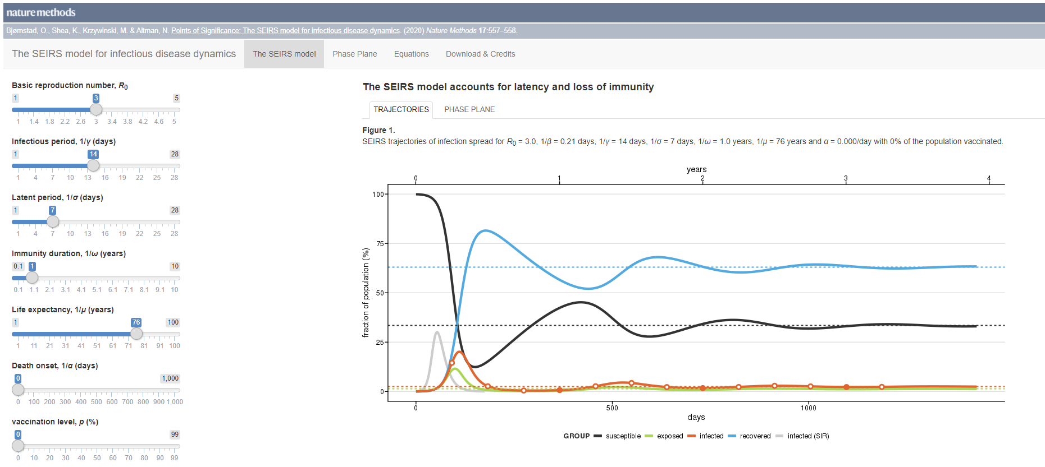
SEIRS Model https://shiny.bcgsc.ca/posepi2/ https://alhill.shinyapps.io/COVID19seir/
Notes:
Abstract is included as part of the requirement of presentation by module coordinator. I wont go through in details as they will be discussed in details in each chapters later.

Slide 22

FBprophet
Prophet is a procedure for forecasting time series data based on an additive model where non-linear trends are fit with yearly, weekly, and daily seasonality, plus holiday effects.
Notes:
Abstract is included as part of the requirement of presentation by module coordinator. I wont go through in details as they will be discussed in details in each chapters later.

Slide 23
Thank you.
https://otexts.com/fpp2/regarima.html - by Rob J. Hyndman
Notes:
Abstract is included as part of the requirement of presentation by module coordinator. I wont go through in details as they will be discussed in details in each chapters later.

