Slide 1
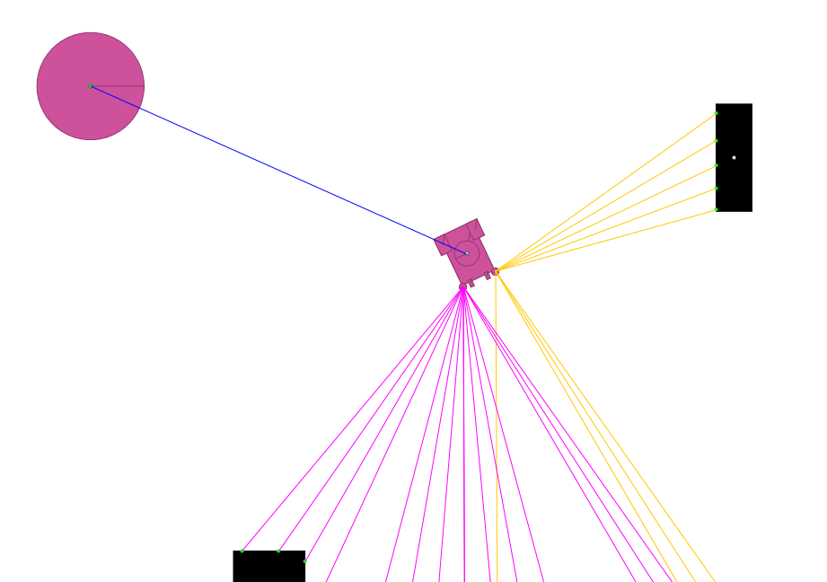


Obstacle State pre-translated to Vehicle body frame
Home
$$\frac{π}{2}$$
0.0
$$−\frac{π}{2}$$

