Slide 1
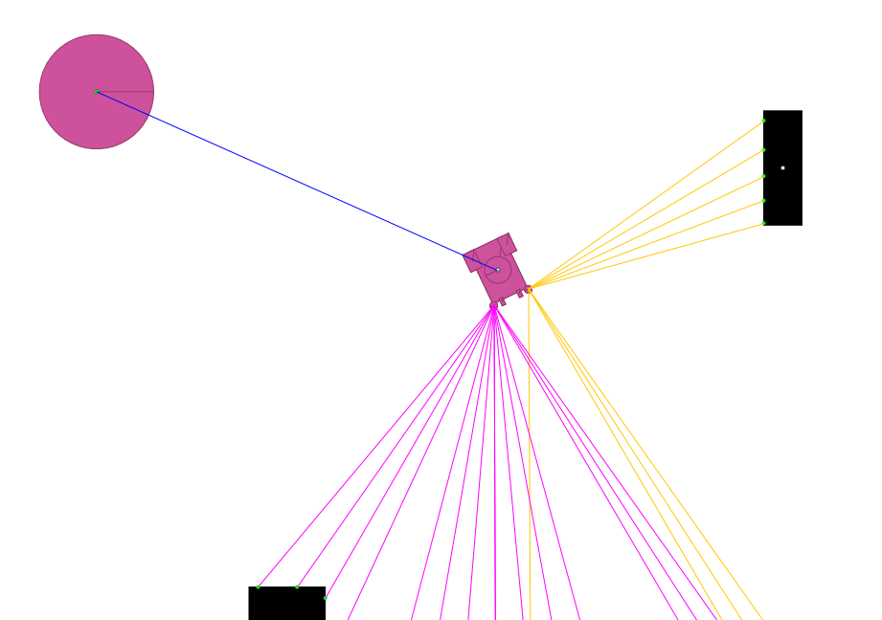


Obstacle State pre-translated to Vehicle body frame
Home
$$\frac{π}{2}$$
0.0
$$−\frac{π}{2}$$

Slide 2
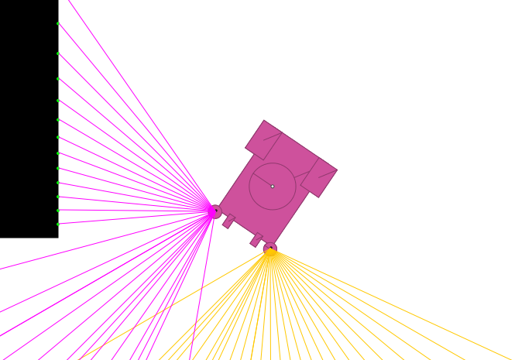
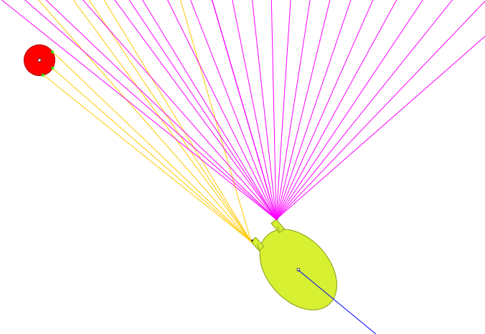
Braitenberg Vehicle Sensor Position
Ant Vehicle Sensor Position

Slide 3
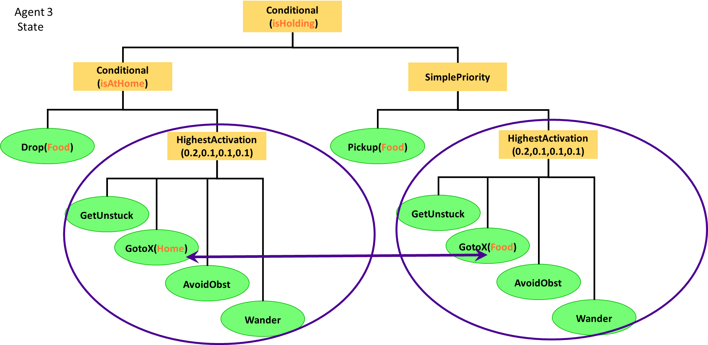
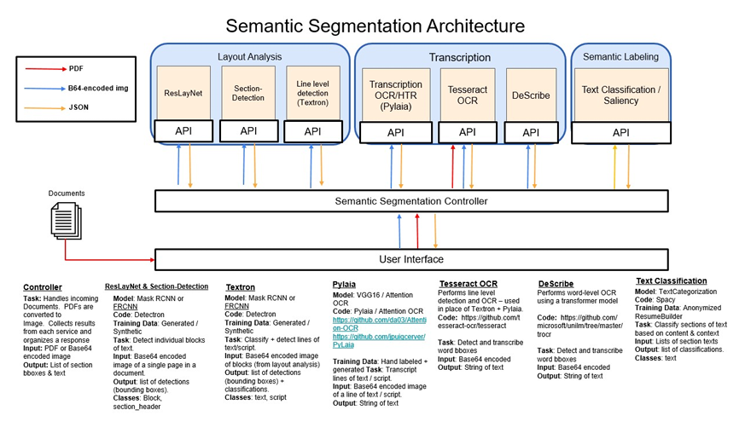
Life-Long System
Problem, most self-organizing happens at one layer. Want at least 2. Addressed with behavior tree and colony performance (will it flatten?)
Alternative individual learning and ?social learning?
Qualia World isn't quite working, but the colony is. So can connect something.
Genetic Programming worked with Robocode. Problem Genetic algorithm approaches are population based, not necessarily based on continuous spawning. How to do this?
Examples found seem to only use mutation.
Fitness eval (length of life) will be very sparse when agents do well. This matches the target domain of ASCE-BITS because feedback from humans has been shown to be sparse in the HRA version.
Not a lot academically:
GADO: A Genetic Algorithm for Continuous Design Optimization Does the Field of Computational life?
Genetic Algorithms and Artificial Life https://pdxscholar.library.pdf.edu/cgi/viewcontent.cgi?article=1003&context=compsci_fac

Slide 4
This means things are going well and need to start connecting to something that changes the agents.
Because the Genetic Program Woolley wrote for his MS Thesis for Robocode worked, I thought that would be easy because I just swap the xml parser for json.... not the case.
The standard GA/GP workflow is: create population -> run -> get fitness -> cross-over/mutation -> new population -> repeat..
Do we start with 1 entity and then go from there; start with 10 and fitness is defined as length of life and something with maintained energy level. And run the entire simulation, then perform the GA process above? Or take the population as the die, and one at a time toss them in and then pool the fitness response? ...
The sample long-life evolutionary systems seem to be structured so that they only do mutation. So, if an entity is successful, it will asexually 'breed' a new one that is only subjected to a mutation operator. I don't think that this is all that we want....
Also, doesn't seem to be a lot academically: https://scholarship.libraries.rutgers.edu/esploro/outputs/technicalDocumentation/GADO-A-Genetic-Algorithm-for-Continuous/991031550235504646
https://pdxscholar.library.pdx.edu/cgi/viewcontent.cgi?article=1003&context=compsci_fac

Slide 5
start with 5 randomly generated.
Each time one drops off food - record their genome.
At spawn time perform cross-over and mutation on those that have dropped off food
- design choices: selection from {since the last spawn, out of the last 5-10, out of all over lifetime, ranked by energy and lifetime}?
If there hasn't been a spawn in a set time period, spawn a new agent anyway?
If there is a colony collapse restart OR carry over best and restart?

