Slide 1
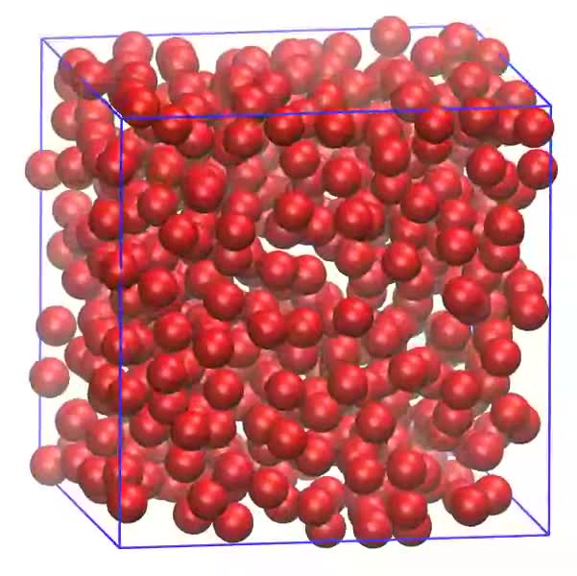
Molecule Dynamics Project
Coupling Python with C
Pablo Alcain
Matias Factorovich
Md. Enamul Hoque

Slide 2
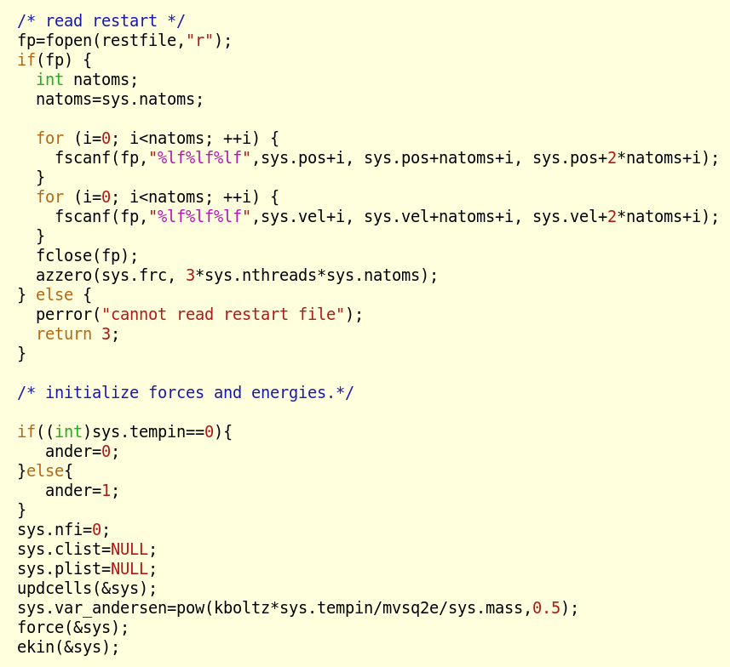

The Challenge:
Make an easy to use MD program and adaptable program that could be used in example for teaching purpose
The problem:
It was written in C

Slide 3
What are our MD C program capabilities?
What we wanted to add?
Screen input
Coordinates and thermodynamic data output to a file
Just NVE support
Lennard-Jones potential
Easy to use GUI support and intimidate graph
Thermostat to Run NVT simulations
Any potential → Look up table .
Make the code clean enough for future enhanced

Slide 4

The Solution:Take our base MD program written in C and coupled it to python.
  Easy program language
  Build features for making graph
  Easy coupling with C through c_types
  Build features for making GUI
Let's get on with it !!!!

Slide 5
The Solution:Take our base MD program written in C and coupled it to python.
  Easy program language
  Build features for making graph
  Easy coupling with C through c_types
  Build features for making GUI
Let's get on with it !!!!

Slide 6
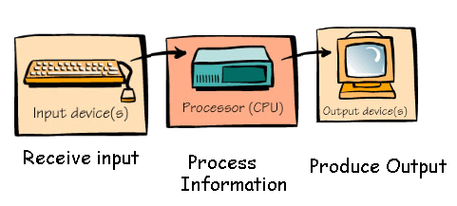
First Goal: Run the MD program as a library Called from python
  Just the heavy calculation will be done in C
    Cell build, force calculation, Verlet integrator
  Management in python
    Input/Output and looping through time-step
Python
C code
Python

Slide 7
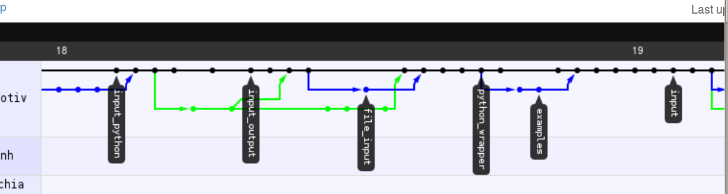
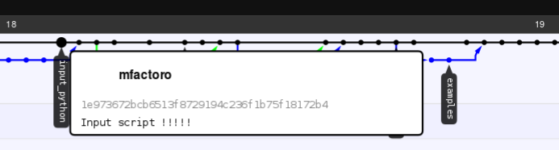
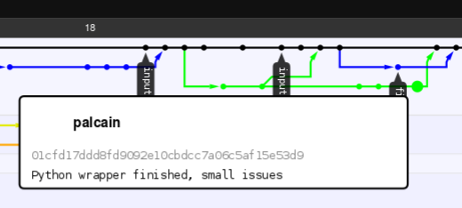
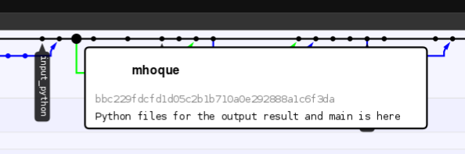
Each one Starts their job

Slide 8
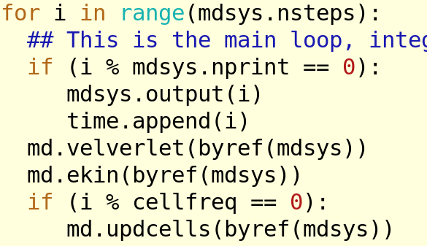
What we achieved ???

Slide 9
Now what ????
[x]: improve input behaviour
(x): sanitize input from python and clean classes
(x): make the proper GUI input (with a flag to mark we want to run GUI, like "./main.py -g")
[x]: "portability": figure out a way to ask for the number of threads in main.py
[x]: Makefiles and c-code
(x): remove the warnings and check that Makefiles work properly
(o): refactor mdsys class in both c and python to remove unneeded info (like nfi, ncellfreq, and such)
[x]: add a LUT potential
[x]: add different integrators methods
(x)write code
(x)make python use it
[ ]: clean GUI input file
[ ]: refactor classes like Potential and mdsys in python
[ ]: finish documentation
----------------------------------------------------
[ ]: add different atom types
To Do List !!!

Slide 10
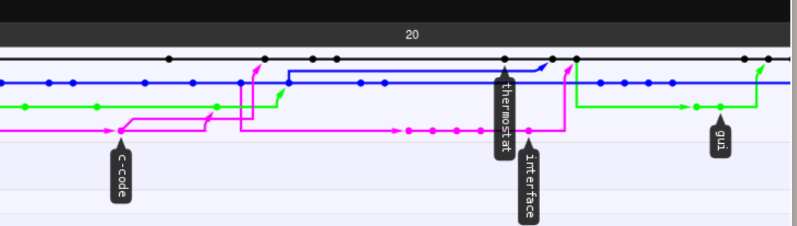
Three main Branches
GUI and output Graph
Andersen Thermostat
Lookup Table

Slide 11
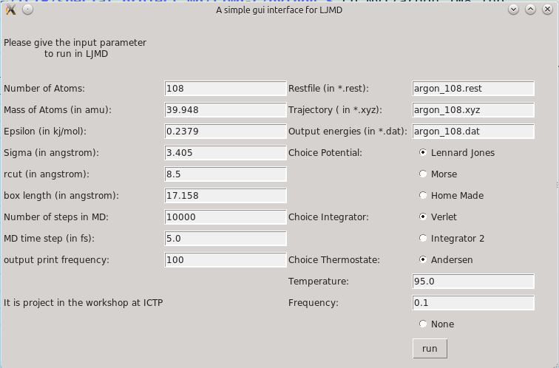
Results
GUI

Slide 12
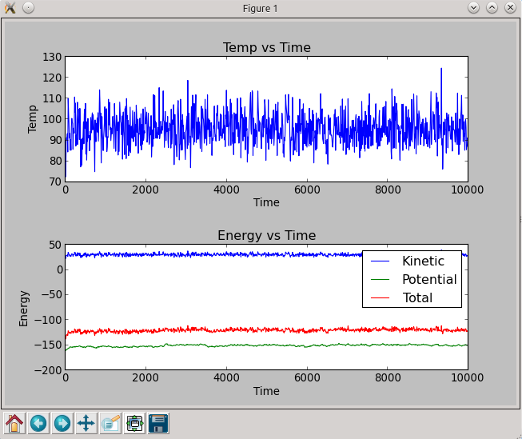
NVT

Slide 13
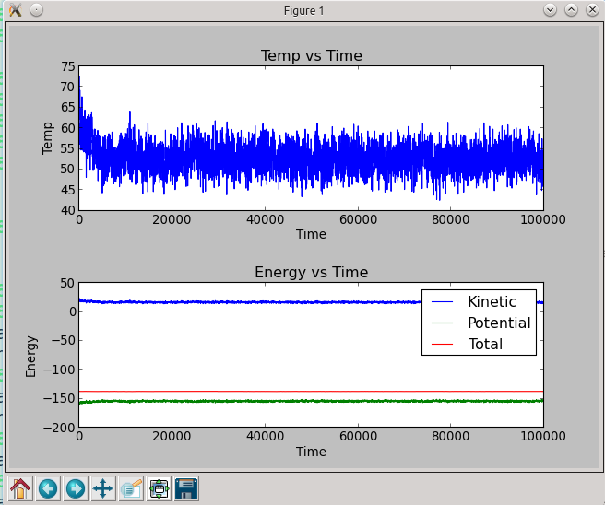
NVE

Slide 14
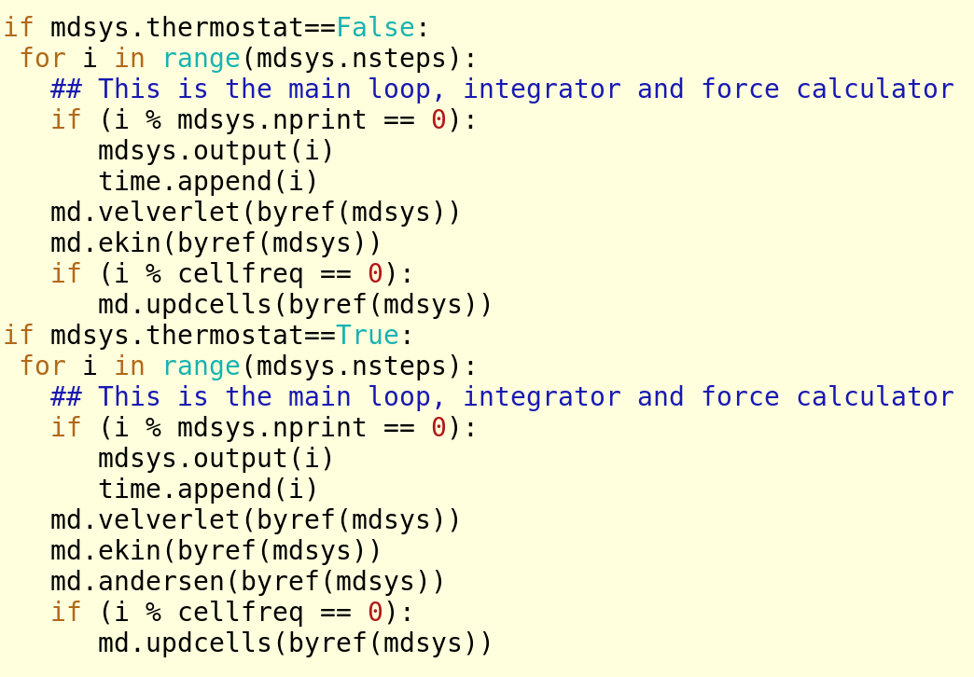
How Does the code look?

Slide 15
What have we achieved
  Learning skills with software development tools
    gdb → debugging
    git →software sharing and development
    Code coupling → making use of C power to perform fast math and python simple language and packages to input and proses and present data
    Having a Tidy(ish) code easy to follow
Git:
git-repo: https://github.com/JLeitmotiv/ljmd-c.git

