Slide 1
Computer Networks
Simulation Project - Router and TCP/UDP Sockets
指導教授:許蒼嶺 博士
研究生:鄭明恩 陳裕承

Slide 2
Project01
https://www.virtualbox.org/
Ubuntu 20.04.6 LTS (Focal Fossa)
VirtualBox 虛擬機器安裝 Ubuntu Desktop 設定與使用教學 | KJie Notes

Slide 3
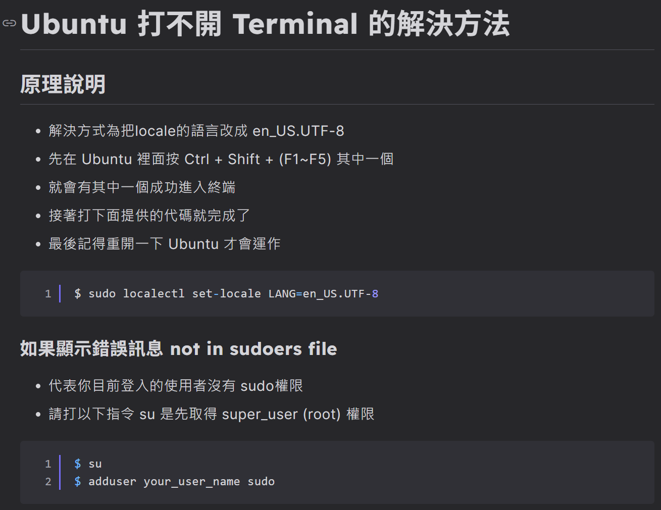
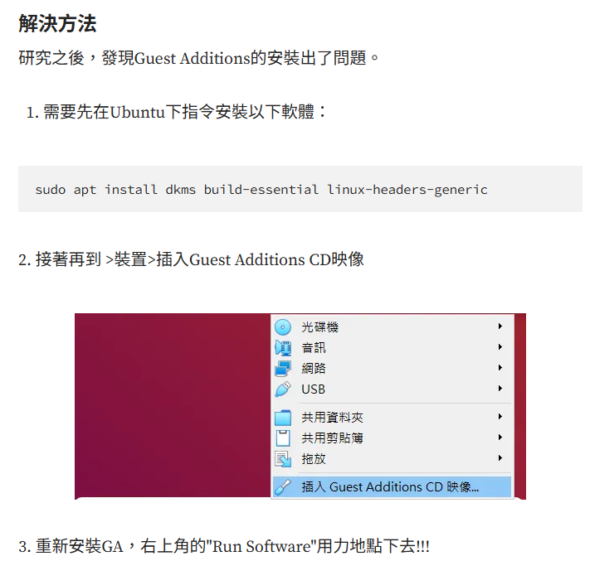
Project01
Ubuntu 打不開 Terminal 的解決方法 - HackMD
解決VirtualBox無法雙向複製貼上. 最近在VirtualBox安裝Ubuntu 18.04.4… | by Oliver Hua 花雲鴻 | 花哥的奇幻旅程 | Medium

Slide 4
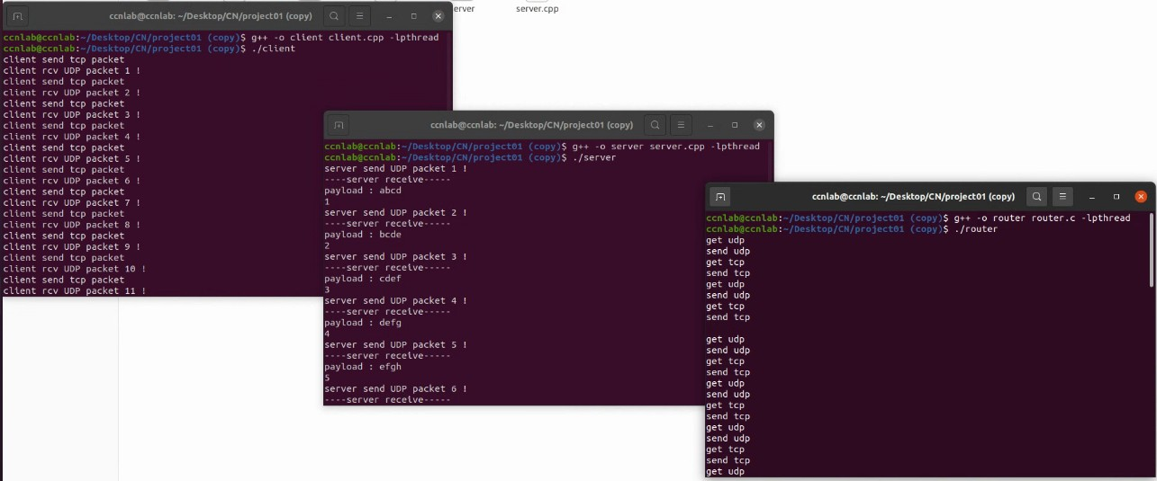
Project01

Slide 5
Project01
請完成UDP, TCP功能以及其餘//code標記部分

Slide 6
Computer Networks
Simulation Project - Router and TCP/UDP Sockets
MoD Video Stream (UDP)
Part I: (50%) As shown in the above figure, on a Linux platform, write down three programs
to simulate a 2-port router and packets transmission between a client and a server.
(a) (25%) On an MoD Server, generate at least 10-second IP packets (including IP and UDP
headers) with MAC payload, MTU = 1500 bytes. Using UDP socket to send
these IP packets to the client (simulation for video streaming).
(b) (25%) On the Client, generate at least 10-second IP packets (including IP and TCP
headers) with MAC payload, MTU = 64 bytes. Using TCP socket to send
these IP packets to the short-message server (simulation for text exchanges).
<NOTE>: Your router program should forward two-way IP packets simultaneously.
Text Messages (TCP)
Client
(PC or notebook)
2-Port
Router
Server
(MoD and short messages)
100 Mbps
Ethernet
100 Mbps
Ethernet
Due Day: Part I: Demo to TA in the Lab on Oct. 20-24, 2025.

