Slide 1
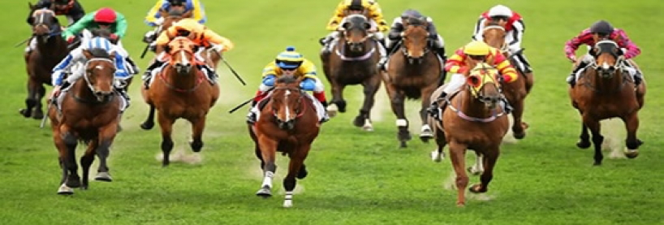
Strategy or Speed
Tactics for horse racing bettors
Jocelyn (Linpei) Luo

Slide 2
Features and Model
Some features that experienced bettors take into account
Former and Recent Performance: The history performance of a horse is a crucial factor. Bettors often look at a horse's recent race history, including wins, placements, and finishes, to assess its current form and competitiveness.
Sectional time: time taken by the horse of the race to reach the end of each section
Jockey: Successful and experienced jockeys and trainers are often associated with better-performing horses.
Class and Distance: The class of the race and the distance are important considerations. Some horses may perform better at specific distances or in races with certain levels of competition.
Track Conditions: The condition of the racing track (e.g., firm, good, soft) can affect a horse's performance. Some horses excel in specific track conditions, so bettors consider this factor when making predictions.
Weight and Draw: The assigned weight and the starting gate draw can influence a horse's chances of winning. Some horses may be more comfortable carrying certain weights or have preferences for inside or outside positions.
Betting Odds: The odds assigned to a horse in the betting market reflect the bookmakers' and bettors' perceptions of its chances of winning. Bettors often seek value by identifying horses with favorable odds relative to their perceived chances of winning.
Horse's Age and Experience: The age and racing experience of a horse can be relevant. Some bettors prefer more experienced horses, while others may look for younger, promising contenders.
Speed: Bettors analyze a horse's speed figures, which represent its past racing performance in terms of speed.
Strategy (measured by smoothness) : Horses that run smoothly will have a higher chance of success ; if horses might experience difficulties maintaining a consistent pace, their overall performance will be affected in the race.
Model > Experience
Random Forest with Cross Validation, both classification and regression
Notes:
Smoothness
Speed (Average)

Slide 3
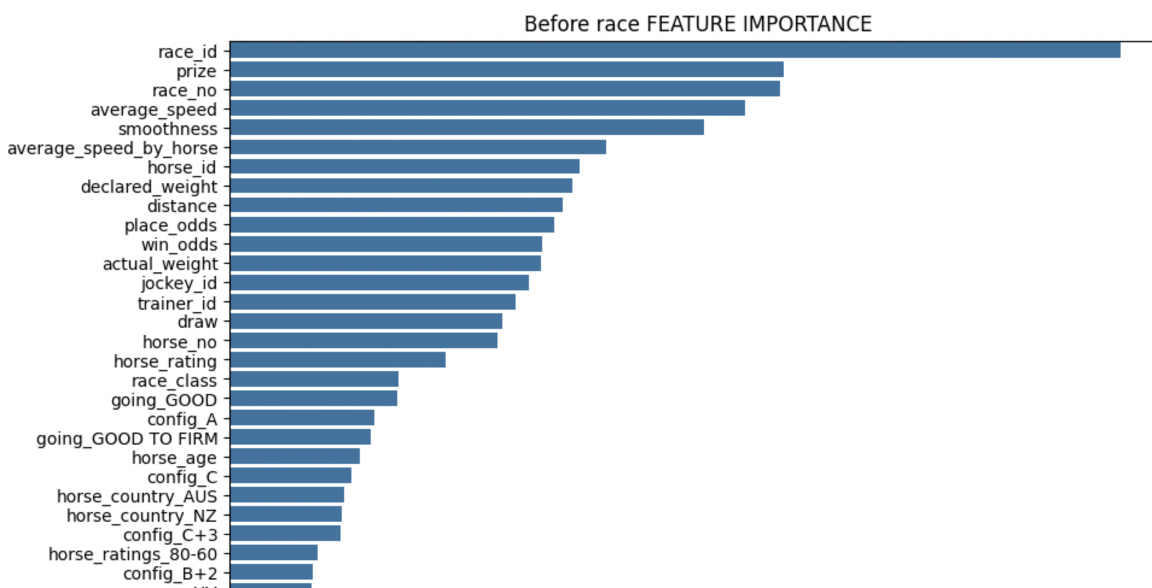
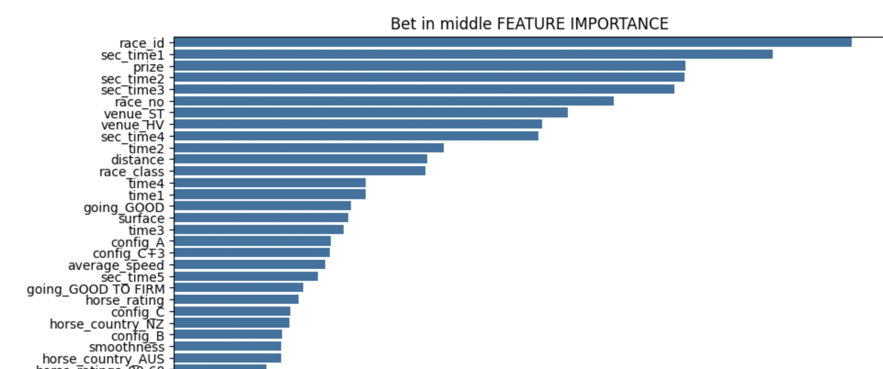
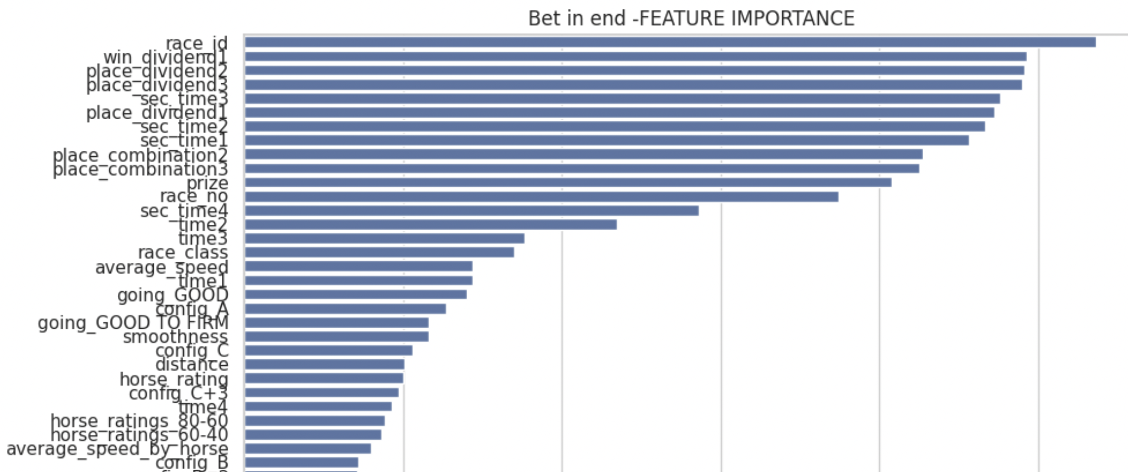
Analysis
Bet before the race start
Bet in the middle of the race (NJ)
Bet in the end of the race
Data not available: Sectional time for leader horse, dividends, 1st/2nd/3rd place, draw
Data available: venue, config, jockey, historical speed, Class and Distance, track condition, weight & age, betting odds
‘
Data not available: dividends, 1st/2nd/3rd place, draw
Data available: Section time, venue, config, jockey, historical speed, Class and Distance, track condition, weight & age, betting odds
Knows everything except winner
Test acc: 77%
Test acc: 99%
Test acc: 100%

Slide 4
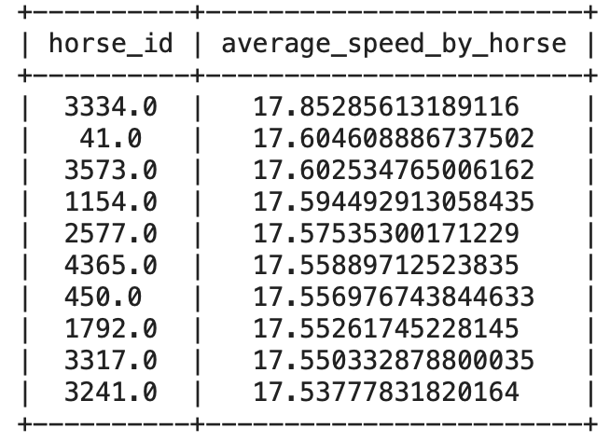
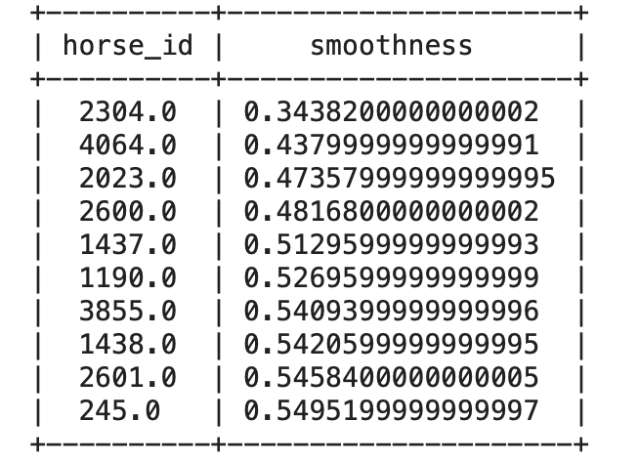
Solution
In the middle of the race
race_id
Sec_time1: time taken by the leader of the race to reach the end of the 1nd sectional point (sec)
Prize
Sec_time2
Sec_time3
Sectional time matters!
They are real time data of the performance of a horse
Speed matters!
showcasing the capacity of a horse
Strategy matters!
Horses that run smoothly will have a higher chance of success ; if horses might experience difficulties maintaining a consistent pace, their overall performance will be affected in the race.
Before the race
race_id
Prize
Race_no
Average speed: average speed of a horse in a specific race (calculated by distance /final time)
Smoothness: consistency of speed across multiple sections of the race, average of the sum of squared differences between sectional time between horses
average_speed _by_horse:average speed of a horse in all races (calculated by distance /final time)
Horse_id
Notes:
race_id : unique identifier for race
Sec_time1: time taken by the leader of the race to reach the end of the 1nd sectional point (sec)
Prize: winning prize
Sec_time2: time taken by the leader of the race to reach the end of the 2nd sectional point (sec)
Sec_time3: time taken by the leader of the race to reach the end of the 3nd sectional point (sec)
race_id : unique identifier for race
Prize: winning prize
race_no: number of the race in the day's meeting
Average speed: average speed of a horse in a specific race (calculated by distance /final time)
Smoothness: consistency of speed across multiple sections of the race, average of the sum of squared differences between sectional time between horses
average_speed _by_horse:average speed of a horse in all races (calculated by distance /final time)
Horse_id: unique identifier for horse

Slide 5
Fun Questions
Should we trust the win-odds?
Yes, according to our model (Before the race), we see place_odds and win_odds are ranked 7th and 8th in our model.
Strategy or speed?
Both of them!
Jockey or horse?
Though in both of the model, jokey_id or trainer_id appears as less important factor than horse_id, but they still show some importance, 10th place in Before the race model (horse_id at 8th place) and 39th place in the In the middle of race model(horse_id at 16th place)
Horse racism?
We did not see significant importance shown by horse_type in both models
Which country’s horse run the fastest?
The country with the fastest horses is GR with an average speed of 16.95 m/s.
Age distribution of horse?
According to the analysis, people tends to favor 3-year-old horses to run the race

Slide 6
Thank you
https://colab.research.google.com/drive/10oFeOn475HWQCbwkiDwzDB39KHg59J0m?usp=sharing

