Slide 1
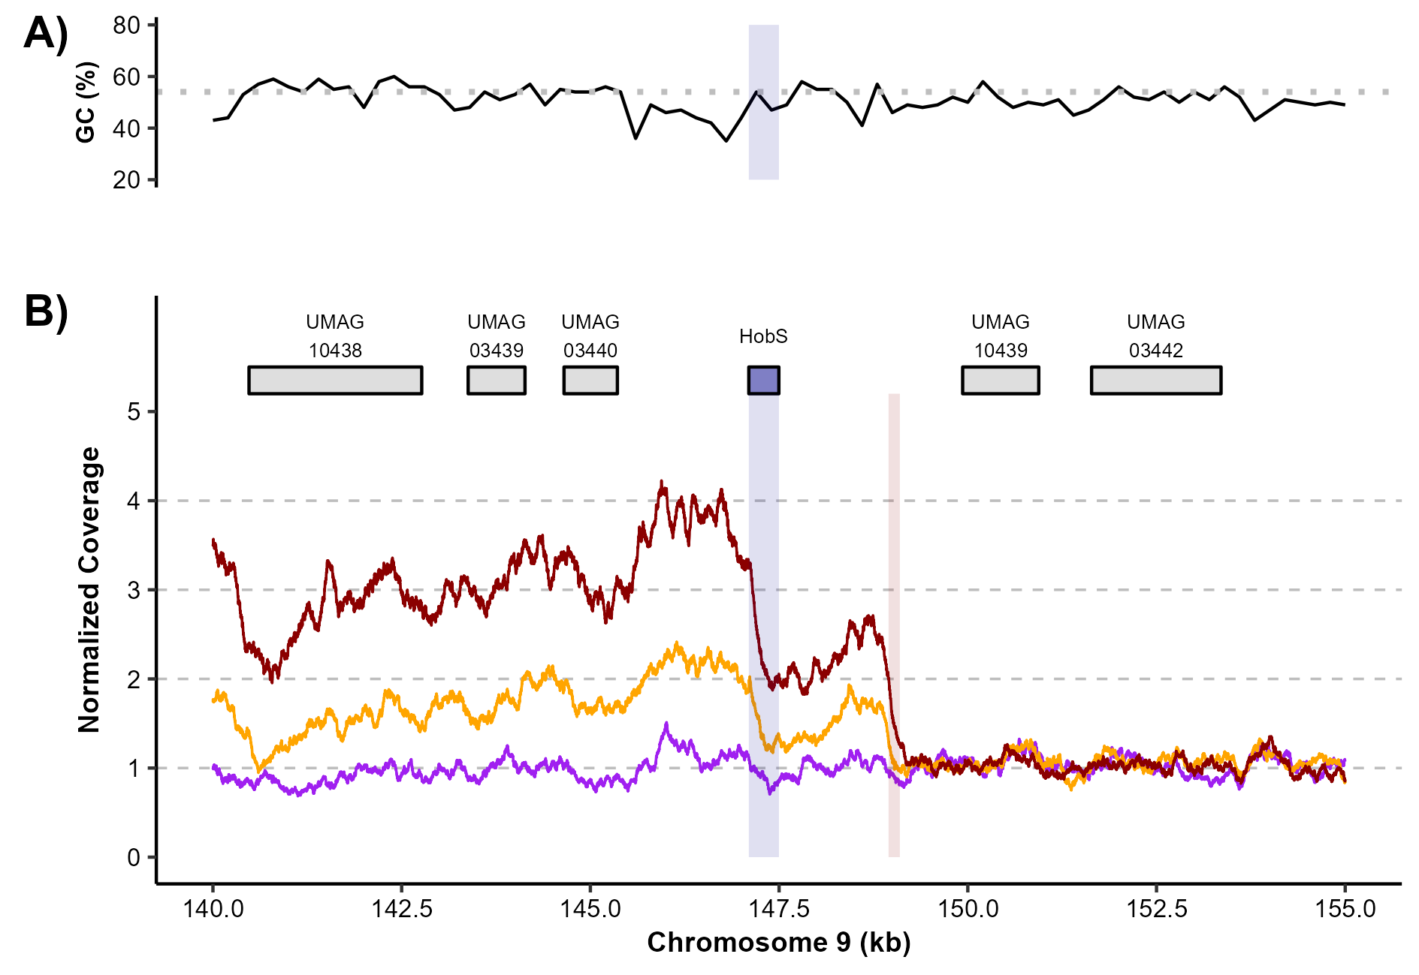
4.5 kb
SG200
T20.LB.4
T20.LC.1

