Slide 1
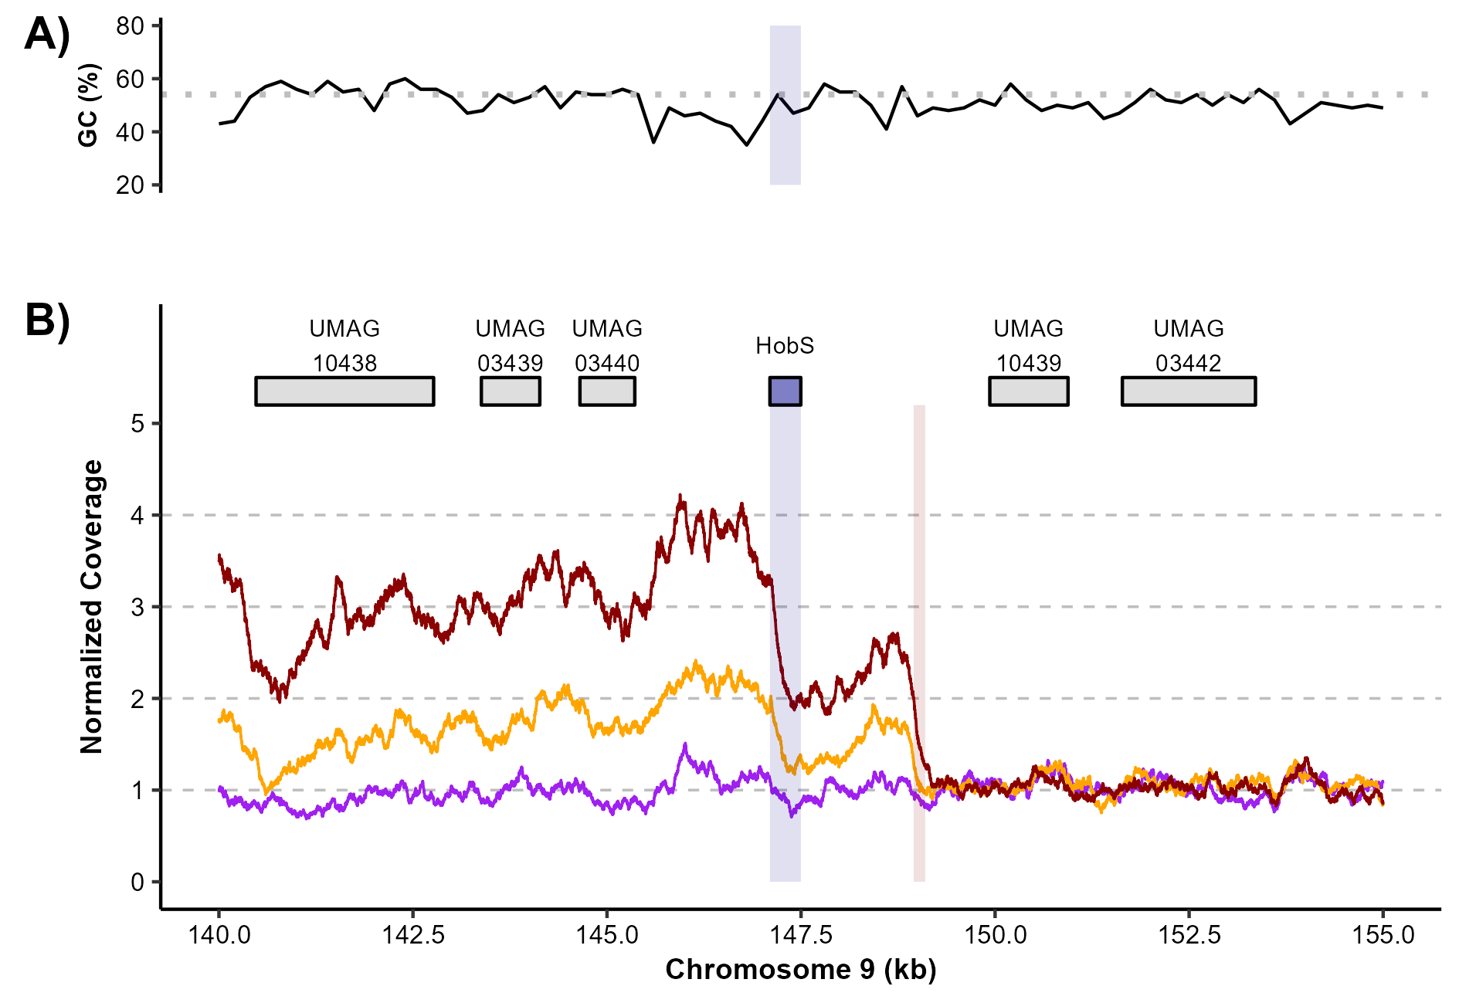
SG200
T20.LB.4
T20.LC.1

