Slide 1

KWIC Software System
By: Team JIDA
CS 4352.0U1
Project Phase 1

Slide 2
JIDA – Team Members
Outline
James Lussier - Team Leader
Irfa Mustafa
Drew Cannedy
Andre Cordero
Team Website:
http://se4352jida.github.io/
Problem Statement
Purpose of this project
Requirement Specifications
Functional Requirements
Non-Functional Requirements
Traceability Matrix
Architectural Design
Abstract Data Type
Implicit Invocation
Trade-Off Analysis
UML Class Diagram
Implementation/Prototype
Why we are better
References
Questions?

Slide 3
Problem Statement
The problem of | Not having an efficient indexing method that will list out the results of a search in sorted order
affects | the users who need search for specific titles
the impact of which is | The unsorted search result that takes a long time to look through to find the desired title
A successful solution will be | The KWIC index system that takes in an ordered set of lines from the user, performs the circular shift on those lines, then orders the shifted lines alphabetically, and outputs the sorted result.

Slide 4

Purpose
The purpose of this project is to:
build a system, known as KWIC (Keyword in Context), that can be used for indexing
build KWIC using java applet
implement the system on the group website
Will be accessible on team’s website
make use of Object-Oriented architectural style in the development of the KWIC system

Slide 5
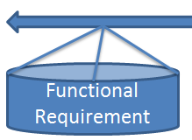
Functional Requirements
FR 1.0 - The KWIC system shall have an input section for the user
FR 2.0 - The KWIC system shall accept an ordered set of lines
FR 2.1 - Each line is an ordered set of words
FR 2.2 - Each word is an ordered set of characters
FR 3.0 - The KWIC system shall circularly shift each line
FR 3.1 - The KWIC system shall remove the first word from the beginning of the line
FR 3.2- The KWIC system shall append the first word to the end of the line
FR 4.0 - The KWIC system shall sort the circularly shifted lines in alphabetical order
FR 5.0 - The KWIC system shall display the output of all the circularly shifted lines that have been alphabetized onto the screen.
FR 6.0 – The KWIC system shall require an active internet connection to perform its task

Slide 6

Non-Functional Requirements
NFR 1.0 - The KWIC system shall be user-friendly
NFR 1.1 - The KWIC system shall have icons that are easy to use
NFR 2.0 - The KWIC system shall be easily understandable
NFR 2.1 - The KWIC system shall be useable by different kinds of users (i.e. kids, elders, etc.)
NFR 3.0 - The KWIC system shall be portable
NFR 3.1 - The KWIC system shall work from any device that has access to the internet
NFR 4.0 - The KWIC system shall be reusable
NFR 4.1 - The KWIC system shall be easy to change and reuse in the future
NFR 5.0 - The KWIC system shall have a good performance
NFR 5.1 - The KWIC system shall display the output within a few seconds
NFR 6.0 - The KWIC system shall be very accurate
NFR 6.1 - The KWIC system shall sort the circularly shifted lines in alphabetical order with an accuracy of more than 98 percent
NFR 6.2 - The KWIC system shall display the alphabetized lines from the performance of the circular shift

Slide 7
Traceability Matrix
 | NFR 1.0 | NFR 2.0 | NFR 3.0 | NFR 4.0 | NFR 5.0 | NFR 6.0
FR 1.0 | X | X
FR 2.0 |  |  |  | X | X | X
FR 3.0 |  |  |  | X | X | X
FR 4.0 |  |  |  | X | X | X
FR 5.0 | X | X |  | X | X | X
FR 6.0 |  |  | X

Slide 8
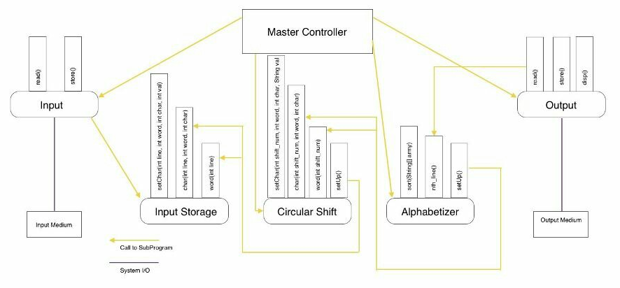
Architectural Design – ADT

Slide 9
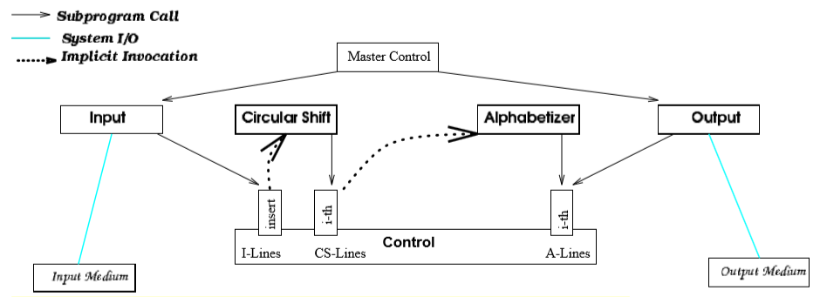
Design 2– Implicit Invocation

Slide 10
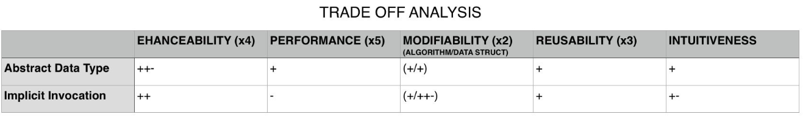
Trade-off Analysis

Slide 11
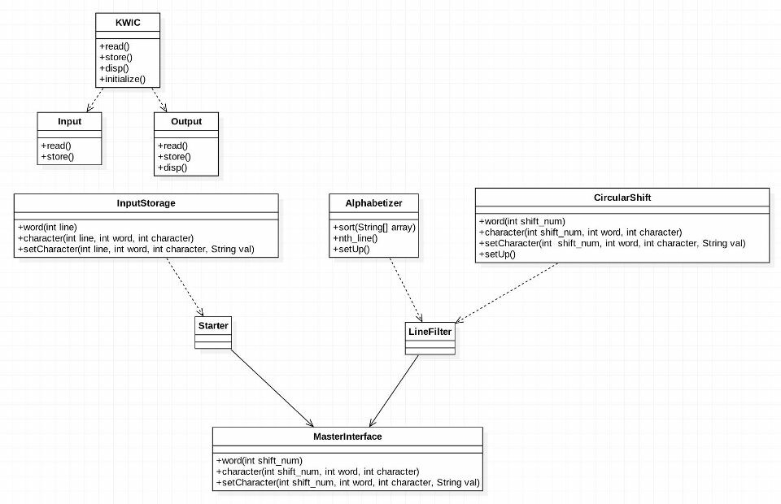
UML Class Diagram - KWIC

Slide 12
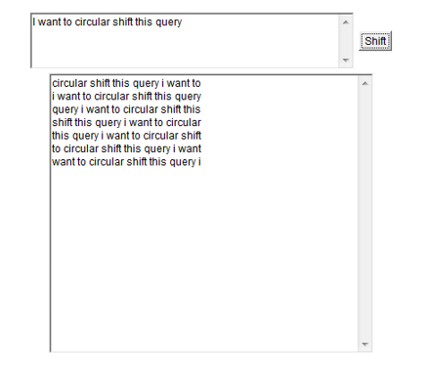
KWIC System Implementation
Java applet on group website
Requires internet access
Implementation / Prototype
https://se4352jida.github.io/phase1/
Example line: I want to circular shift this query

Slide 13

Better then the rest
Our team is superior due to
our prototype being:
Simple
Efficient
Easy-to-understand
Continuous improvement
throughout project
Comprehensive documentation on architecture and requirements
Reflects some of the thoroughness of the final design

Slide 14
References
Software Architectural Design CS/SE 4352 Website
http://utdallas.edu/~chung/CS4352/syllabus.htm
Former Project Samples listed on Dr. Chung’s website
http://www.utdallas.edu/~maryellen.oltman/

Slide 15

Questions?

