Slide 1
Python
Dr.Manish Jain

Slide 2
Python facts
There is actually a poem written by Tim Peters named as THE ZEN OF PYTHON which can be read by just writing import this in the interpreter. Import this

Slide 3
Ever wondered why is it named Python?
There’s an interesting story about it. While implementing Python, Van Rossumwas also reading the published scripts from “Monty Python’s Flying Circus”, a BBC comedy series from the 1970s. Since he wanted a short, unique and slightly mysterious name for his invention, he got inspired by the series and named it Python!

Slide 4
Python's name is derived from Monty Python's Flying Circus and has nothing to do with the species of snakes! Common variables in Python spam and eggs are also taken from Monty Python's Flying Circus! Python is one of the official languages at Google. Earlier versions of BitTorrent were written in Python. NASA uses Python!

Slide 5
How to Install package in Jupyter
!pip install pandas
!pip install Numpy
For CMD
pip install Numpy
Conda install numpy

Slide 6
Check Python Version
from platform import python_version
print(python_version())

Slide 7
How to check Package version
!pip show numpy
import numpy
print(numpy.__version__)

Slide 8
How to check / Change PWD
import os
os.getcwd()
import os
os.chdir('c://Users//Manish//Desktop')
import os
os.getcwd()

Slide 9
Clear the console ( only for IDLE shell)
def cls(): print ("\n" * 50)
cls()
* First define a simple function, this funtion will print 50 newlines;(the number 50 will depend on how many lines you can see on your screen, so you can change this number)

Slide 10
Print list of all installed packages
help('modules')
!pip freeze

Slide 11
list of all installed packages in Table format
!pip install tabulate
import tabulate
try:
from pip import get_installed_distributions
except:
from pip._internal.utils.misc import get_installed_distributions
tabpackages = []
for _, package in sorted([('%s %s' % (i.location, i.key), i) for i in get_installed_distributions()]):
tabpackages.append([package.location, package.key, package.version])
print(tabulate.tabulate(tabpackages))

Slide 12
Important Package for AI/ML and Data Science
Numpy
Pandas
Matplotlib
Scikit-Learn
Scipy
* Total : 1,13,000 Python packages

Slide 13
Python Identifiers
A Python identifier is a name used to identify a variable, function, class, module, or other object.
An identifier starts with a letter A to Z or a to z, or an underscore (_)
followed by zero or more letters, underscores and digits (0 to 9).
Python does not allow punctuation characters such as @, $, and % within identifiers.
Python is a case sensitive programming language. Thus, Manpower and manpower

Slide 14
Multi-Line Statements
days = ['Monday', 'Tuesday', 'Wednesday',
'Thursday', 'Friday']
total = item_one + \
item_two + \
item_three

Slide 15
Quotation in Python
word = 'word‘
sentence = "This is a sentence.“
"""This is a paragraph. It is
made up of multiple lines and sentences."""

Slide 16
Comments in Python
# Single Line
“”” “”” Multiline comment

Slide 17
Multiple Statements on a Single Line
import sys; x = 'Manish'; sys.stdout.write(x + '\n')
x = 'Manish'; print(x)
for i in range(10): print(“A"); print(“B")
for i in range(10): print("i equals Value") if i==7 else None
for i in range(80, 90): print(i, end=" ") if (i!=89) else print(i)

Slide 18
Assigning Values to Variables
counter = 5 # An integer
miles = 1000.0 # A floating point
name = “Manish" # A string
print(type( counter))
sys.getsizeof(counter) # returns 24 bytes
sys.getsizeof("") #returns 49 as its tuple
sys.getsizeof([]) #returns 64 as its list
** sys.getsizeof() returns the memory size of the object in bytes

Slide 19
Multiple Assignment
a = b = c = 1
a, b, c = 1, 2, “Mohan"

Slide 20
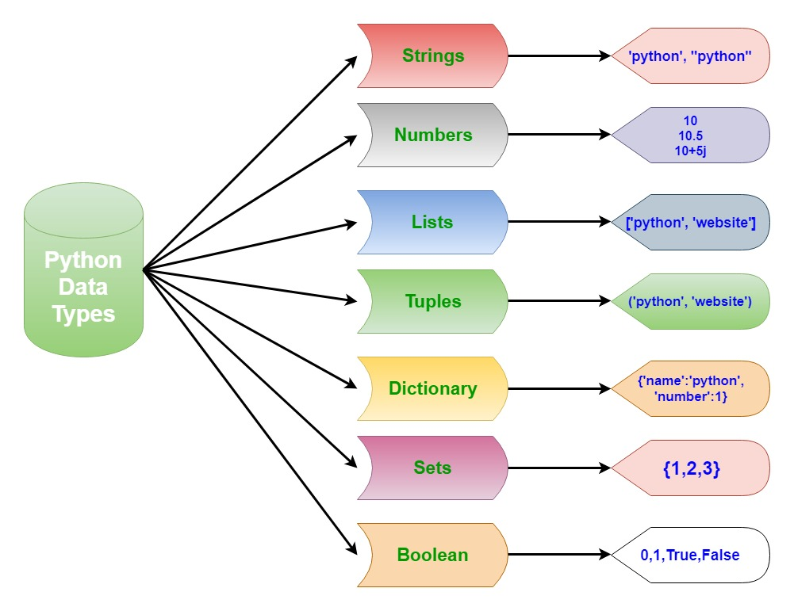
Standard Data Types

Slide 21
Numbers
print(0o10) # Octal 8
print(0x10) # Hexa
print(0b10) #Binary
type(10)
4.2e-4 # 0.00042
.4e7 #4000000.0
type(2+3j) #complex

Slide 22
String
Strings in Python are identified as a contiguous set of characters represented in the quotation marks.
Python allows for either pairs of single or double quotes.
Subsets of strings can be taken using the slice operator ([ ] and [:] ) with indexes starting at 0 in the beginning of the string and working their way from -1 at the end.
The plus (+) sign is the string concatenation operator and the asterisk (*) is the repetition operator.

Slide 23
str = 'Hello World!’
print(str) # Prints complete string
print(str[0]) # Prints first character of the string
print(str[2:5]) # Prints characters starting from 3rd to 5th
print(str[2:]) # Prints string starting from 3rd character
print(str * 2) # Prints string two times
print(str + "TEST") # Prints concatenated string
print(str[:-2]) # Hello Worl
print(str[-2]) #d
print(str[-2:]) #d!
print(str[::-1]) # Reverse !dlroW olleH ( start : stop : step)
print(str[::-2]) # Alternative reverse !lo le
Print(len(str)) # 12 including space
str.count(' ') # Space Count

Slide 24
print("a\tb") # a b
print("a\141\x61") # aaa (ASCII)
print("a\nb") # a b (New Line)
print('\u2192 \N{rightwards arrow}') #→ →
print(chr(59)) print(“;”)
print(chr(8383))
print(chr(8377))
count = 0
for a in "Hello World":
if (a == "o"):
count = count + 1
print(count," letters found")

Slide 25
#Membership
"pl" in "apple" #True
"A" in "apple" #False
a =list(enumerate("apple"))
a #[(0, 'a'), (1, 'p'), (2, 'p'), (3, 'l'), (4, 'e’)]
A = "{},{} and {}".format("hello","hi","IBM")
print(A)
A1 = "{1},{0} and {2}".format("hello","hi","IBM")
print(A1)
A2 = "{s},{s1} and {s2}".format(s1="hello",s2="hi",s="IBM")
print(A2)

Slide 26
a=245678.34567
print("value of a is %0.3f" %a)
print("MaNiSh".lower())
print("manish".upper())
print("Hello all how are you".split())
print(' '.join(["Hello","Team","How","are","you"]))
print("IBM India".find("d"))
print("IBM India".replace("India" , " Bangalore"))

Slide 27
Python Lists List is an ordered sequence of items
a = [ ‘xyz', 123, 1.23, ‘ABC', 17.5 ]
b= [123, ‘OPI']
print(a) # Prints complete list
print(a[0]) # Prints first element of the list
print(a[1:3]) # Prints elements starting from 2nd till 3rd
print(a[2:]) # Prints elements starting from 3rd element
print(b * 2) # Prints list two times
print(a + b) # Prints concatenated lists
a.append(“Manish”) #Applicable
print(“list[3:] = ", list[3:])
b.insert(1,”Mohan”) # To add new value
b
Notes:
list = [ 'xyz', 123, 1.23, 'RAM', 17.5 ]
tinylist = [123, 'RAM']
print(list) # Prints complete list
print(list[0]) # Prints first element of the list
print(list[1:3]) # Prints elements starting from 2nd till 3rd
print(list[2:]) # Prints elements starting from 3rd element
print(tinylist * 2) # Prints list two times
print(list + tinylist) # Prints concatenated lists
list.append("Manish") #Applicable
print("list[3:] = ", list[3:])
tinylist.insert(1,"Mohan") # To add new value

Slide 28
a=["IBM" ,[1,3,4]] #Nested list
print(a[0][2]) #M
print(a[1][2]) #4
a = [1,2,3,4,5]
a[0]=11
print(a) #[11, 2, 3, 4, 5]
a[1:4] = [44,55,66]
print(a) #[11, 44, 55, 66, 5]

Slide 29
a=[1,4,5]
a.append(8)
a #[1, 4, 5, 8]
a.extend([77,88,99])
a #[1, 4, 5, 8, 77, 88, 99]
a=[1, 4, 5, 8, 77, 88, 99,5,5]
print(a.index(5))
print(a.count(5))
a.sort()
a.reverse()
a = [3 ** i for i in range(20)]
a
a = []
for i in range(20):
a.append(3**i)
print(a)

Slide 30
Python Tuples Lists are enclosed in brackets ( [ ] ) and their elements and size can be changed, while tuples are enclosed in parentheses ( ( ) ) and cannot be updated. Tuples is readonly
tuple = (‘xyz', 123, 1.23, ‘RAM', 17.5 )
tinytuple = (123, ‘RAM‘)
print(tuple) # Prints complete list
print(tuple[0]) # Prints first element of the list
print(tuple[1:3]) # Prints elements starting from 2nd till 3rd
print(tuple[2:]) # Prints elements starting from 3rd element
print(tinytuple * 2) # Prints list two times
print (tuple + tinytuple) # Prints concatenated lists
tuple.append(‘Manish’) # Not Applicable
a = []
for i in range(20):
a.append(3**i)
print(a)

Slide 31
How to Modify tuple Values?
T1=(10,50,20,9,40,25,60,30,1,56)
L1=list(T1)
L1[5]=100
T1=tuple(L1)
T1
*convert tuple to list by built-in function list(). You can always update an item to list object assigning new value to element at certain index. Then use another built-in function tuple() to convert this list object back to tuple

Slide 32
Python Dictionary Dictionaries are enclosed by curly braces ({ }) and values can be assigned and accessed using square braces ([]).
dict = {}
dict['one'] = "This is one"
dict[2] = "This is two“
tinydict = {'name’: ‘ABC','code’:’8989’, 'dept': ‘IT'}
print(dict['one']) # Prints value for 'one' key
print(dict[2]) # Prints value for 2 key
print(tinydict) # Prints complete dictionary
print(tinydict.keys()) # Prints all the keys
print(tinydict.values()) # Prints all the values

Slide 33
a={}.fromkeys(["A","B","c"],0)
for i in a.items():
print(i)
print(a.keys())
a={i : i * i for i in range(20)}
a

Slide 34
Python Set
Set is an ordered and unordered collection of unique items. Set is defined by values separated by comma inside braces { }.
a = {5,2,3,1,4,3,4} # printing set variable
print("a = ", a)
print(type(a)) # data type of variable a

Slide 35
# Working with sets # Initialize two sentences.
sentence_1 = "There is nothing new in the world except history you do not know"
sentence_2 = "With the new day comes new strength and new thoughts"
# Create set of words from strings
sentence_1_words = set(sentence_1.split())
sentence_2_words = set(sentence_2.split())
# Find out the number of unique words in each set, vocabulary size.
no_words_in_sentence_1 = len(sentence_1_words)
no_words_in_sentence_2 = len(sentence_2_words)
# Find out the list of common words between the two sets & their count
common_words = sentence_1_words.intersection(sentence_2_words)
number_of_common_words = len(sentence_1_words.intersection(sentence_2_words))

Slide 36
#A Find a list of unique words between the two sets and their count
unique_words = sentence_1_words.union(sentence_2_words)
number_of_unqiue_words = len(sentence_1_words.union(sentence_2_words))
print("Words in sentence 1 = ", sentence_1_words)
print("No of words in sentence 1 =%d"% no_words_in_sentence_1)
print("Words in sentence 2 = ", sentence_2_words)
print("No of words in sentence 2 =%d"% no_words_in_sentence_2)
print("No of words in common =%d"% number_of_common_words)
print("Common words are", common_words)
print("number of unique words are = %d"% number_of_unqiue_words)
print("Unique words are ", unique_words)

Slide 37
Python Operators
Operators are used to perform operations on variables and values.
Arithmetic operators
Assignment operators
Comparison operators
Logical operators
Identity operators
Membership operators

Slide 38
Arithmetic operators
+ - * / %
** - Exponentiation
// - Floor division
A=5 and B=3 , A ** B , 125 ( 5*5*5)
11//3=3 , 5//2.0=2.0 , 7//3=2 , 9//2=4

Slide 39
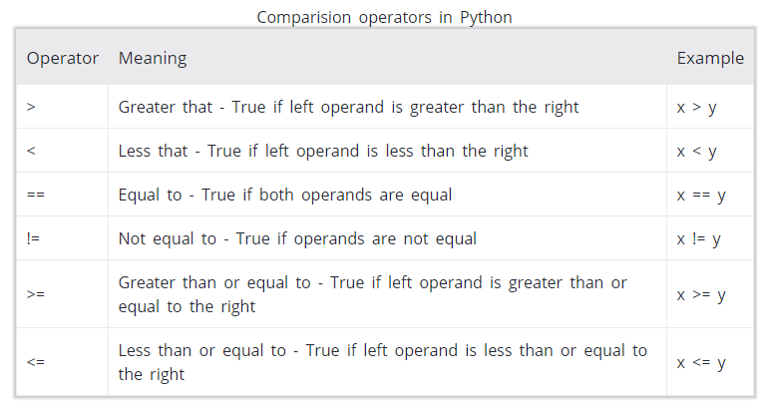
Comparison / relational operators It either returns True or False according to the condition.

Slide 40
x = 10
y = 12
print('x > y is',x>y)
print('x < y is',x<y)
print('x == y is',x==y)
print('x != y is',x!=y)
print('x >= y is',x>=y)
print('x <= y is',x<=y)

Slide 41
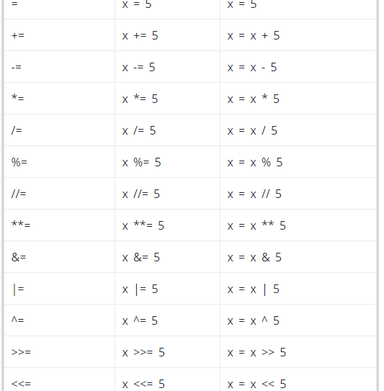
Assignment Operators

Slide 42
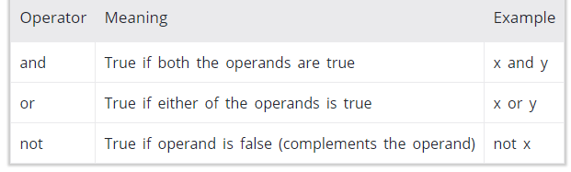
Logical operators
x = True
y = False
# Output: x and y is False
print('x and y is',x and y)
# Output: x or y is True
print('x or y is',x or y)
# Output: not x is False
print('not x is',not x)

Slide 43
Identity operators
is and is not are the identity operators in Python. They are used to check if two values (or variables) are located on the same part of the memory. Two variables that are equal does not imply that they are identical.
Here, we see that x1 and y1 are integers of same values, so they are equal as well as identical. Same is the case with x2 and y2 (strings).
But x3 and y3 are list. They are equal but not identical. It is because interpreter locates them separately in memory although they are equal.
x1 = 5
y1 = 5
x2 = 'Hello'
y2 = 'Hello'
x3 = [1,2,3]
y3 = [1,2,3]
print(x1 is not y1) # Output: False
print(x2 is y2) # Output: True
print(x3 is y3) # Output: False

Slide 44
Membership operators
in and not in are the membership operators in Python. They are used to test whether a value or variable is found in a sequence (string, list, tuple, set and dictionary). In a dictionary we can only test for presence of key, not the value.
Here, 'H' is in x but 'hello' is not present in x (remember, Python is case sensitive). Similary, 1 is key and 'a' is the value in dictionary y. Hence, 'a' in y returns False.
x = 'Hello world'
y = {1:'a',2:'b'}
print('H' in x) # Output: True
print('hello' not in x) # Output: True
print(1 in y) # Output: True
print('a' in y) # Output: False

Slide 45
Programs
num1 = 1.5
num2 = 6.3
sum = float(num1) + float(num2)
print('The sum of {0} and {1} is {2}'.format(num1, num2, sum))
______________________________________________________
num = float(input('Enter a number: '))
num_sqrt = num ** 0.5
print('The square root of %0.3f is %0.3f'%(num ,num_sqrt))
______________________________________________________
a=b=c=5
s = (a + b + c) / 2
area = (s*(s-a)*(s-b)*(s-c)) ** 0.5
print('The area of the triangle is %0.2f' %area)

Slide 46
# Solve the quadratic equation ax**2 + bx + c = 0
import cmath
a = float(input('Enter a: '))
b = float(input('Enter b: '))
c = float(input('Enter c: '))
d = (b**2) - (4*a*c)
sol1 = (-b-cmath.sqrt(d))/(2*a)
sol2 = (-b+cmath.sqrt(d))/(2*a)
print('The solution are {0} and {1}'.format(sol1,sol2))
________________________________________________
import random
Random.seed(10)
print(random.randint(0,9)) # only 1 random value
numpy.random.randint(0,9,size=4) # only 4 random values
random.sample(range(9),4) # only 4 Unique values

Slide 47
import numpy
import random
numpy.random.seed(9)
numpy.random.randint(0,100,size=5)
___________________________________________
import random
random.seed(88)
random.sample(range(100),10)
__________________________________
import random
a = ["a","b","c"] # a =“Welcome”
print(random.choice(a))

Slide 48
celsius = 37.5
fahrenheit = (celsius * 1.8) + 32
print('%0.1f degree Celsius is equal to %0.1f degree Fahrenheit' %(celsius,fahrenheit))
____________________________________________________
import calendar
yy = int(input("Enter year: "))
mm = int(input("Enter month: "))
print(calendar.month(yy, mm))

Slide 49
Searching in the list
num = [1,2,3,4,5]
i = int(input('number'))
for item in num:
if (i==item):
print(f'number {item} is available in the list')

Slide 50
65 % 10 + 65 // 10
a = int(input())
c=0
while a!= 0:
c=c+(a%10)
a=a//10
print(c)
sum((list(int(x) for x in str(655))))

Slide 51
n = (input("enter a number: "))
sum = 0
for digit in str(n):
sum += int(digit)
print(sum)
num=input("enter any digits more than one digit:")
sum=int(num[0])+int(num[1])
print(sum)
num = int(input("enter a number"))
result=0
while num>0:
m=num%10
result =result+m
num=num//10
print("sum:",result)

Slide 52
Looping and Branching
if statement
if..else statements
nested if statements
if-elif ladder
For loop
While loop

Slide 53
If else
a = 200 b = 33 if b > a: print("b is greater than a") elif a == b: print("a and b are equal") else: print("a is greater than b“)
a = 200 b = 33 if b > a: print("b is greater than a") else: print("b is not greater than a")
Notes:
a = 900
b = 900
if b > a:
print("b is greater than a")
elif a == b:
print("a and b are equal")
else:
print("a is greater than b")

Slide 54
if a > b: print("a is greater than b")
print("A") if a > b else print("B")
print("A") if a > b else print("=") if a == b else print("B")
if a > b and c > a: print("Both conditions are True")
if a > b or a > c: print("At least one of the conditions is True")

Slide 55
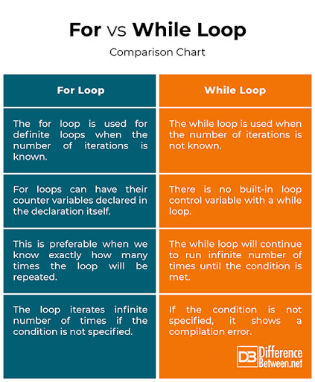

Slide 56
Loop
num = int(input("Display multiplication table of? "))
for i in range(1, 11):
print(num,'x',i,'=',num*i)
_________________________________________________
import calendar
yy = int(input("Enter year: "))
mm = int(input("Enter starting month: "))
mm1 = int(input("Enter ending month: "))
for i in range(mm,mm1+1):
print(calendar.month(yy,i))
________________________________________________
calendar.calendar(yy)

Slide 57
While
# n = int(input("Enter n: "))
n = 0
# initialize sum and counter
sum = 10
i = 1
while i <= n:
sum = sum + i
i = i+1 # update counter
# print the sum
print("The sum is", sum)
counter = 0
while counter < 3:
print("Inside loop")
counter = counter + 1
else:
print("Inside else")

Slide 58
Break
for val in "string":
if val == "i":
break
print(val)
print("The end")
___________________
for val in "string":
if val == "i":
continue
print(val)
print("The end")
In Python programming, the pass statement is a null statement. The difference between a comment and a pass statement in Python is that while the interpreter ignores a comment entirely, pass is not ignored.
However, nothing happens when the pass is executed. It results in no operation (NOP).
'''pass is just a placeholder for
functionality to be added later.'''
sequence = {'p', 'a', 's', 's'}
for val in sequence:
pass
def function(args):
pass
class Example:
pass

Slide 59
Functions
def greet(name):
"""
This function greets to
the person passed in as
a parameter
"""
print("Hello, " + name + ". Good morning!")
greet('Paul')
__________________________________
print(greet.__doc__) #Docstrings
__________________________________
def my_func():
x = 10
print("Value inside function:",x)
x = 20
my_func()
print("Value outside function:",x)
def add_numbers(x,y):
sum = x + y
return sum
num1 = 5
num2 = 6
print("The sum is", add_numbers(num1, num2))

Slide 60
Function with Arguments
def greet(name, msg):
"""This function greets to the person with the provided message"""
print("Hello", name + ', ' + msg)
greet("Monica", "Good morning!")
def greet(name, msg="Good morning!"):
"""
This function greets to
the person with the
provided message.
If the message is not provided,
it defaults to "Good
morning!"
"""
print("Hello", name + ', ' + msg)
greet("Kate")
greet("Bruce", "How do you do?")
def greet1(*names): #Arbitrary Arguments
"""This function greets all
the person in the names tuple."""
# names is a tuple with arguments
for name in names:
print("Hello", name)
greet("Monica", "Luke", "Steve", "John")

Slide 61
Python Anonymous/Lambda Function
In Python, an anonymous function is a function that is defined without a name.While normal functions are defined using the def keyword in Python, anonymous functions are defined using the lambda keyword.Hence, anonymous functions are also called lambda functions.
lambda arguments: expression
# Program to show the use of lambda functions
double = lambda x: x * 2
print(double(5))
def double(x):
return x * 2
my_list = [1, 5, 4, 6, 8, 11, 3, 12]
new_list = list(filter(lambda x: (x%2 == 0) , my_list))
print(new_list)
my_list = [1, 5, 4, 6, 8, 11, 3, 12]
new_list = list(map(lambda x: x * 2 , my_list))
print(new_list)
Notes:
import statistics
num=[1,3,4,5,5,6,6,6]
print('1 . mean')
print('2 . median')
print('3 . mode')
z=int(input('Enter the option: '))
if z == 1:
print('mean :',statistics.mean(num))
elif z == 2:
print('median :',statistics.median(num))
elif z == 3:
print('mode :',statistics.mode(num))

Slide 62
Modules
# Python Module example example.py and keep it inside the script folder
def add(a, b):
"""This program adds two
numbers and return the result"""
result = a + b
return result
import example
example.add(4,5.5)
import example
example.path
dir(example)

Slide 63
a=[45,55,2,67,1]
a.pop(3)
____________________
list = [4, 5, 2, 6, 7, 8, 10]
res = list[-2:]
print(res)

Slide 64
NUMPY - Numerical Python
NumPy is a general-purpose array-processing package. It provides a high-performance multidimensional array object, and tools for working with these arrays.
A powerful N-dimensional array object
Sophisticated (broadcasting) functions
Tools for integrating C/C++ and Fortran code
Useful linear algebra, Fourier transform, and random number capabilities
!pip show numpy

Slide 65
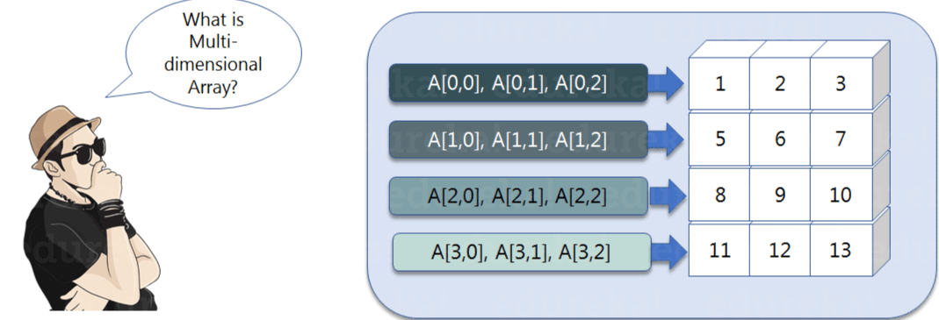
import numpy as np
a=np.array([(1,2,3),(4,5,6)])
A

Slide 66
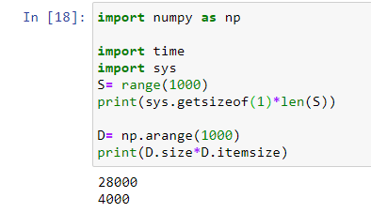
Python NumPy Array v/s List
We use python numpy array instead of a list because of the below three reasons:
Less Memory
Fast
Convenient
Notes:
import time
import sys
S = range(1000)
print(sys.getsizeof(1)*len(S))
D = np.arange(1000)
print(D.size*D.itemsize

Slide 67
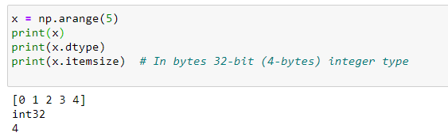
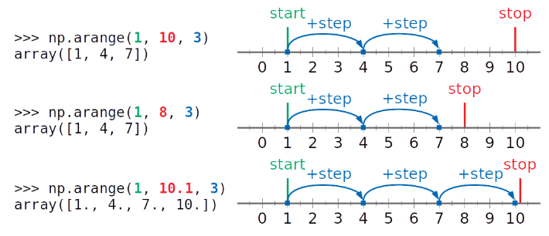
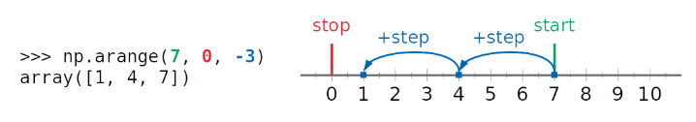
Np.arange
np.arange(1,11,3)

Slide 68
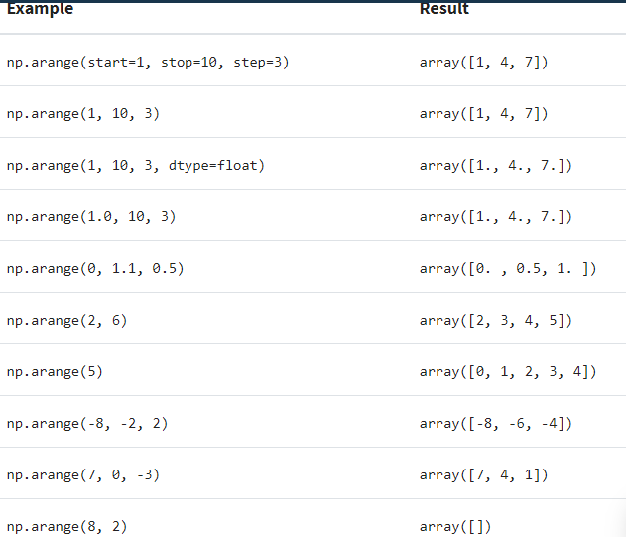
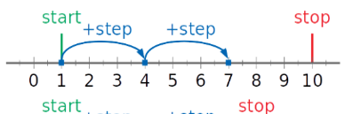

Slide 69
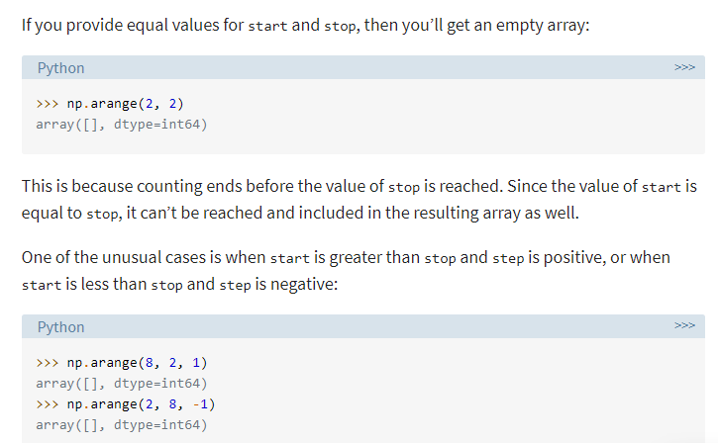
Empty array
np.arange(1,8,3)[::-1]
np.flip(np.arange(1,8,3))
a=np.arange(6).reshape(2,3)
a

Slide 70
ndim
Find the dimension of the array, whether it is a two-dimensional array or a single dimensional array
import numpy as np
a1=np.array([1,2,3])
a2= np.array([(1,2,3),(4,5,6)])
a3 = np.array([((1,2,3),(4,5,6)),((1,2,3),(4,5,6))])
print(a1.ndim)
print(a2.ndim)
print(a3.ndim)

Slide 71
itemsize
calculate the byte size of each element
import numpy as np
a = np.array([(1,2,3)])
print(a.itemsize)

Slide 72
dtype
find the data type of the elements that are stored in an array. So, if you want to know the data type of a particular element, you can use ‘dtype’ function which will print the datatype along with the size.
import numpy as np
a = np.array([(1,2,3)])
print(a.dtype)

Slide 73
‘size’ and ‘shape’
find the size and shape of the array using ‘size’ and ‘shape’ function respectively.
import numpy as np
a = np.array([(1,2,3,4,5,6)])
a1 = np.array([(1,2,3),(4,5,6)])
print(a.size)
print(a.shape)

Slide 74
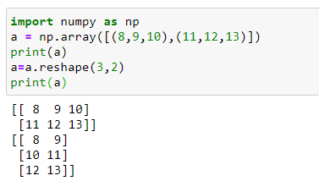
Reshape
Reshape is when you change the number of rows and columns which gives a new view to an object.
import numpy as np
a1 = np.array([(1,2,3),(4,5,6)])
a1
a2=a1.reshape(3,2)
a2

Slide 75
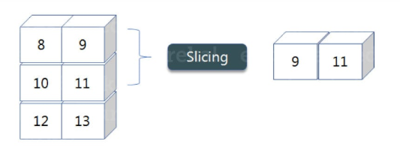
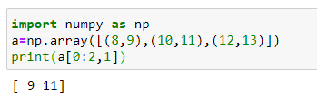
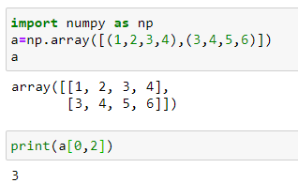
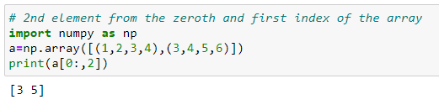
slicing
Slicing is basically extracting particular set of elements from an array.
a = np.array([(8,9), (10,11), (12,13)])
print(a[0:2,1])

Slide 76
linspace
returns evenly spaced numbers over a specified interval.
import numpy as np
a=np.linspace(1,3,10)
print(a)
It has printed 10 values between 1 to 3

Slide 77
max/ min
import numpy as np
a= np.array([1,2,3])
print(a.min())
print(a.max())
print(a.sum())

Slide 78
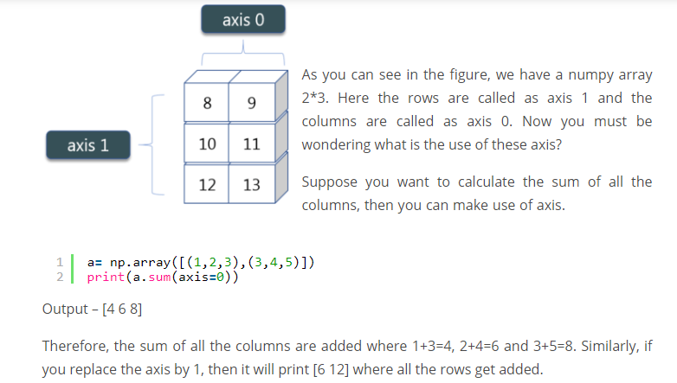
axis
a = np.array([(8,9), (10,11), (12,13)])
a
print(a.sum(axis=0))
print(a.sum(axis=1))

Slide 79
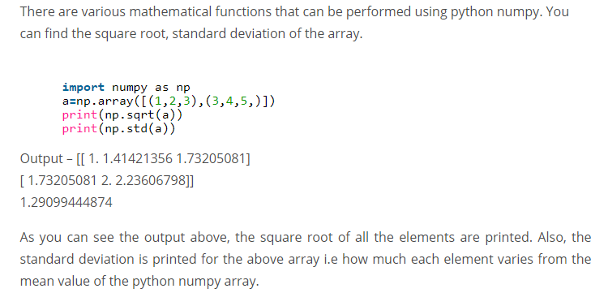
Square Root & Standard Deviation

Slide 80
import numpy as np
x= np.array([(1,2,3),(3,4,5)])
y= np.array([(1,2,3),(3,4,5)])
print(x+y)
print(x-y)
print(x*y)
print(x/y)

Slide 81
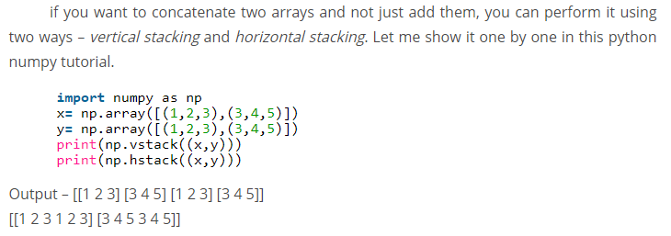
Vertical & Horizontal Stacking
x= np.array([(1,2,3),(3,4,5)])
y= np.array([(1,2,3),(3,4,5)])
print(np.vstack((x,y)))
print(np.hstack((x,y)))

Slide 82
ravel
convert one numpy array into a single column i.e ravel.
import numpy as np
x= np.array([(1,2,3),(3,4,5)])
print(x.ravel())

Slide 83
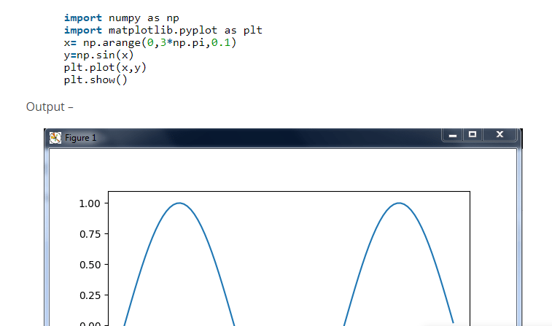
%matplotlib inline

Slide 84
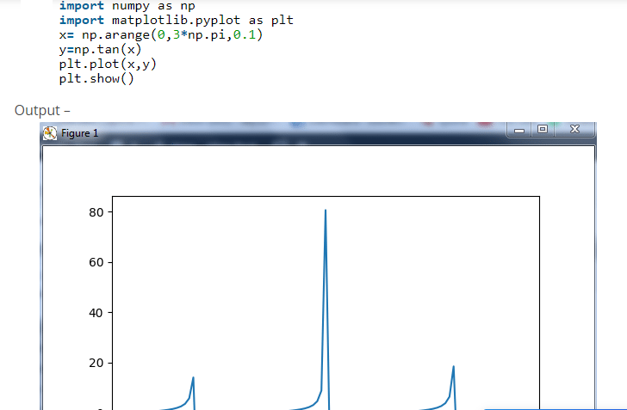

Slide 85
Now in exponential, the e value is somewhere equal to 2.7 and in log, it is actually log base 10. When we talk about natural log i.e log base e, it is referred as Ln.
a= np.array([1,2,3])
print(np.exp(a))
import numpy as np
import matplotlib.pyplot as plt
a= np.array([1,2,3])
print(np.log(a))
print(np.log10(a))

Slide 86
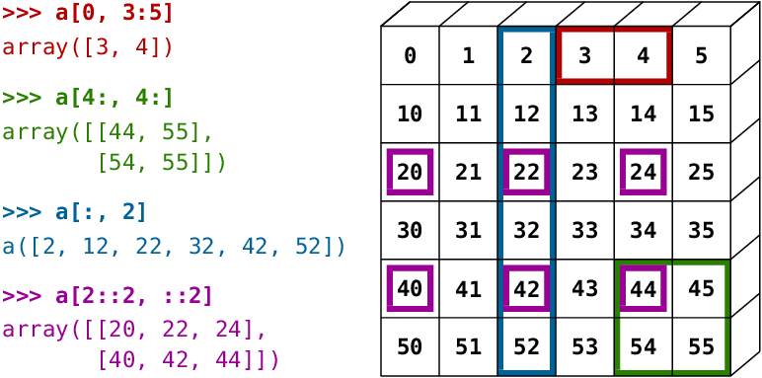

Slide 87
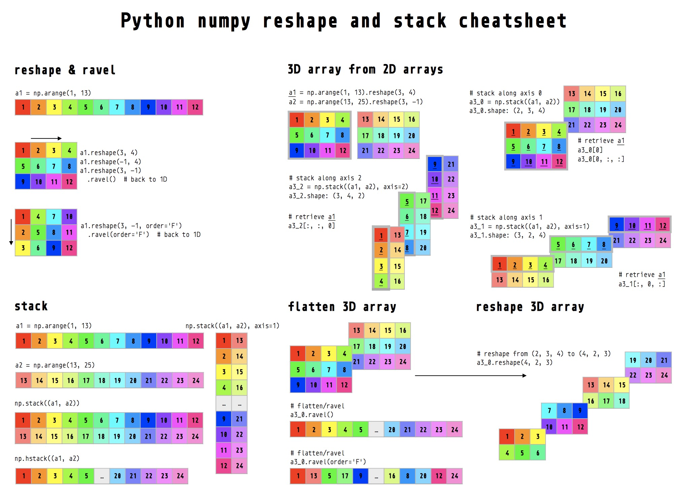

Slide 88
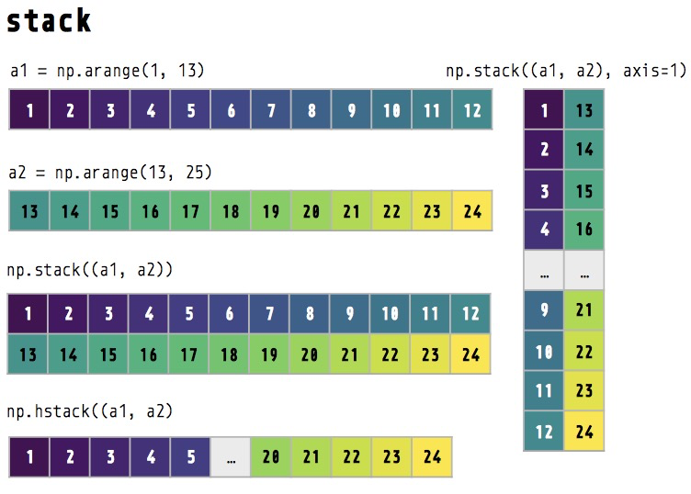

Slide 89
print(np.nonzero([1,2,0,0,4,0]))
print(np.zeros(10)) #null vector of size 10
#null vector of size 10 but the fifth value which is 1
Z = np.zeros(10)
Z[4] = 1
print(Z)
#Create a vector with values ranging from 10 to 49
Z = np.arange(10,50)
print(Z)
#Reverse a vector (first element becomes last)
Z = np.arange(50)
Z = Z[::-1]

Slide 90
#Create a 3x3 matrix with values ranging from 0 to 8
Z = np.arange(9).reshape(3,3)
print(Z)
#Create a 3x3 identity matrix
Z = np.eye(3)
print(Z)

Slide 91
#Create a 3x3x3 array with random values
Z = np.random.random((3,3,3))
print(Z)
#Create a 10x10 array with random values and find the minimum and maximum values
Z = np.random.random((10,10))
Zmin, Zmax = Z.min(), Z.max()
print(Zmin, Zmax)
#Create a random vector of size 30 and find the mean value
Z = np.random.random(30)
m = Z.mean()
print(m)

Slide 92
#Create a 2d array with 1 on the border and 0 inside
Z = np.ones((10,10))
Z[1:-1,1:-1] = 0
#Create a 5x5 matrix with values 1,2,3,4 just below the diagonal
Z = np.diag(1+np.arange(4),k=-1)
print(Z)
#Create a 8x8 matrix and fill it with a checkerboard pattern
Z = np.zeros((8,8),dtype=int)
Z[1::2,::2] = 1
Z[::2,1::2] = 1
print(Z)

Slide 93
#Consider a (6,7,8) shape array, what is the index (x,y,z) of the 100th element?
print(np.unravel_index(100,(6,7,8)))
#Extract the integer part of a random array using 5 different methods
Z = np.random.uniform(0,10,10)
print (Z - Z%1)
print (np.floor(Z))
print (np.ceil(Z)-1)
print (Z.astype(int))
print (np.trunc(Z))

Slide 94
PANDAS
Pandas stands for “Python Data Analysis Library ”. According to the Wikipedia page on Pandas, “the name is derived from the term “panel data”, an econometrics term for multidimensional structured data sets.”
Pandas is a software library written for the Python programming language for data manipulation and analysis. In particular, it offers data structures and operations for manipulating numerical tables and time series. It is free software released under the three-clause BSD license.

Slide 95
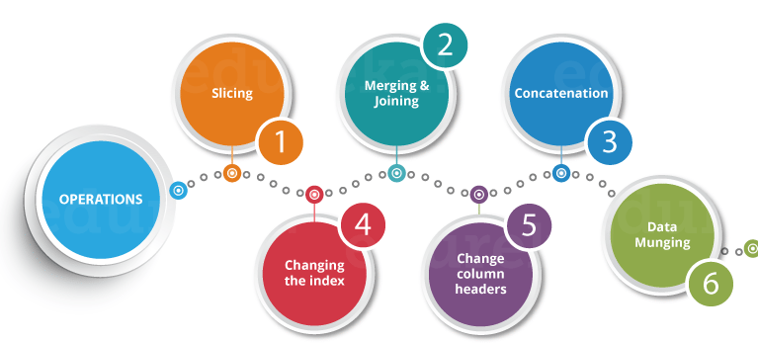

Slide 96
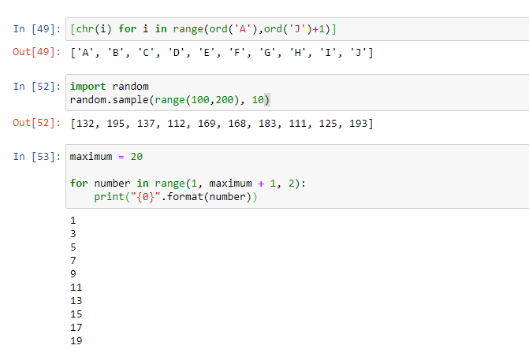

Slide 97
Create DataFrame with 3 columns with conditions
import random
Import pandas as pd
l = []
for i in range (1,20) :
if(i %2 != 0):
l.append(i)
l1= []
for letter in 'abcdefghij':
l1.append(letter)
l2=random.sample(range(1,100),10)
df=pd.DataFrame(list(zip(l,l1,l2)))
print(df)
Notes:
import random
import pandas as pd
import numpy as np
b = np.arange(1,20,2)
a = np.arange(65,75,1)
c = []
for i in a:
c.append(chr(i))
Z = np.random.randint(100,200,10)
df=pd.DataFrame(list(zip(b,c,Z)))
df=pd.DataFrame({"Q1":b, "Q2":c,"Q3":Z})
print(df)

Slide 98
import pandas as pd
import numpy as np
import string
z= []
letters = []
for num in range(1, 20):
if num % 2 != 0:
z.append(num)
for c in range(97, 107):
letters.append(chr(c))
numbers = np.random.randint(100,200,10)
df=pd.DataFrame({“col1":z,“col2":letters,“col3":numbers})
df

Slide 99
Dataframe with Multiple values
import random
import datetime
col1 = [chr(65 + i) for i in range(0,10)]
col2 = [chr(97 + i) for i in range(0,10)]
col3 = [random.randint(100,200) for i in range(10)]
col4 = random.sample(range(100,200), 10)
col5 = [i for i in range(0,20) if i%2 != 0]
col6 = datetime.datetime.now()
df=pd.DataFrame({"a":col1,"b":col2,"c":col3,"d":col4,"e":col5,"f":col6})
df

Slide 100
Upload data from local machine
A1 = pd.read_csv("Amazon Superstore_updated.csv" , encoding="unicode_escape")
A1
import pandas as pd
df = pd.read_csv("Amazon.csv" , engine = "python")
df

Slide 101
Reading data using pandas
#Read csv file
df = pd.read_csv(" https://github.com/mgoycoolea/PythonDataScienceCourse/blob/master/Python-for-Data-Analysis/Pandas/Pandas%20Exercises/Salaries.csv")
In [ ]:
There is a number of pandas commands to read other data formats:
pd.read_excel('myfile.xlsx',sheet_name='Sheet1', index_col=None, na_values=['NA'])
pd.read_stata('myfile.dta')
pd.read_sas('myfile.sas7bdat')
pd.read_hdf('myfile.h5','df')
Notes:
import pandas as pd
import numpy as np
df = pd.read_csv("https://docs.google.com/spreadsheets/d/e/2PACX-1vQLnRgw8s4DSyfpPqB_IUXpb9W3n_JspPbscAUCB_8JlRM3rBC5qUATUPS-DY0xPg/pub?gid=1119289715&single=true&output=csv")
df

Slide 102
import pandas mydataset = { 'cars': [“Apple", “Mango", “Banana"], 'passings': [3, 7, 2] } myvar = pandas.DataFrame(mydataset) print(myvar)
print(myvar[0])
__________________________________________________
A Pandas Series is like a column in a table.
It is a one-dimensional array holding data of any type.
import pandas as pd
a = [1, 7, 2]
myvar = pd.Series(a)
print(myvar)
import pandas as pd
a = [1, 7, 2]
myvar = pd.Series(a, index = ["x", "y", "z"])
print(myvar)
print(myvar["y"])
_______________________________
import pandas as pd
calories = {"day1": 420, "day2": 380, "day3": 390}
myvar = pd.Series(calories)
print(myvar)

Slide 103
import pandas as pd calories = {"day1": 420, "day2": 380, "day3": 390} myvar = pd.Series(calories, index = ["day1", "day2"]) print(myvar)

Slide 104
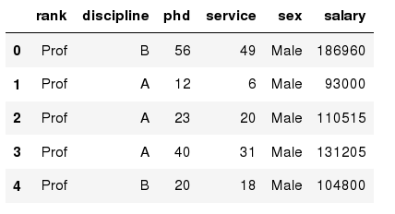
Exploring data frames
In [3]:
#List first 5 records
df.head()
Out[3]:

Slide 112
Data Frame data types
Pandas Type | Native Python Type | Description
object | string | The most general dtype. Will be assigned to your column if column has mixed types (numbers and strings).
int64 | int | Numeric characters. 64 refers to the memory allocated to hold this character.
float64 | float | Numeric characters with decimals. If a column contains numbers and NaNs(see below), pandas will default to float64, in case your missing value has a decimal.
datetime64, timedelta[ns] | N/A (but see the datetime module in Python’s standard library) | Values meant to hold time data. Look into these for time series experiments.

Slide 113
Data Frame data types
In [4]:
#Check a particular column type
df['salary'].dtype
Out[4]: dtype('int64')
In [5]:
#Check types for all the columns
df.dtypes
Out[4]:
object
object
int64
int64
object
int64
rank
discipline
phd
service
sex
salary
dtype: object

Slide 114
Data Frames attributes
Python objects have attributes and methods.
df.attribute | description
dtypes | list the types of the columns
columns | list the column names
axes | list the row labels and column names
ndim | number of dimensions
size | number of elements
shape | return a tuple representing the dimensionality
values | numpy representation of the data

Slide 115
Hands-on exercises
Find how many records this data frame has;
How many elements are there?
What are the column names?
What types of columns we have in this data frame?

Slide 116
Data Frames methods
Unlike attributes, python methods have parenthesis.
All attributes and methods can be listed with a dir() function: dir(df)
df.method() | description
head( [n] ), tail( [n] ) | first/last n rows
describe() | generate descriptive statistics (for numeric columns only)
max(), min() | return max/min values for all numeric columns
mean(), median() | return mean/median values for all numeric columns
std() | standard deviation
sample([n]) | returns a random sample of the data frame
dropna() | drop all the records with missing values

Slide 117
Selecting a column in a Data Frame
Method 1: Subset the data frame using column name:
df['sex']
Method 2: Use the column name as an attribute:
df.sex
Note: there is an attribute rank for pandas data frames, so to select a column with a name "rank" we should use method 1.

Slide 118
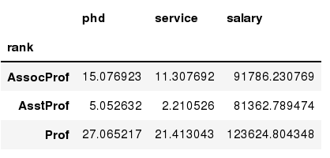
Data Frames groupby method
Using "group by" method we can:
Split the data into groups based on some criteria
Calculate statistics (or apply a function) to each group
Similar to dplyr() function in R
In [ ]:
#Group data using rank
df_rank = df.groupby(['rank'])
In [ ]:
#Calculate mean value for each numeric column per each group
df_rank.mean()

Slide 119
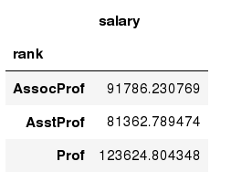
Data Frames groupby method
Once groupby object is create we can calculate various statistics for each group:
In [ ]:
#Calculate mean salary for each professor rank:
df.groupby('rank')[['salary']].mean()
Note: If single brackets are used to specify the column (e.g. salary), then the output is Pandas Series object. When double brackets are used the output is a Data Frame

Slide 120
Data Frames groupby method
groupby performance notes:
- no grouping/splitting occurs until it's needed. Creating the groupby object only verifies that you have passed a valid mapping
- by default the group keys are sorted during the groupby operation. You may want to pass sort=False for potential speedup:
In [ ]:
#Calculate mean salary for each professor rank:
df.groupby(['rank'], sort=False)[['salary']].mean()

Slide 121
Data Frame: filtering
To subset the data we can apply Boolean indexing. This indexing is commonly known as a filter. For example if we want to subset the rows in which the salary value is greater than $120K:
In [ ]:
#Calculate mean salary for each professor rank:
df_sub = df[ df['salary'] > 120000 ]
Any Boolean operator can be used to subset the data:
> greater; >= greater or equal;
< less; <= less or equal;
== equal; != not equal;
In [ ]:
#Select only those rows that contain female professors:
df_f = df[ df['sex'] == 'Female' ]

Slide 122
Data Frames: Slicing
There are a number of ways to subset the Data Frame:
one or more columns
one or more rows
a subset of rows and columns
Rows and columns can be selected by their position or label

Slide 123
Data Frames: Slicing
When selecting one column, it is possible to use single set of brackets, but the resulting object will be a Series (not a DataFrame):
In [ ]:
#Select column salary:
df['salary']
When we need to select more than one column and/or make the output to be a DataFrame, we should use double brackets:
In [ ]:
#Select column salary:
df[['rank','salary']]

Slide 124
Data Frames: Selecting rows
If we need to select a range of rows, we can specify the range using ":"
In [ ]:
#Select rows by their position:
df[10:20]
Notice that the first row has a position 0, and the last value in the range is omitted:
So for 0:10 range the first 10 rows are returned with the positions starting with 0 and ending with 9

Slide 125
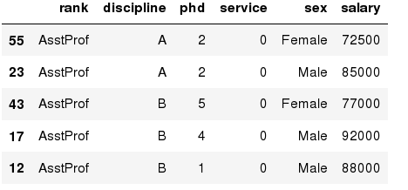
Data Frames: Sorting
We can sort the data by a value in the column. By default the sorting will occur in ascending order and a new data frame is return.
In [ ]:
# Create a new data frame from the original sorted by the column Salary
df_sorted = df.sort_values( by ='service')
df_sorted.head()
Out[ ]:

Slide 126
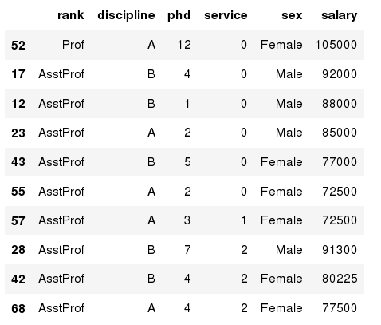
Data Frames: Sorting
We can sort the data using 2 or more columns:
In [ ]:
df_sorted = df.sort_values( by =['service', 'salary'], ascending = [True, False])
df_sorted.head(10)
Out[ ]:

Slide 127
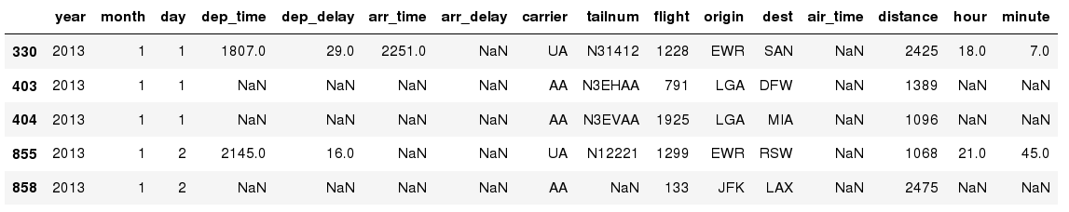
Missing Values
Missing values are marked as NaN
In [ ]:
# Read a dataset with missing values
flights = pd.read_csv("http://rcs.bu.edu/examples/python/data_analysis/flights.csv")
In [ ]:
# Select the rows that have at least one missing value
flights[flights.isnull().any(axis=1)].head()
Out[ ]:

Slide 128
Missing Values
There are a number of methods to deal with missing values in the data frame:
df.method() | description
dropna() | Drop missing observations
dropna(how='all') | Drop observations where all cells is NA
dropna(axis=1, how='all') | Drop column if all the values are missing
dropna(thresh = 5) | Drop rows that contain less than 5 non-missing values
fillna(0) | Replace missing values with zeros
isnull() | returns True if the value is missing
notnull() | Returns True for non-missing values

Slide 129
Missing Values
When summing the data, missing values will be treated as zero
If all values are missing, the sum will be equal to NaN
cumsum() and cumprod() methods ignore missing values but preserve them in the resulting arrays
Missing values in GroupBy method are excluded (just like in R)
Many descriptive statistics methods have skipna option to control if missing data should be excluded . This value is set to True by default (unlike R)

Slide 130
print(df['A'].isnull())
# Making a list of missing value types
missing_values = ["n/a", "na", "--"]
df = pd.read_csv("property data.csv", na_values = missing_values)
# Total missing values for each feature
print(df.isnull().sum())
# Any missing values?
print(df.isnull().values.any())

Slide 131
# Total number of missing values
print(df.isnull().sum().sum())
# Replace missing values with a number
df['ST_NUM'].fillna(125, inplace=True)
# Location based replacement
df.loc[2,'ST_NUM'] = 125
# Replace using median
median = df['A'].median()
df['A'].fillna(median, inplace=True)

Slide 132
Aggregation Functions in Pandas
Aggregation - computing a summary statistic about each group, i.e.
compute group sums or means
compute group sizes/counts
Common aggregation functions:
min, max
count, sum, prod
mean, median, mode, mad
std, var

Slide 133
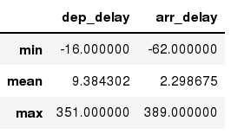
Aggregation Functions in Pandas
agg() method are useful when multiple statistics are computed per column:
In [ ]:
flights[['dep_delay','arr_delay']].agg(['min','mean','max'])
Out[ ]:

Slide 134
Basic Descriptive Statistics
df.method() | description
describe | Basic statistics (count, mean, std, min, quantiles, max)
min, max | Minimum and maximum values
mean, median, mode | Arithmetic average, median and mode
var, std | Variance and standard deviation
sem | Standard error of mean
skew | Sample skewness
kurt | kurtosis

Slide 135
Graphics to explore the data
Seaborn package is built on matplotlib but provides high level interface for drawing attractive statistical graphics, similar to ggplot2 library in R. It specifically targets statistical data visualization
To show graphs within Python notebook include inline directive:
In [ ]:
%matplotlib inline

Slide 136
Graphics
 | description
distplot | histogram
barplot | estimate of central tendency for a numeric variable
violinplot | similar to boxplot, also shows the probability density of the data
jointplot | Scatterplot
regplot | Regression plot
pairplot | Pairplot
boxplot | boxplot
swarmplot | categorical scatterplot
factorplot | General categorical plot

Slide 137
Slicing the Data Frame
import pandas as pd
XYZ_web= {'Day':[1,2,3,4,5,6], "Visitors":[1000, 700,6000,1000,400,350], "Bounce_Rate":[20,20, 23,15,10,34]}
df= pd.DataFrame(XYZ_web)
print(df)

Slide 138
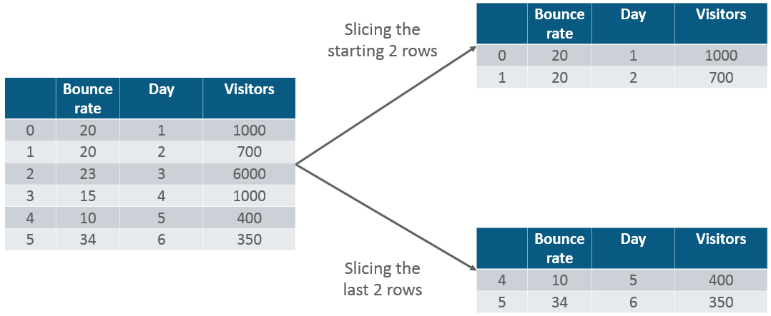
print(df.head()) #first 5 rows print(df.head(2))# first 2 rows print(df.tail(2)) #last 2 rows df.iloc[2:4] or df[2:4] #Middle row df[5:21:5]

Slide 139
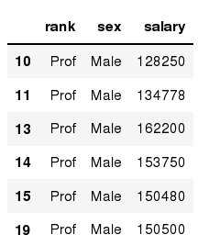
Data Frames: method loc
If we need to select a range of rows, using their labels we can use method loc:
In [ ]:
#Select rows by their labels:
df_sub.loc[10:20,['rank','sex','salary']]
Out[ ]:

Slide 140
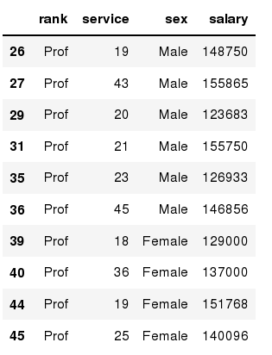
Data Frames: method iloc
If we need to select a range of rows and/or columns, using their positions we can use method iloc:
In [ ]:
#Select rows by their labels:
df_sub.iloc[10:20,[0, 3, 4, 5]]
Out[ ]:

Slide 141
Data Frames: method iloc (summary)
df.iloc[0] # First row of a data frame
df.iloc[i] #(i+1)th row
df.iloc[-1] # Last row
df.iloc[:, 0] # First column
df.iloc[:, -1] # Last column
df.iloc[0:7] #First 7 rows
df.iloc[:, 0:2] #First 2 columns
df.iloc[1:3, 0:2] #Second through third rows and first 2 columns
df.iloc[[0,5], [1,3]] #1st and 6th rows and 2nd and 4th columns

Slide 142
loc gets rows (or columns) with particular labels from the index.
iloc gets rows (or columns) at particular positions in the index (so it only takes integers).
print(df.loc[df['Age'] < 30, ['Color', 'Height']])
print(df.iloc[(df['Age'] < 30).values, [1, 3]])

Slide 143
# Single selections using iloc and DataFrame
# Rows:
data.iloc[0] # first row of data frame
data.iloc[1] # second row of data frame
data.iloc[-1] # last row of data frame
# Columns:
data.iloc[:,0] # first column of data frame
data.iloc[:,1] # second column of data frame
data.iloc[:,-1] # last column of data frame
# Multiple row and column selections using iloc and DataFrame
data.iloc[0:5] # first five rows of dataframe
data.iloc[:, 0:2] # first two columns of data frame with all rows
data.iloc[[0,3,6,24], [0,5,6]] # 1st, 4th, 7th, 25th row + 1st 6th 7th columns.
data.iloc[0:5, 5:8] # first 5 rows and 5th, 6th, 7th columns of data frame

Slide 144
# Select rows with first name Antonio, # and all columns between 'city' and 'email'
data.loc[data['first_name'] == 'Antonio', 'city':'email']
# Select rows where the email column ends with 'hotmail.com', include all columns
data.loc[data['email'].str.endswith("hotmail.com")]
# Select rows with last_name equal to some values, all columns
data.loc[data['first_name'].isin(['France', 'Tyisha', 'Eric'])]
# Select rows with first name Antonio AND hotmail email addresses
data.loc[data['email'].str.endswith("gmail.com") & (data['first_name'] == 'Antonio')]

Slide 145
# select rows with id column between 100 and 200, and just return 'postal' and 'web' columns
data.loc[(data['id'] > 100) & (data['id'] <= 200), ['postal', 'web']]
# A lambda function that yields True/False values can also be used.
# Select rows where the company name has 4 words in it.
data.loc[data['company_name'].apply(lambda x: len(x.split(' ')) == 4)]
# Selections can be achieved outside of the main .loc for clarity:
# Form a separate variable with your selections:
idx = data['company_name'].apply(lambda x: len(x.split(' ')) == 4)
# Select only the True values in 'idx' and only the 3 columns specified:
data.loc[idx, ['email', 'first_name', 'company']]

Slide 146
# ix indexing works just the same as .loc when passed strings
data.ix[['Andrade']] == data.loc[['Andrade']]
# ix indexing works the same as .iloc when passed integers.
data.ix[[33]] == data.iloc[[33]]
# ix only works in both modes when the index of the DataFrame is NOT an integer itself.
# Change the first name of all rows with an ID greater than 2000 to "John"
data.loc[data['id'] > 2000, "first_name"] = "John"
# Change the first name of all rows with an ID greater than 2000 to "John"
data.loc[data['id'] > 2000, "first_name"] = "John“
* https://www.shanelynn.ie/select-pandas-dataframe-rows-and-columns-using-iloc-loc-and-ix/

Slide 147
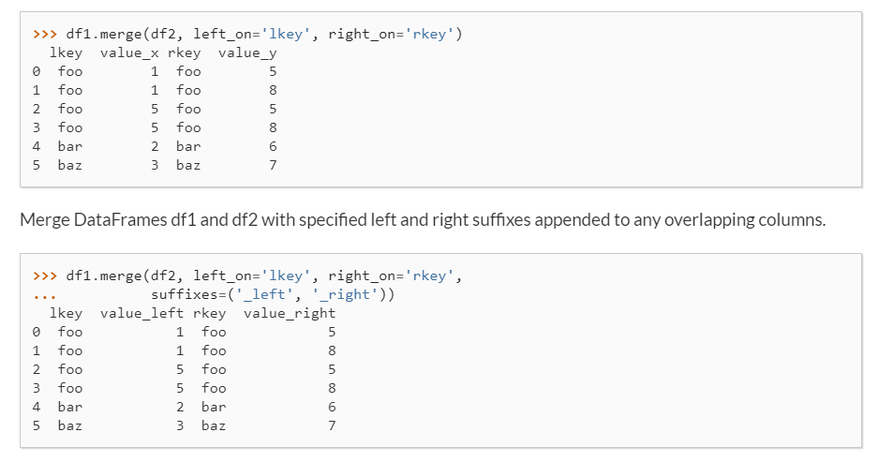
Merge
df1 = pd.DataFrame({'lkey': ['foo', 'bar', 'baz', 'foo'], 'value': [1, 2, 3, 5]})
df2 = pd.DataFrame({'rkey': ['foo', 'bar', 'baz', 'foo'],'value': [5, 6, 7, 8]})
df1.merge(df2, left_on='lkey', right_on='rkey’)
df1.merge(df2, left_on='lkey', right_on='rkey',suffixes=('_left', '_right'))

Slide 148
df1 = pd.DataFrame({"HPI":[80,90,70,60],"Int_Rate":[2,1,2,3], "IND_GDP":[50,45,45,67]}, index=[2001, 2002,2003,2004])
df2 = pd.DataFrame({"HPI":[80,90,70,60],"Int_Rate":[2,1,2,3],"IND_GDP":[50,45,45,67]}, index=[2005, 2006,2007,2008])
merged= pd.merge(df1,df2,on ="HPI")
merged

Slide 149
Joining
This is quite similar to the “merge” operation, except the joining operation will be on the “index” instead of the “columns”. Let us implement it practically.
df1 = pd.DataFrame({"Int_Rate":[2,1,2,3], "IND_GDP":[50,45,45,67]}, index=[2001, 2002,2003,2004])
df2 = pd.DataFrame({"Low_Tier_HPI":[50,45,67,34],"Unemployment":[1,3,5,6]}, index=[2001, 2003,2004,2004])
joined= df1.join(df2)
print(joined)

Slide 150
Concatenation
Concatenation basically glues the dataframes together. You can select the dimension on which you want to concatenate. For that, just use “pd.concat” and pass in the list of dataframes to concatenate together.
df1 = pd.DataFrame({"HPI":[80,90,70,60],"Int_Rate":[2,1,2,3], "IND_GDP":[50,45,45,67]}, index=[2001, 2002,2003,2004])
df2 = pd.DataFrame({"HPI":[80,90,70,60],"Int_Rate":[2,1,2,3],"IND_GDP":[50,45,45,67]}, index=[2005, 2006,2007,2008])
concat= pd.concat([df1,df2])
print(concat)

Slide 151
the two dataframes are glued together in a single dataframe, where the index starts from 2001 all the way upto 2008. Next, you can also specify axis=1 in order to join, merge or cancatenate along the columns.
df1 = pd.DataFrame({"HPI":[80,90,70,60],"Int_Rate":[2,1,2,3], "IND_GDP":[50,45,45,67]}, index=[2001, 2002,2003,2004])
df2 = pd.DataFrame({"HPI":[80,90,70,60],"Int_Rate":[2,1,2,3],"IND_GDP":[50,45,45,67]}, index=[2005, 2006,2007,2008])
concat= pd.concat([df1,df2],axis=1)
print(concat)

Slide 152
Change the Column Headers
import pandas as pd
df = pd.DataFrame({"Day":[1,2,3,4], "Visitors":[200, 100,230,300], "Bounce_Rate":[20,45,60,10]})
df = df.rename(columns={"Visitors":"Users"})
print(df)

Slide 153
Data Munging
In Data munging, you can convert a particular data into a different format. For example, if you have a .csv file, you can convert it into .html or any other data format as well.
import pandas as pd
country= pd.read_csv("D:UsersAayushiDownloadsworld-bank-youth-unemploymentAPI_ILO_country_YU.csv",index_col=0)
country.to_html('edu.html')

Slide 154
df[‘Temp’].value_counts # Frequency of each no
index = pd.Index([2, 2, 5, 3, 4, np.nan])
index.value_counts()
25 / 10 + 25 % 10

Slide 155
Questions
What is the average age of the Titanic passengers?
What is the median age and ticket fare price of the Titanic passengers?
What is the average age for male versus female Titanic passengers?
What is the mean ticket fare price for each of the sex and cabin class combinations?
What is the number of passengers in each of the cabin classes?
import seaborn as sns
t1 = sns.load_dataset("titanic")
t1.head()
sns.get_dataset_names()

Slide 156
Summary Statistics
#What is the average age of the Titanic passengers?
t1["age"].mean()
#What is the median age and ticket fare price of the Titanic passengers?
t1[["age", "fare"]].median()

Slide 157
t1[["age", "fare"]].describe()
t1.agg({"age": ["min", "max", "median", "skew"],"fare": ["min", "max", "median", "mean"],})
//skewness is the measure of how much the probability distribution of a random variable deviates from the normal distribution
#What is the average age for male versus female Titanic passengers?
t1[["sex", "age"]].groupby("sex").mean()
t1.groupby("sex").mean()
t1.groupby("sex")["age"].mean()

Slide 158
#What is the mean ticket fare price for each of the sex and cabin class combinations?
t1.groupby(["sex", "pclass"])["fare"].mean()
#What is the number of passengers in each of the cabin classes?
t1["pclass"].value_counts()
or
titanic.groupby("Pclass")["Pclass"].count()

Slide 159
Mean
(4 + 8 + 6 + 5 + 3 + 2 + 8 + 9 + 2 + 5) / 10 = 5.2
def my_mean(sample):
return sum(sample) / len(sample)
my_mean([4, 8, 6, 5, 3, 2, 8, 9, 2, 5] )
import statistics
statistics.mean([4, 8, 6, 5, 3, 2, 8, 9, 2, 5])
Arr = [1,2,3,4,5]
numpy.mean(Arr)

Slide 160
Median
If the sample has an odd number of observations, then the middle value in the sorted sample is the median
If the sample has an even number of observations, then we'll need to calculate the mean of the two middle values in the sorted sample
If we have the sample [3, 5, 1, 4, 2] and want to find its median, then we first sort the sample to [1, 2, 3, 4, 5]. The median would be 3 since that's the value in the middle.
On the other hand, if we have the sample [1, 2, 3, 4, 5, 6], then its median will be (3 + 4) / 2 = 3.5.

Slide 161
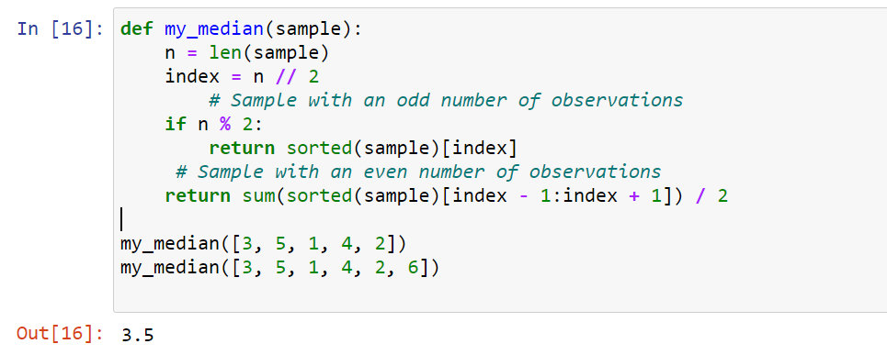
def my_median(sample):
n = len(sample)
index = n // 2
# Sample with an odd number of observations
if n % 2:
return sorted(sample)[index]
# Sample with an even number of observations
return sum(sorted(sample)[index - 1:index + 1]) / 2
my_median([3, 5, 1, 4, 2])
my_median([3, 5, 1, 4, 2, 6])
import statistics
statistics.median([3, 5, 1, 4, 2])
statistics.median([3, 5, 1, 4, 2, 6])

Slide 162
Mode
The mode is the most frequent observation (or observations) in a sample. If we have the sample [4, 1, 2, 2, 3, 5], then its mode is 2 because 2 appears two times in the sample whereas the other elements only appear once.
The mode doesn't have to be unique. Some samples have more than one mode. Say we have the sample [4, 1, 2, 2, 3, 5, 4]. This sample has two modes 2 and 4 because they're the values that appear more often and both appear the same number of times.
The mode is commonly used for categorical data. Common categorical data types are:
Boolean - Can take only two values like in true or false, male or female
nominal - Can take more than two values like in American - European - Asian - African
ordinal - Can take more than two values but the values have a logical order like in few - some – many
When we're analyzing a dataset of categorical data, we can use the mode to know which category is the most common in our data.

Slide 163
from collections import Counter
def my_mode(sample):
c = Counter(sample)
return [k for k, v in c.items() if v == c.most_common(1)[0][1]]
my_mode(["male", "male", "female", "male"])
my_mode(["few", "few", "many", "some", "many"])
my_mode([4, 1, 2, 2, 3, 5])
my_mode([4, 1, 2, 2, 3, 5, 4])
We first count the observations in the sample using a Counter object (c). Then, we use a list comprehension to create a list containing the observations that appear the same number of times in the sample.
Since .most_common(1) returns a list with one tuple of the form (observation, count), we need to get the observation at index 0 in the list and then the item at index 1 in the nested tuple. This can be done with the expression c.most_common(1)[0][1]. That value is the first mode of our sample.
Note that the comprehension's condition compares the count of each observation (v) with the count of the most common observation (c.most_common(1)[0][1]). This will allow us to get multiple observations (k) with the same count in the case of a multi-mode sample.

Slide 164
import statistics
statistics.mode([4, 1, 2, 2, 3, 5])
statistics.mode([4, 1, 2, 2, 3, 5, 4])
statistics.mode(["few", "few", "many", "some", "many"])

Slide 165
Python 3.8 we can also use statistics.multimode() which accepts an iterable and returns a list of modes.
import statistics
statistics.multimode([4, 1, 2, 2, 3, 5, 4])
statistics.multimode(["few", "few", "many", "some", "many"])
st.multimode([4, 1, 2, 2, 3, 5])

Slide 166
Calculate a probability in python
A=[10,30,20,10,10]
calculate the probability of receiving a value of 10? (10 occurs 3 times in total, 3/5 = 0.6)
import numpy as np
import collections
npArray= np.array([10,30,20,10,10])
c=collections.Counter(npArray)
c # Generate a dictionary {"value":"nbOfOccurrences"}
arraySize=npArray.size
nbOfOccurrences=c[10] #assuming you want the proba to get 10
proba=(nbOfOccurrences/arraySize)*100
print(proba) #print 60.0

Slide 167
Permutations and combinations
import itertools
st ="Manish"
per = itertools.permutations(st)
for val in per:
print(*val)
_______________________________
import itertools
st =[1,2,3,4]
per = itertools.permutations(st)
for val in per:
print(*val)

Slide 168
import itertools
st =[1,2,3,4]
per = itertools.permutations(st,2)
for val in per:
print(*val)

Slide 169
import random
random.seed(5)
print(random.randint(0,100)) # only 1 random value
_______________________________
import numpy
numpy.random.randint(0,100,size=4) # only 4 random values
_______________________________
random.sample(range(100),40) # only 4 Unique values

Slide 170
variance
import statistics
A = [23, 42, 77, 68, 35]
print(statistics.variance(A))
import statistics
A = [23, 42, 77, 68, 35]
statistics.mean(A)
statistics.variance(A)

Slide 171
Measures the spread of the data about the mean value
A = [15,15,15,14,16]
B = [2,7,14,22,30]
print(statistics.mean(A))
print(statistics.stdev(A))
print(statistics.mean(B))
print(statistics.stdev(B))
import statistics
A = [23, 42, 77, 68, 35]
statistics.stdev(A)
import statistics
A = [1,2,3,4,5]
print(statistics.mean(A))
print(statistics.variance(A))
print(statistics.stdev(A))

Slide 172
import seaborn as sns
t1 = sns.load_dataset("iris")
t1.head()
https://github.com/mwaskom/seaborn-data

