Slide 1
4th Year STUDENTS
ORIENTATION
August 25, 2023

Slide 2
AGENDA
Capstone42
Electives
Graduating Students Requirements and activities

Slide 3
Capstone42
1. Orientation
2. Capstone Project Advisers’ Forum
3. Skills Test - Individual machine-based programming component for grading
4. Oral Defense Manuscript Writing
5. System Planning and Analysis
6. System Designing
7. System Development
8. System Testing
9. Oral Defense (Required Face to Face)
10. Research/Capstone Projects Colloquium/Forum

Slide 4
Capstone 42 Guidelines
Orientation.
On the first week of classes, a general orientation will be conducted where this Capstone Project Manual will be discussed again and reiterated.
All students will then be required to secure the Oath of Confirmation pertaining to receipt of copy and discourse about of said manual

Slide 5
2. Capstone Project Advisers’ Forum.
Each team adviser must meet her/his teams in one setting.
General and specific issues and concerns must be reported and settled.
Furthermore, if there are changes or the Dean and Subject Teacher approved team regrouping, a new duly- signed copy of the Team Composition Form

Slide 6
Capstone Guidelines
3. Skills Test.
Each Capstone42 student must take the Skills Test which is an important component of the grading system.
This is an individual machine-based programming exam and does not in any way involve team activities.

Slide 7
4. Finalization of the List of Modules.
The Project Manager and her/his team must finalize the List of Modules.
The adviser must check that the same list is anchored from the title, objectives and scope.

Slide 8
5. Adviser-Team Consultation.
The team will continue doing formal consultations with their adviser.
This time, each team is required of at least 3 consultation cycles imposing extent of completion of modules. Filled-up Capstone 42 Consultation Logs Form.
The adviser and the project manager will affix their signatures in each formal consultation.
Said form will be required in the processing of the Oral Defense Hearing Notice.
Hence, the adviser will be made to endorse the team whether or not they are allowed to defend their project or not.

Slide 9
6. Panel-Team Consultation.
The team can, from time to time, consult any member of the Panel to whom they proposed/defended for clarifications of their recommendations.
The panel member must ensure that academic integrity is observed and therefore must not be biased in any form/aspect.

Slide 10
7. Censor-Team Consultation.
The team will once again consult to the Censor/Technical Editor, this time, the Oral Defense Manuscript incorporating additional chapters/section and the ACM-formatted Manuscript.
The Censor/Technical Editor will once again certify and endorse the team’s manuscripts for oral defense. (Censor/Technical Editor’s Certificate Template)

Slide 11
8. Oral Defense Manuscript Finalization.
The manuscript for Capstone42 must be completed and finalized by the team and their adviser and duly-checked by the censor.
There is an official outline to follow
Oral Defense Manuscript Mechanics must be strictly followed

Slide 12
9. Oral Defense Presentation Preparation.
The oral defense presentation must be prepared well by the team.
It must strictly follow the set outline and rules.. It must be precisely-timed and must be duly-checked by both adviser and censor.

Slide 13
11. Processing of Oral Defense Hearing Notice and Form 10.
After all the necessary steps will have been complied, the team will secure the ff:
Oral Defense Hearing Notice Form
Panel Honoraria (Form 10).

Slide 14
Together with the 2 forms will be the following requirements to be submitted to your Instructor:
1 copy of the complete Oral Defense Manuscript
5 copies of the complete ACM-formatted Manuscript
Consultation Logs Form with Adviser’s Endorsement
Technical Editor/Censor’s Certificate

Slide 15
12. Oral Defense.
If the 2 forms are successfully processed, the team will then undergo the oral defense as scheduled.
Oral Defense Rules and Mechanics will have to be followed and strictly adhered.
During the proceedings, the Technical Editor/Censor and Adviser will take note of all the recommendations of the Oral Defense panel.

Slide 16
13. Oral Defense Manuscript Revisions.
The team and adviser will ensure that all the recommendations will have been incorporated in the Revised Oral Defense Manuscript with the corresponding title page.

Slide 17
14. System output Revisions.
The team then implements all the recommendations not only of the manuscript but also the equally-important system or output.
Said revisions will be bases of the panel member(s) in the signing of the Approval Sheet

Slide 18
15. Oral Defense Approval Sheet Routing.
The team then routes the Oral Defense Approval Sheet together with the revised system output to all required signatories.

Slide 19
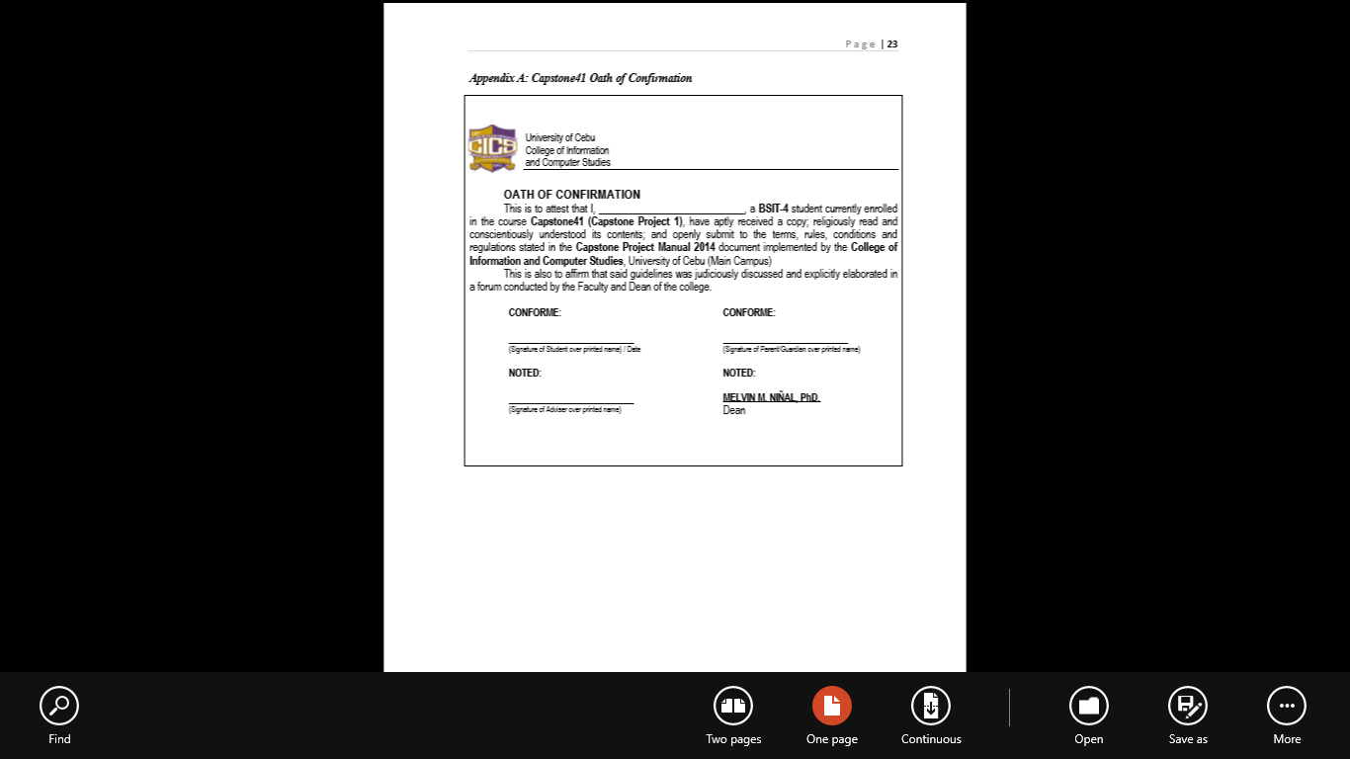

Slide 20
Grading System
Manuscript is complete (complete required revisions from Capstone41/Thesis41 ) | 5
Skills Test (Individual, ON THE SPOT) | 20
Panels Grade:
Output(developed System)[Group Grade]
- Title= Objectives= Output | 20
- Scope = Modules = Output | 20
- System = Method = Output | 10
Oral Presentation | 25
TOTAL | 100

Slide 21
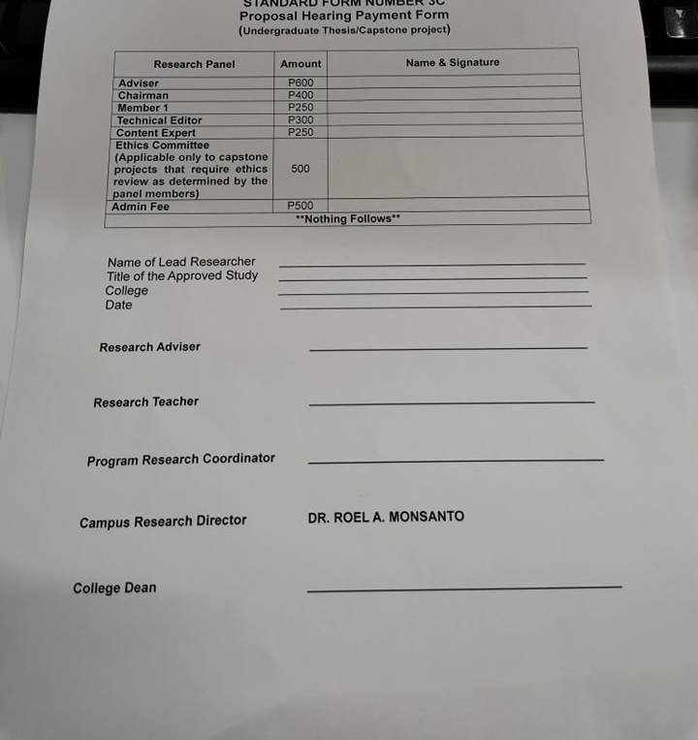
Standard Form Number 3C
Position | Honorarium
Adviser | PHP 600.00
Chairman | PHP 400.00
Panel Member 1 | PHP 250.00
Content Expert | PHP 250.00
Administrative Fee | PHP 500.00
TOTAL | PHP 2,000.00
* Process on your own. Ask Ms. Gian for instructions/process
** Still to submit to Research for Grammarly and Plagiarism Check (P100.00) up to 3 attempts only

Slide 22
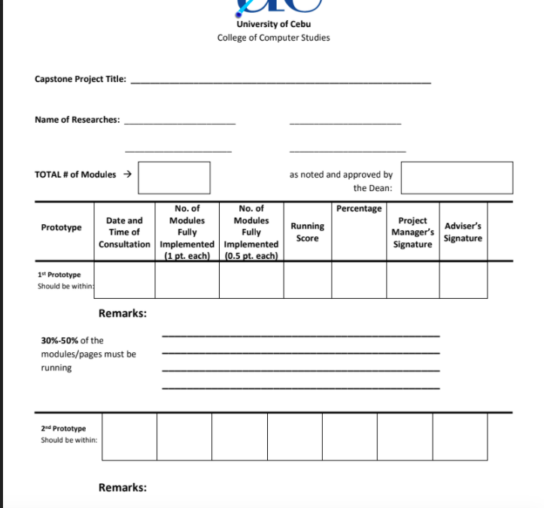
Consultation Logs

Slide 23
Compiled Corrections and Required Changes in the Manuscript
Rationale of the Study
Objectives of the Study
Scope of the Study
Flow of the Study
References - Updated references – 2018-2022
Proper Citations, end notes and paraphrasing
Theoretical Background
Related Literature
Related Studies
HLDs based on the discussion
BMC/Validation Board/Questionnaires
Database Design
Formal Picture (2x2), no selfie picture
Copy of the Grammarly
Approval Sheet - same title as the title page

Slide 24
Additional Documents
Testing Tools
Selenium
Open source technology
Automating browser-based applications
Risk Management Plan/Framework
User Guide
Installation Guide
Project Roadmap

Slide 25
Calendar of Activities
September 22, 2023 : 50%
October 20, 2023 : 60%
November 24, 2023 : 80%
December 7, 2023 : 90%
January 8-10, 2024 : Final Defense and Skills Test
January 22, 2024 : Final Manuscript
*Dates are subject to change

Slide 26
Concerns/Issues
Lacking team members during Final Defense
cannot present / reschedule until all members are complete
Absent during the skills test
considered as zero
non-compliance to required revisions from Capstone41 or incomplete
Capstone42 will not be signed or grade will not be submitted / may have INC
Submission of Hardbound manuscript and CD
receipts in lieu of harbound - not allowed

Slide 27
Concerns/Issues
Regrouping is allowed if less than 50% of the members passed from Capstone/Thesis41
Consultation Logs
Review tech stack - make sure familiar and follow the assigned module

Slide 28
ELECTIVES
IT ELEC 3 | Information Security 2 /Cybersecurity | Alliance Software Inc
IT ELEC 4 | ReactJS | Alliance Software Inc
FREE EL 4 | Nihonggo

Slide 29
Questions?

