Slide 1
Jest JavaScript Unit testing
Mark Westerlund
Jared Moser
SWENG 431

Slide 2

Agenda
What Is Jest?
Pros and Cons
Functional Features
Usage Examples

Slide 3

Introduction
Why did we choose Jest?
Ease of configuration
Familiarity with JavaScript
Familiarity with the Framework
Easy to understand documentation

Slide 4
What is Jest
JavaScript Unit Testing Framework

Slide 5
What is Jest?
Frameworks
Jest is a framework and library agnostic unit testing framework for JavaScript and TypeScript. Jest works by taking advantage of the way JavaScript treats functions as first-class objects attached to objects. This allows the framework to easily isolate functions and classes to perform tests only on the desired unit.
Jest works with any JavaScript library or framework
React
Vue
Angular
Node
JavaScript or TypeScript
Babel
Webpack

Slide 6
Pros and Cons
Jest

Slide 7
Pros
What Jest does well
Pros
Easy Configuration
Jest requires almost no configuration.
Simple but rich API
Jest’s API and naming convention allow the user to easily understand how to use it.
Jest is also extendable and popular, so other plugins are available if the native API isn’t enough.
Easy Mocking of JavaScript functions
Jest allows functions to be “spied on” meaning Jest knows when a function has been called.
Jest mocking allows on the fly alteration of function implementation.
Easy to understand faults and errors.
Expected and received values are displayed like a git diff.
Faults and errors are presented with context for quick analyzations.

Slide 8
Cons
What Jest Struggles with
Cons
Unable to mock language object constructors
Has difficulty spying on native language constructors.
Asynchronous unit testing can be tricky
There are several ways to mock asynchronous functions which can make it difficult to know what to use when
Function responses inside loops can be difficult to work with
Mocking return values can be tricky inside loops.
Strictly does unit testing
There is no ability to test web API calls.

Slide 9
Functional Features
Jest

Slide 10
Global Functions
Test Blocks
Set up and Tear down
Test/It() Functions
All tests are contained within a test or an it block
Contains a name and a test function
Executes the tests inside the function
Describe()
Groups tests together for common setup and tear down
Makes tests more readable.
AfterAll()
Executes tear down after all tests are completed
After Each()
Executes tear down after each test runs
BeforeAll()
Sets up before any test is executed
BeforeEach()
Executes before ever test is executed

Slide 11
Expect Clauses
Expect Clauses are assertions for tests in Jest
Expect(Value)
Expect takes in an operation or function as its parameter and is extended with a matcher function.
Matcher functions is what Jest tests the actual value against.
toEqual()
Matcher that explicitly matches a value.
Deep matching of all objects and arrays
.not.
Negates the matcher that is executed after the .not. in the function chain
Expect.any()
Tests whether an object is an instance of a particular type or class.
.toBeUndefined()
Tests whether a value is explicitly undefined.
Other matchers can be used for null, NaN, truthy, and falsey.
.toHaveBeenCalled()
Matcher to test executions of mocked functions.
Other matchers include .toHaveBeenCalledWith() and .toHaveBeenCalledTimes()

Slide 12
Mocked Functions
Mocked functions replace a function implementation for a test
SpyOn
SpyOn takes in a class instance and an function name then replaces its implementation with a Jest mock function.
jest.spyOn(myClass, 'function2’)
Jest.fn()
Creates a jest mock function by assignment
window.fetch = jest.fn()
.mockImplementation()
Replaces the implementation of a function with another test specific function
function3 = jest.fn().mockImplementation((i) => i.id)
.mockReturnValue()
Replaces the implementation of a function and only returns the value defined.
Jest.fn().mockReturnValue( 'returned');

Slide 13
Feature Examples
Jest

Slide 14
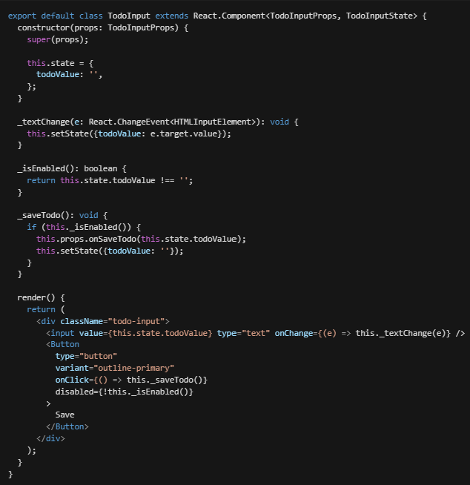
Unit Test Example
This is an example of using Jest to unit test a single React class component written in TypeScript. This test is run using two files “TodoInput.tsx” and “TodoInput.test.tsx.”
A full example of working code can be found at:
www.github.com/MwesterlundDev/todo-app

Slide 15

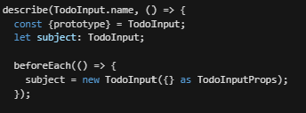
Test Suite Set up
To begin setting up the tests for this class, the necessary modules must be imported at the top of the file
After the modules are imported, the testing suite is set up. This is where the subject instance is created, which allows jest to spy on an instance of the class being tested.

Slide 16
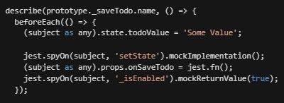
Test Set up
Each function then gets its own testing suite in a describe block. Each function also sets up its own tests using a beforeEach() unique to each function test suite.
The setState function only requires a mocked implemenation because it is a void function. This means the only thing that can be tested is the function has been called, and what it was called with.
The onSaveTodo function on the prop passed in to the class has to be mocked out by reassigning the function with a jest mock function. The jest.fn() object acts exactly the same as the jest.spyOn().mockImplementation().
The _isEnabled() function is mocked with a return value because this function returns a boolean that is necessary to prevent an empty value from being added to the list.

Slide 17
Test Set up
Each function then gets its own testing suite in a describe block. Each function also sets up its own tests using a beforeEach() unique to each function test suite.
The setState function only requires a mocked implemenation because it is a void function. This means the only thing that can be tested is the function has been called, and what it was called with.
The onSaveTodo function on the prop passed in to the class has to be mocked out by reassigning the function with a jest mock function. The jest.fn() object acts exactly the same as the jest.spyOn().mockImplementation().
The _isEnabled() function is mocked with a return value because this function returns a boolean that is necessary to prevent an empty value from being added to the list.

Slide 18
Test Set up
Each function then gets its own testing suite in a describe block. Each function also sets up its own tests using a beforeEach() unique to each function test suite.
The setState function only requires a mocked implemenation because it is a void function. This means the only thing that can be tested is the function has been called, and what it was called with.
The onSaveTodo function on the prop passed in to the class has to be mocked out by reassigning the function with a jest mock function. The jest.fn() object acts exactly the same as the jest.spyOn().mockImplementation().
The _isEnabled() function is mocked with a return value because this function returns a boolean that is necessary to prevent an empty value from being added to the list.

Slide 19


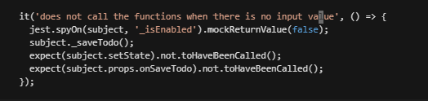
Test Execution
Looking at each line in the _saveTodo function, there are four tests that need to be created. A test for calling onSaveTodo and setState each for when _isEnabled returns true, and a test for each of these calls for when _isEnabled returns false.
Test for SaveTodo
Test for setState
Tests for when _isEnabled is false

Slide 20
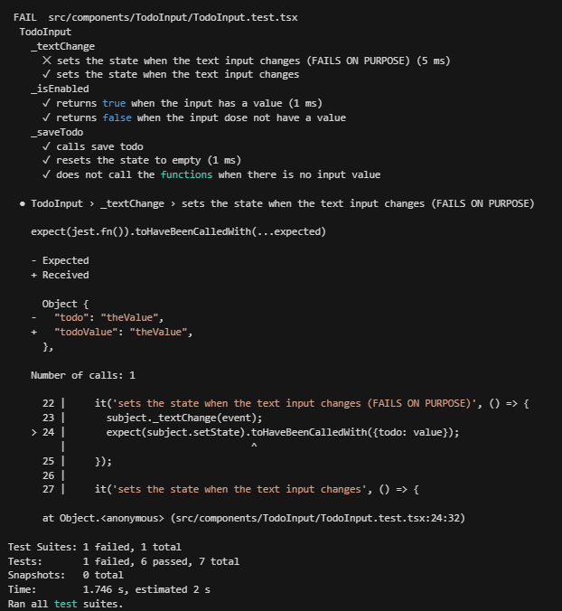
Jest CLI example
This is an example of using Jest CLI to run tests
Tests that fail are labeled with an ‘x’.
Tests that pass are labeled with a check mark.
Detailed description for each failed test is laved and shows specifically what failed in the test.
The line number of the failed test along with a few lines of context are show to find the faulty test.
The total run details are listed after all other information.
An interactive CLI environment allows the user to narrow down tests and suites more in depth.

Slide 21
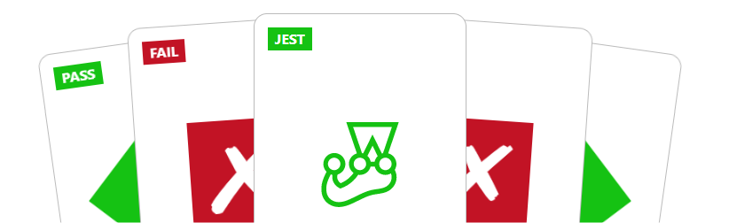

Summary
Jest is an extremely powerful Unit testing suite for JavaScript. Jest’s ability to manipulate JavaScript function and object allows for easy test isolation and more accurate coverage. Jest is framework and library agnostic, which allows it to be used with any type of JavaScript and TypeScript.

Slide 22




Thank you
Mark Westerlund and Jared Moser
maw5114@psu.edu
https://jestjs.io/

