Slide 1
Intro to RMarkdown
Kaitlin Flynn
Schloss lab meeting
1-25-16

Slide 2

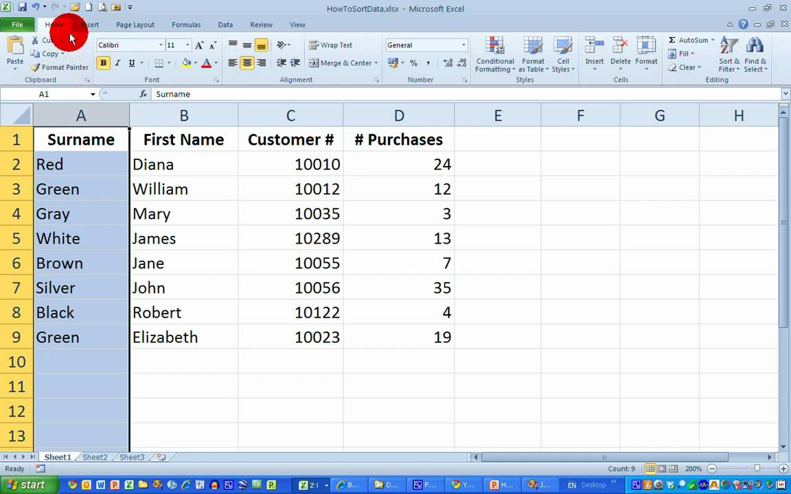

Old school: research reports
But what if something changes? What if you repeat an experiment? What if you find out your values were calculated improperly?
What if someone wants to use your data? See how you did something? Are you going to have your PI send them Excel formulas??

Slide 3
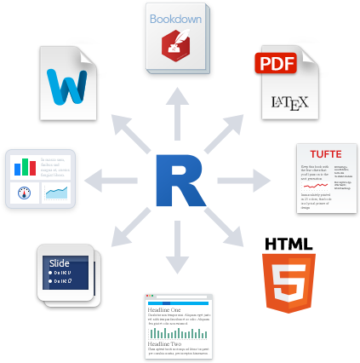


New school: reproducible reports
If you need to change a value – do it once in R
Report generated through RMarkdown will incorporate the new value into calculations and reports
Need to add a figure? Can do that without renumbering by hand
Someone wants your data or formulas? Easy!

Slide 4
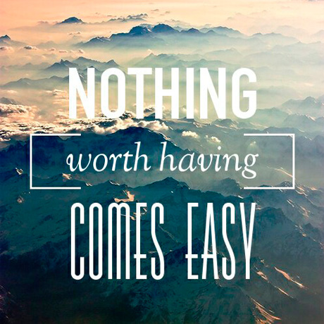

Slide 5
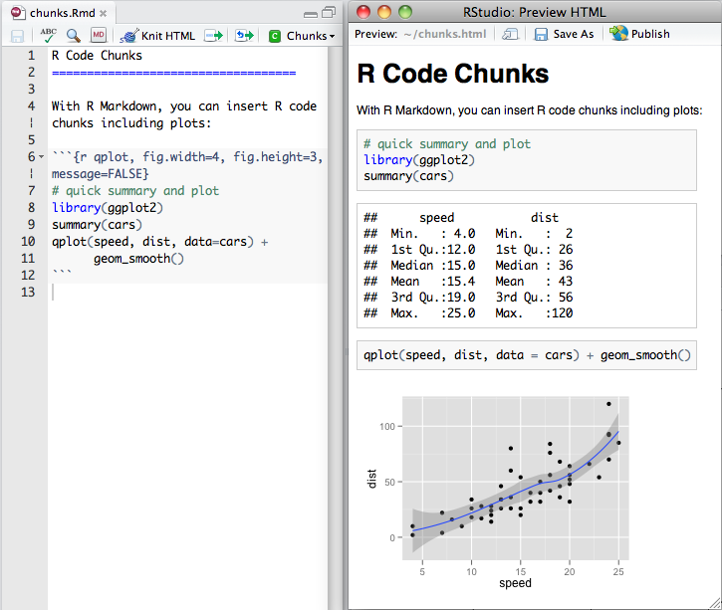
R + Markdown = RMarkdown

Slide 6

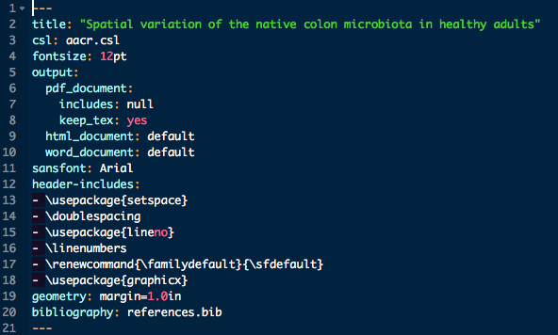
The bones of an .Rmd- Header

Slide 7
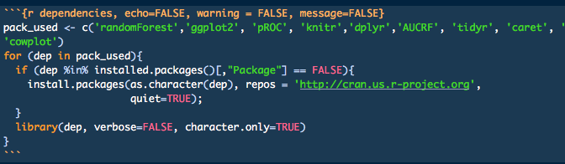
Chunks and parameters

Slide 8
Chunk parameters
There are tons
Code evaluation
Results
Plots
https://www.rstudio.com/wp-content/uploads/2015/03/rmarkdown-reference.pdf

Slide 9
Text and formatting
Headers, bullets, bold, italics
# Header
## smaller header
* bullet
+ sub bullet
**bold**, _italic_
Inline values
“There were `r length(thing)` things in the room”
“There were 8 things in the room”

Slide 10
Demo a basic RMD

Slide 11
Exercises!
https://github.com/kjflynn/rmd_labmeeting

Slide 12
Advanced tricks from senior members of the lab
Anyone?

Slide 13
Advanced exercise
Create a bibliography for your report using bibtex
Cite a paper about diamonds
Create a file called references.bib in the repo
Put the bibtex citation in there
https://www.doi2bib.org/
Add bibliography: references.bib to header
Reference in the text using [@paper]
Knit!

