Slide 1
Intro to RMarkdown
Kaitlin Flynn
Schloss lab meeting
1-25-18

Slide 2

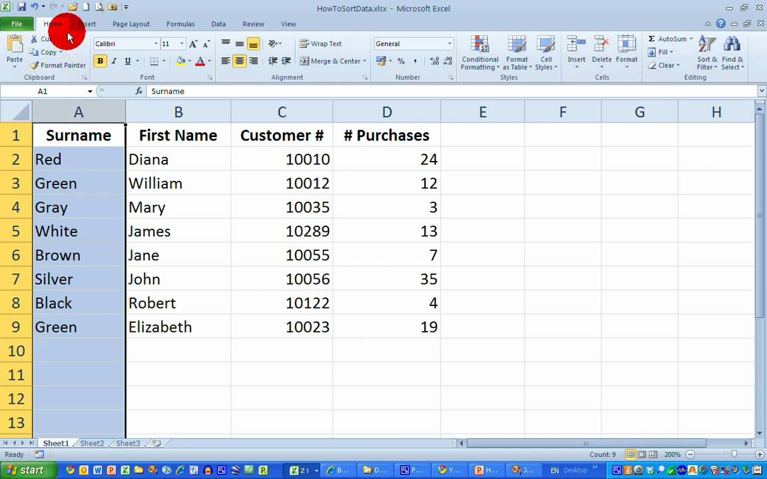

Old school: research reports
But what if something changes? What if you repeat an experiment? What if you find out your values were calculated improperly?
What if someone wants to use your data? See how you did something? Are you going to have your PI send them Excel formulas??

Slide 3
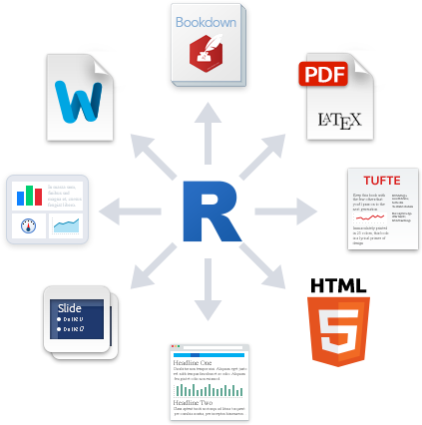


New school: reproducible reports
If you need to change a value – do it once in R
Report generated through RMarkdown will incorporate the new value into calculations and reports
Need to add a figure? Can do that without renumbering by hand
Someone wants your data or formulas? Easy!

Slide 4
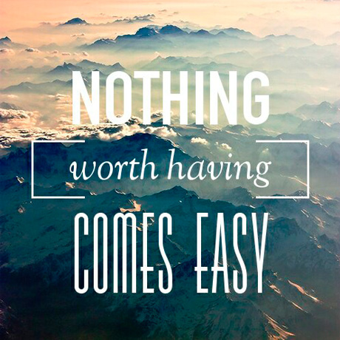

Slide 5
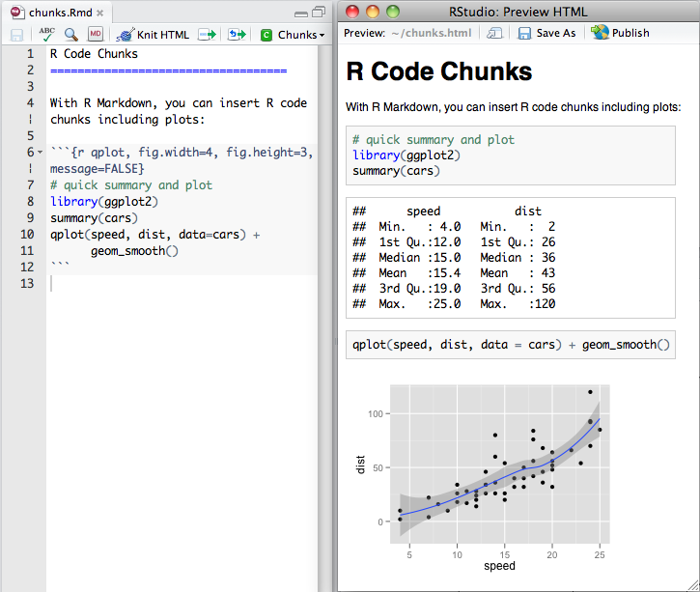
R + Markdown = RMarkdown

Slide 6
The bones of an .Rmd

Slide 7
Chunks and parameters

Slide 8
Formatting stuff and cheatsheet

Slide 9
Exercises!

Slide 10
Advanced tricks from senior members of the lab

Slide 11
Advanced exercise
Create a bibliography for your report using bibtex
Cite these papers:
https://www.doi2bib.org/

