Slide 1
QUERY OPTIMIZATION IN BIG DATA USING
HADOOP, HIVE
AND NEO4J
BY
M. ARUN
S.BEN STEWART
P.SANJAY

Slide 2
SPECIAL THANKS TO
Dr. T. V. GEETHA
Dean
College of Engineering, Guindy
Anna University
DR. T. RAGHUVEERA
SR. Assistant Professor
Department of Computer Science and Engineering
College of Engineering, Guindy
Anna University
DR. D. MANJULA
Professor and Head
Department of Computer Science and Engineering
College of Engineering, Guindy
Anna University
MRS. SHINEY JEYARAJ
Research Scholar
Department of Computer Science and Engineering
College of Engineering, Guindy
Anna University

Slide 3
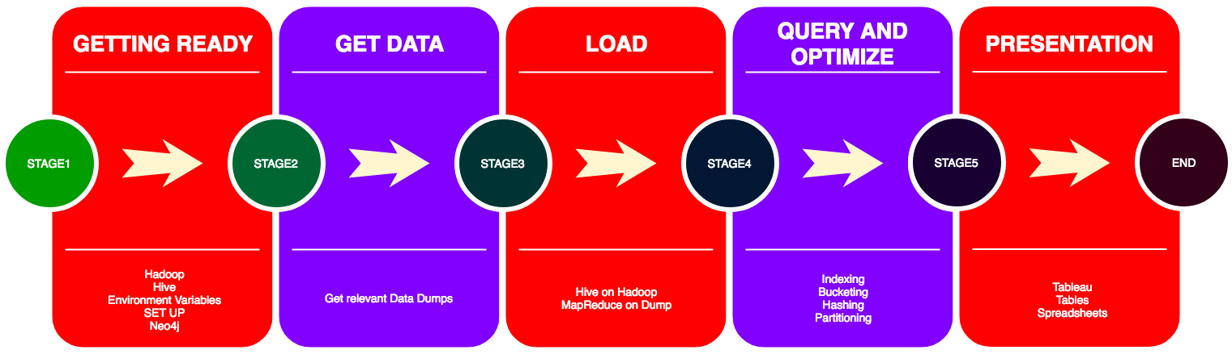
THE WORKFLOW

Slide 4

WHY?
OPEN SOURCE
NETWORKING
DATA STORAGE
COMPUTING
CLUSTERS

Slide 5
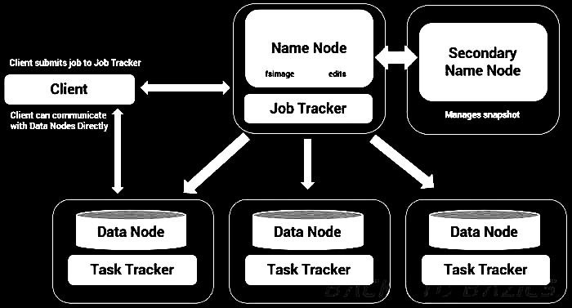
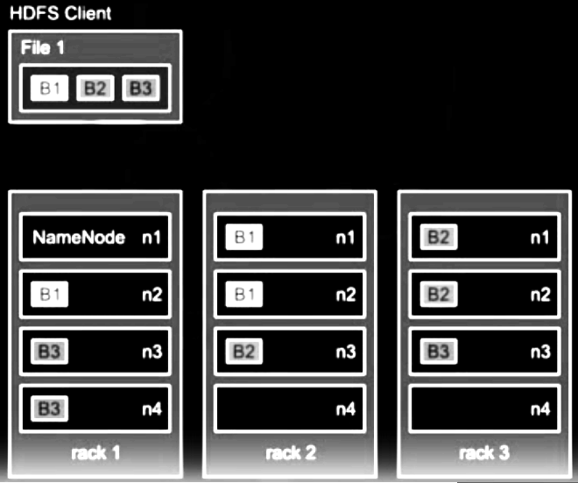
HADOOP ARCHITECTURE

Slide 6
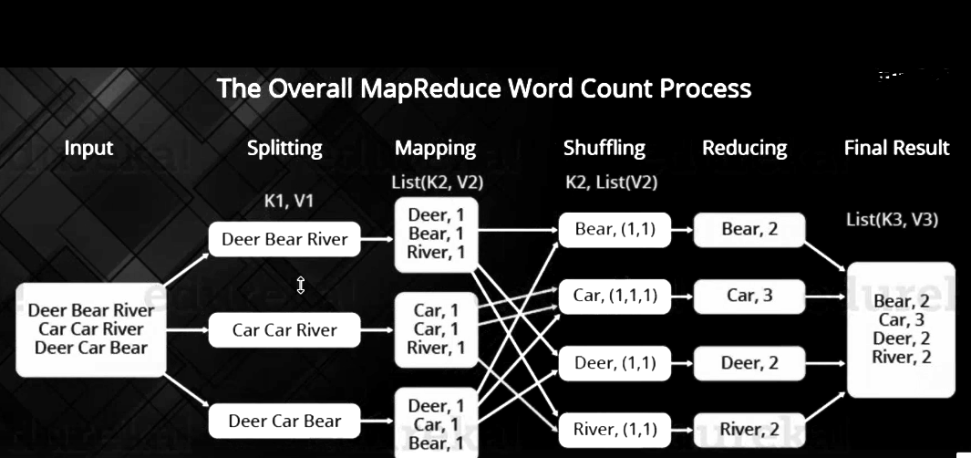
THE CONCEPT BEHIND MAPREDUCE
MAP()
REDUCE())

Slide 7
MAPREDUCE
PROS
PARALLEL EXECUTION
NATIVE HADOOP SUPPORT
FAILPROOF
JAVA
CONS
CODE
UNDERSTANDING
SKILLSET
JAVA
NO DB STRUCTURE

Slide 8
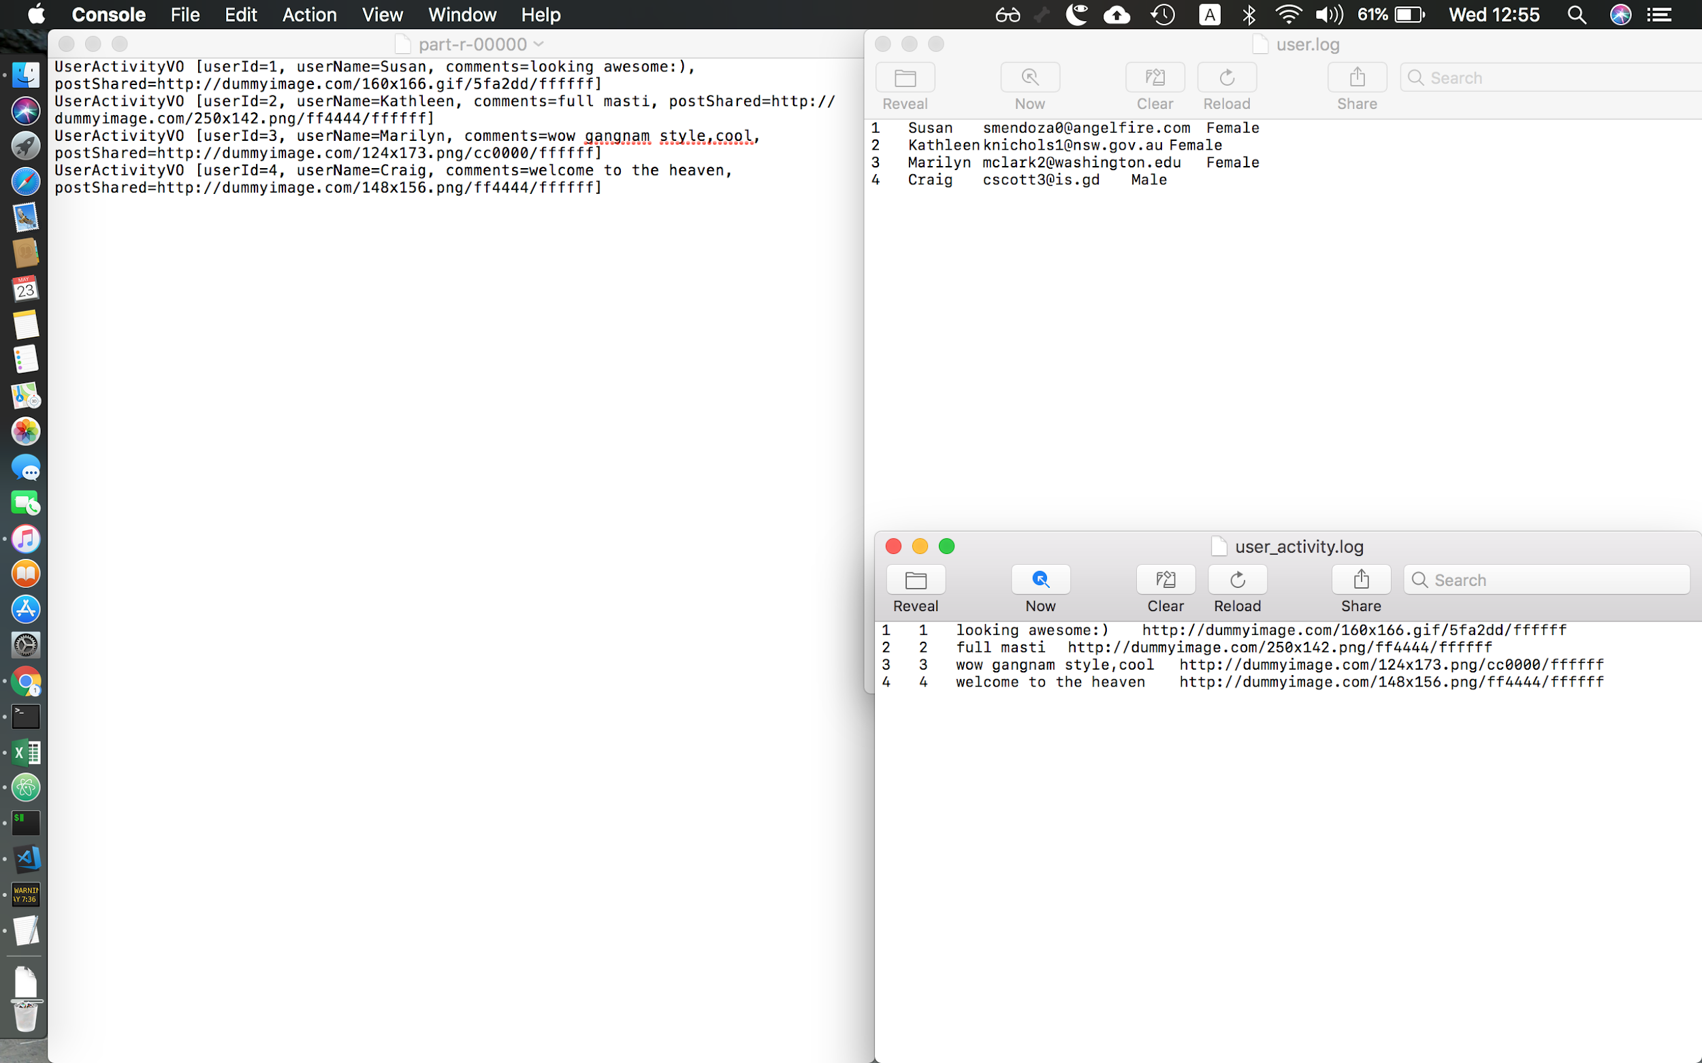

Slide 9
CHALLENGES FACED
INGESTING FILES OF DIFFERENT DATA TYPES
JAVA VIRTUAL MACHINE
MEMORY INDEX OUT OF BOUNDS
MAPPER AND REDUCER CLASSES
ALL THE ABOVE FOR EACH QUERY

Slide 10

WHY?
INTERFACE USED
SQL
DB SUPPORT
EXECUTION ENGINES
HADOOP SUPPORT

Slide 11
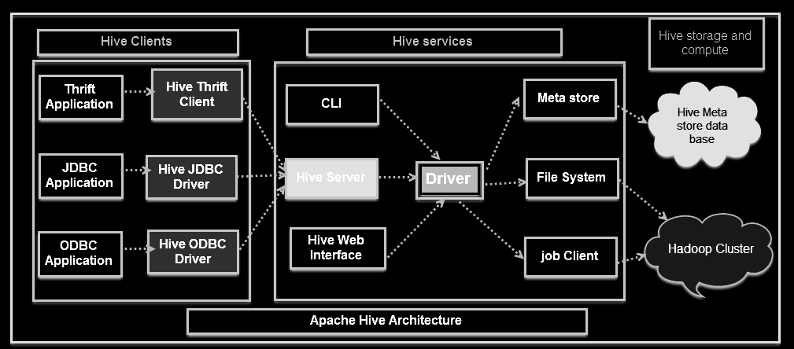

Slide 12

DATA DUMP
WIKIPEDIA DUMP
STACK EXCHANGE
ICIJ OVERSEAS PAPERS
AIRLINES NETWORK
WHY NOT JUST ONE SET?
USE CASES

Slide 13
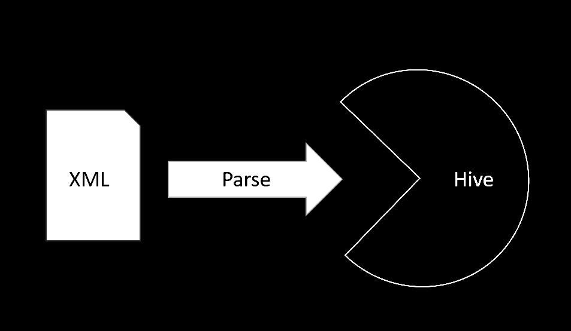
GET ATTRIBUTES AND DB SCHEMA FROM THE XML FILE
ISSUES WHEN FILE IS VERY LARGE
MULTIPLE FILES
IMPORT DATA OF FILE INTO HIVE DB
JAR FILES
CONNECTORS
DB STATE
PYTHON
SPARK

Slide 14
QUERYING
SELECT *
WHERE CONDITIONALS
JOINS
STRING FUNCTIONS
AGGREGATES
EXECUTION TIME IS IN MILLISECONDS
GETS THE OUTPUT OF THE COMPLEX MAPREDUCE
HiveQL INTERFACE IS SIMILAR TO SQL SYNTAX

Slide 15
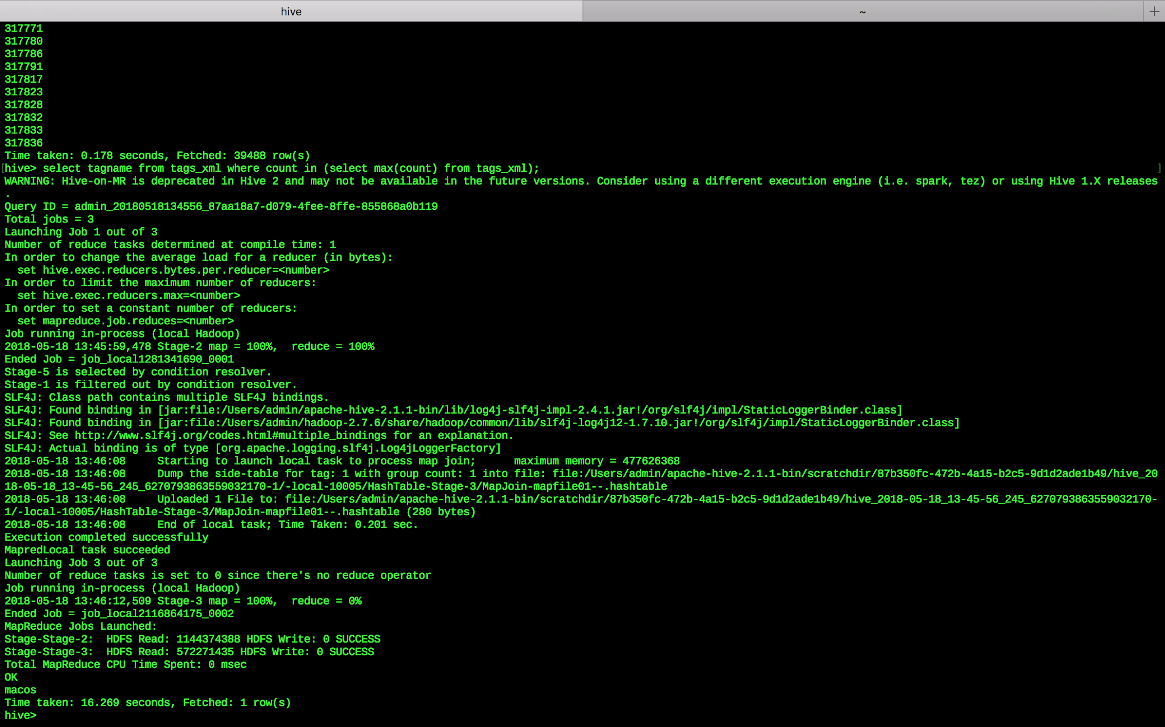

Slide 16
QUERY OPTIMIZATION
THE NEED FOR QUERY OPTIMISATION.
DIFFERENT OPTIMISATION METHODS :
PARTITIONING:
SYNTAX:CREATE TABLE flight_data_p(flight_num INT,..)PARTITIONED BY (month int)
ROW FORMAT DELIMITED
FIELDS TERMINATED BY ','

Slide 17


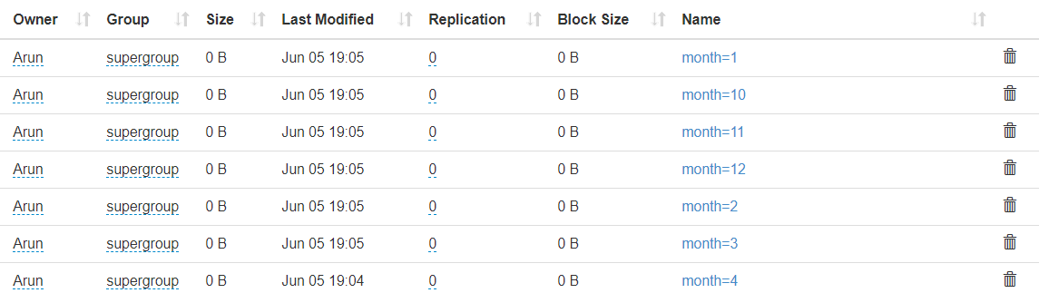
SELECT avg(arr_delay) FROM flight_data WHERE month=7 AND origin='SFO';
SELECT avg(arr_delay) FROM flight_data_p WHERE month=7 AND origin='SFO';

Slide 18
SYNTAX:
CREATE EXTERNAL TABLE flight_data_b(flight_num INT,..)CLUSTERED BY (unique_carrier) INTO 4 BUCKETS
ROW FORMAT DELIMITED
FIELDS TERMINATED BY ',';

Slide 19
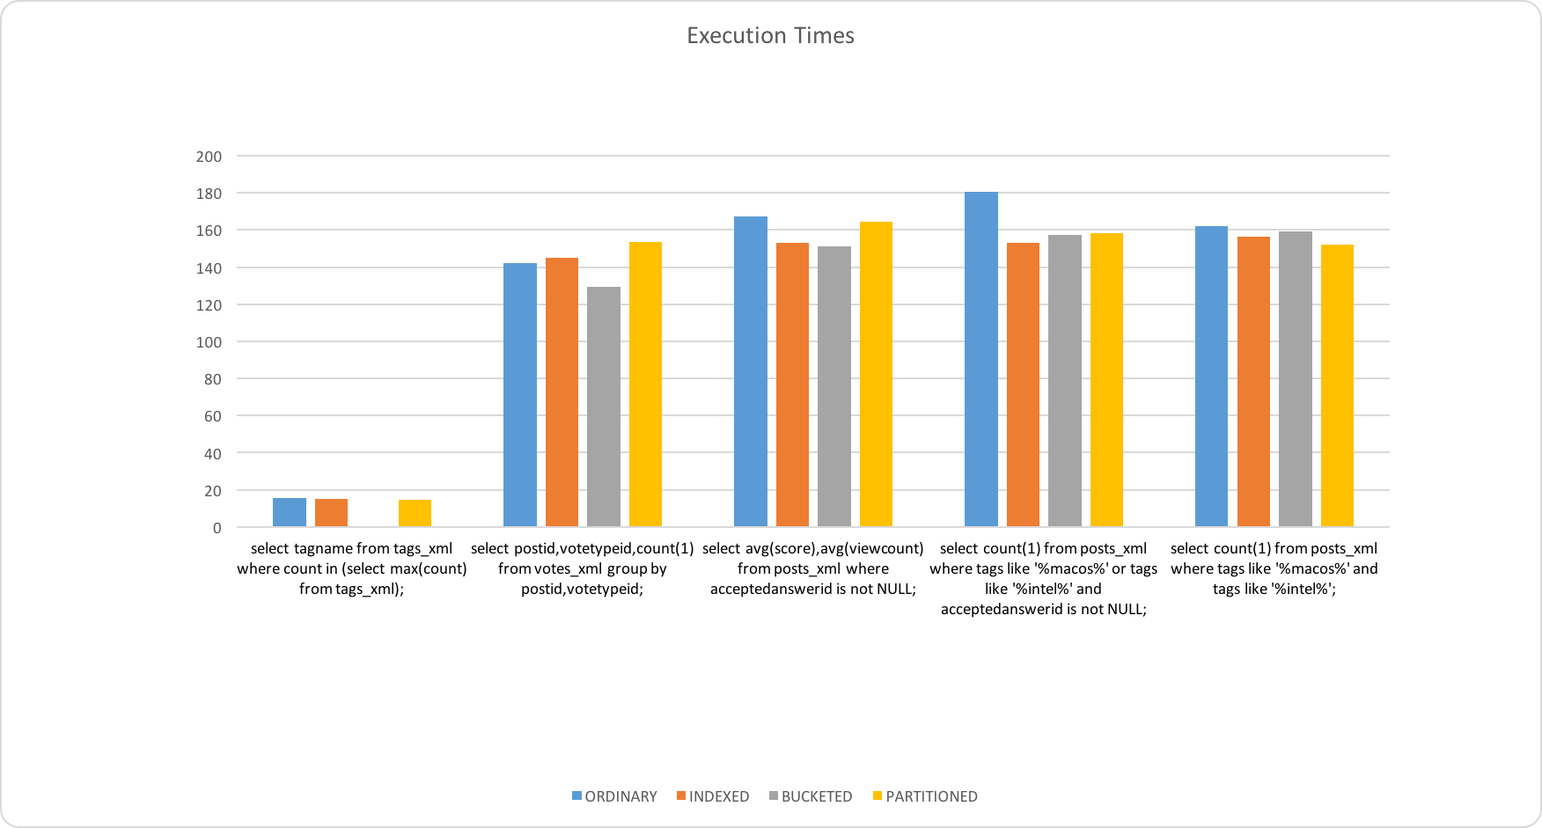

Slide 20
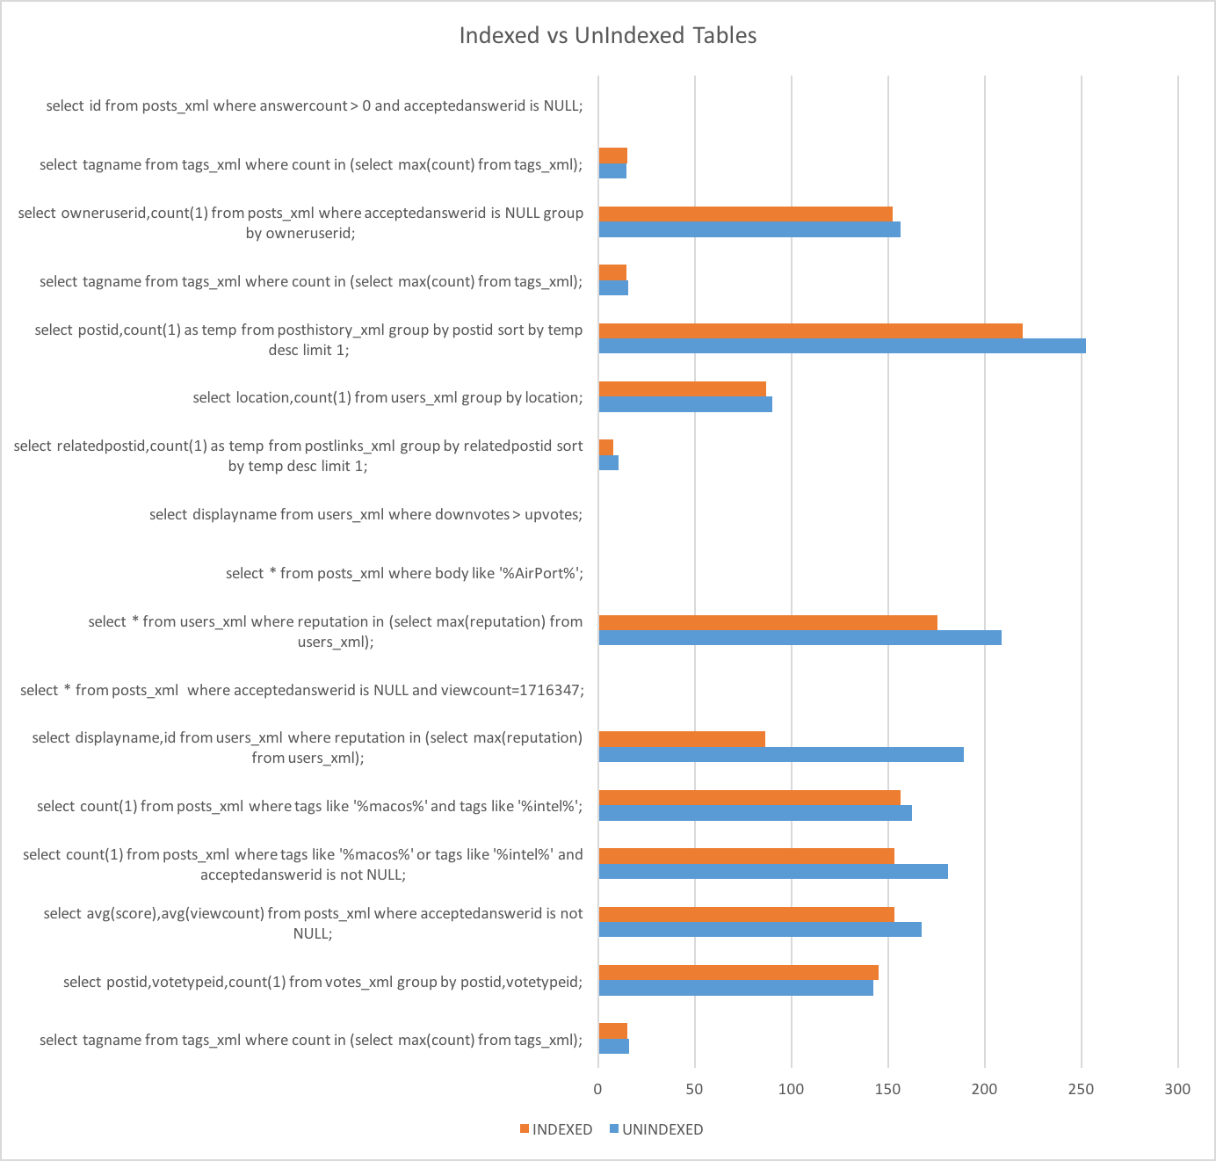

Slide 21
RESULTS
INDEXING GIVES AN AVERAGE 30% FASTER EXECUTION
BUCKETING FOR JOINS
PARTITION BASED ON QUERY
INDEX AND RUN QUERIES
AND FINALLY,
PREFERABLY HASH FOR INTEGERS AND BUCKET FOR STRINGS

Slide 22
LONG EXECUTION TIMES
DATABASE DUMPS
COMPLEX RELATIONS
MULTIPLE JOINS
THE SOLUTION
GRAPH DATABASES

Slide 23

OVERVIEW
WHY GRAPH DATABASE?
THE PROPERTY OF GRAPH MODEL
WHAT IS NEO4J?

Slide 24
WHY GRAPH DATABASE?
ONLY A DATABASE THAT NATIVELY EMBRACES
RELATIONSHIPS IS ABLE TO STORE, PROCESS, AND QUERY CONNECTIONS EFFICIENTLY COMPARING TO OTHER DATABASES

Slide 25
THE PROPERTY GRAPH MODEL
NODES ARE ENTITIES IN THE GRAPH
EDGES PROVIDES RELATIONSHIPS

Slide 26
WHAT IS NEO4J?
USE CASE
NEO4J IS OPEN SOURCE FOR GRAPH DATABASE
NoSQL NATIVE GRAPH DATABASE
IT IS NOT FOR ONLY SOCIAL NETWORKS,AND IT IS USED FOR NETWORK & IT OPERATIONS,MASTER DATA MANAGEMENT AND ETC

Slide 27
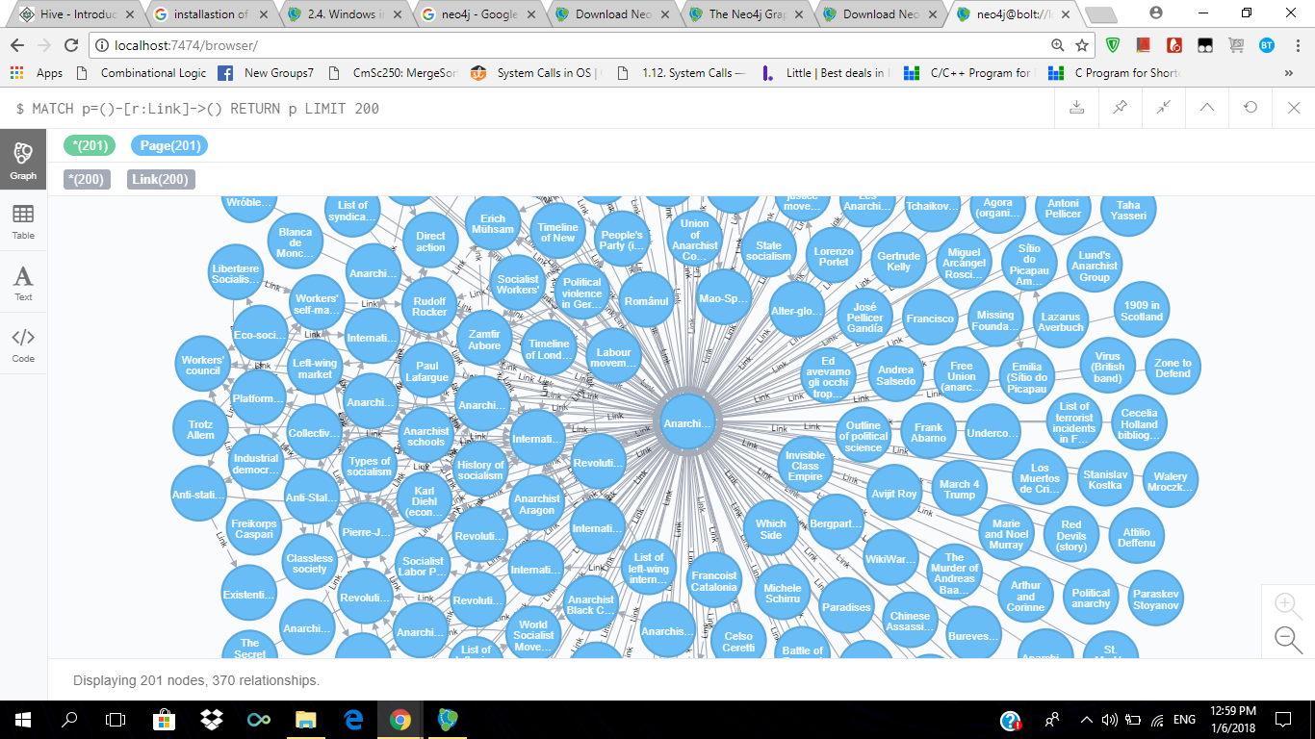

Slide 28
PAGE RANK
CALL.algo.pageRank(null,null,{write:true,writeProperty:’pagerank_g’})
MATCH (e.Entity) WHERE exists(e.pagerank_g)
RETURN e.name AS entity,e.jurisdiction_description AS jurisdiction,e.pagerank_g AS pagerank ORDER BY pagerank DESC LIMIT 15

Slide 29
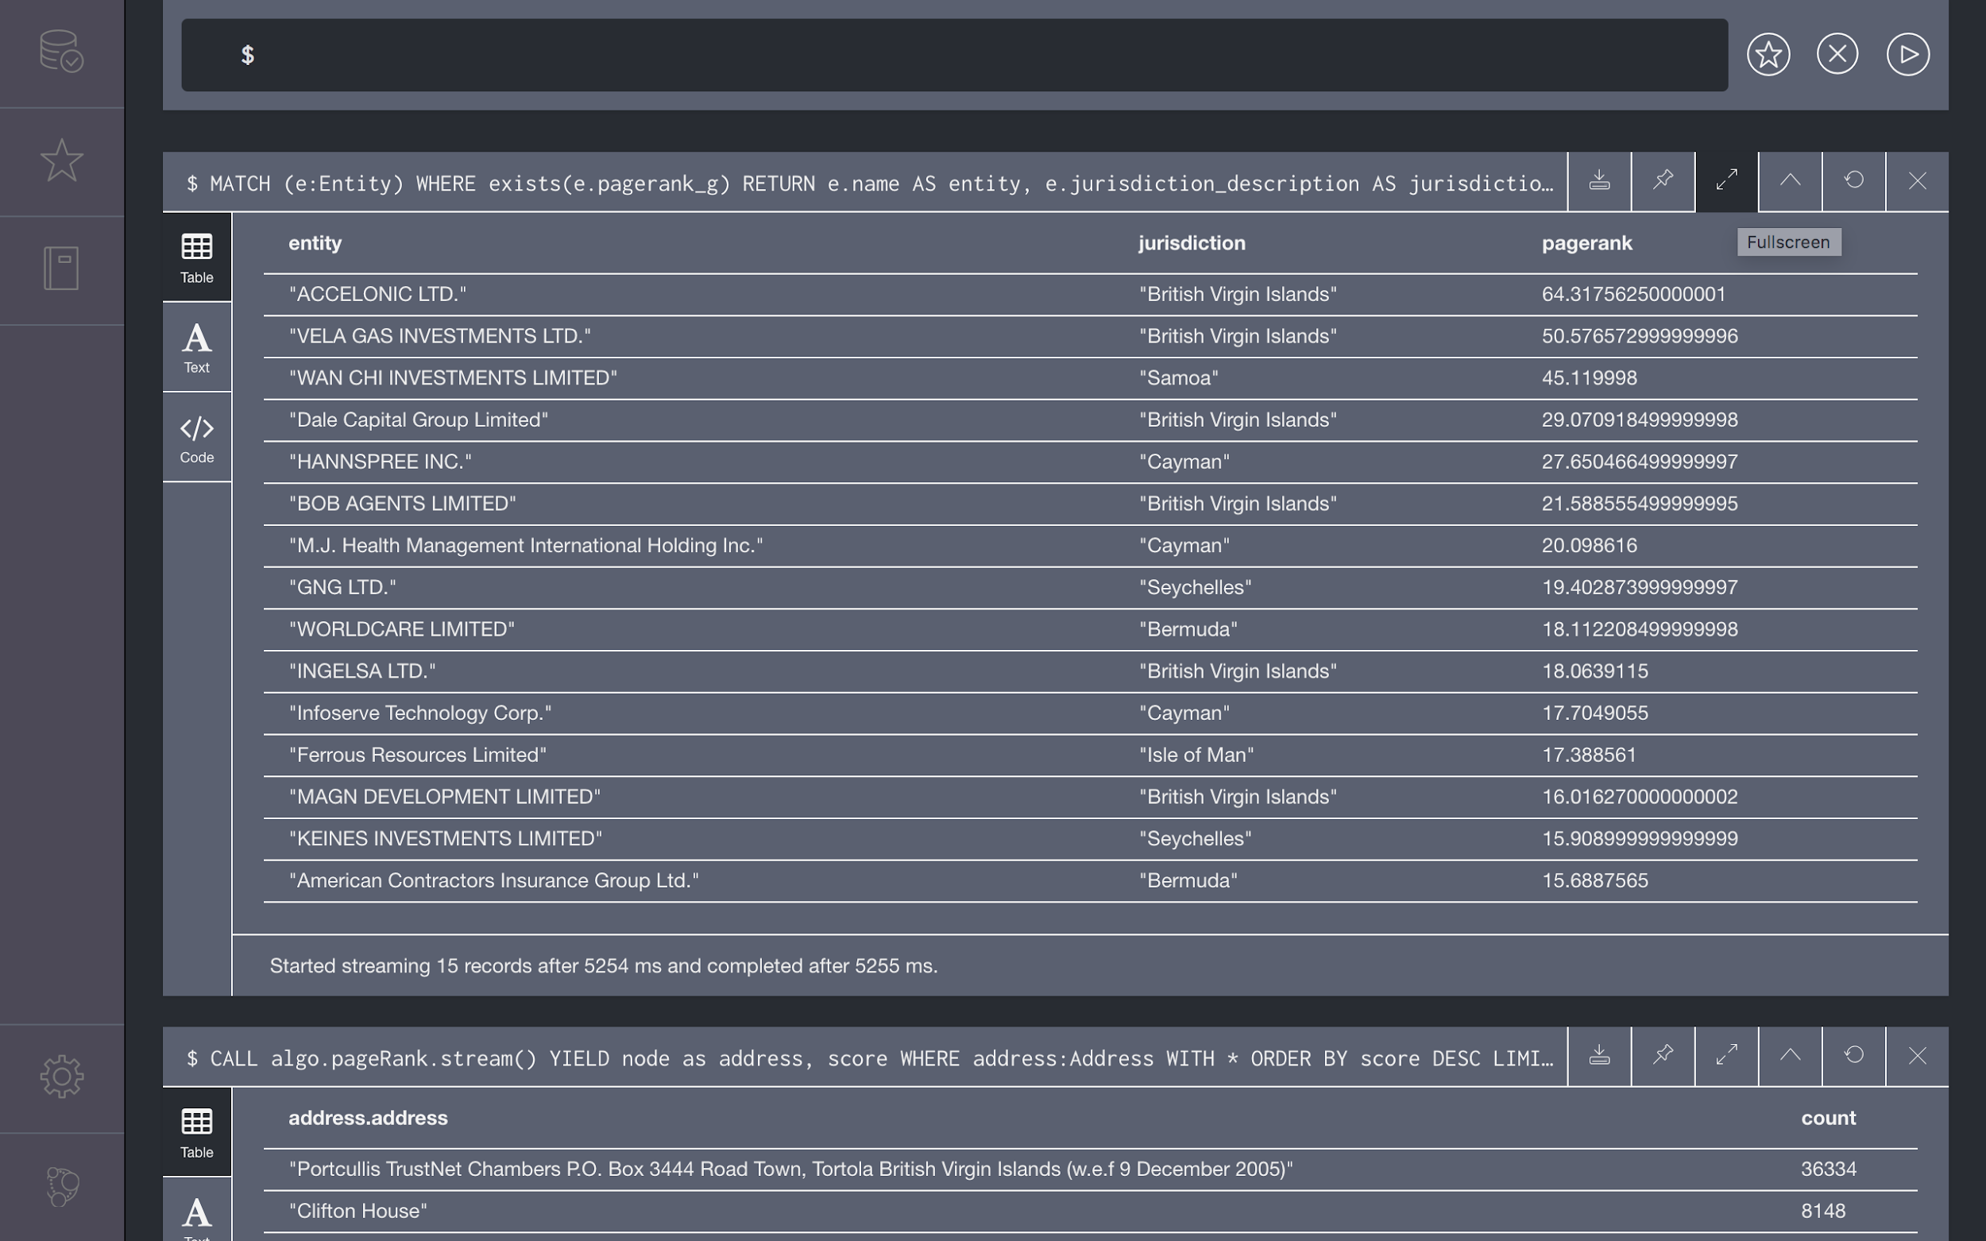

Slide 30
QUERY FOR BETWEENNESS
MATCH p=allShortestPaths((rex:Officer)-[*]-(queen:Officer))
WHERE rex.name=”Tillerson - Rex” AND queen.name=”The Duchy of Lancaster”
RETURN P

Slide 31
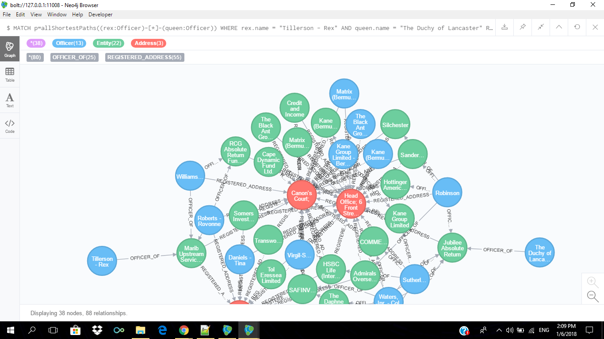

Slide 32
CONCLUSION
With the datadump being loaded into the Hadoop single node cluster and performing mapreduce tasks and also having the Hive architecture to use a simpler SQL interface the query optimization techniques were tried out. Out of all the methods the one that is universal is to index based on a related attribute on the table before any query is executed. Also the features built into the execution engines may be used to the fullest extent. This project can be taken further down the development lane with support for real-time data being crawled into the database and in such a case bucketing becomes more realistic when you know the queries before hand especially the ones involving join operations. Finally, when the datadump becomes very large then the partitioning both vertical and horizontal provide justice for the execution time.

Slide 33
QUERY OPTIMIZATION IN BIG DATA USING
HADOOP, HIVE
AND NEO4J
BY
M. ARUN
S.BEN STEWART
P.SANJAY

