Slide 1
骨髄バンクにおけるナッジ・メッセージの効果検証
Hiroki Kato Fumio Ohtake

Slide 2
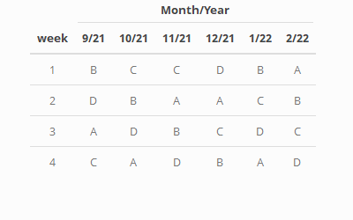
割り当てスケジュール

Slide 3
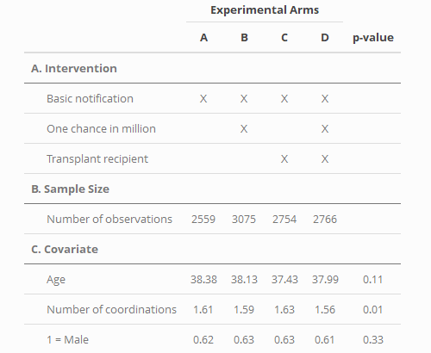
フィールド実験概要

Slide 4
Difference-in-mean Test

Slide 5
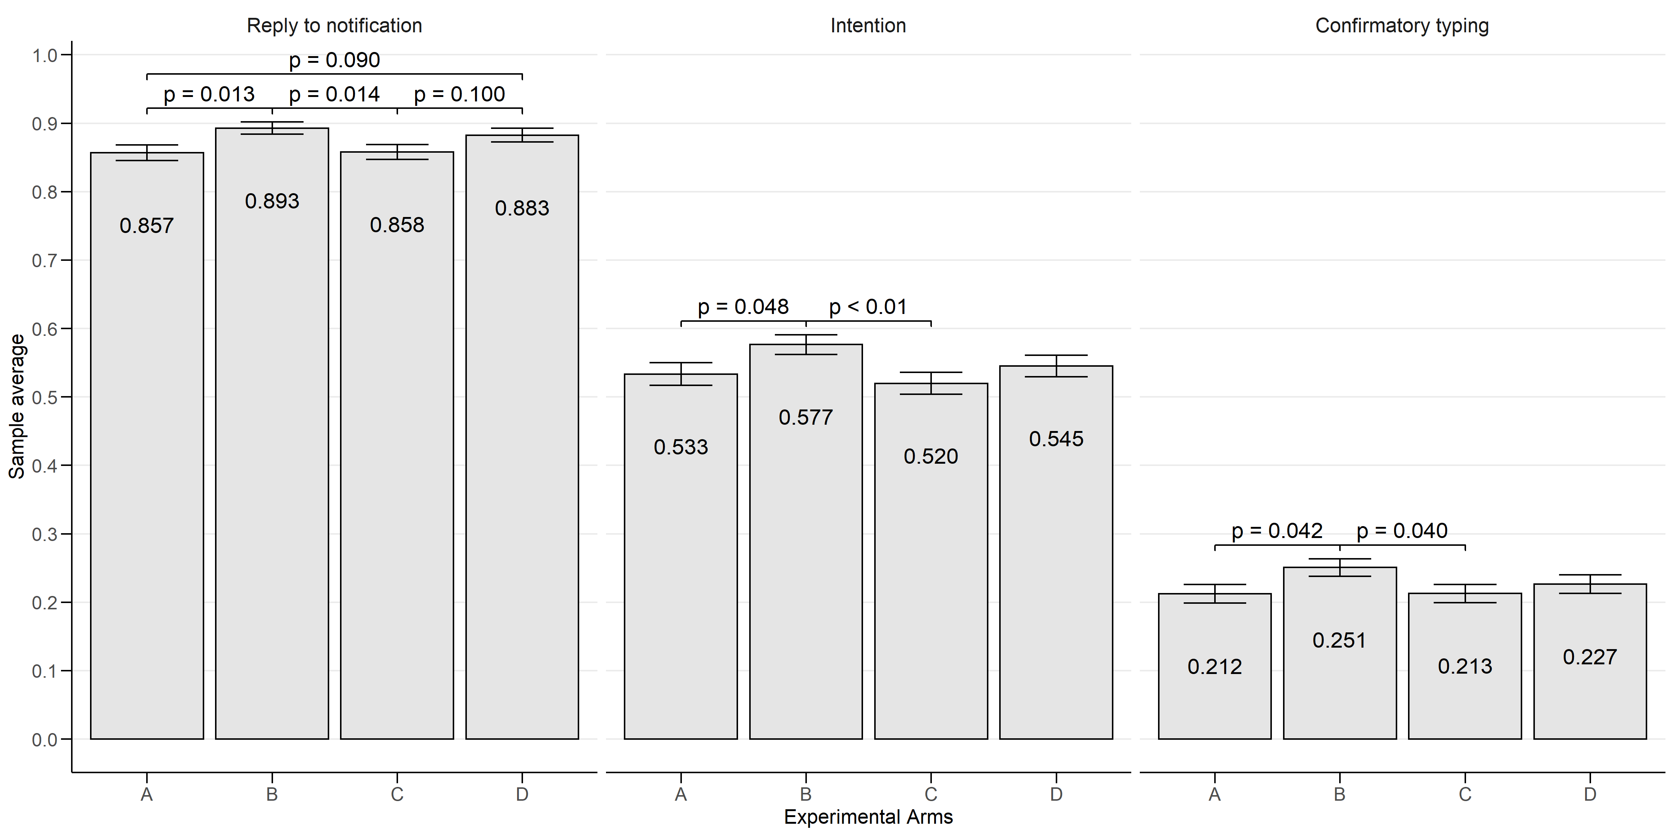
男性１
Average of Outcomes before Donor Candidate Selection among Males

Slide 6
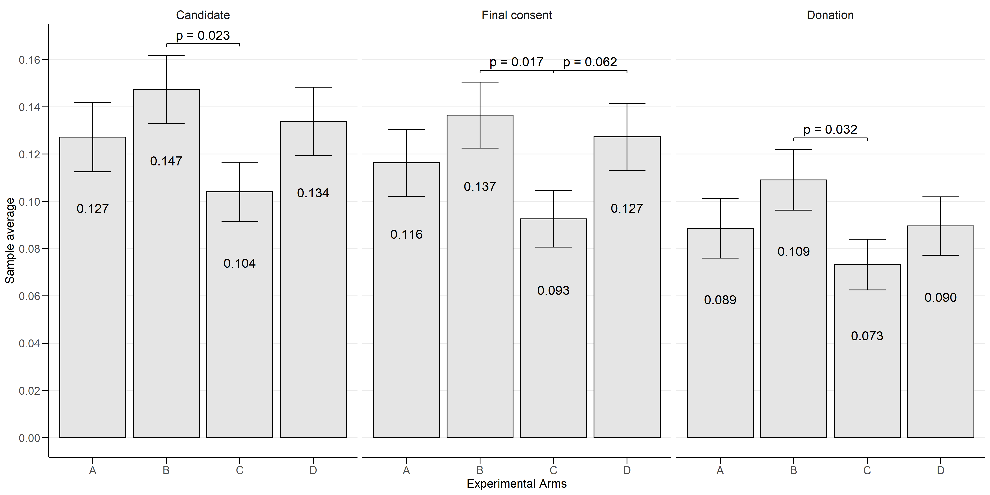
男性２
Average of Outcomes after Donor Candidate Selection among Males

Slide 7
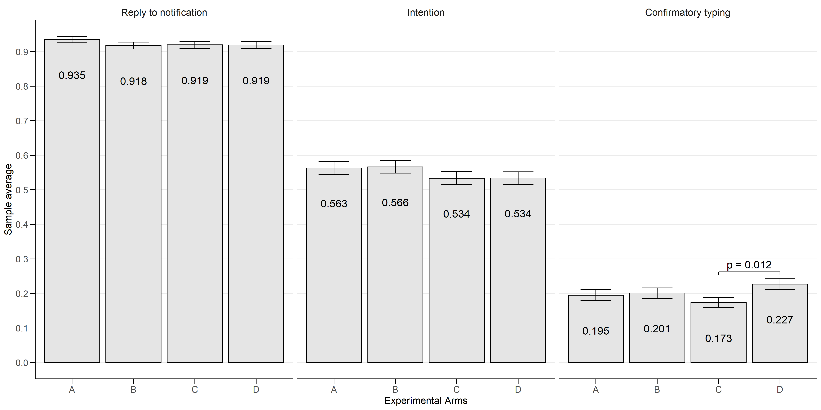
女性１
Average of Outcomes before Donor Candidate Selection among Females

Slide 8
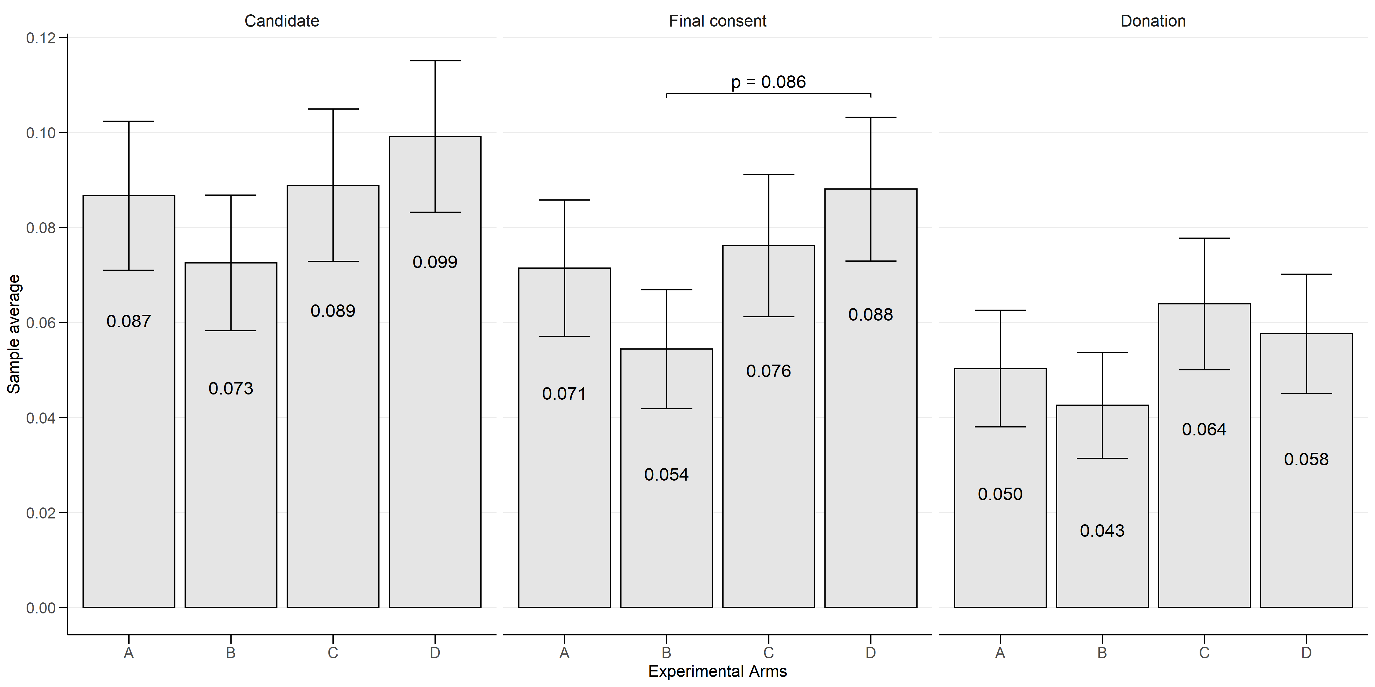
女性２
Average of Outcomes after Donor Candidate Selection among Females

