Slide 1
Employee Data Analysis using Excel
STUDENT NAME: Johann Melvin Fredrick
REGISTER NO: 312212064\B9759A24682ADCEB83B4E52083DC4A7C
DEPARTMENT: B COM GENERAL
COLLEGE Mar Gregorios College

Slide 2
PROJECT TITLE
Employee Performance Analysis using Excel

Slide 3


AGENDA
Problem Statement
Project Overview
End Users
Our Solution and Proposition
Dataset Description
Modelling Approach
Results and Discussion
Conclusion
3/21/2024 Annual Review

Slide 4

PROBLEM STATEMENT Identifying Strengths and Weaknesses: It helps in identifying which employees are performing well and which ones need improvement. Performance Metrics: It allows the organization to track key performance indicators (KPIs) such as task completion, sales targets, and other measurable objectives. Informed Decision-Making: Management can make informed decisions about promotions, rewards, or additional training based on performance data. Resource Allocation: Helps in optimizing the allocation of resources by identifying where more support or training may be needed. Employee Development: It assists in creating personalized development plans for employees, helping them grow in their roles.

Slide 5

PROJECT Overview
.
The Employee Performance Analysis using Excel project aims to evaluate and improve employee productivity within an organization by leveraging Excel's data analysis and visualization capabilities. The project involves collecting relevant performance data such as attendance, task completion rates, and sales figures, and organizing this information into a structured Excel workbook. Using various Excel functions and tools, the data will be analyzed to identify trends, strengths, and areas needing improvement.

Slide 6
WHO ARE THE END USERS?
Management: They will gain insights into employee productivity and performance trends, helping them make informed decisions about promotions, rewards, and resource allocation.
HR Department: HR professionals can use the analysis to identify training needs, develop personalized development plans, and ensure fair and data-driven performance evaluations.
Employees: Employees will benefit from clear feedback on their performance, leading to opportunities for growth, recognition, and career advancement.
Team Leaders: They can use the analysis to understand team dynamics, identify top performers, and address any performance issues within their teams.
The Organization as a Whole: By optimizing employee performance and productivity, the organization can achieve better overall efficiency, reduce costs, and improve employee satisfaction and retention.

Slide 7

OUR SOLUTION AND ITS VALUE PROPOSITION
Conditional formatting-missing
Filter-remove
Formula-performance
Pivot-summary
Graph-data visualization

Slide 8
Dataset Description
Employee - Tony Stark
Features - 7
EMP ID Number - 3434
NAME-TEXT - Calibri
Business unit - STKI
Job Function - Engineer
Gender - Male
Employee rating number - 5
Performance score - Fully meets

Slide 9

THE "WOW" IN OUR SOLUTION
Performance level =IFS(Z11>=5,"very high",Z11>=4,"high",Z11>=3,"medium",TRUE,"low")
3/21/2024 Annual Review
9

Slide 10
MODELLING
1. Data Collection and Entry:
Sheet in: This sheet contains detailed employee information, including Employee ID, names, start dates, job titles, supervisors, email addresses, business units, and performance-related data. This is the primary data source for my analysis.
2. Data Preparation:
Sheet in:
I have gathered comprehensive employee data, possibly from various sources, and compiled it into this sheet.
The data includes demographic information, job details, and performance metrics like "Performance Score" and "Employee Rating."
This sheet also has a "Performance level" column, though some values appear to be missing.
3. Aggregation of Performance Data:
Sheet Sheet1:
This sheet appears to summarize performance data by Business Unit.
The table is organized to show the count of employees in each performance level (high, low, medium, very high) across different Business Units (e.g., BPC, CCDR).
I used Excel functions like COUNTIF or PivotTables to aggregate this data.
The sheet also includes a "Grand Total" column, which summarizes the total count of employees across performance levels for each Business Unit.
10

Slide 11
4. Visualization:
Although not explicitly shown in the provided data, it’s common to create charts or graphs in Excel to visualize performance distributions.
I have used the data in Sheet1 to create bar charts or pie charts illustrating the distribution of performance levels across different Business Units.
5. Additional Data Analysis (Sheet2):
Sheet Sheet2:
Contains ID-marks pair, possibly related to some other aspect of performance or another dataset.
It might be used for supplementary analysis, though it’s unclear how it ties into the main performance analysis.
6. Final Analysis and Reporting:
I would likely compile these analyses into a coherent report, possibly adding explanations, visualizations, and insights directly into the Excel file or exporting the data into a presentation format.
Key insights could include identifying top-performing Business Units, areas needing improvement, and employee distribution across performance levels.

Slide 12
RESULTS
12

Slide 13
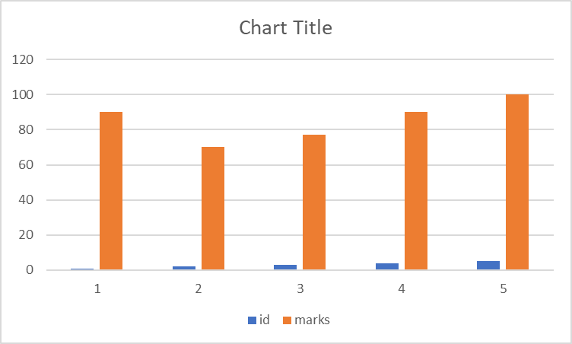

Slide 14
conclusion
The Employee Performance Analysis reveals varied performance levels across different Business Units, with a significant number of employees falling into the "medium" and "low" categories, particularly in units like BPC and CCDR. There are also strong performers in the "very high" category, suggesting potential for leadership development. However, some data gaps, such as missing "Performance level" entries, need addressing for more accurate insights. Overall, the analysis suggests a need for targeted training and development in lower-performing units, recognition programs for high performers, and improved data accuracy for future assessments.

