Slide 1
Reactive Programming with Observables

Slide 2
What is reactive programming?
Programming with asynchronous data streams
Everything is a stream
Every stream is observable
Streams can manipulate data
Streams can be combined
Multiple observers per stream

Slide 3
Why Use Reactive Programming?
Higher level of abstraction
Powerful front-end development technique
More complex and efficient UI
Helps increase asynchronicity

Slide 4
Promises (A refresher)
Can be attached to success/failure callback functions that will trigger asynchronously
Can only succeed or fail once
Callback function will trigger even if attached to promise that has already been settled
Places greater emphasis on result
Can act as a proxy for a ‘future’ value that has not yet been evaluated

Slide 5
Observables: More Powerful Promises
A data stream that can be triggered multiple times, or retried
Can define setup and teardown routines
Are cancellable
Can be “Lazy”, not necessarily generating data unless accessed

Slide 6
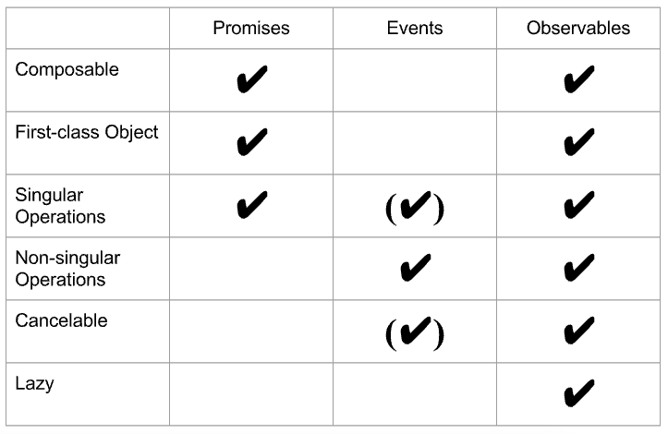

Slide 7
The Observable Contract
Must send out notifications for OnNext, OnCompleted, and OnError
Must connect with observers via Subscribe and Unsubscribe
Must issue notifications serially
Must not communicate with observers once completed or failed

Slide 8
The Observer Interface
interface Observer<T> {
next: (value: T) => void;
error: (err: any) => void;
complete: () => void;
}

Slide 9
Example #1: Count multiple clicks over short period of time

Slide 10
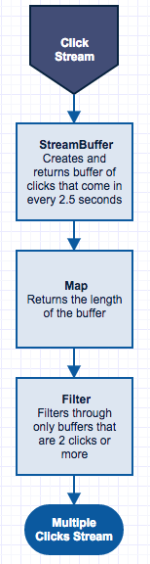

Slide 11


Slide 12
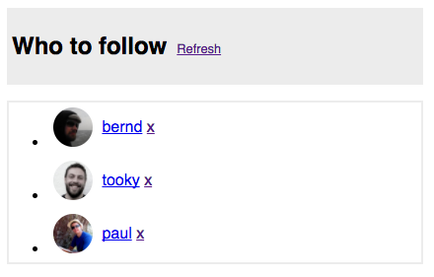
Example #2: Git User Suggestions

Slide 13
