Slide 1
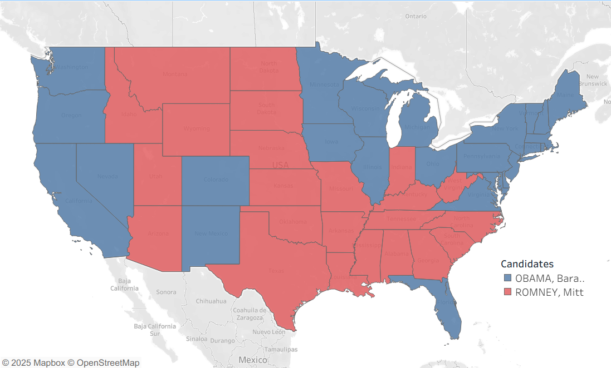
Comparing Electoral College Methods To Reflect The Popular Vote and Possibly Change Election Outcomes
By James M. Halaz

Slide 2
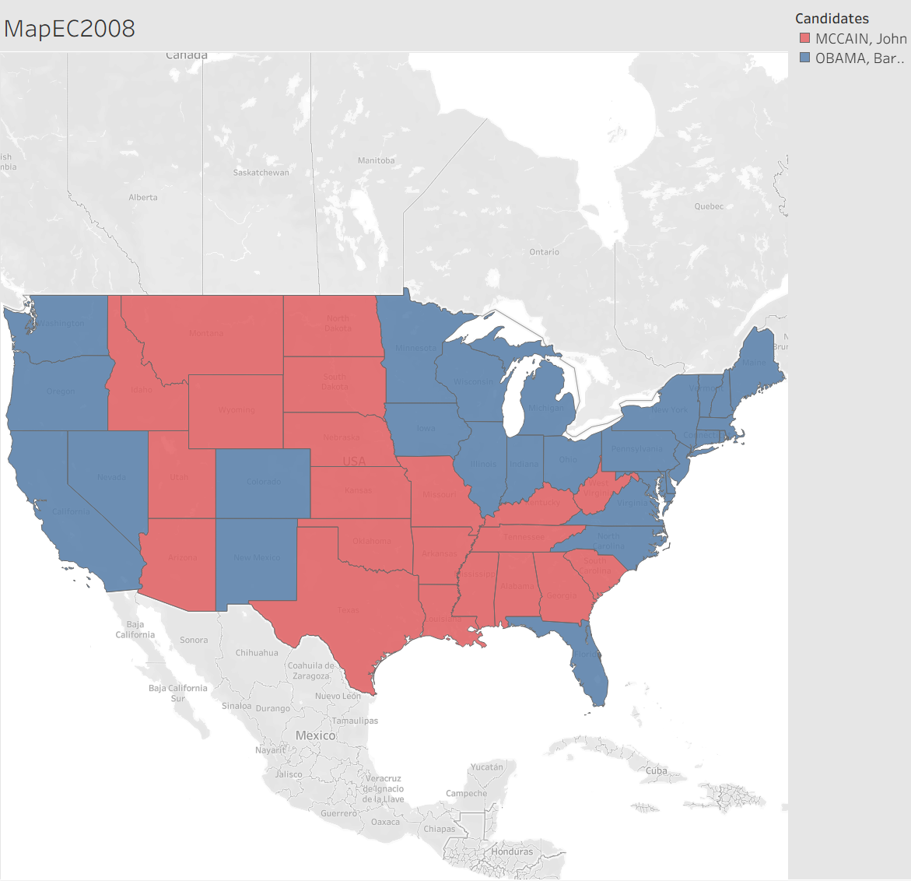
In the current Electoral College, the candidate with the highest number of popular votes in a state obtains all the Electoral Votes for that state.
Each state and the District of Columbia is apportioned with at least one vote for each representative out of 436 and two votes for each senator.
The candidate who reaches 270 Electoral Votes, or over half the Electoral College Votes, becomes president.
However, it is important to note the states of Nebraska and Maine award the two senatorial votes to the plurality winner of the state and each representative vote to the popular vote winner of each Congressional District.

Slide 3
Another important aspect to note is the US Constitution calls for at least one representative for every state, but no more than one representative for every 30,000 people.
For the purposes of this analysis, this brings about two important questions:
Why is the number of representatives set to 435?
The Permanent Apportionment Act of 1929 set the limit of 435 representatives by equating it to the 1910 US Census apportionment. This number was locked in place out of fears of the House of Representatives growing too large to conduct business properly. However, this decision has allowed the population for each representative to balloon to anywhere from 542,704 to 990,837 according to the 2020 US Census numbers
If the District of Columbia is not a state, why does it count in the Electoral College?
The 23rd Amendment states "The District ... shall appoint … A number of electors ... equal to the whole number of Senators and Representatives in Congress to which the District would be entitled if it were a State, but in no event more than the least populous State; they shall be in addition to those appointed by the States, but they shall be considered … to be electors appointed by a State;"

Slide 4
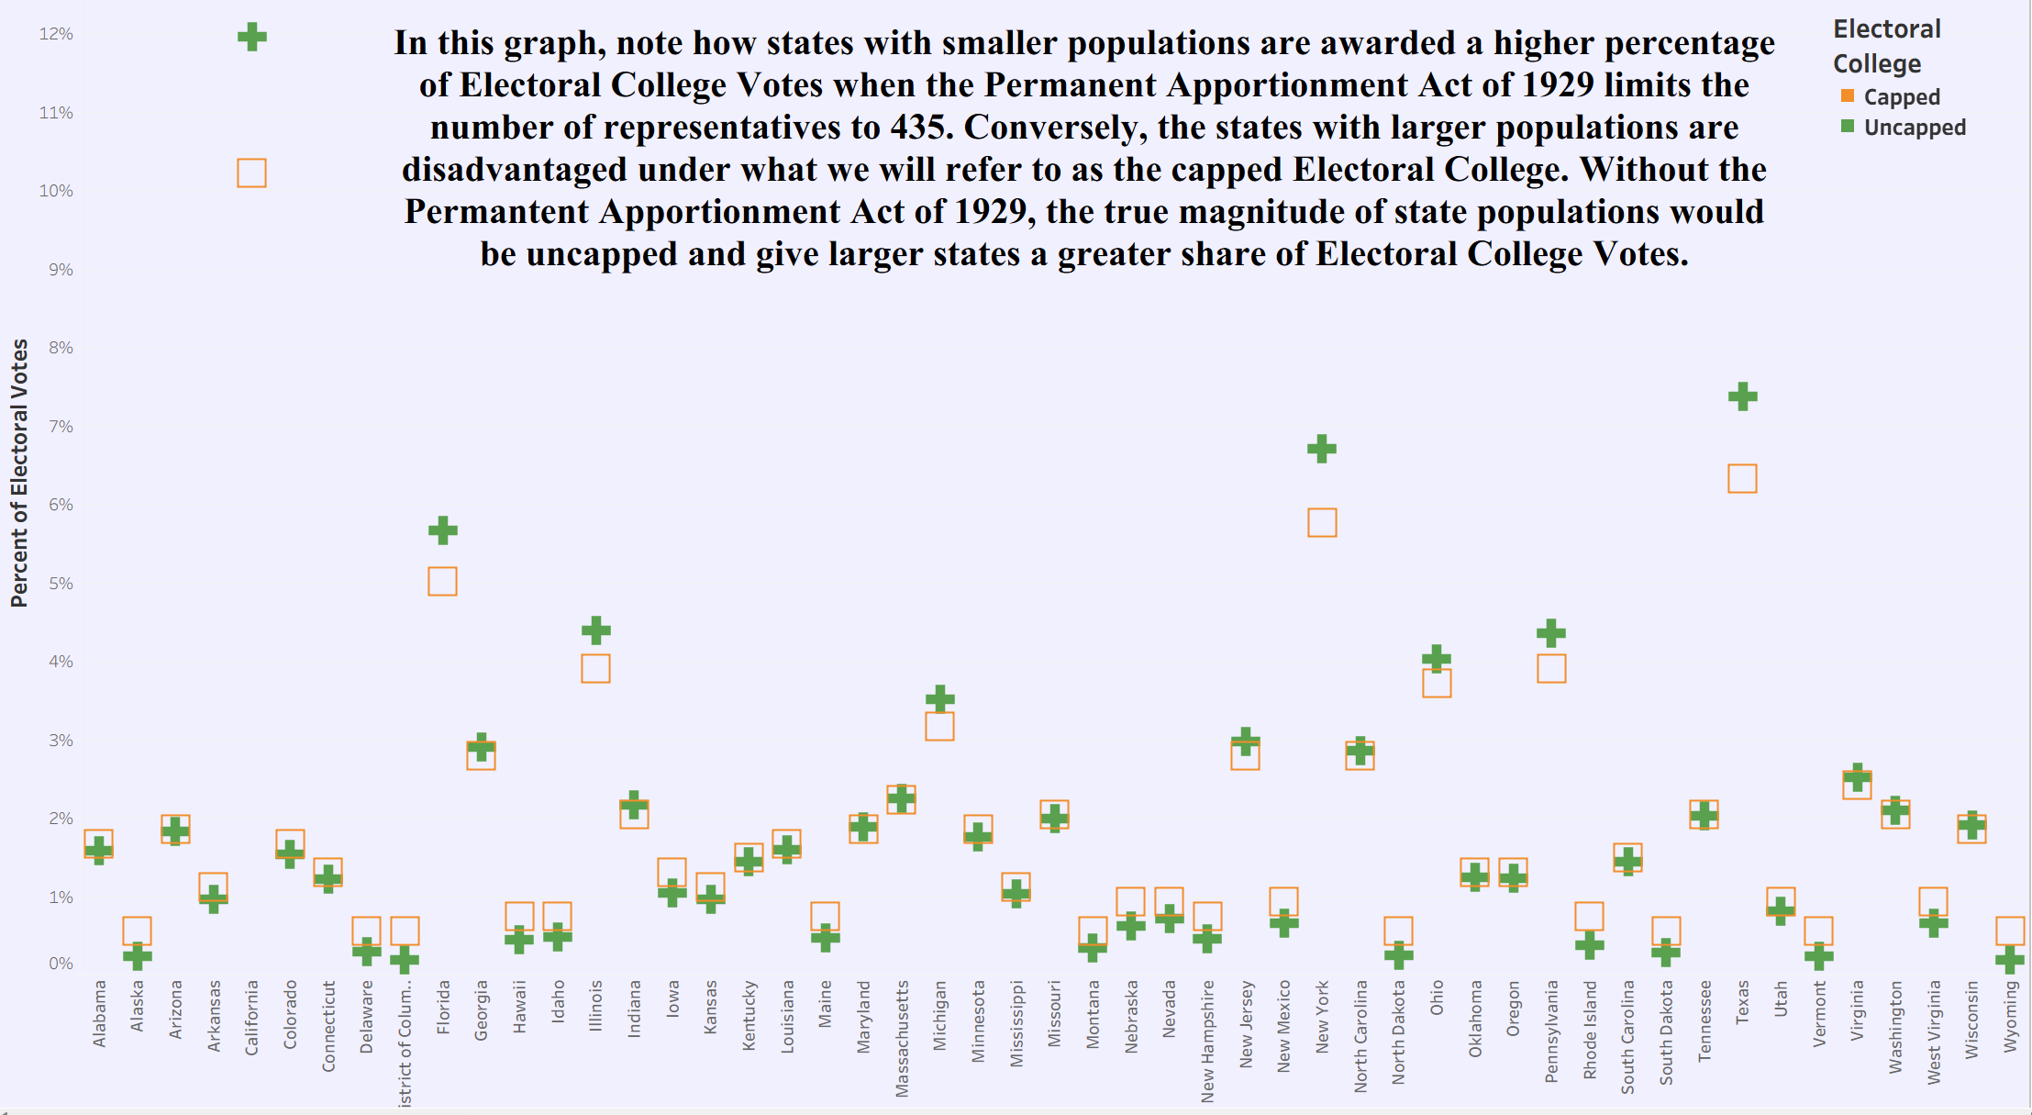

Slide 5
The Premise
With these facts in mind, this project will attempt to investigate, how accurately, methods of awarding Electoral College Votes hold to the principles of representational government. Therefore, three methods of awarding Electoral College Votes will be tested with both the capped number of representatives and an uncapped number of representatives. To test this idea fully, as many representatives as possible will be given to each state, while still holding to the provision that there shall not be more than one representative for every 30,000 people. The standard for accuracy of representation will be awarding Electoral College Votes in percentages nearest to the popular vote percentage. In order to gauge the precision of these methods, each will be tested using the state voting numbers from the U.S. Presidential Elections in 2008, 2012, 2016, and 2020.

Slide 6
The State of Simplicity
As the methods of awarding Electoral Votes can be complicated, a model state has been created to demonstrate the full process in simplified form. In order to highlight the similarities and differences in awarding Electoral College Votes among methods, the comparable steps of each method will be demonstrated in juxtaposition. The necessary analytical characteristics of the imagined state are listed below along with the names of the three methods to be demonstrated.
Methods
- Winner Take All - State's highest popular vote candidate awarded all of the State's Electoral College Votes
- Full Divide - State's Electoral College Votes awarded by dividing Electoral College Votes by portion of votes for each candidate
- Nebraska-like System - State's Representative Electoral College Votes awarded by dividing Electoral College Votes by number of votes for each candidate. State's Senatorial Electoral College Votes awarded to the highest popular vote candidate
Total Popular Votes = 48
Total Number of EC Votes = 6
- Number of Representatives = 4
- Number of Senators = 2
Candidate A popular votes = 22
Candidate B popular votes = 8
Candidate C popular votes = 18

Slide 7
The first steps in the Full Divide and Nebraska-like systems are to divide the total number of popular votes by the state's number of Electoral College Votes or Representative Electoral College Votes. The result, referred to as the Electoral Vote Population in each respective method, will then be used to divide the candidates' popular votes to award Electoral College Votes.
Full Divide
48 / 6 = 8
22 / 8 = 2 R = 6
8 / 8 = 1 R = 0
18 / 8 = 2 R = 2
Electoral Votes Awarded
2 | 1 | 2
Nebraska-like
48 / 4 = 12
22 / 12 = 1 R = 10
8 / 12 = 0 R = 8
18 / 12 = 1 R = 6
Electoral Votes Awarded
1 | 0 | 1
Total Popular Votes = 48
Total Number of EC Votes = 6
- Number of Representatives = 4
Number of Senators = 2
Candidate A popular votes = 22
Candidate B popular votes = 8
Candidate C popular votes = 18
Remainder = R

Slide 8
After the initial awarding of Electoral College Votes, the remaining unawarded Electoral College Votes are calculated by subtracting the awarded Electoral College Votes from the state's Electoral College Vote total in the Full Divide method and the state's Representative Electoral College number in the Nebraska-like method. The popular vote remainders are ranked highest to lowest and one Electoral College vote is awarded to each candidate in rank order until no Electoral College Votes remain.
Full Divide
6 - (2 + 1 + 2) = 1
Candidate A R = 6
Candidate C R = 2
Candidate B R = 0
Electoral Votes Awarded
3 | 1 | 2
Nebraska-like
4 - (1 + 0 + 1) = 2
Candidate A R = 10
Candidate B R = 8
Candidate C R = 6
Electoral Votes Awarded
2 | 1 | 1
Total Popular Votes = 48
Total Number of EC Votes = 6
- Number of Representatives = 4
- Number of Senators = 2
Candidate A popular votes = 22
Candidate B popular votes = 8
Candidate C popular votes = 18
Popular Vote Remainder = R

Slide 9
The last operation completed the Full Divide method, but the Winner Take All Electoral College Votes and Nebraska-like Senatorial Electoral College Votes are yet to be awarded. As both calculations award their unawarded Electoral College Votes to the plurality winner of the popular vote, all of their votes will be given to Candidate A. The Electoral College Votes by method are shown below and help to understand the coding operations presented in the upcoming slides.
Total Popular Votes = 48
Total Number of EC Votes = 6
- Number of Representatives = 4
- Number of Senators = 2
Candidate A popular votes = 22
Candidate B popular votes = 8
Candidate C popular votes = 18
Full Divide
Electoral Votes Awarded
3 | 1 | 2
Nebraska-like
Electoral Votes Awarded
4 | 1 | 1
Winner Take All
Electoral Votes Awarded
6 | 0 | 0

Slide 10
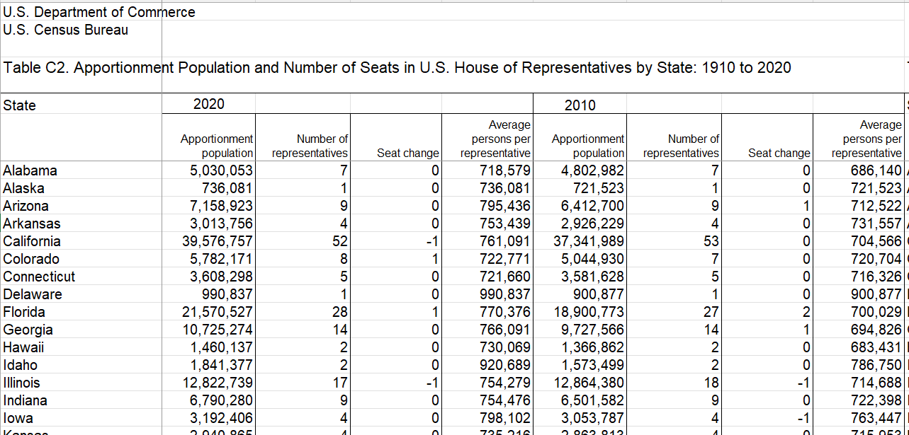
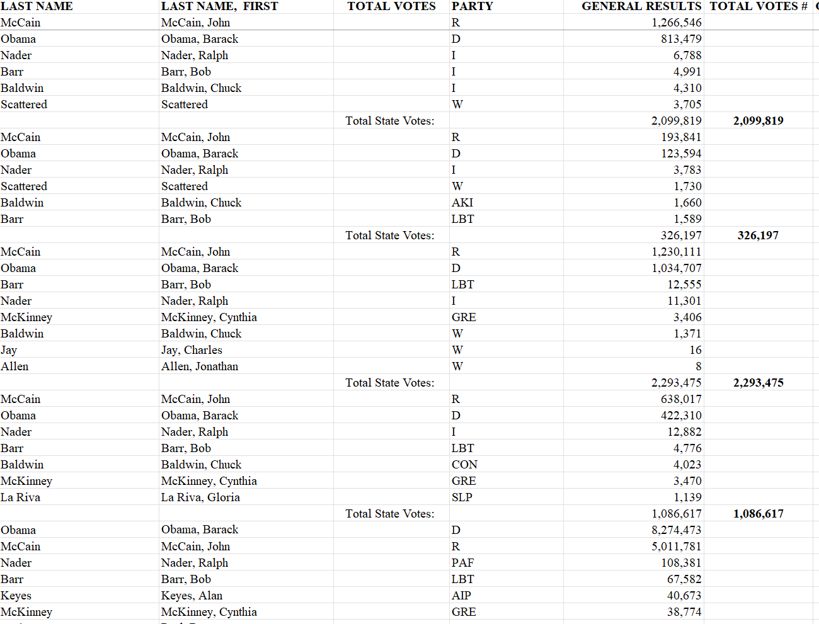
Clean and Organize
The data for this project was acquired from the US Census Bureau and the Federal Election Commission in Excel workbooks
Using Excel and SQLite, the data columns were unmerged and separated into a usable dataframe without most null values

Slide 11
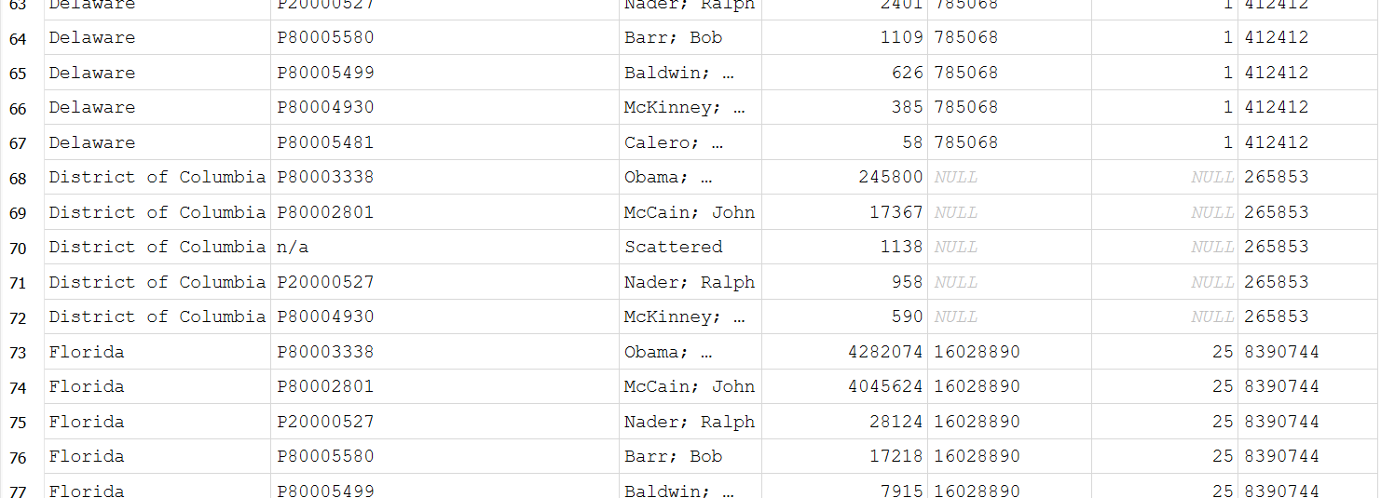
Python, Pandas, and DC
The cleaned and organized data was transferred in Python utilizing the Pandas library.
The problem of the District of Columbia having no apportionment data (as it does not have any representatives in Congress) was addressed by inserting the same number of Electoral Votes as the least populous state.
Using the floor division and modulus operators, the needed quotient and remainder values split to be used in later steps of the project.
Examples of this Python code can be seen on the next slide.
//%
//
%//%

Slide 12


Slide 13
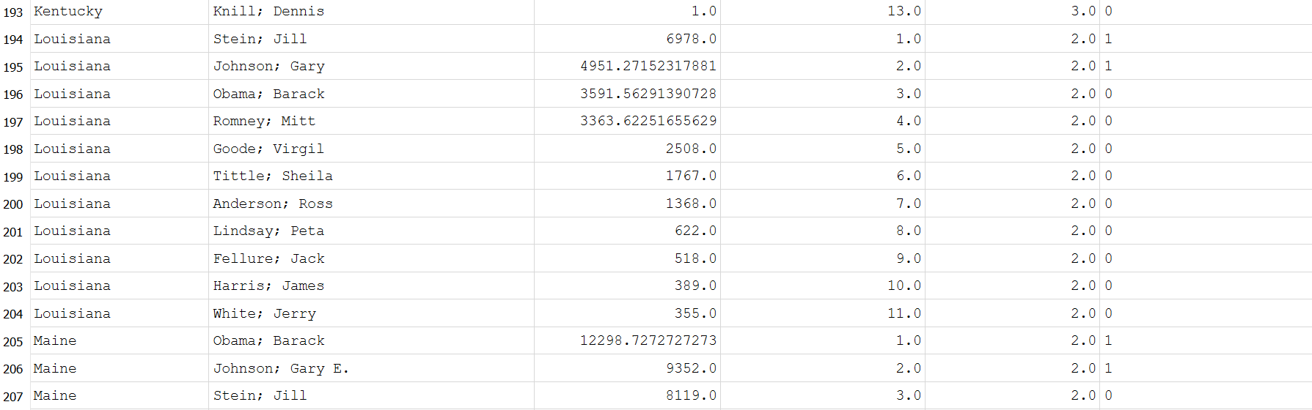
The dataframe was then transferred in SQLite where two main problems soon emerged.
First Problem: Calculating the Remaining Electoral College Votes
The initial thought was to total the popular vote remainders and divide by the Electoral Vote Population. After failed attempts, it was determined a rounding error occurred when transferring from Python into SQLite. In response, the method of subtracting the total Electoral College votes of all candidates from the state Electoral Votes total was later devised.
Second Problem: Ordering the Remaining Popular Vote and Awarding Electoral College Votes
Figuring out how to rank candidates' popular vote remainders within states became the next difficulty as the candidate popular vote remainders for all states were in one column. After some investigation, the "partition by" clause emerged as the answer. The candidate remainder column could be partitioned by state, arranged in descending order, and then numbered starting with one as the largest amount of popular vote remainders. The rank of candidates' state popular vote remainders was compared to the number of Electoral Votes remaining unclaimed for each state. If a rank was below or equal to the number of remaining Electoral Votes, the candidate was apportioned an Electoral Vote.
The SQL code used to amend these situations appears on the next slide.

Slide 14
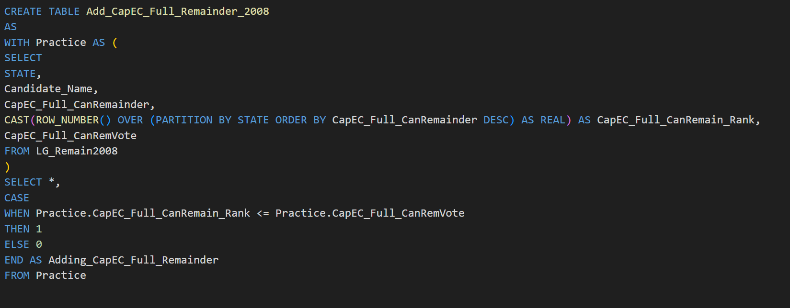
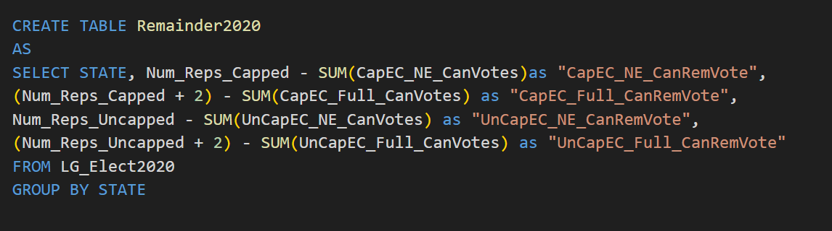

Slide 15
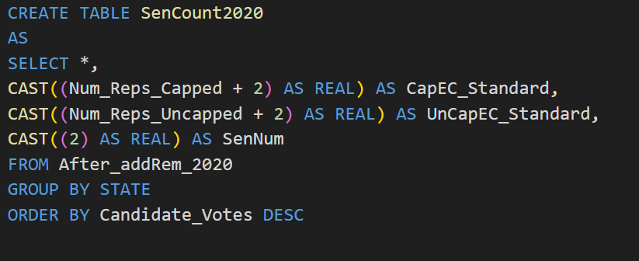
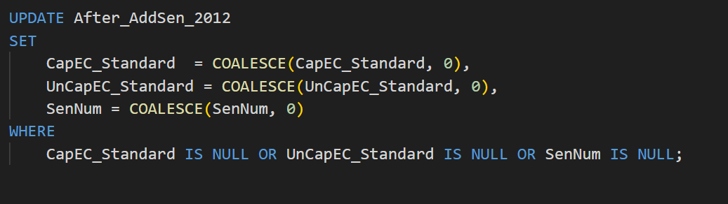
Senate Coalescing
The final steps in SQLite were to award the highest popular vote candidate in each state the Winner Take All Electoral Votes and the Senatorial Electoral Votes for the Nebraska-like method. The first rank candidate in the popular vote of each state was isolated with Electoral Votes being awarded in each method. However, a coalesce function was employed to replace null values with zero before the final table calculations could be completed.

Slide 16
Interpreting The Results
The following four graphs use all three methods, with both capped and uncapped Electoral College totals, to determine Electoral College percentages for each candidate. For the U.S. Presidential Elections of 2008, 2012, 2016, and 2020, the Electoral College percentages of the top eight candidates are shown in comparison to the candidate's popular vote percentage. Some interesting aspects to take note of in the following graphs are:
1) The percentages of the Winner Take All methods are significantly different than the percentages of the other methods and the popular vote percentages.
2) The Winner Take All methods seem to inflate the Electoral College percentages of leading candidates and suppress the Electoral College percentages of lagging competitors.
3) Due to the inflation and suppression of the Winner Take All method, utilized by most states currently, the 2016 U.S. Presidential Election had a decisive winner. The other methods would have resulted in no candidate securing over 50 percent of the Electoral College and the election would have been decided by Congressional vote.
4) Methods other than Winner Take All allowed for third party candidates to receive Electoral College Votes

Slide 17
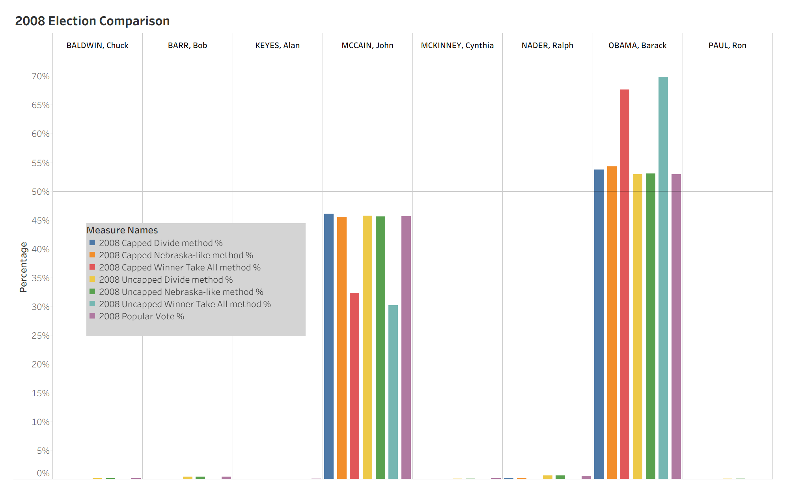

Slide 18
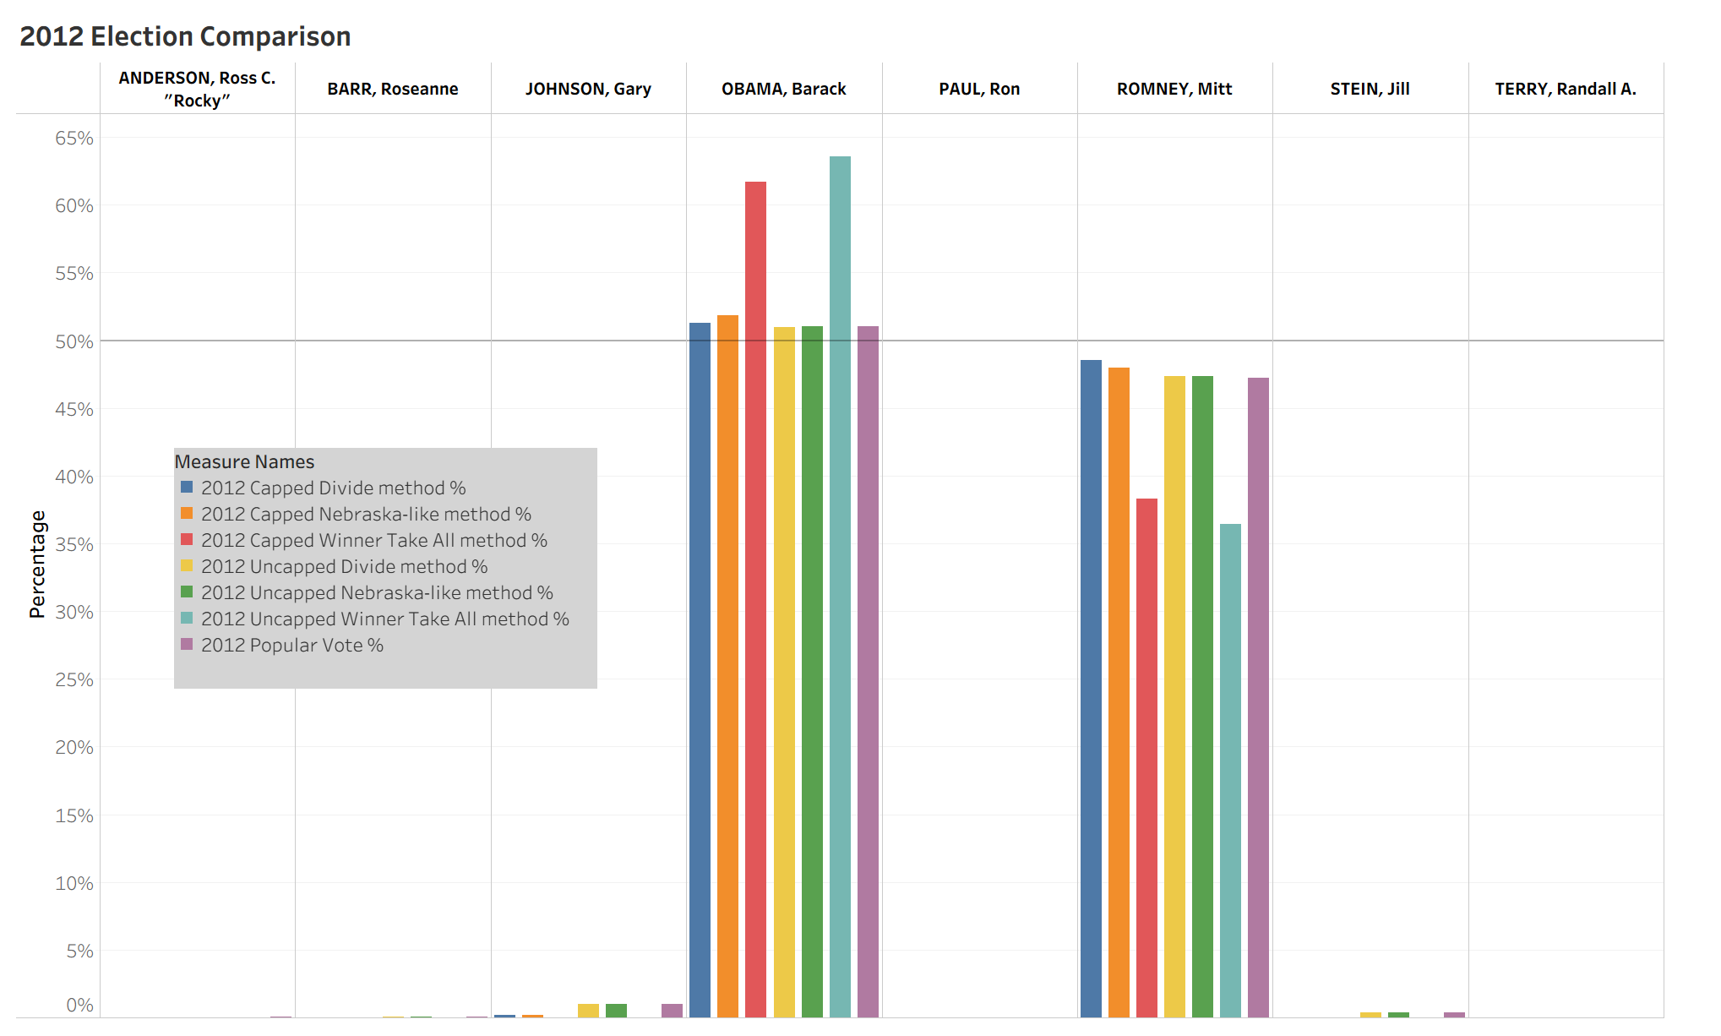

Slide 19
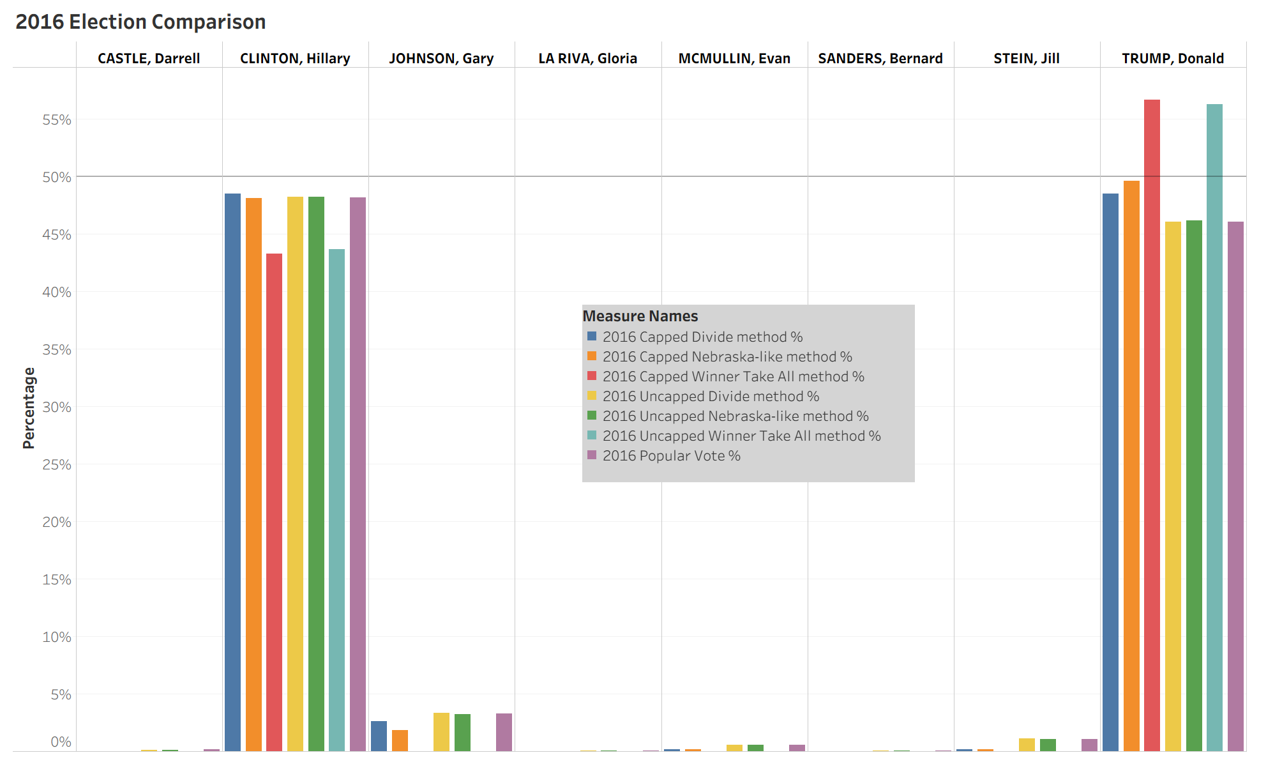

Slide 20
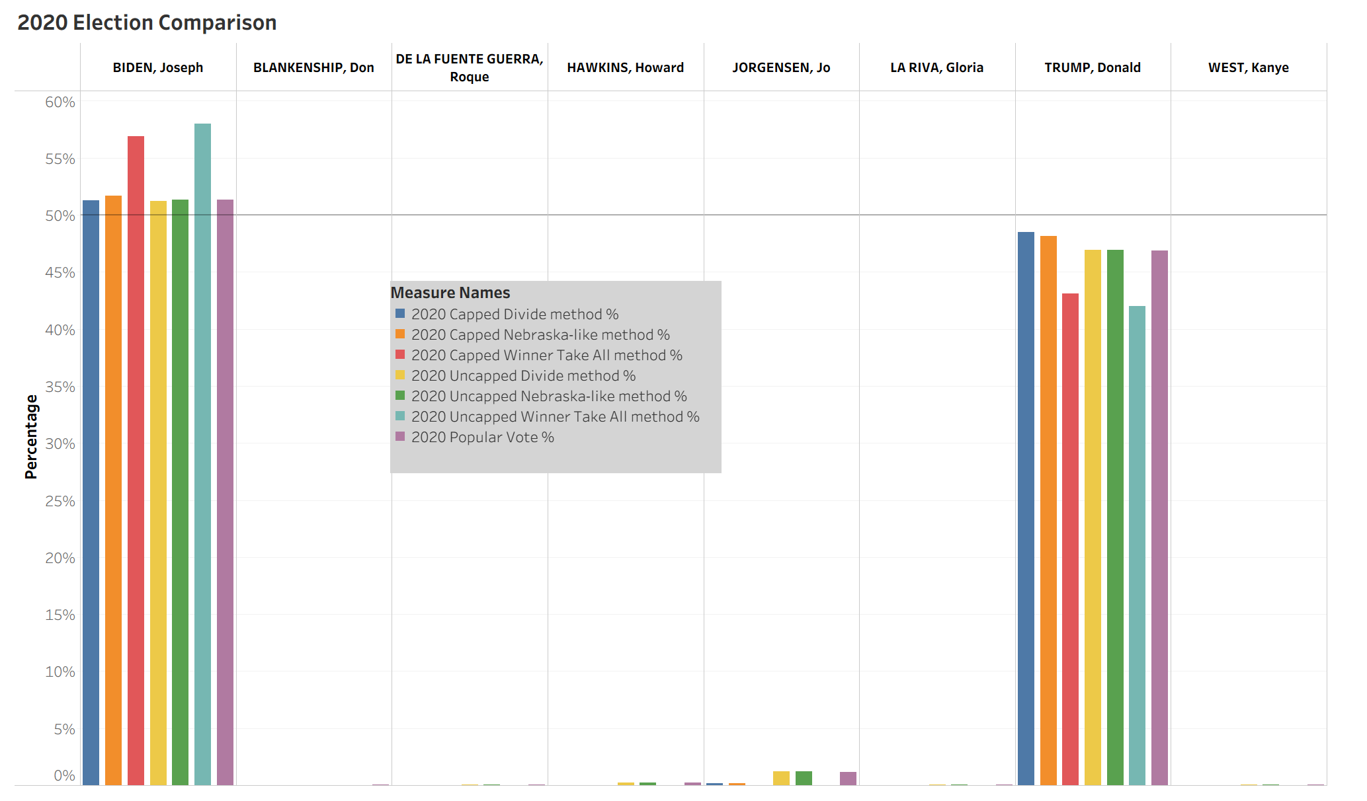

Slide 21
Interpreting The Results
The four graphs, following this slide, depict a more detailed comparison of popular vote and the four more closely associated method percentages as seen by the previous slides.
Method Percentages Compared
Full Divide - Capped Electoral College
Nebraska-like - Capped Electoral College
Full Divide - Uncapped Electoral College
Nebraska-like - Uncapped Electoral College
Popular Vote Percentage
In the following graphs please note how the uncapped Electoral College Methods are aligned more closely with the Popular Vote Percentages.

Slide 22
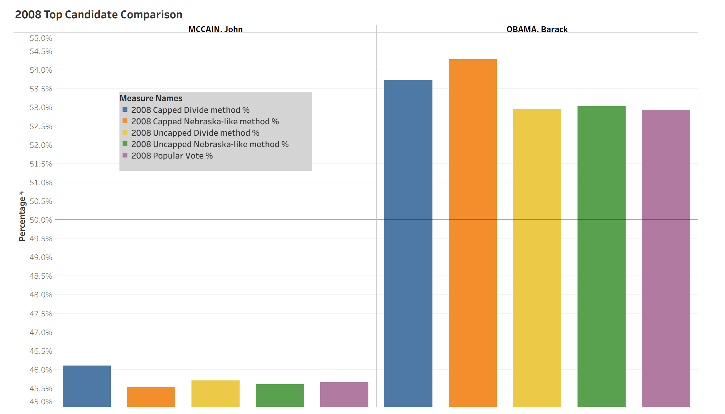

Slide 23
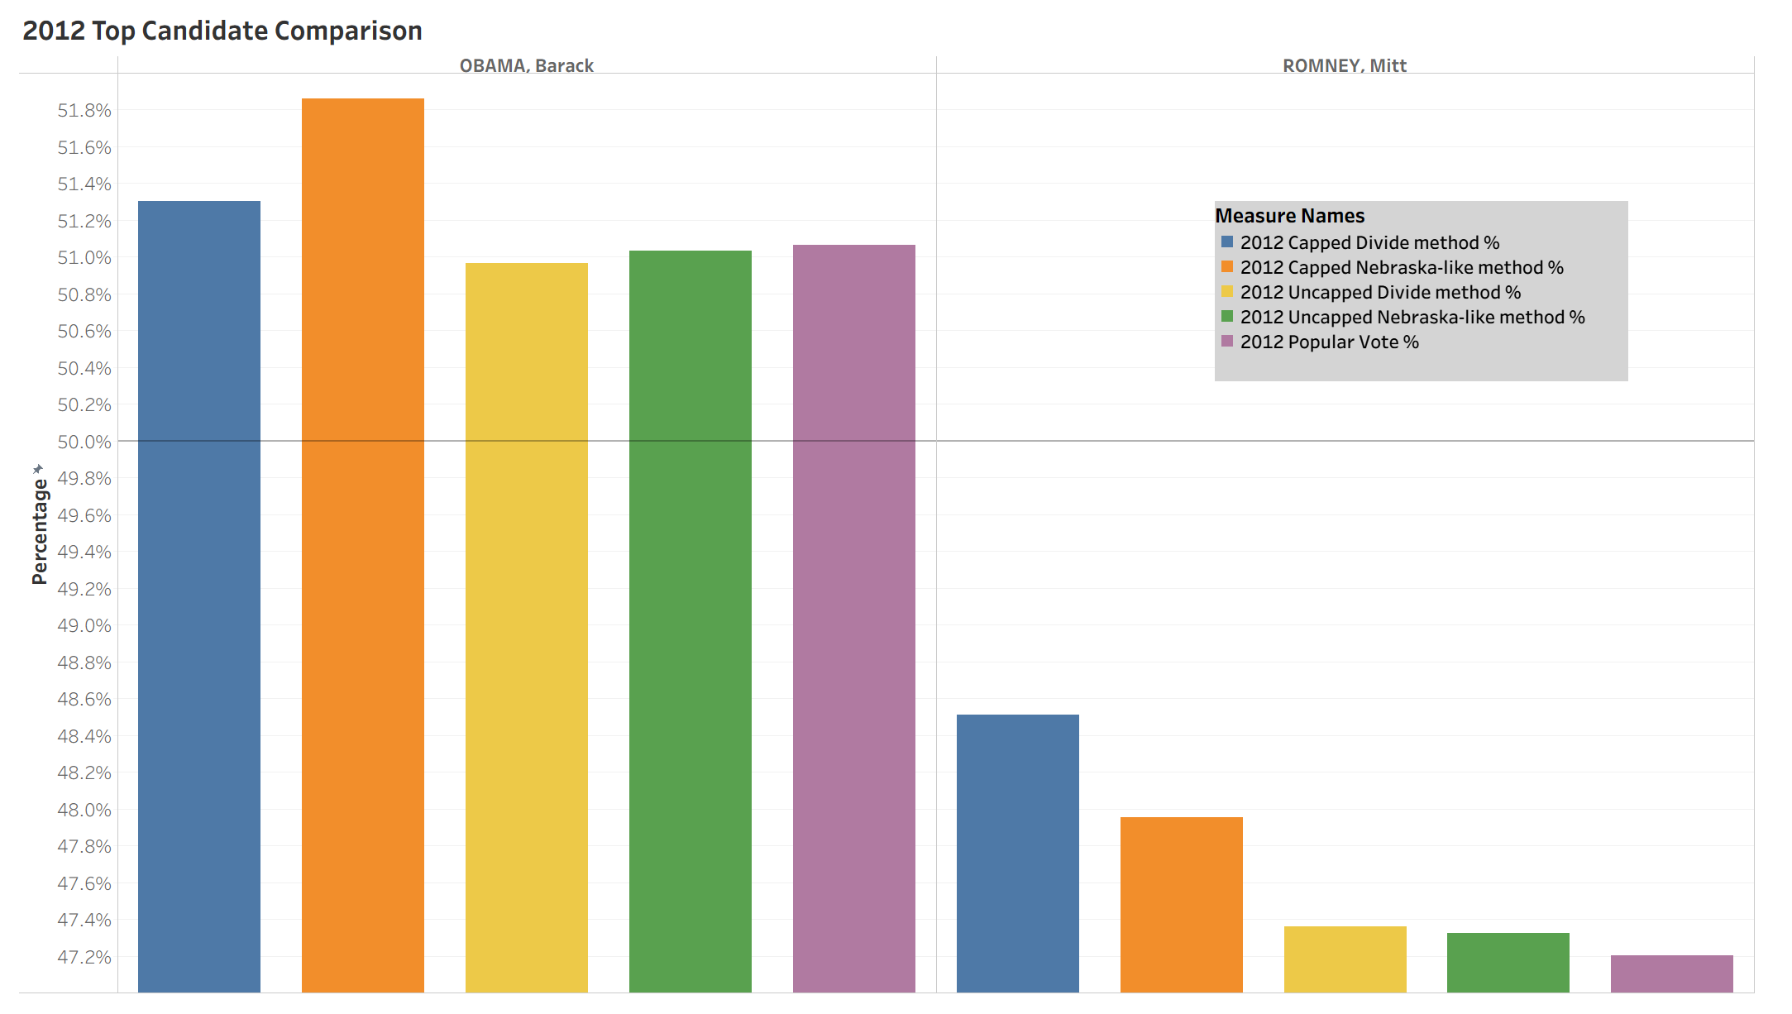

Slide 24
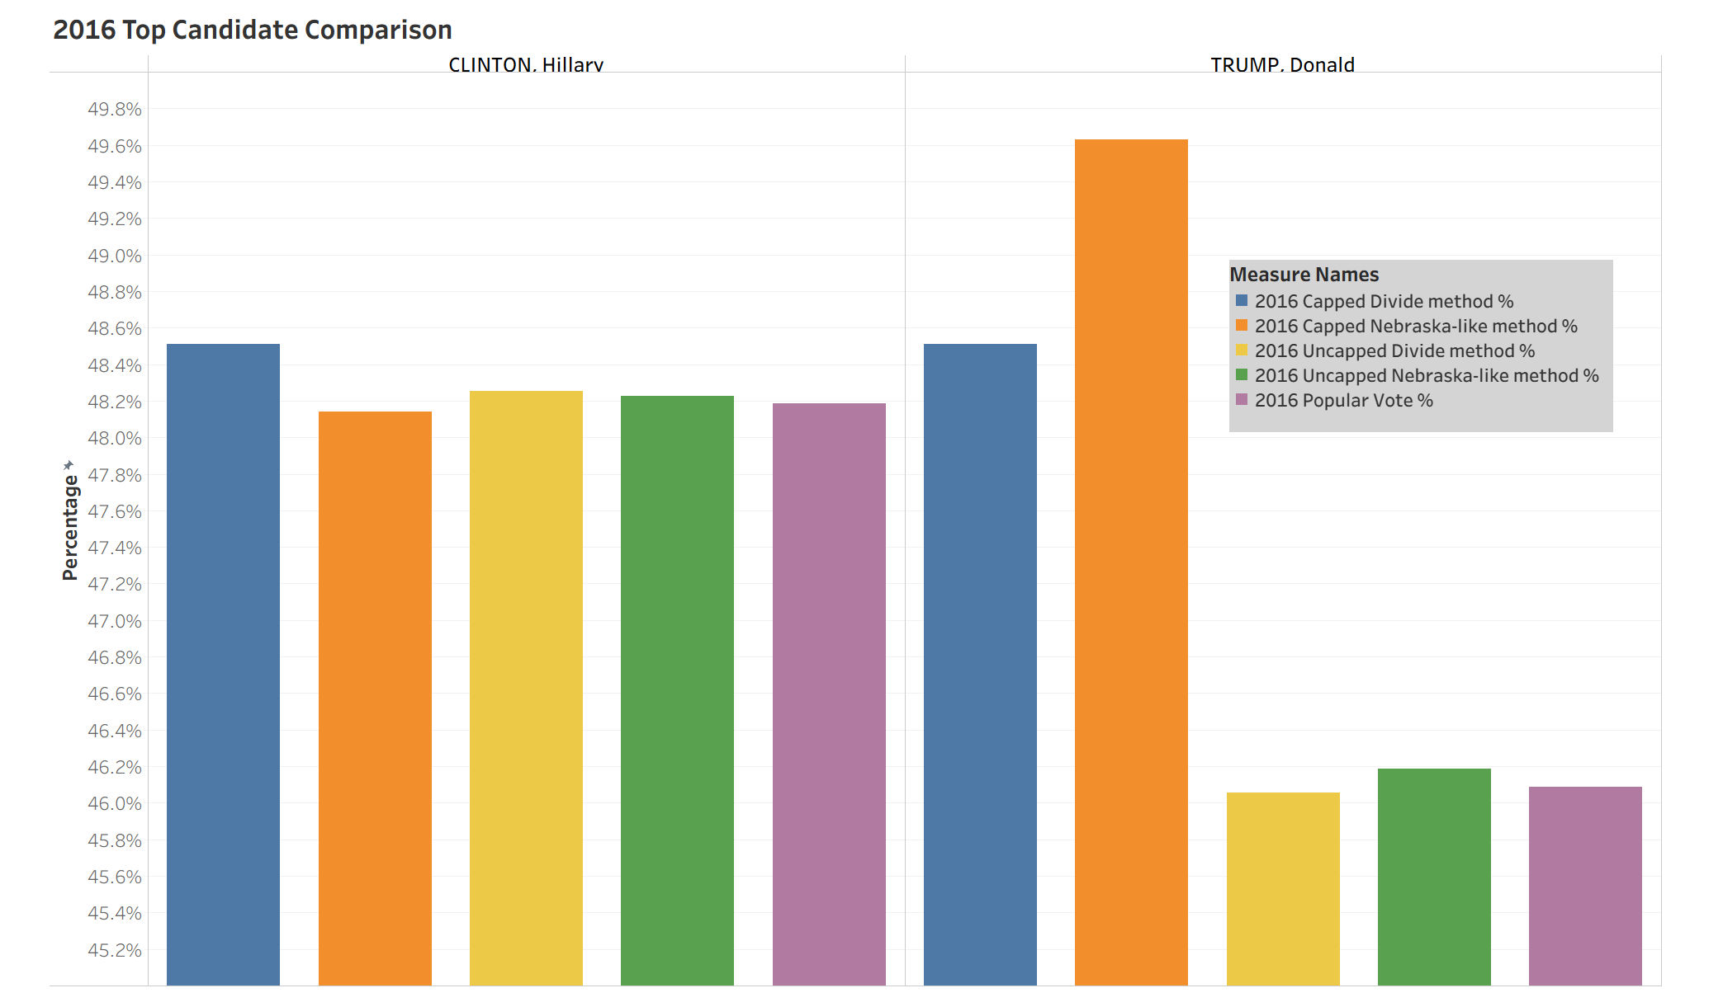

Slide 25
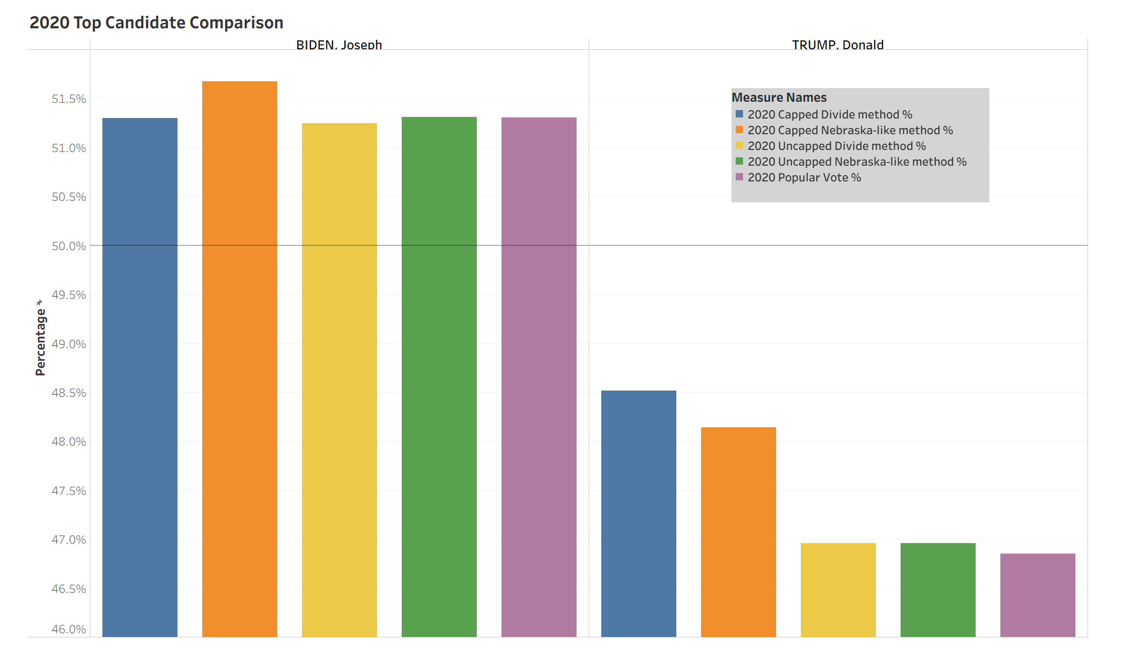

Slide 26
Interpreting The Results
As the percentages of the uncapped Full Divide and uncapped Nebraska-like methods were closest to the popular vote percentage, the final graphs focus on the precision of each method in proximity to the popular vote percentage. To determine this precision, the popular vote percentage was subtracted from the percentage of each method and repeated for each of the top two candidates in the U.S. Presidential Elections of 2008, 2012, 2016, and 2020.
Unfortunately, the following graphs do not render a clear decision for the most accurate method of distributing Electoral College Votes. Each method's difference from the popular vote percentage stays within a fifth of a percent and each method has a smaller difference in two of the elections. Therefore, one method cannot be determined to be superior without further analysis and increased sample sizes.

Slide 27
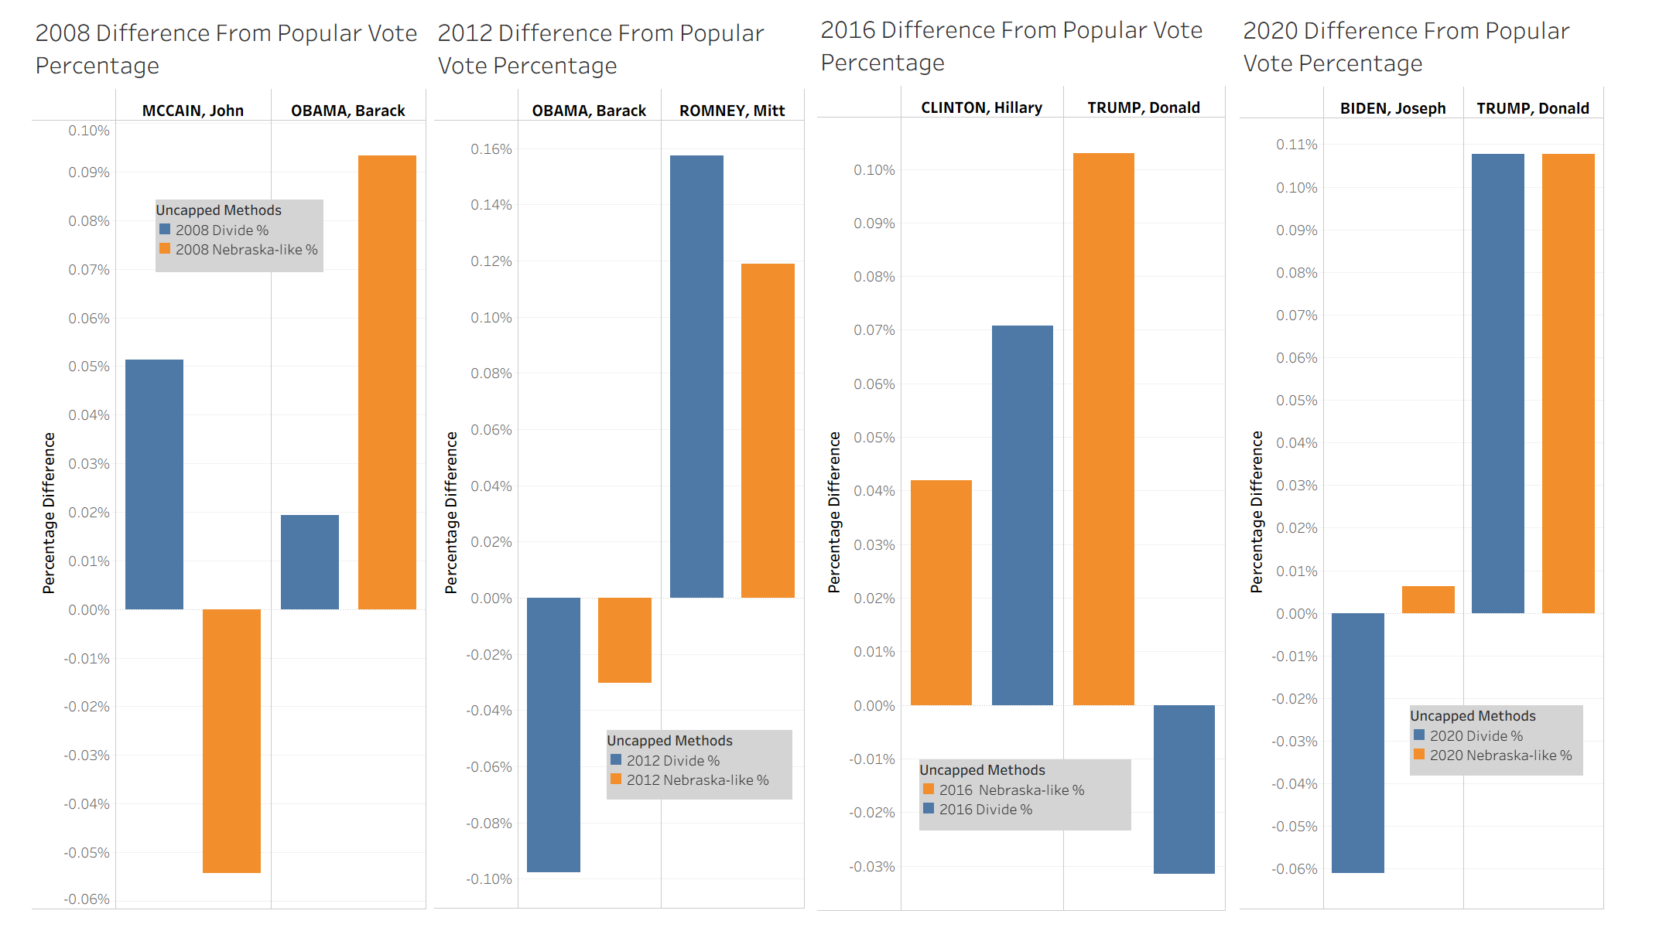

Slide 28
Data Sets
FEC. (2009, July). Federal elections 2008. [2008 Presidential General Election Results]. FEC.gov. https://www.fec.gov/introduction-campaign-finance/election-results-and-voting-information/federal-elections-2008/
Leamon, E. J., & Bucelato, J. (Eds.). FEC. (2015). Federal elections 2012. [2012 Presidential Election Results]. FEC.gov. https://www.fec.gov/introduction-campaign-finance/election-results-and-voting-information/federal-elections-2012/
Leamon, E. J., & Bucelato, J. (Eds.). FEC. (2023, Jan.). Federal elections 2016. [2016 Presidential Election Results]. FEC.gov. https://www.fec.gov/introduction-campaign-finance/election-results-and-voting-information/federal-elections-2016/
Leamon, E. J., & Bucelato, J. (Eds.). FEC. (2022, Oct.). Federal elections 2020. [2020 Presidential Election Results]. FEC.gov. https://www.fec.gov/introduction-campaign-finance/election-results-and-voting-information/federal-elections-2020/
US Census Bureau. (2024, June 7). 2020 census Apportionment Results. Census.gov. https://www.census.gov/data/tables/2020/dec/2020-apportionment-data.html

Slide 29
Other References
Electoral Ventures LLC. (2025). Split electoral votes in Maine and Nebraska - 270towin. 270toWin.com. https://www.270towin.com/content/split-electoral-votes-maine-and-nebraska/
National Archives and Records Administration. (2025, April 14). The Constitution: Amendments 11-27. National Archives and Records Administration. https://www.archives.gov/founding-docs/amendments-11-27
US House of Representatives. (n.d.). The Permanent Apportionment Act of 1929. US House of Representatives: History, Art & Archives. https://history.house.gov/Historical-Highlights/1901-1950/The-Permanent-Apportionment-Act-of-1929/
Wang, H. L. (2021, April 20). Stuck at 435 representatives? why the U.S. House hasn’t grown with Census counts. NPR. https://www.npr.org/2021/04/20/988865415/stuck-at-435-representatives-why-the-u-s-house-hasnt-grown-with-census-counts

