Slide 1
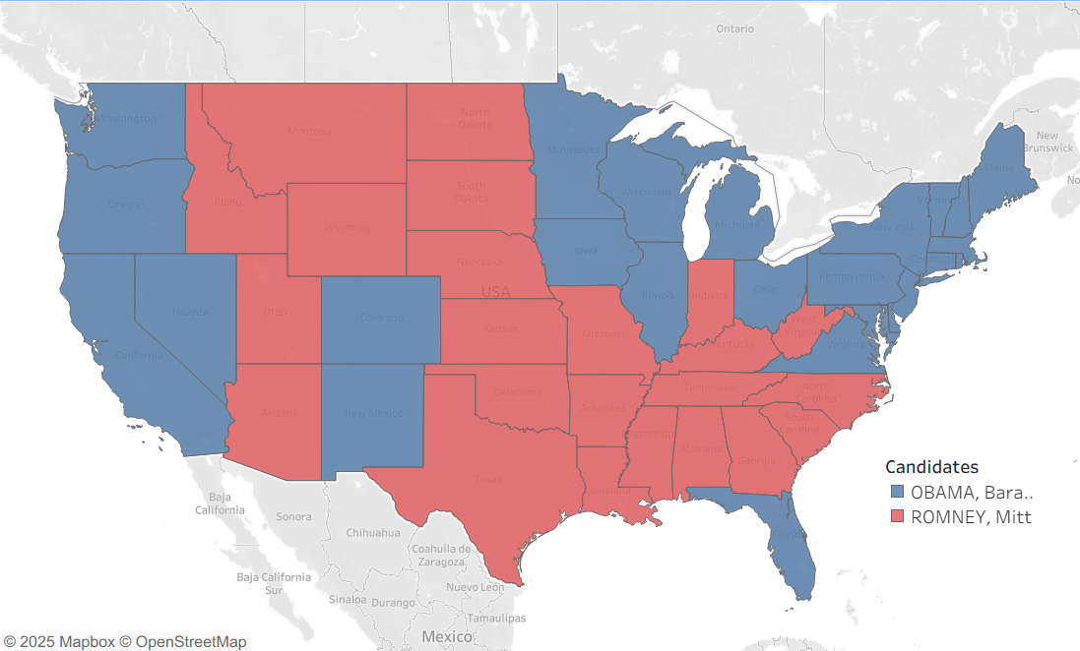
Changing Election Outcomes:
Comparing Electoral College Methods To The Popular Vote
By James M. Halaz

Slide 2
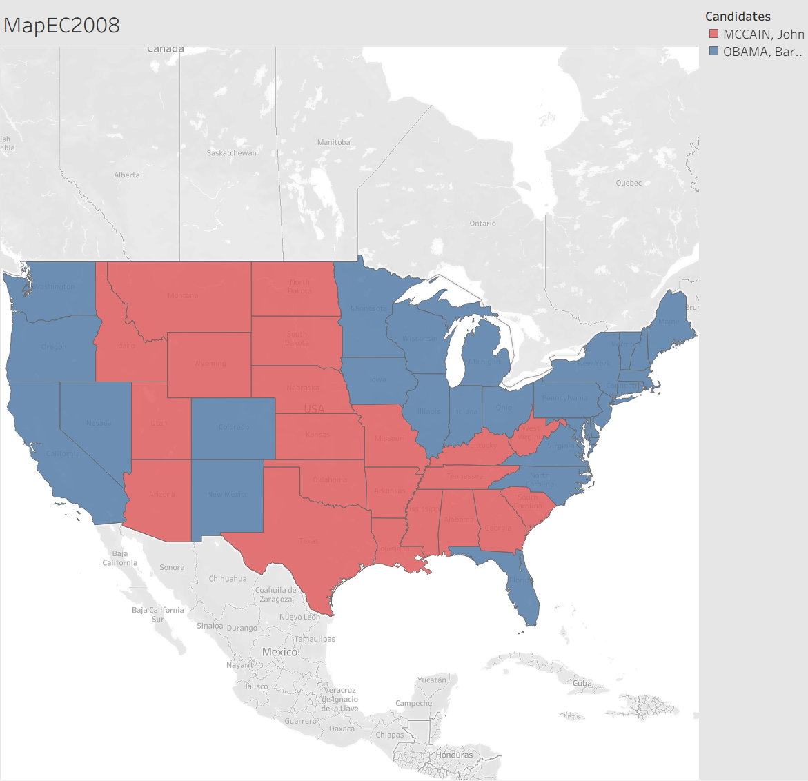
In the current Electoral College, the candidate with the highest number of popular votes in a state obtains all the Electoral Votes for that state.
Each state and the District of Columbia is apportioned with at least one vote for each representative out of 436 and two votes for each senator.
The candidate who reaches 270 Electoral Votes, or over half the Electoral College Votes, becomes president.
However, it is important to note the states of Nebraska and Maine award the two senatorial votes to the plurality winner of the state and each representative vote to the popular vote winner of each Congressional District.

Slide 3
Another important aspect to note is the US Constitution calls for at least one representative for every state, but no more than one representative for every 30,000 people.
For the purposes of this analysis, this brings about two important questions:
Why is the number of representatives set to 435?
The Permanent Apportionment Act of 1929 set the limit of 435 representatives by equating it to the 1910 US Census apportionment. This number was locked in place out of fears of the House of Representatives growing too large to conduct business properly. However, this decision has allowed the population for each representative to balloon to anywhere from 542,704 to 990,837 according to the 2020 US Census numbers
If the District of Columbia is not a state, why does it count in the Electoral College?
The 23rd Amendment states "The District ... shall appoint … A number of electors ... equal to the whole number of Senators and Representatives in Congress to which the District would be entitled if it were a State, but in no event more than the least populous State; they shall be in addition to those appointed by the States, but they shall be considered … to be electors appointed by a State;"

Slide 4
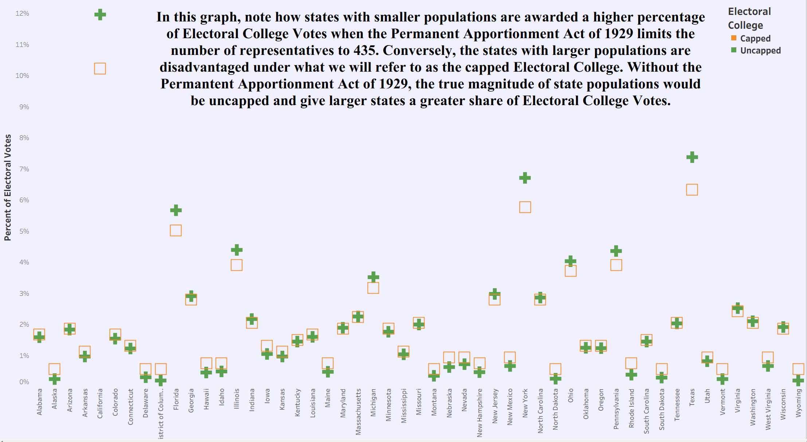

Slide 5
The Premise
With these facts in mind, this project will attempt to investigate, how accurately, methods of awarding Electoral College Votes hold to the principles of representational government. Therefore, three methods of awarding Electoral College Votes will be tested with both the capped number of representatives and an uncapped number of representatives. To test this idea fully, as many representatives as possible will be given to each state, while still holding to the provision that there shall not be more than one representative for every 30,000 people. The standard for accuracy of representation will be awarding Electoral College Votes in percentages nearest to the popular vote percentage. In order to gauge the precision of these methods, each will be tested using the state voting numbers from the U.S. Presidential Elections in 2008, 2012, 2016, and 2020.

Slide 6
The State of Simplicity
As the methods of awarding Electoral Votes can be complicated, a model state has been created to demonstrate the full process in simplified form. In order to highlight the similarities and differences in awarding Electoral College Votes among methods, the comparable steps of each method will be demonstrated in juxtaposition. The necessary analytical characteristics of the imagined state are listed below along with the names of the three methods to be demonstrated.
Methods
- Winner Take All - State's highest popular vote candidate awarded all of the State's Electoral College Votes
- Full Divide - State's Electoral College Votes are awarded by the proportion of popular votes for each candidate
- Nebraska-like System – A state's Representative Electoral College Votes are awarded by the proportion of popular votes for each candidate. However, a state's Senatorial Electoral College Votes are awarded to the highest popular vote candidate
Total Popular Votes = 48
Total Number of EC Votes = 6
- Number of Representatives = 4
- Number of Senators = 2
Candidate A popular votes = 22
Candidate B popular votes = 8
Candidate C popular votes = 18

Slide 7
The first steps in the Full Divide and Nebraska-like systems are to divide the total number of popular votes by the state's number of Electoral College Votes or Representative Electoral College Votes. The result, referred to as the Electoral Vote Population in each respective method, will then be used to divide the candidates' popular votes to award Electoral College Votes.
Full Divide
48 / 6 = 8
22 / 8 = 2 R = 6
8 / 8 = 1 R = 0
18 / 8 = 2 R = 2
Electoral Votes Awarded
2 | 1 | 2
Nebraska-like
48 / 4 = 12
22 / 12 = 1 R = 10
8 / 12 = 0 R = 8
18 / 12 = 1 R = 6
Electoral Votes Awarded
1 | 0 | 1
Total Popular Votes = 48
Total Number of EC Votes = 6
- Number of Representatives = 4
Number of Senators = 2
Candidate A popular votes = 22
Candidate B popular votes = 8
Candidate C popular votes = 18
Remainder = R

Slide 8
After the initial awarding of Electoral College Votes, the remaining unawarded Electoral College Votes are calculated by subtracting the awarded Electoral College Votes from the state's Electoral College Vote total in the Full Divide method and the state's Representative Electoral College number in the Nebraska-like method. The popular vote remainders are ranked highest to lowest and one Electoral College vote is awarded to each candidate in rank order until no Electoral College Votes remain.
Full Divide
6 - (2 + 1 + 2) = 1
Candidate A R = 6
Candidate C R = 2
Candidate B R = 0
Electoral Votes Awarded
3 | 1 | 2
Nebraska-like
4 - (1 + 0 + 1) = 2
Candidate A R = 10
Candidate B R = 8
Candidate C R = 6
Electoral Votes Awarded
2 | 1 | 1
Total Popular Votes = 48
Total Number of EC Votes = 6
- Number of Representatives = 4
- Number of Senators = 2
Candidate A popular votes = 22
Candidate B popular votes = 8
Candidate C popular votes = 18
Popular Vote Remainder = R

Slide 9
The last operation completed the Full Divide method, but the Winner Take All Electoral College Votes and Nebraska-like Senatorial Electoral College Votes are yet to be awarded. As both calculations award their unawarded Electoral College Votes to the plurality winner of the popular vote, all of their votes will be given to Candidate A. The Electoral College Votes by method are shown below and help to understand the complexities of these methods.
Total Popular Votes = 48
Total Number of EC Votes = 6
- Number of Representatives = 4
- Number of Senators = 2
Candidate A popular votes = 22
Candidate B popular votes = 8
Candidate C popular votes = 18
Full Divide
Electoral Votes Awarded
3 | 1 | 2
Nebraska-like
Electoral Votes Awarded
4 | 1 | 1
Winner Take All
Electoral Votes Awarded
6 | 0 | 0

Slide 10
Data Sets
FEC. (2009, July). Federal elections 2008. [2008 Presidential General Election Results]. FEC.gov. https://www.fec.gov/introduction-campaign-finance/election-results-and-voting-information/federal-elections-2008/
Leamon, E. J., & Bucelato, J. (Eds.). FEC. (2015). Federal elections 2012. [2012 Presidential Election Results]. FEC.gov. https://www.fec.gov/introduction-campaign-finance/election-results-and-voting-information/federal-elections-2012/
Leamon, E. J., & Bucelato, J. (Eds.). FEC. (2023, Jan.). Federal elections 2016. [2016 Presidential Election Results]. FEC.gov. https://www.fec.gov/introduction-campaign-finance/election-results-and-voting-information/federal-elections-2016/
Leamon, E. J., & Bucelato, J. (Eds.). FEC. (2022, Oct.). Federal elections 2020. [2020 Presidential Election Results]. FEC.gov. https://www.fec.gov/introduction-campaign-finance/election-results-and-voting-information/federal-elections-2020/
US Census Bureau. (2024, June 7). 2020 census Apportionment Results. Census.gov. https://www.census.gov/data/tables/2020/dec/2020-apportionment-data.html

Slide 11
Other References
Electoral Ventures LLC. (2025). Split electoral votes in Maine and Nebraska - 270towin. 270toWin.com. https://www.270towin.com/content/split-electoral-votes-maine-and-nebraska/
National Archives and Records Administration. (2025, April 14). The Constitution: Amendments 11-27. National Archives and Records Administration. https://www.archives.gov/founding-docs/amendments-11-27
US House of Representatives. (n.d.). The Permanent Apportionment Act of 1929. US House of Representatives: History, Art & Archives. https://history.house.gov/Historical-Highlights/1901-1950/The-Permanent-Apportionment-Act-of-1929/
Wang, H. L. (2021, April 20). Stuck at 435 representatives? why the U.S. House hasn’t grown with Census counts. NPR. https://www.npr.org/2021/04/20/988865415/stuck-at-435-representatives-why-the-u-s-house-hasnt-grown-with-census-counts

