Slide 1
Interpreting The Results
The following four graphs use all three methods, with both capped and uncapped Electoral College totals, to determine Electoral College percentages for each candidate. For the U.S. Presidential Elections of 2008, 2012, 2016, and 2020, the Electoral College percentages of the top eight candidates are shown in comparison to the candidate's popular vote percentage. Some interesting aspects to take note of in the following graphs are:
1) The percentages of the Winner Take All methods are significantly different than the percentages of the other methods and the popular vote percentages.
2) The Winner Take All methods seem to inflate the Electoral College percentages of leading candidates and suppress the Electoral College percentages of lagging competitors.
3) Due to the inflation and suppression of the Winner Take All method, utilized by most states currently, the 2016 U.S. Presidential Election had a decisive winner. The other methods would have resulted in no candidate securing over 50 percent of the Electoral College and the election would have been decided by Congressional vote.
4) Methods other than Winner Take All allowed for third party candidates to receive Electoral College Votes

Slide 2
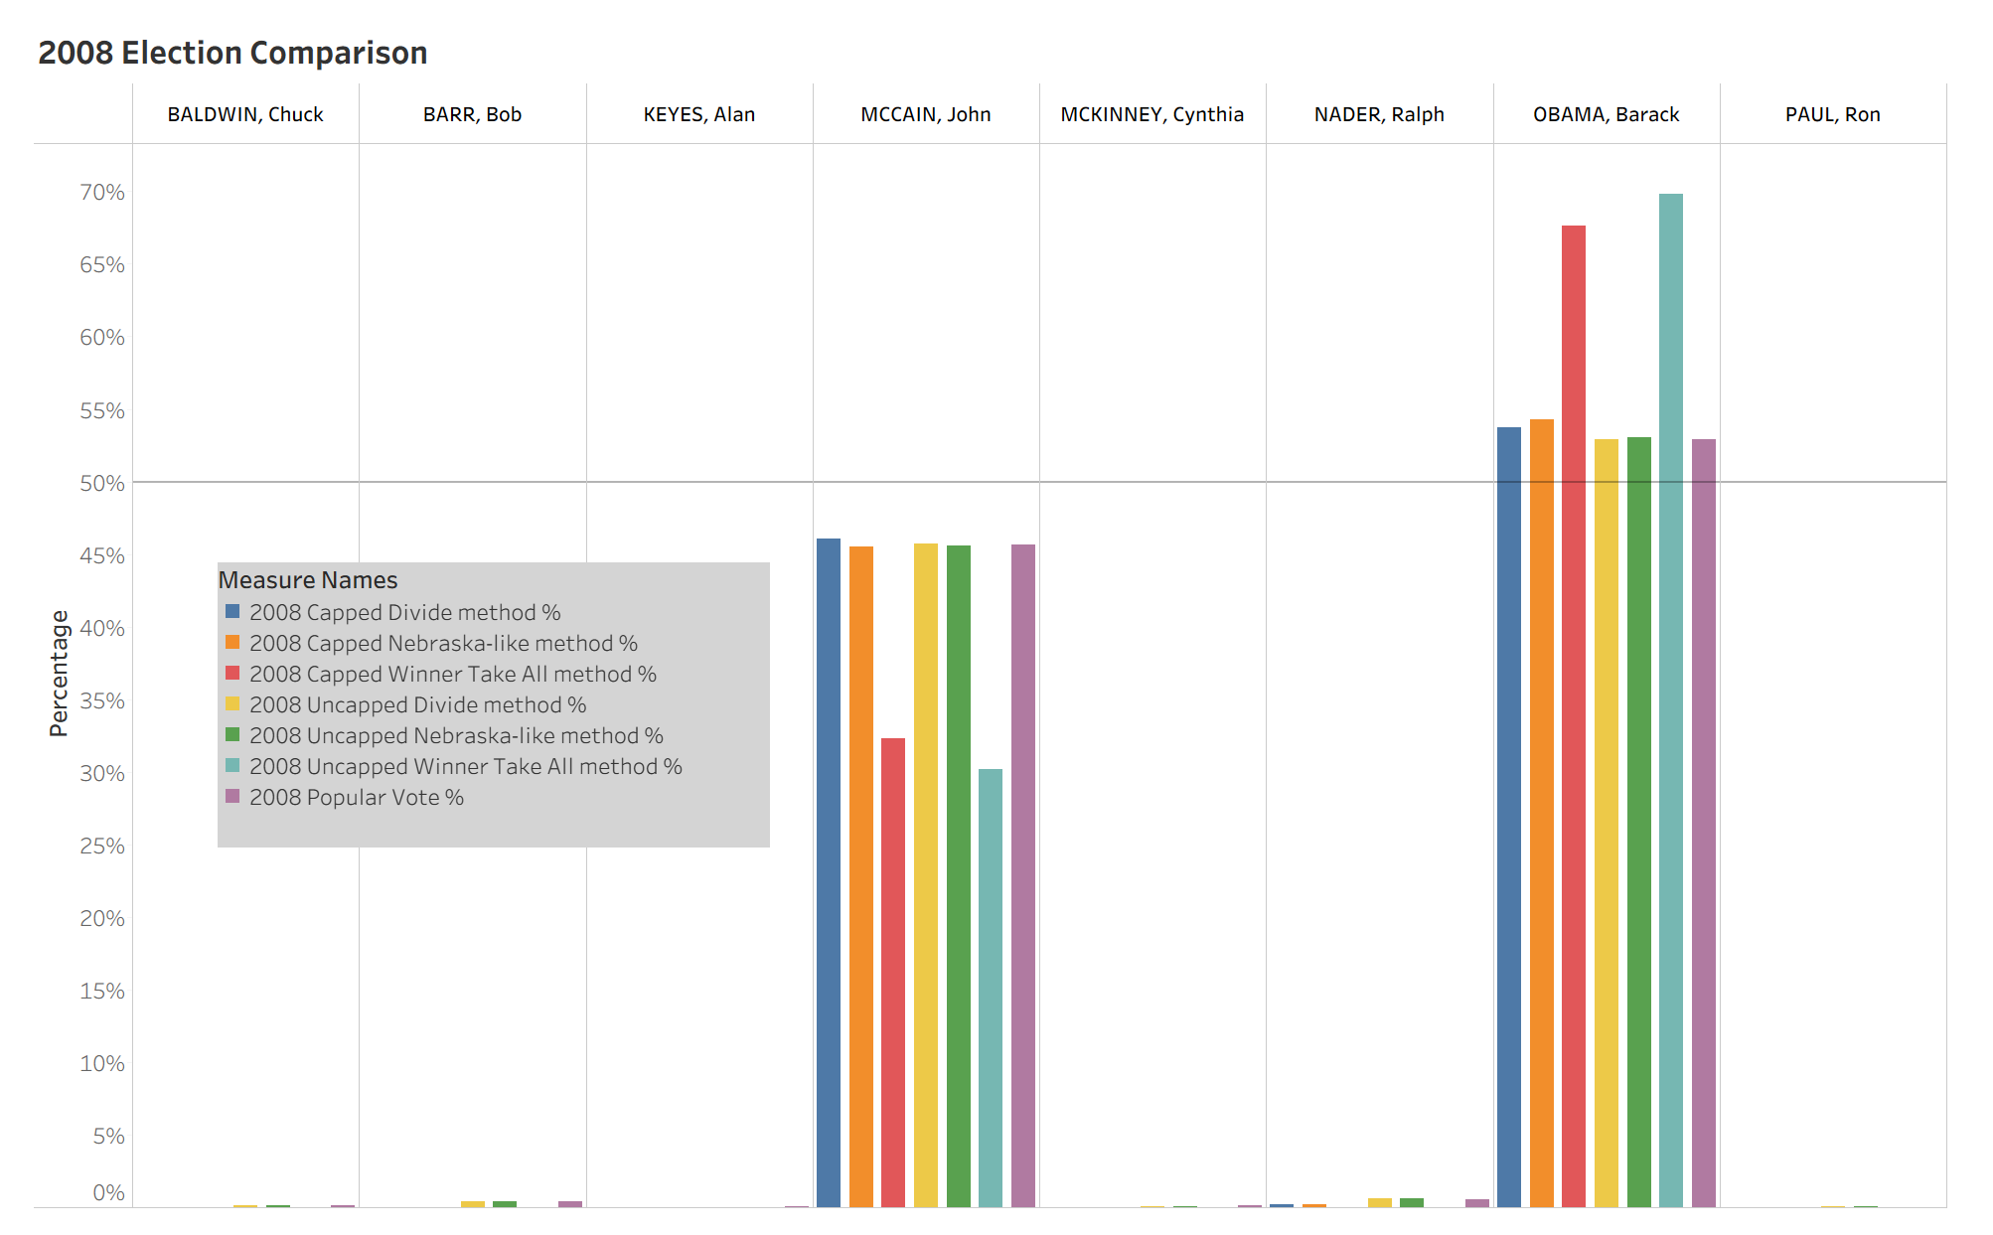

Slide 3
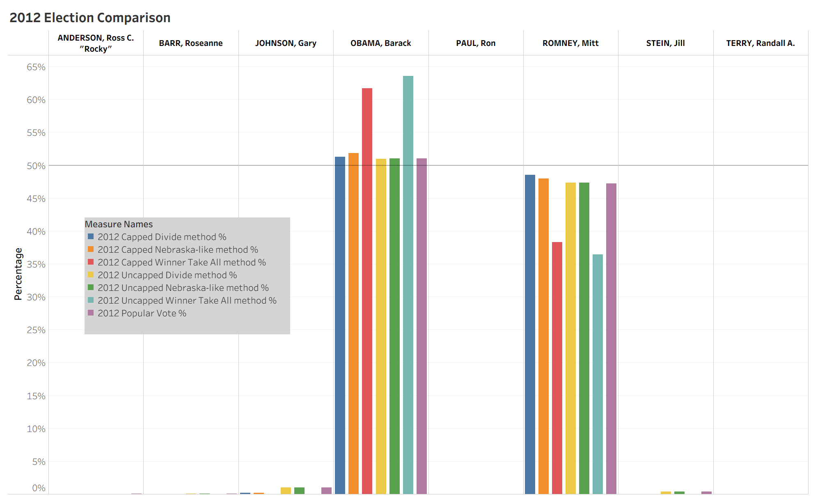

Slide 4
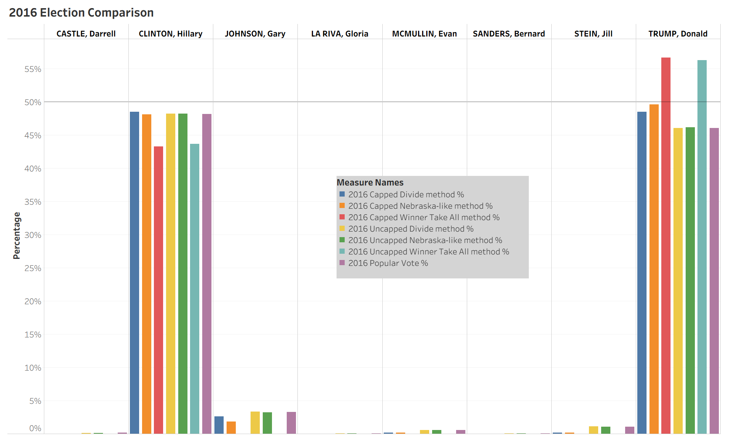

Slide 5
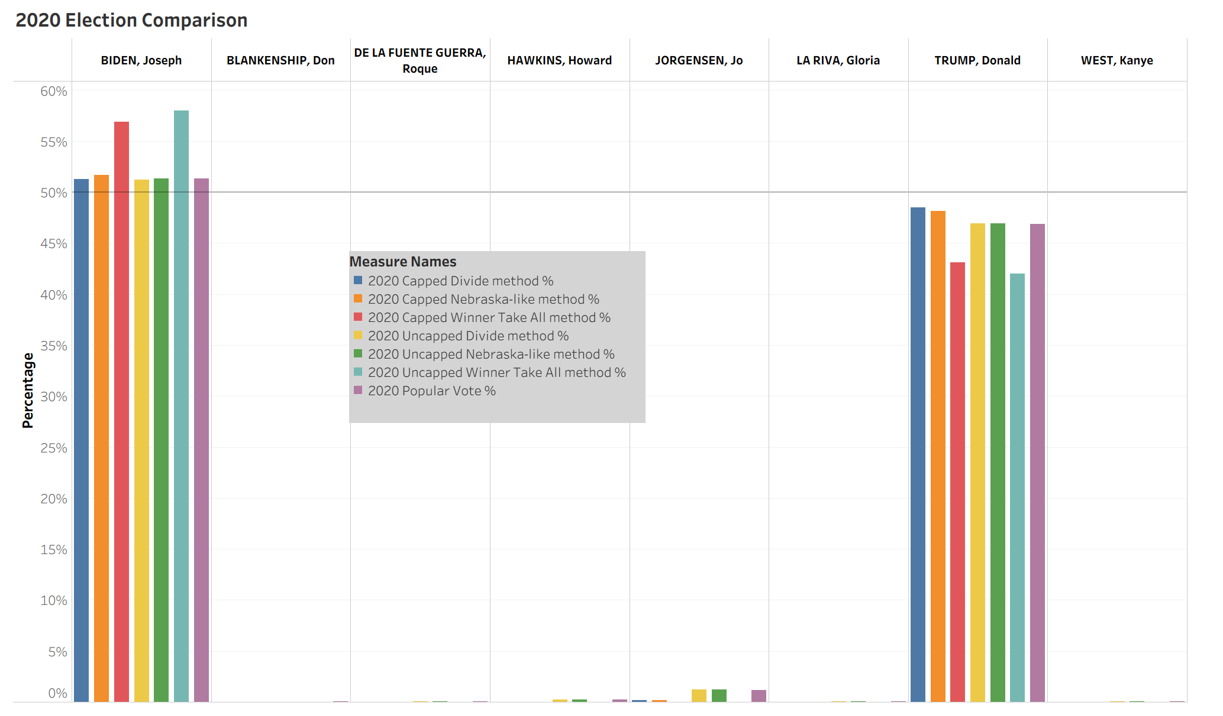

Slide 6
Interpreting The Results
The four graphs, following this slide, depict a more detailed comparison of popular vote and the four more closely associated method percentages as seen by the previous slides.
Method Percentages Compared
Full Divide - Capped Electoral College
Nebraska-like - Capped Electoral College
Full Divide - Uncapped Electoral College
Nebraska-like - Uncapped Electoral College
Popular Vote Percentage
In the following graphs please note how the uncapped Electoral College methods are aligned more closely with the Popular Vote Percentages.

Slide 7
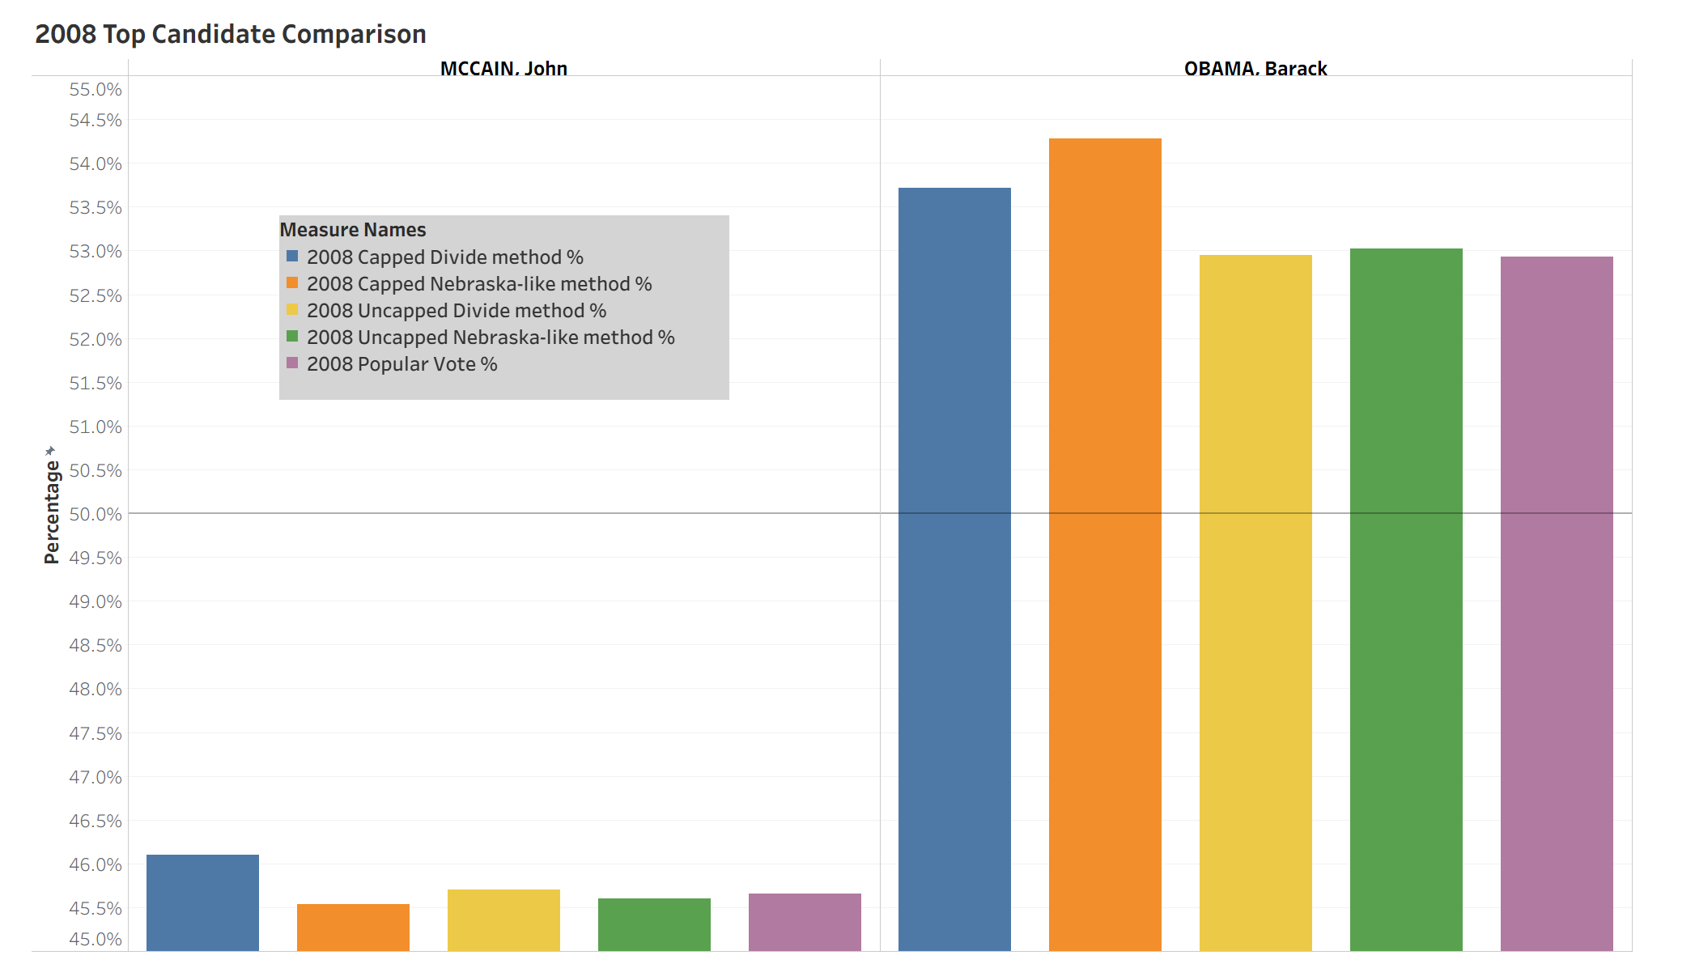

Slide 8
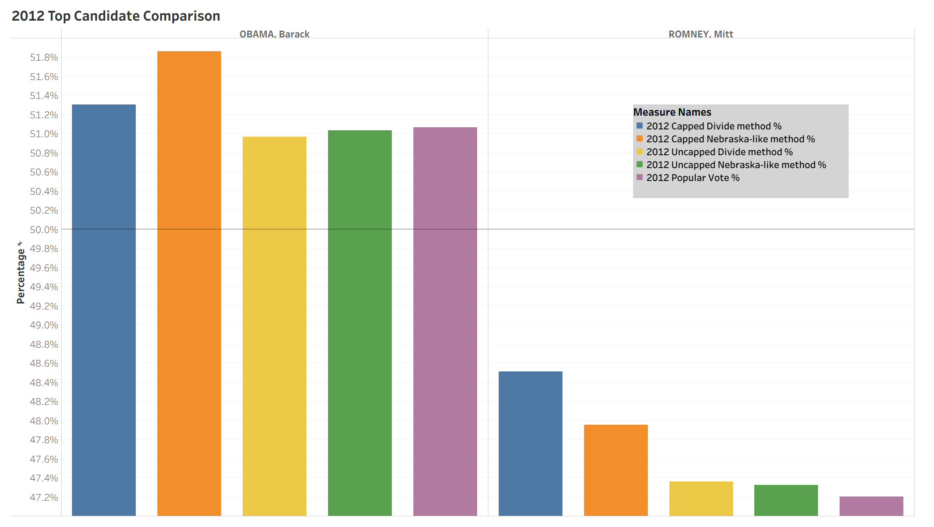

Slide 9
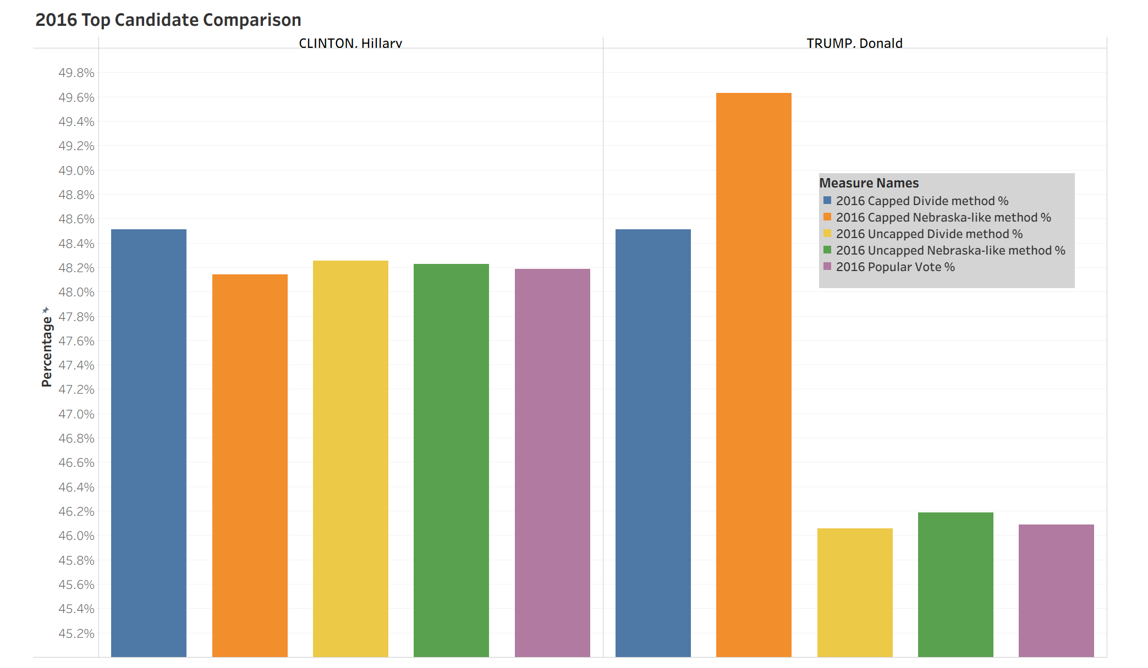

Slide 10
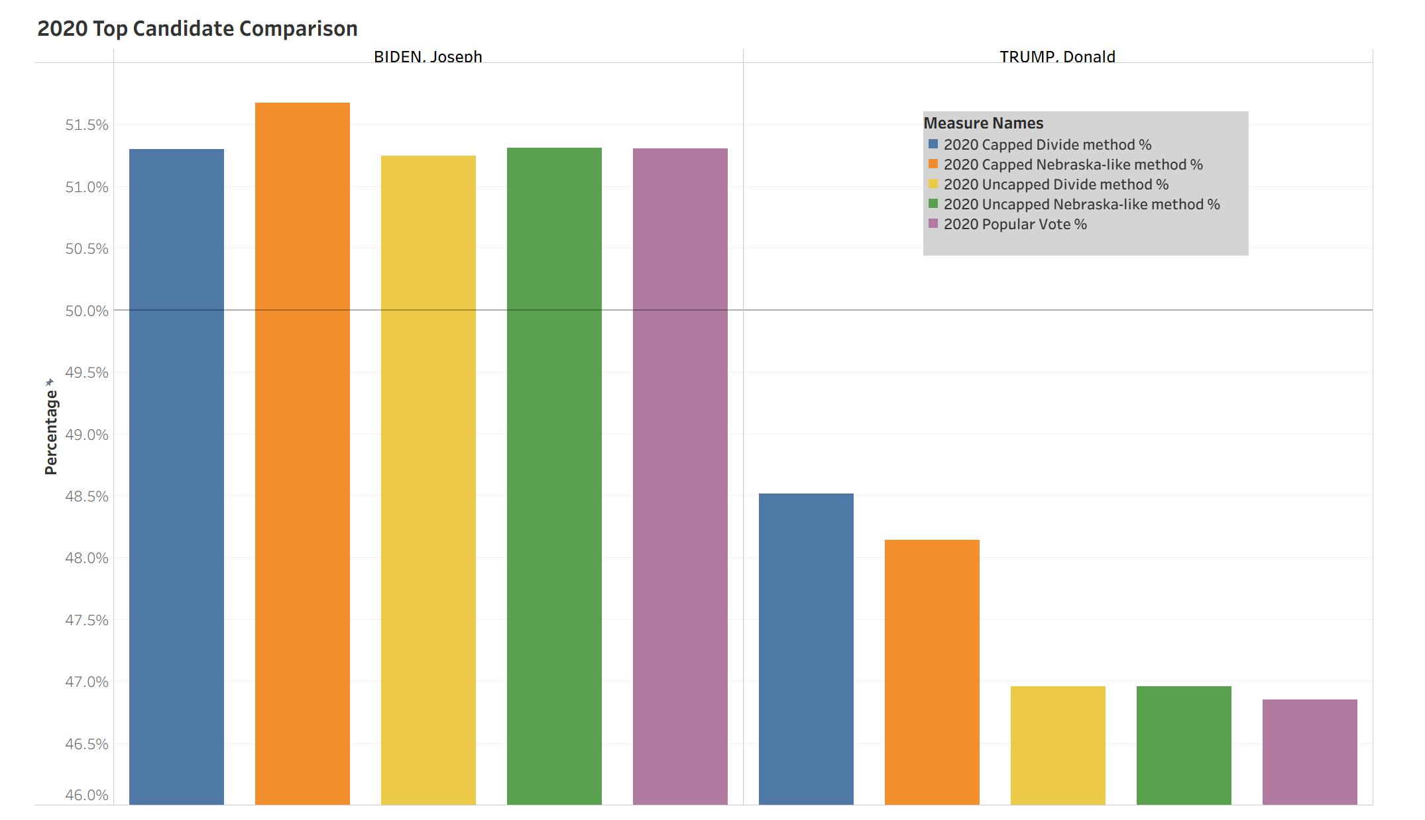

Slide 11
Interpreting The Results
As the percentages of the uncapped Full Divide and uncapped Nebraska-like methods were closest to the popular vote percentage, the final graphs focus on the precision of each method in proximity to the popular vote percentage. To determine this precision, the popular vote percentage was subtracted from the percentage of each method and repeated for each of the top two candidates in the U.S. Presidential Elections of 2008, 2012, 2016, and 2020.
Unfortunately, the following graphs do not render a clear decision for the most accurate method of distributing Electoral College Votes. Each method's difference from the popular vote percentage stays within a fifth of a percent and each method has a smaller difference in two of the elections. Therefore, one method cannot be determined to be superior without further analysis and increased sample sizes.

Slide 12
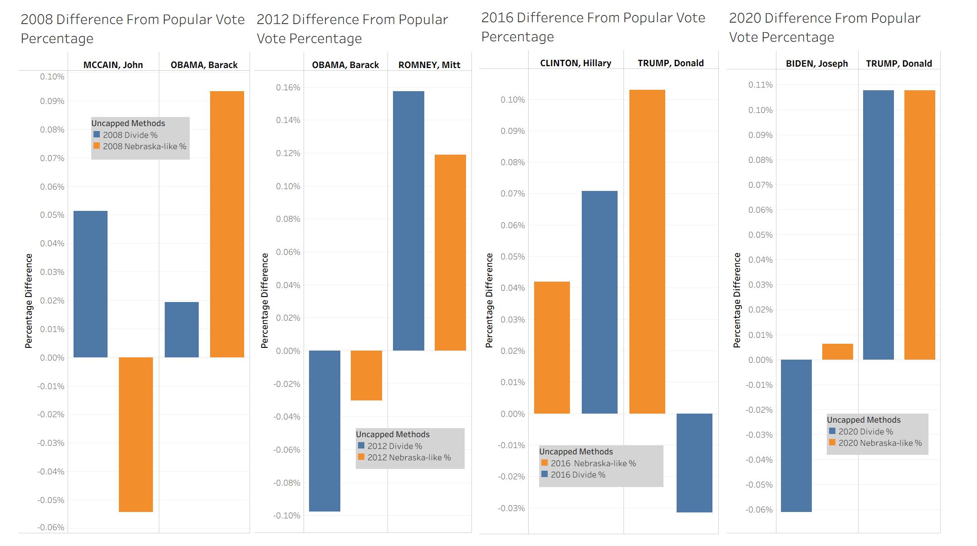

Slide 13
Data Sets
FEC. (2009, July). Federal elections 2008. [2008 Presidential General Election Results]. FEC.gov. https://www.fec.gov/introduction-campaign-finance/election-results-and-voting-information/federal-elections-2008/
Leamon, E. J., & Bucelato, J. (Eds.). FEC. (2015). Federal elections 2012. [2012 Presidential Election Results]. FEC.gov. https://www.fec.gov/introduction-campaign-finance/election-results-and-voting-information/federal-elections-2012/
Leamon, E. J., & Bucelato, J. (Eds.). FEC. (2023, Jan.). Federal elections 2016. [2016 Presidential Election Results]. FEC.gov. https://www.fec.gov/introduction-campaign-finance/election-results-and-voting-information/federal-elections-2016/
Leamon, E. J., & Bucelato, J. (Eds.). FEC. (2022, Oct.). Federal elections 2020. [2020 Presidential Election Results]. FEC.gov. https://www.fec.gov/introduction-campaign-finance/election-results-and-voting-information/federal-elections-2020/
US Census Bureau. (2024, June 7). 2020 census Apportionment Results. Census.gov. https://www.census.gov/data/tables/2020/dec/2020-apportionment-data.html

Slide 14
Other References
Electoral Ventures LLC. (2025). Split electoral votes in Maine and Nebraska - 270towin. 270toWin.com. https://www.270towin.com/content/split-electoral-votes-maine-and-nebraska/
National Archives and Records Administration. (2025, April 14). The Constitution: Amendments 11-27. National Archives and Records Administration. https://www.archives.gov/founding-docs/amendments-11-27
US House of Representatives. (n.d.). The Permanent Apportionment Act of 1929. US House of Representatives: History, Art & Archives. https://history.house.gov/Historical-Highlights/1901-1950/The-Permanent-Apportionment-Act-of-1929/
Wang, H. L. (2021, April 20). Stuck at 435 representatives? why the U.S. House hasn’t grown with Census counts. NPR. https://www.npr.org/2021/04/20/988865415/stuck-at-435-representatives-why-the-u-s-house-hasnt-grown-with-census-counts

