Slide 1
Update on GOSI10 sea ice work
JMMP Quarterly Meeting
Emma Fiedler, Ed Blockley
20 November 2025

Slide 2
GOSI10 sea ice update
GOSI10.beta.5 - Upgrades to the sea ice dynamics to improve sea ice model effective resolution and representation of landfast (immobile) ice
Landfast ice: Instability along the north fold (fixed)
Super-cooled ocean grid points impacting sea ice strength and growth (ongoing)

Slide 3
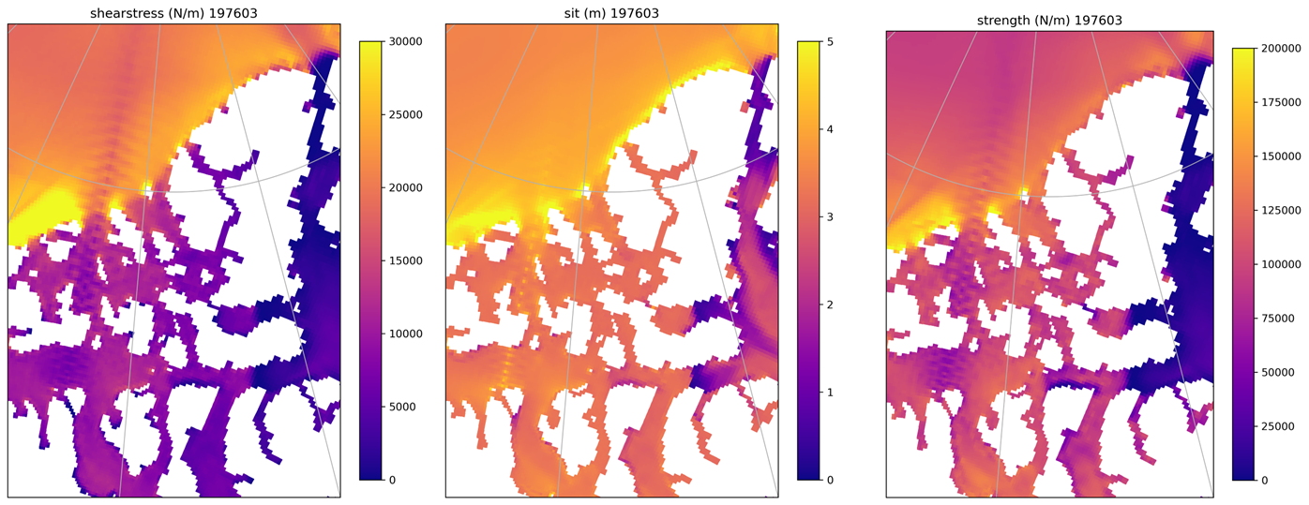
Landfast ice: Instability along north fold
Lemieux et al. (2016) landfast ice scheme increases basal stress for grounded ridges, and tensile stress to allow arches to develop
Notes:
u-ds646, month 3
R75+aEVP, no max strength, + smoothing, landfast on (default namelist settings)

Slide 4
Landfast ice: Instability along north fold
An issue in NEMO5 already identified and fixed by Daley ensured all points on the north fold in the sea ice rheology code are set by lbc_lnk, not just halo points
    Avoids instabilities building up in iterative solver
This was implemented only on the final rheology subcycle
However, for the landfast ice scheme, this is insufficient
    Instead, now performed on all subcycles, not just final one
Update is now in the GOSI10 main
Notes:
Numerically different results can be produced in this area on either side of the north fold, causing instabilities to build up in the iterative solver of icedyn_rhg_evp.F90

Slide 5
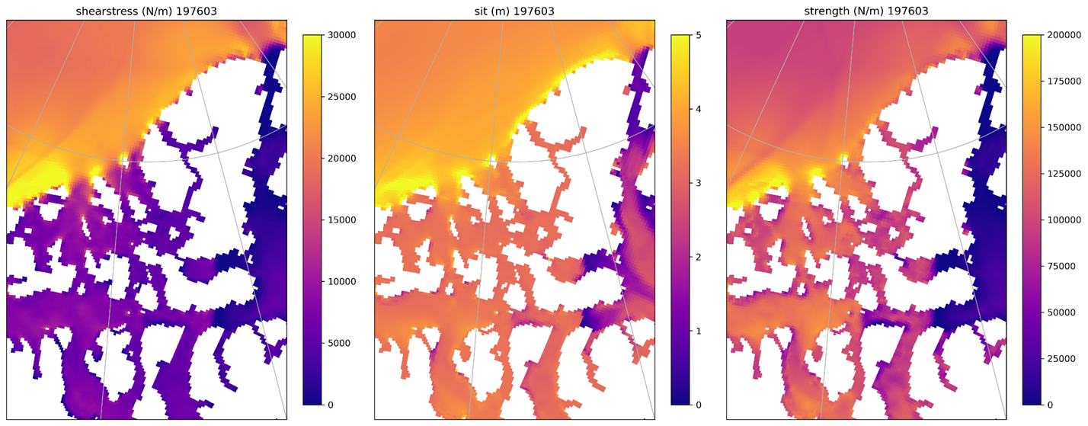
Landfast ice: Instability along north fold
With fix.
Notes:
u-dt261, month 3
R75+aEVP, no max strength, + smoothing, landfast on (default namelist settings)
with ldfull=.true. (lines 634 and 741 icedyn_rhg_evp.F90)

Slide 6
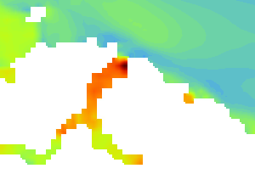

Supercooled ocean grid-points
A point in the high Arctic is behaving oddly. This is a coastal point off Ellesmere Island. Excessive sea ice strength and thickness are seen here. The plots shown are after a 5-year run with the new sea ice dynamics. However, the issue is seen in the NEMO5 release, GOSI10.beta.4, without any sea ice updates.
Sea ice strength is 2 x 10⁶ N/m at this point. The next strongest globally is about 6 x 10⁵ N/m (over 3 times smaller)
Sea ice thickness is growing excessively (17 m at this location)
Notes:
These are from run u-ds570. Point is at i=982, j=1180

Slide 7
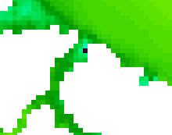

Supercooled ocean grid-points
After 1 month (monthly mean ocean temperature, January 1976)
After 4 years (monthly mean ocean temperature, January 1980)
tos_con (sea surface conservative temperature) is -2.68C at this point (which is the global minimum). Surrounding temps are around -1.70C.
Signal disappears at about 10 m depth (in thetao_con; conservative temperature) - so it’s surface only
tos_con here is -3.74C (global minimum), with surrounding area around -2.0C, disappears by 5 m depth.
Nothing odd in the start files at this location, but this shouldn’t persist for years anyway…

Slide 8

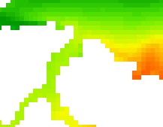
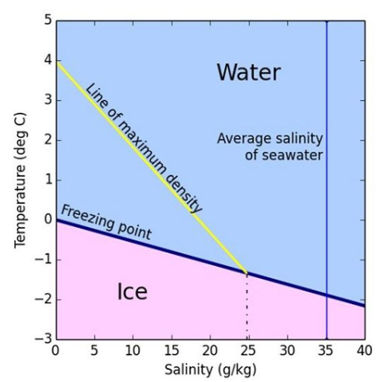
Supercooled ocean grid-points
Salinity looks fine (mean after 1 month shown, but similar for 4 years), and pattern corresponds to the river flux as expected. Salinity in this area ~30.71 g/kg
River flux looks fine.
Values are small here compared to other locations
For a freezing temperature of -2.67 C, would need salinity of above 40 g/kg.
So the ocean is persistently supercooled at this point…

Slide 9
Supercooled ocean grid-points
What we know:
The supercooled ocean surface temperature grid-point occurs in the GOSI10.beta.4 release (NEMO5, without any sea ice updates) but not in NEMO4.2.2
New sea ice dynamics (incl. strength scheme based on ridging) impacted by this but not previous configuration
This is not a problem with the start files
It does not appear to be an issue with the atmospheric forcing (but the response to the ocean behaviour can be seen in the fluxes)
The supercooled ocean is causing the ice to grow via basal growth
Ocean low temperature comes in very quickly - appears on day 1 (have not looked at timestep level)
Potentially happening in other regions too, but with less impact on the sea ice
Bathymetry very steep at this location. Looked odd too but smoothing this out did not help the problem

Slide 10
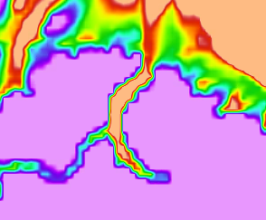
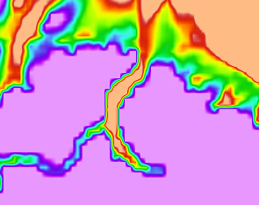
Supercooled ocean grid-points
Original GOSI10 bathymetry, 0-500 m depth shown, large gradient at this location
Updated bathymetry, 0-500 m depth shown
Axel Heiberg
Island
Axel Heiberg
Island
Ellesmere Island
Ellesmere Island
GOSI10 default
bathy_metry in domain_cfg_GOSI10p3_CanadaArchEdit.nc
file produced by Dave
Notes:
GOSI10 default: bathy_metry in
/data/users/nemo/GOSIdev/GOSI10p3/eORCA025/domain_cfg_MEs_novf_4env_2930_r12_r16-r075-r040-r035_it2-r030.nc

Slide 11
Supercooled ocean grid-points
Theories?
There is a known, similar-looking issue in the coastal ocean configuration, where steep bathymetry can affect surface points in a non-conservation issue. This appears in the context of wetting and drying.
There is a fix for this but it is only applicable for terrain-following co-ordinates
To quote Dave: “We could implement it in ZPS coordinates but it wouldn't change the answer very much. So probably not a candidate for fixing your problem.”
Any other ideas??
Notes:
Improvement to the consistency between the barotropic time-stepping and the advection of tracers at interfaces between tracer points that have different numbers of levels.

Slide 12
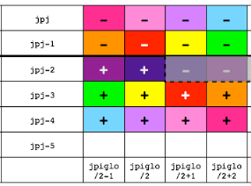
Landfast ice: Instability along north fold
This required an additional fix to an issue already identified and fixed by Daley:
The eastern half of the northernmost row of “inner” domain (non-halo points, shaded in diagram) also considered part of the north fold. However, these points are not normally updated by lbc_lnk, resulting in instabilities building up in the iterative solver of the sea ice rheology code.
Daley's fix: set ldfull=.true. in lbc_lnk calls of rheology subcycling
Ensures that all points on the north fold are set by lbc_lnk, not just the halo points.
This was initially done only for the final rheology subcycle.
However, for the landfast ice scheme, this has proved insufficient. Instead, now performed on all subcycles, not just final one.
This update is now in the GOSI10 main.
Notes:
Numerically different results can be produced in this area on either side of the north fold, causing instabilities to build up in the iterative solver of icedyn_rhg_evp.F90

