Slide 1


Slide 2

P
Cloud
P a r k e r

Slide 3
P

Slide 4
P

Slide 5
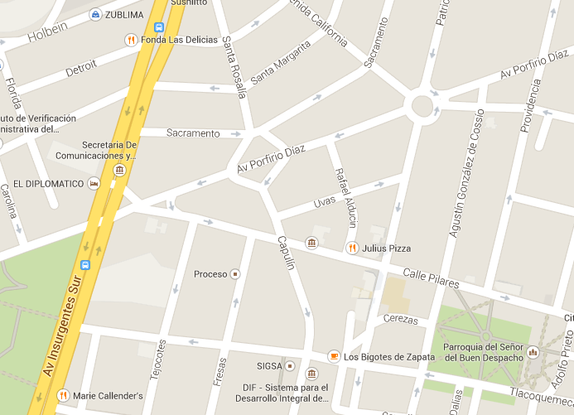

Slide 6


