Slide 1
Does State Medicaid coverage for different type of tobacco cessation treatments affect cigarette use？
Lyuan Han

Slide 2
Background:Tobacco Use in the United States
Tobacco Use: In 2022, 19.8% of U.S. adults (49.2 million) used tobacco (CDC, 2024).
Health Impact: Smoking remains the top preventable cause of disease and death (Cancer Progress Report, 2024).
Disparities: Smoking disproportionately affects low-income adults, especially Medicaid enrollees (CDC, 2024).
Medicaid Expansion: The ACA (2014) allowed states to expand Medicaid to adults earning ≤138% of the FPL to reduce uninsured rates and improve healthcare access (KFF, 2024).

Slide 3
3 Types of Smoking Cessation Treatment
Nicotine Replacement Therapy (NRT):
includes patches, gum, lozenges, spray, inhalers.
Delivers nicotine in controlled doses to ease withdrawal
Medications:
Varenicline: Reduces cravings and smoking rewards.
Bupropion: Eases cravings via dopamine/noradrenaline pathways.
Counseling:
Individual Counseling: Increases quitting likelihood by 40–80% (Lancaster & Stead, 2017).
Group Counseling: Quit rates improve to 8–12% with group support (Stead et al., 2017).

Slide 4
Data
Behavioral Risk Factor Surveillance System (BRFSS) from 2011–2020, conducted by the CDC
American Lung Association State Tobacco Cessation Coverage Database provides state-level data on Medicaid coverage of cessation treatments and treatment access from 2011 to 2020.

Slide 5
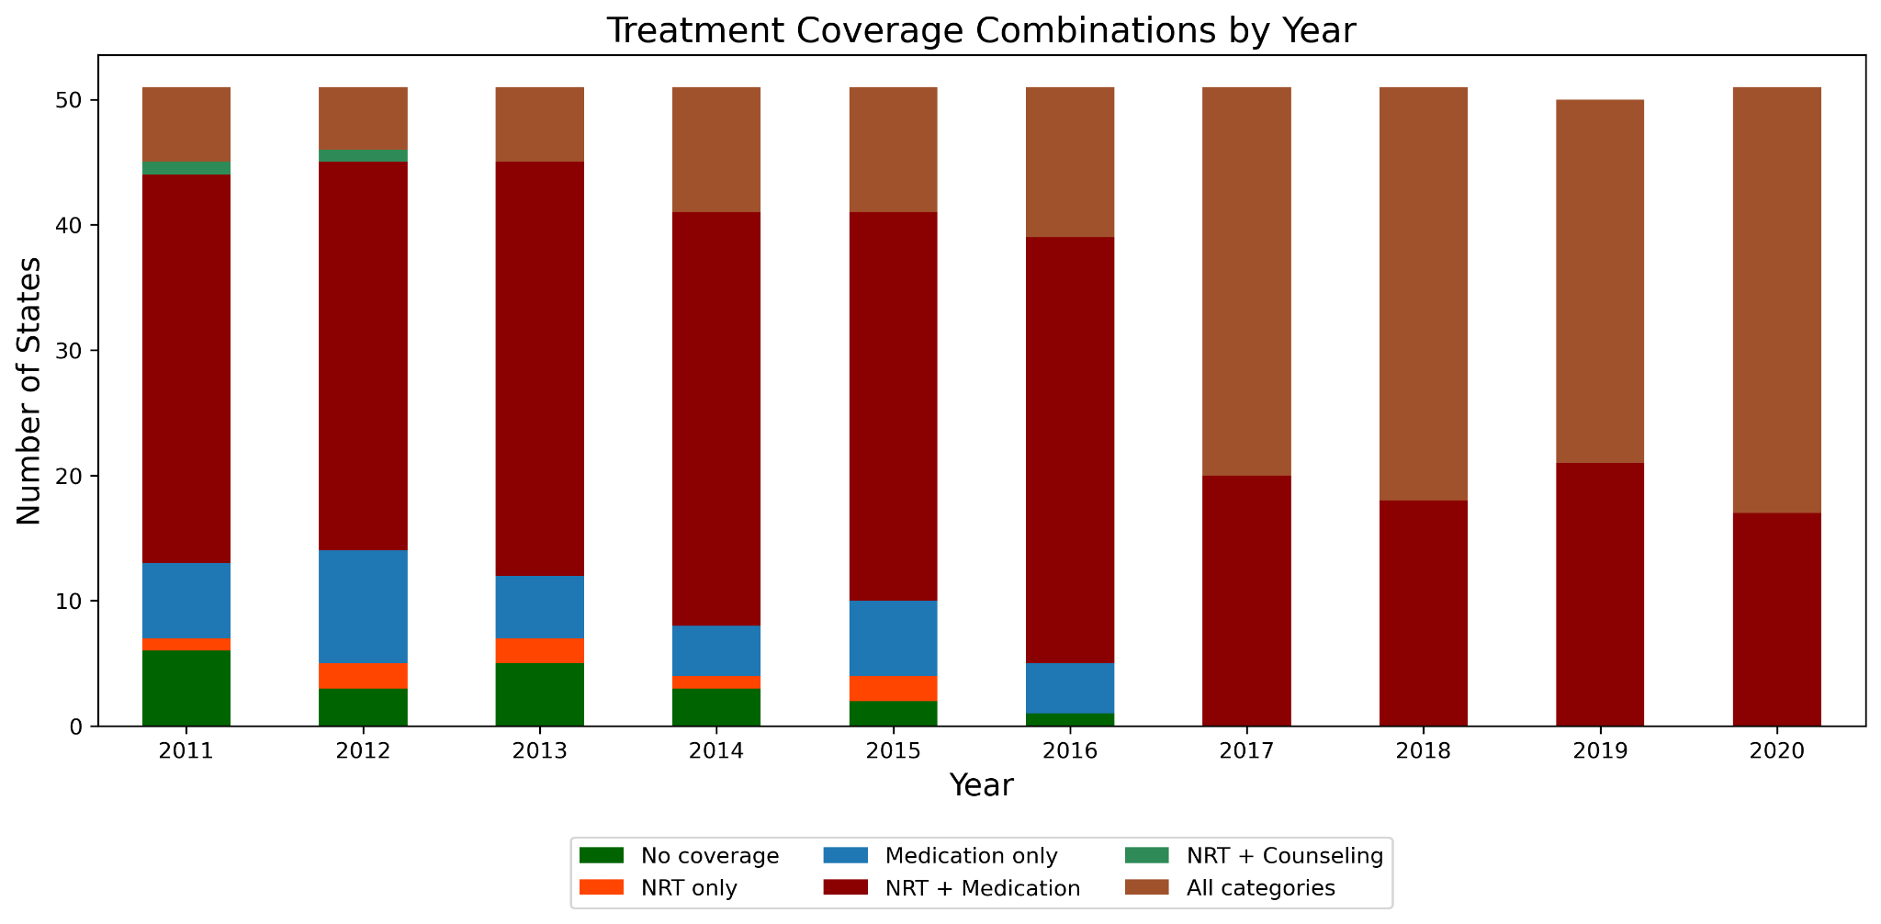

Slide 6
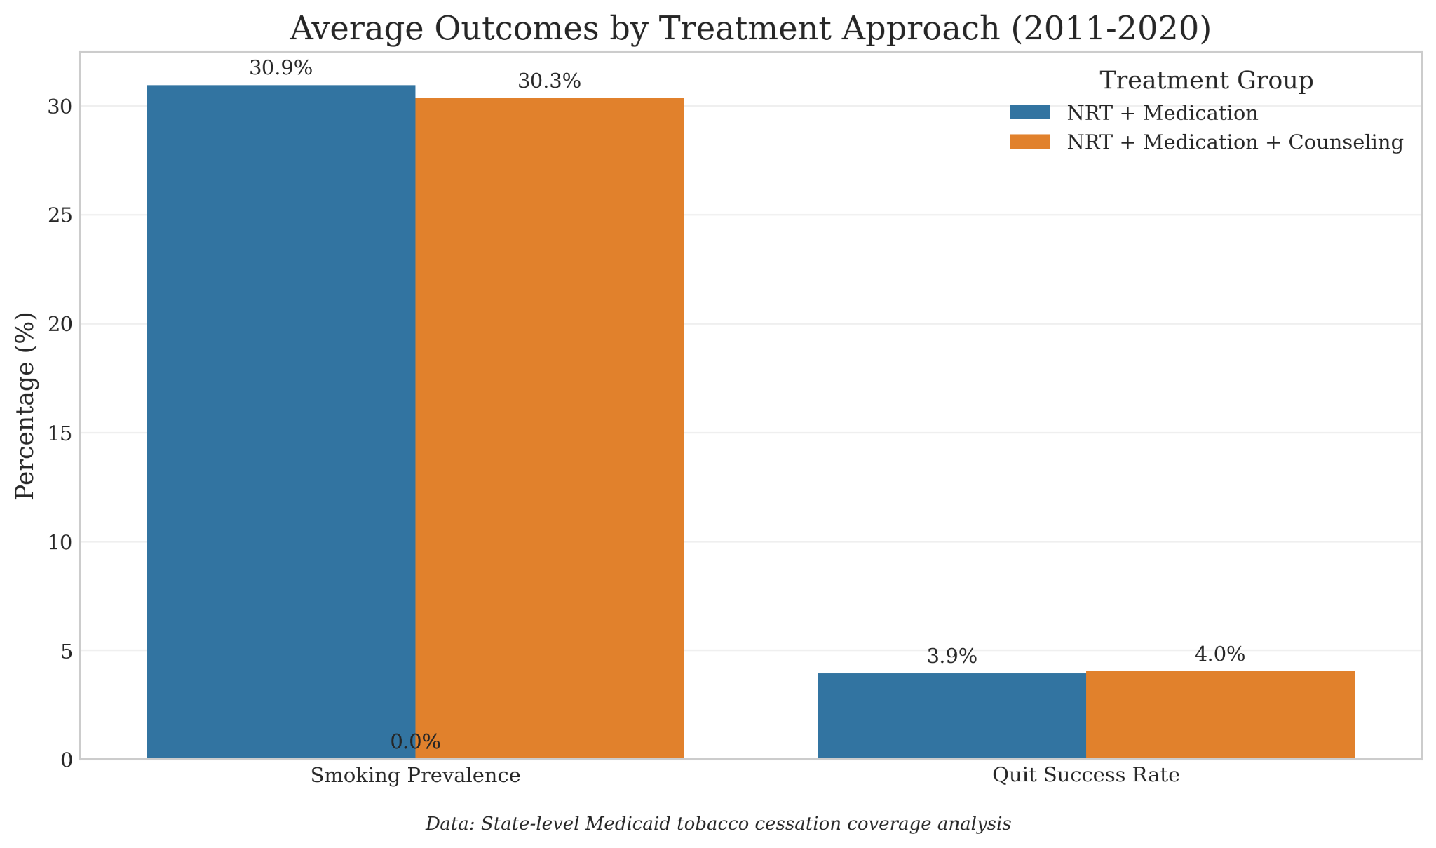

Slide 7
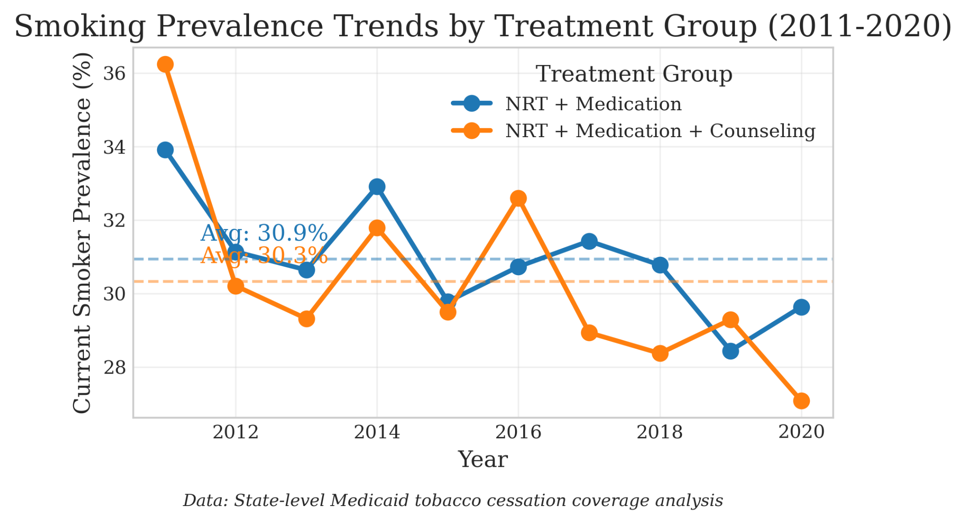

Slide 8
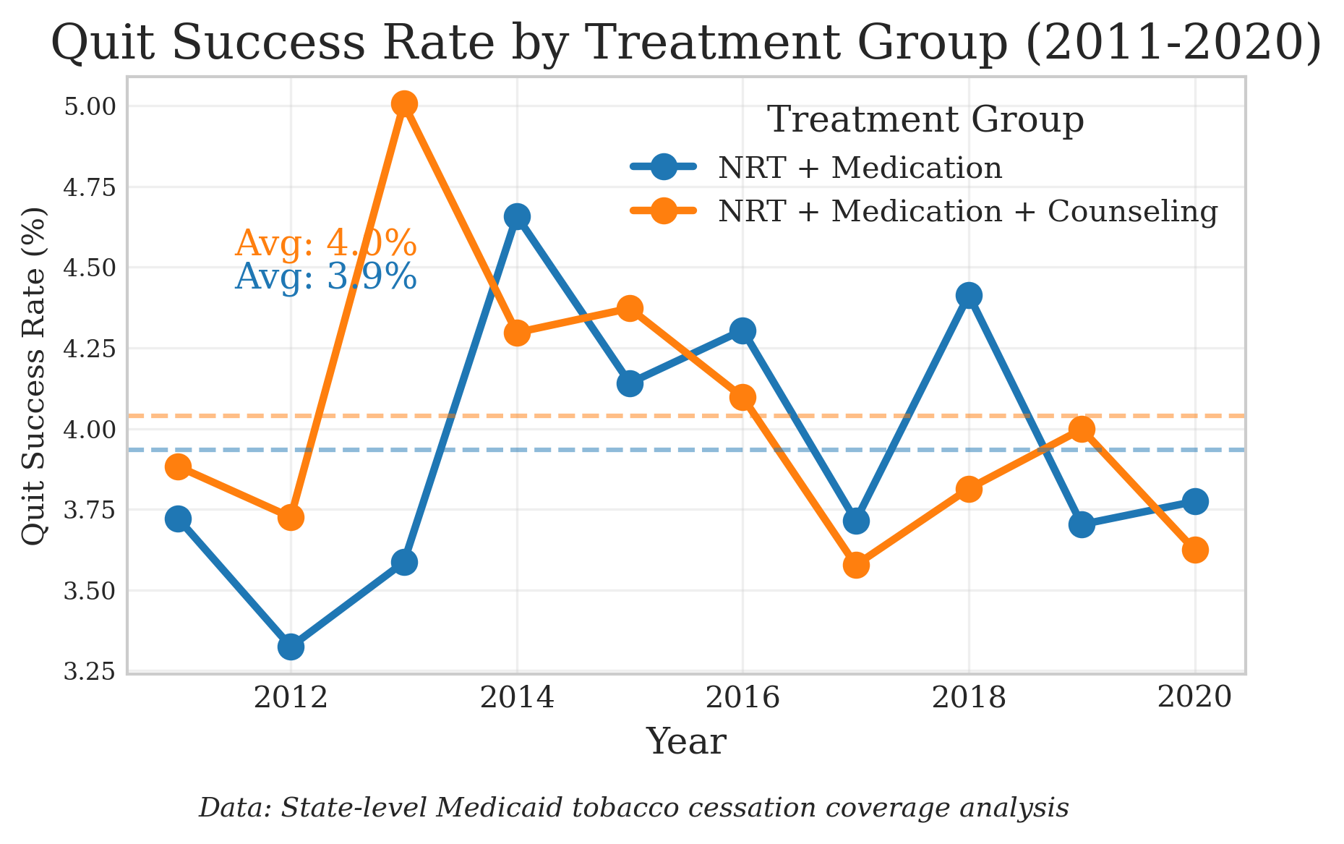

Slide 9
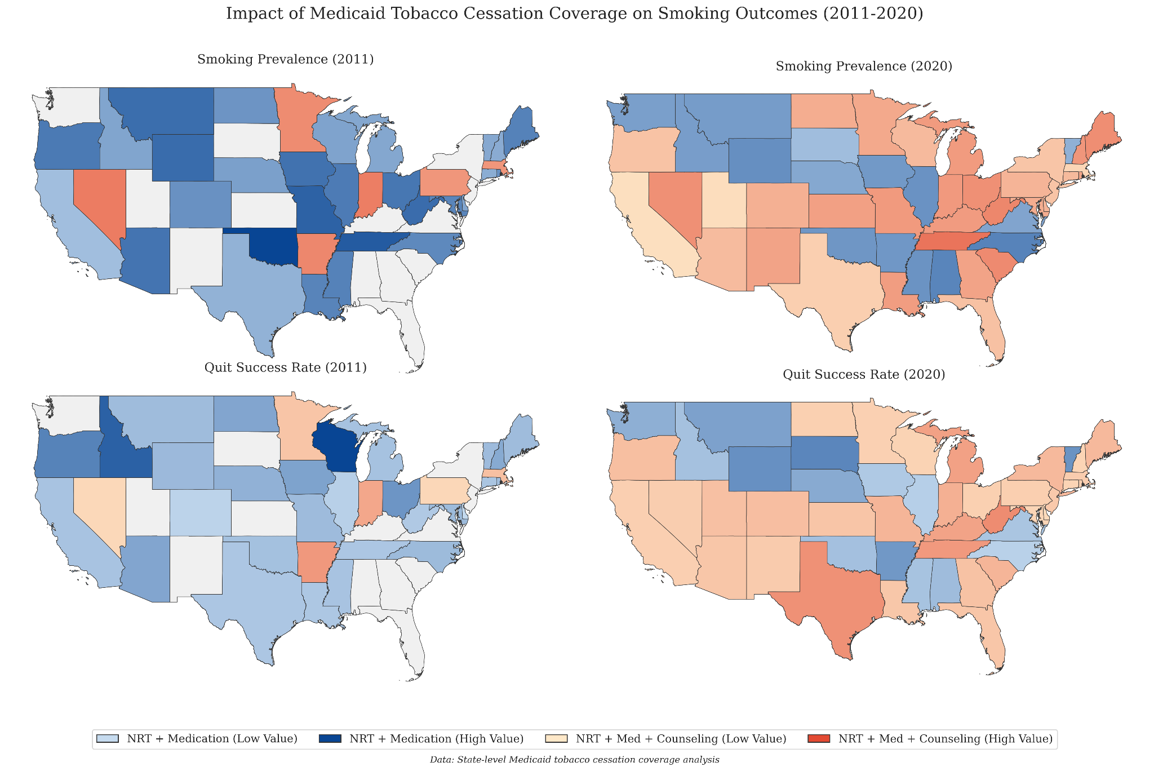

Slide 10
Thank You!
Lyuan Han
lhan10@syr.edu

