Slide 1

Sick_scan_xd: Integration of lidar3d / mrs100 / multiscan136 V. 1.0 2022-02-10

Slide 2
Sick_scan_xD
Lidar3d integration
Project goals sick_scan_xd + sick_lidar3d:
Integrate sick_scan_xd and sick_lidar3d
One repository for sick_scan_xd driver incl. MRS100 / Multiscan136
Unified support, features, API and usage

Slide 3
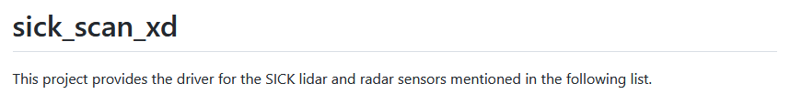
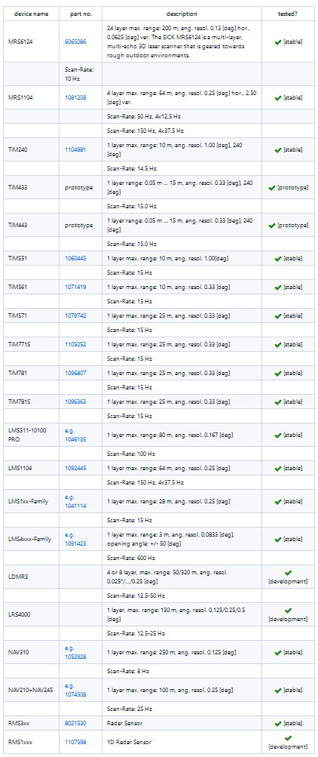
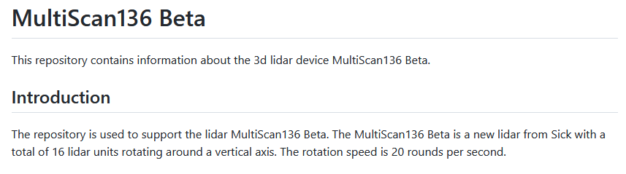
Sick_scan_xD
Lidar3d integration
sick_scan_xd = sick_scan_xd + sick_lidar3d
sick_lidar3d integrated in sick_scan_xd
https://github.com/SICKAG/sick_scan_xd:
https://github.com/SICKAG/sick_lidar3d:
+

Slide 4
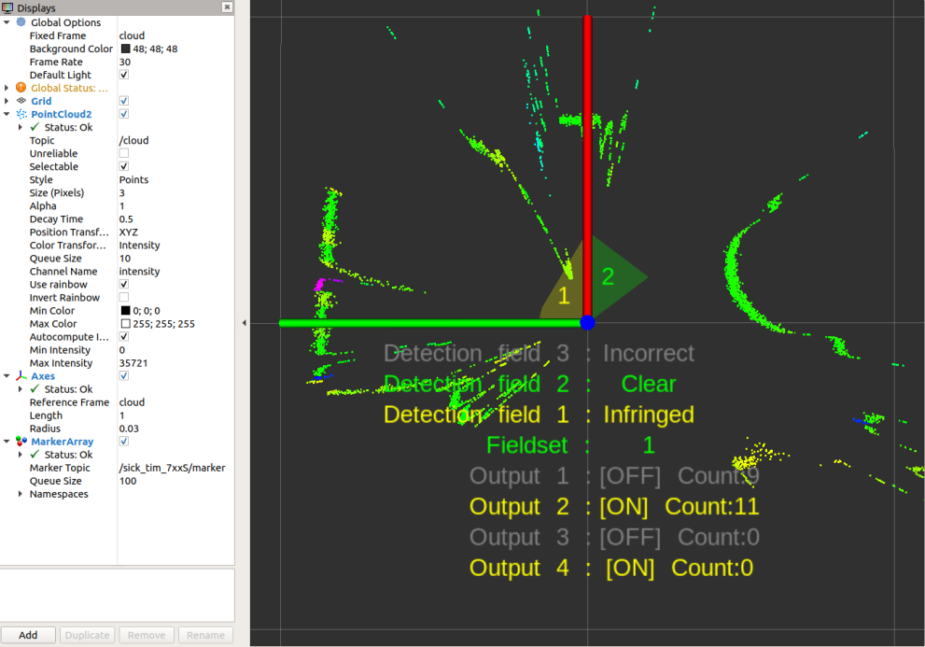
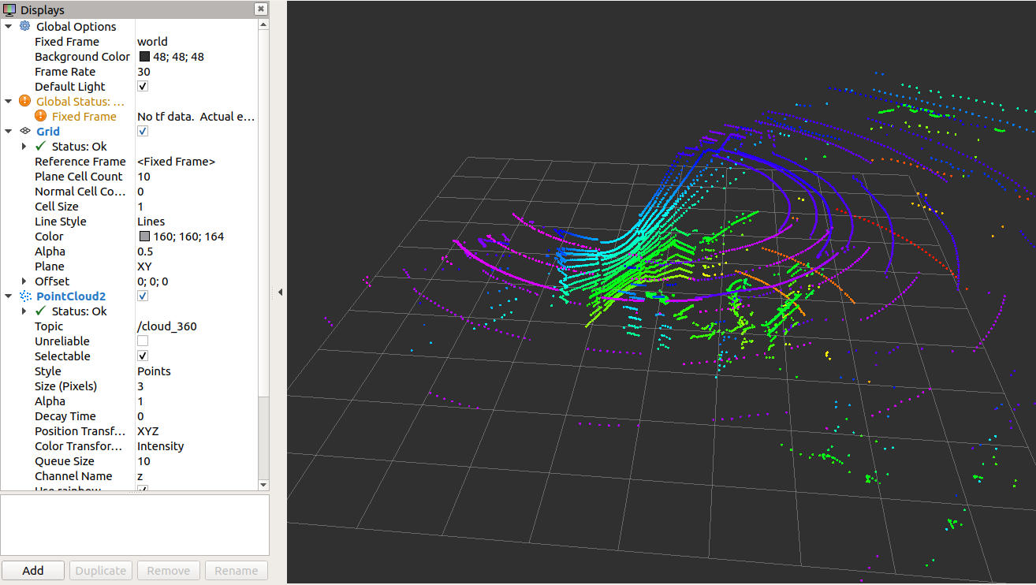
Sick_scan_xD
Lidar3d integration
Integration of sick_scan_xd and sick_lidar3d:
sick_scan_xd: TiM7xxS example:
sick_lidar_3d: MRS100 example:

Slide 5
Sick_scan_xD
Lidar3d integration
Integration of sick_scan_xd and sick_lidar3d:
sick_scan_xd / sick_lidar3d use different protocols, message and data formats:
sick_scan_xd: TCP, SOPAS
sick_lidar3d: msgpacks, json
sick_scan_xd / sick_lidar3d support different functions
sick_scan_xd: pointcloud, services
sick_lidar3d: pointcloud, msgpack validation

Slide 6
Sick_scan_xD
Lidar3d integration
Integration of sick_scan_xd and sick_lidar3d:
Integration of different protocols, functions, message and data formats
Integration of sick_lidar3d sources in sick_scan_xd with “branching under the hood” (i.e. call lidar3d-sources in sick_generic_laser.cpp)
Integration similar to LDMRS

