Slide 1
PROJECT NAME
ONLINE ADMISSION SYSTEM

Slide 2
Submitted by :
Nilanjan Chakraborty, Sourav Jana & Subhankar Mallik
Project guide by:
Mr. Debojit Sen Sharma

Slide 3
Project Objective
Online admission is the process that can be helpful to admit student without come to university. It could be helpful for someone for getting from over the internet as well as admit card.

Slide 4
From this project we get
For Admin
Admin can login the system.
View all student details.
Update student status.

Slide 5
Student Activity
User can submit his/her own details.
User can cheack status through application no.

Slide 6
System Specification
Software Requirements
OPERATING SYSTEM :
WINDOWS XP/VISTA/7/8
LANGUAGE :
PHP, JAVASCRIPT, HTML, CSS
DATABASE
MYSQL

Slide 7
System Specification
Hardware Requirements
Pentium-IV or higher processor with equivalent mother board
512 MB RAM
160 GB HDD
DVD RAM drive
Monitor
Keyboard
Mouse
Notes:
7

Slide 8
Php:
PHP (recursive acronym for "PHP: Hypertext Pre-processor") is a widely-used Open Source general-purpose scripting language that is especially suited for Web development and can be embedded into HTML.
PHP is a server-side scripting language.
PHP scripts are executed on the server.
PHP supports many databases (MySQL, Informix, Oracle, Sybase, Solid, PostgreSQL, Generic ODBC, etc.)
PHP is an open source software.
PHP files can contain text, HTML tags and scripts.
PHP files are returned to the browser as plain HTML .
PHP files have a file extension of ".php", ".php3", or ".phtml“.
Mysql
MySQL is a database server.
MySQL is ideal for both small and large applications.
MySQL supports standard SQL.
MySQL compiles on a number of platforms.

Slide 9
Data flow diagram of project

Slide 10
Context level DFD
ADMIN
STUDENT
ONLINE
ADMISSION
SYATEM
Information view,change ststus
Information add

Slide 11
1st Level DFD For Admin
ADMIN
Student details Table
Username
+
password
Access
Student
details
Login
View
student
details
Change student status

Slide 12
1st level DFD of Student
STUDENT
Student details table
Cheack status
Submit from

Slide 13
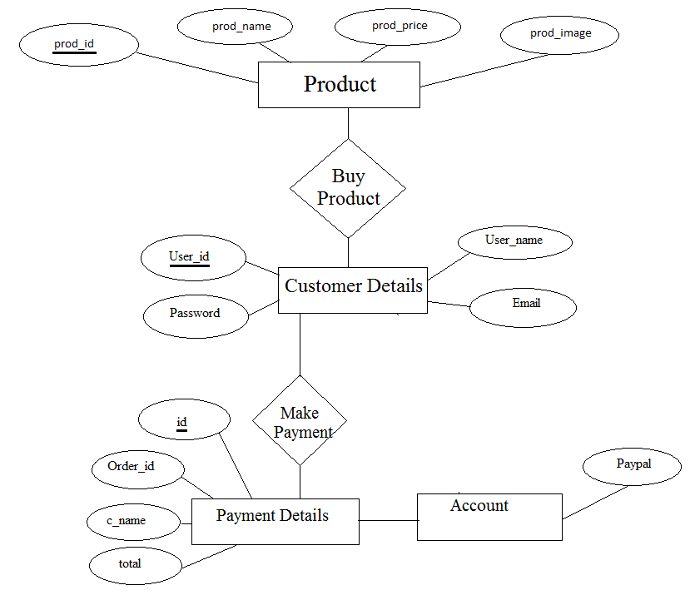
ER diagram

Slide 14
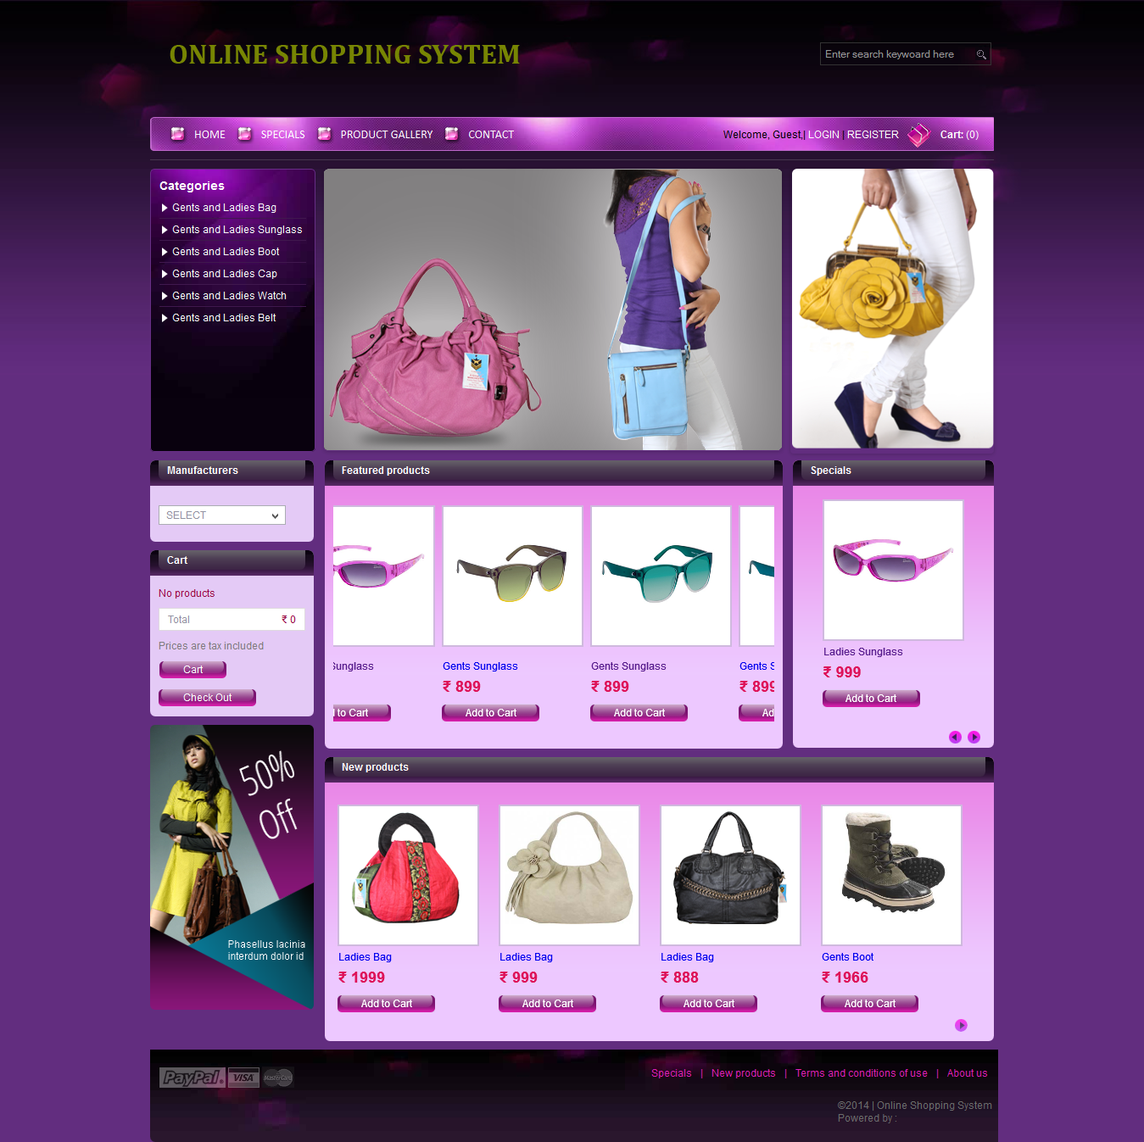
Project home page

Slide 15
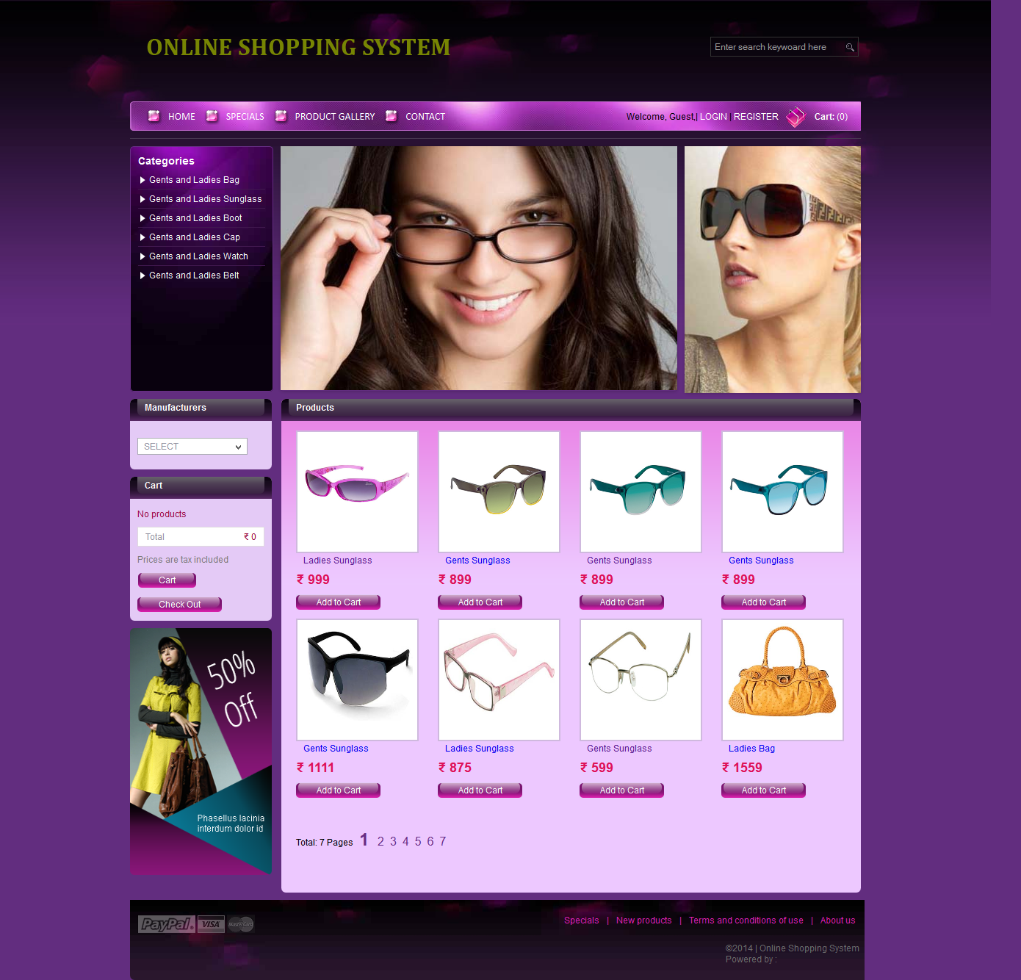
Product gallery page

Slide 16
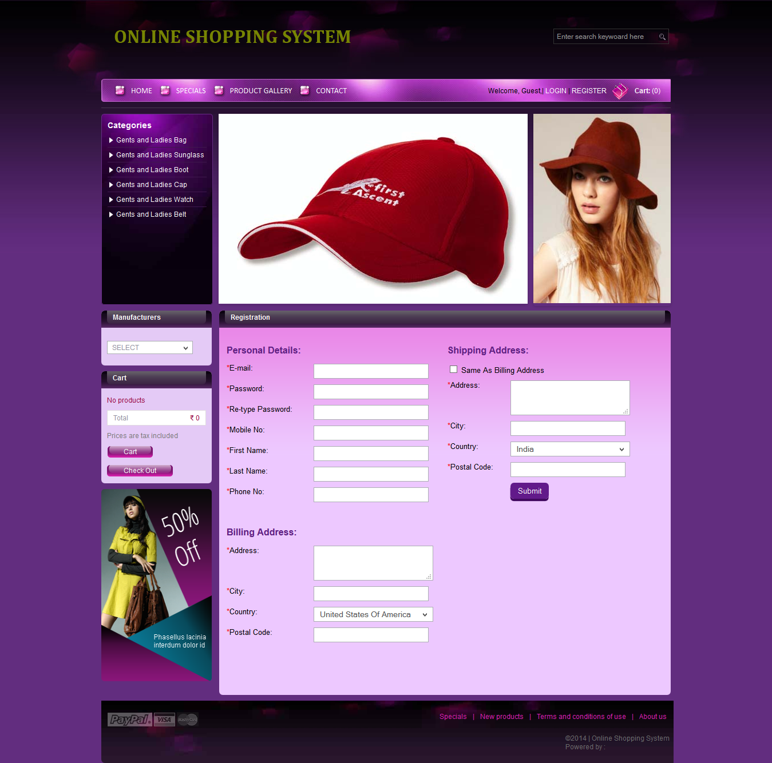
Customer registration page

Slide 17
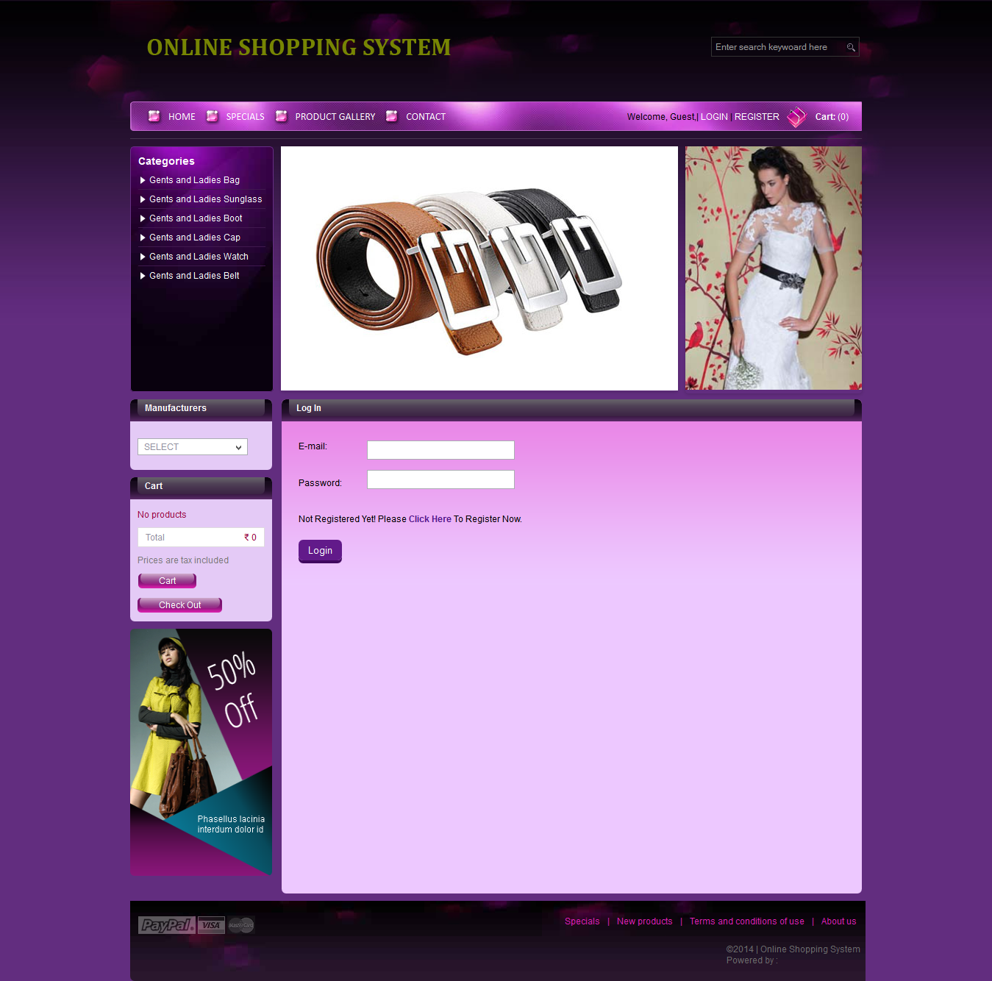
Customer login page

Slide 18
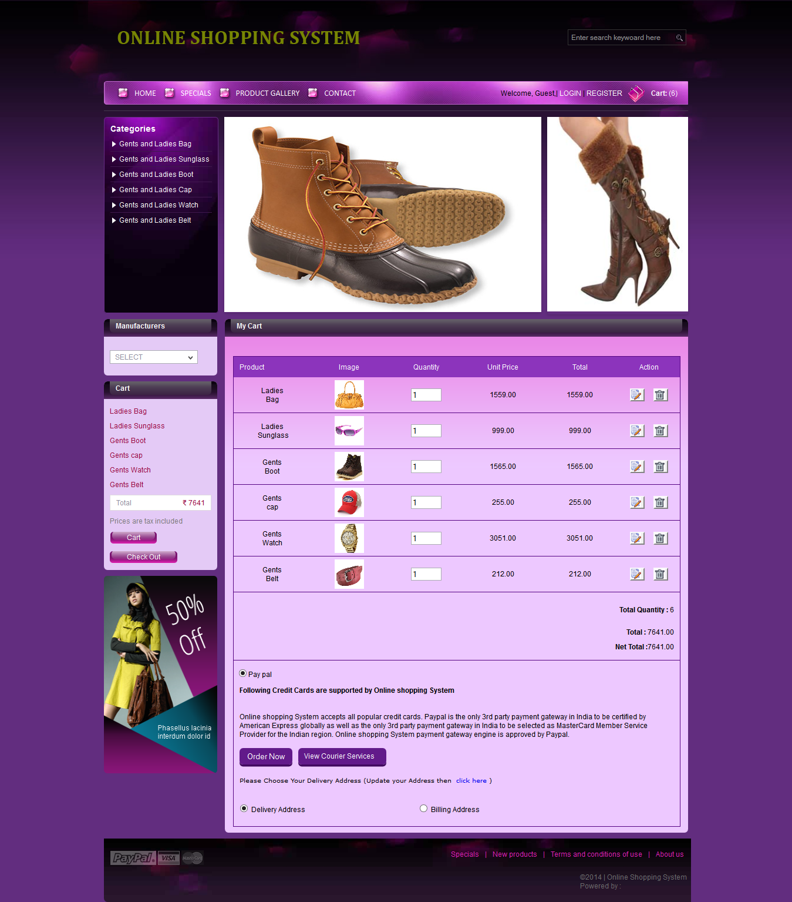
Products add to cart page

Slide 19
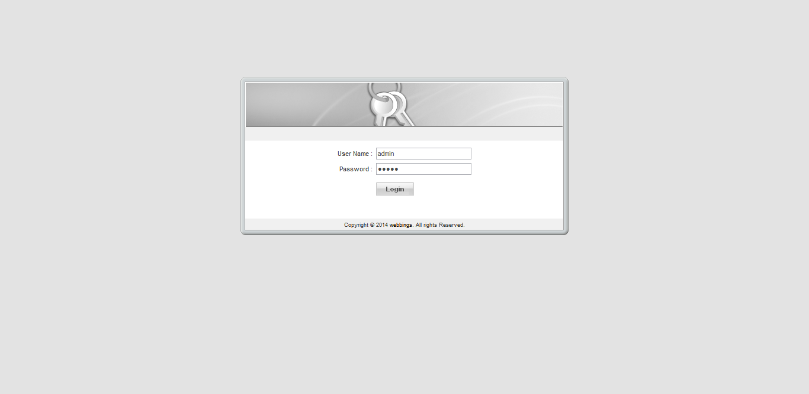
Admin login page

Slide 20
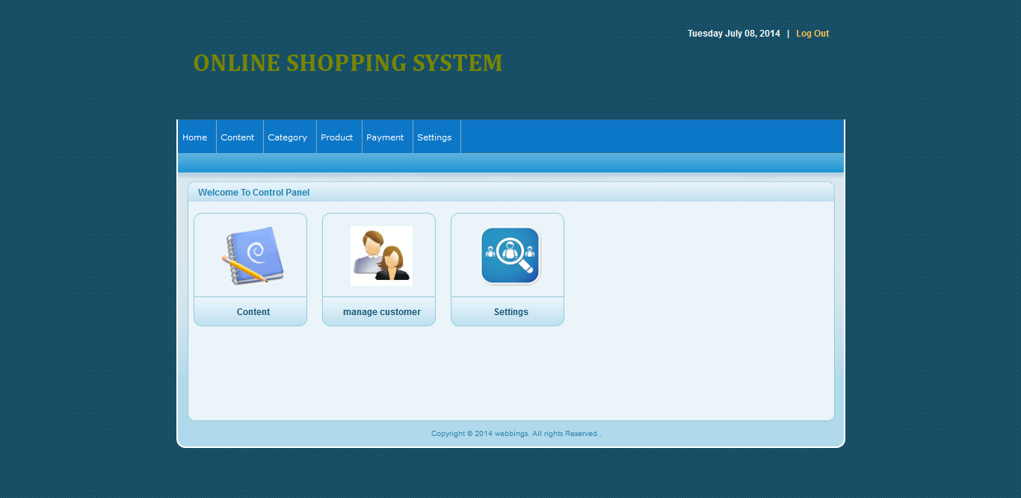
Admin page

Slide 21
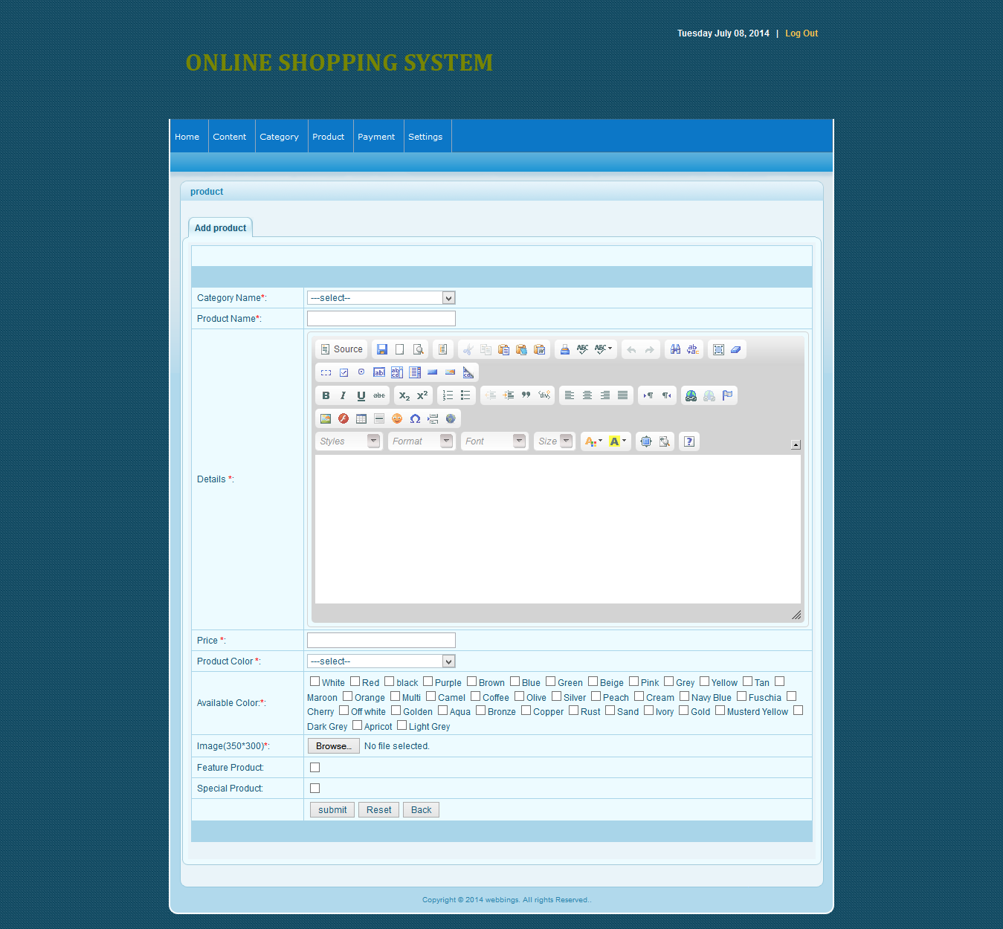
Add products pagee

Slide 22
Limitation
Admin cannot manage student details.
Student cannot show own details.

Slide 23
Conclusion
This system, being the first We have created in PHP, has proven more difficult thanoriginally imagined. While it may sound simple to fill out a few forms and process the information, much more is involved in the selection of applicants than this. Every time progress was made and features were added, ideas for additional features or methods to improve the usability of the system made themselves apparent.ust debug can be.

Slide 24
Bibliography
We collect our data from the following source
Web database application with PHP and MYSQL
Author: Hugh E. Williams and David Lane
PHP Manual
Beginning JavaScript 2nd Edition, by Wilton
The Complete Reference MYSQL
The Complete Reference HTML
Images and banners from SnapDeal.com , Flipkart.com , Myntra.com etc.
Websits referred:
http://www.google.com
http://w3schools.com

Slide 25
Thank You

